Slide 1


Starter activities
These activities can be used at the start of the lessons or as stand alone activities
Further ideas and resources can be found in the Primary Guidance document and supporting materials from the NCETM
Notes:
1

Slide 2
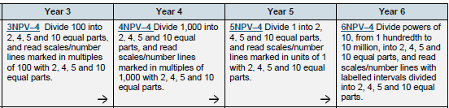
Ready-to-progress Criteria from the 2020 DfE Primary Maths Guidance
Resources to support these criteria can be found in the Number and Place Value Topic materials:
https://www.ncetm.org.uk/classroom-resources/exemplification-of-ready-to-progress-criteria/
Notes:
This set of criteria focus on interpreting and reading scales marked in different divisions. This has a relevance in statistics and also in measures as well as linking to an understanding of the number system and place value.
2

Slide 3
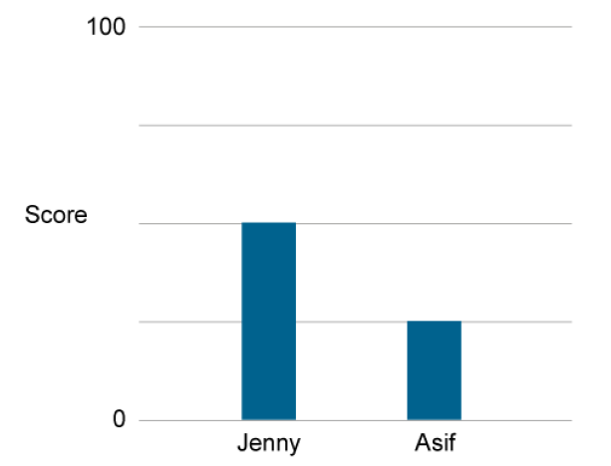
From the guidance document Y3
What do you notice about the scale?
What labels would you give to the unmarked lines?
Notes:
This is an example from the assessment questions in the guidance document for criteria 3NPV-4.
The slide encourages the pupils to think about the scale. This is a good approach to encourage whenever pupils are faced with information presented on a graph or with a measurement scale.
Encouraging them to focus on understanding the scale and putting values on the unmarked divisions will support them when solving problems and answering questions.
3

Slide 4
From the guidance document Y3
What were Jenny and Asif’s scores?
Notes:
This is the question from the guidance document.
4

Slide 5
From the guidance document Y3
Where would your bar be if you had scored 80?
Notes:
This is an additional question to encourage pupils to think about estimating as there is no line at 80.
Pupils should be able to reason that the bar will be above the line for 75 but closer to that line than 100.
You may decide to ask more questions like this to develop this sort of reasoning.
5

Slide 6
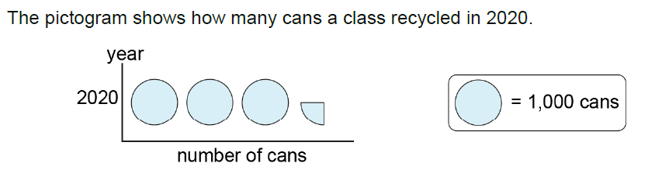
From the guidance document Y4
Does this graph need a scale?
Why do you think that?
Notes:
This is one of the assessment questions from the guidance for criteria 4NPV-4.
This is a pictogram so there is no need for a scale as the values are shown in the images.
Through explaining why a scale is not needed, pupils should be guided to talking about what a half or a quarter of the shape represents.
6

Slide 7
From the guidance document Y4
How many cans did the class recycle in 2020?
What would the graph look like if they had recycled 2,750 cans?
Notes:
Reading the value of a pictogram is important and this is the question from the guidance document.
The additional question gives pupils a chance to think about how 2,750 can be partitioned into 2 one-thousands, 1 five-hundred and 1 two-hundred and fifty. Recording this on mini whiteboards and discussing with a partner would give the teacher an opportunity to monitor confidence with this.
This develops their partitioning away from just 2,000 + 700 + 50 and links to the criteria by splitting 1,000 into 4 equal groups.
You might want to ask additional questions such as:
What if they had collected 500 fewer cans?
What if they had collected 750 more cans?
What if they had collected twice as many cans?
Etc.
7

Slide 8
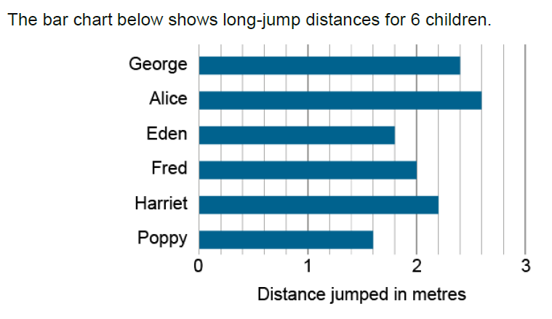
From the guidance document Y5
What do you notice about this graph?
What can you say about the scale?
What if the scale said ‘Distance jumped in centimetres’?
Notes:
This is an example from the Year 5 guidance assessment questions for criteria 5NPV-4.
Again there is a chance for pupils to explore the information presented and to interpret the unmarked divisions on the scale.
There is also an opportunity to think about converting between metres and centimetres.
8

Slide 9
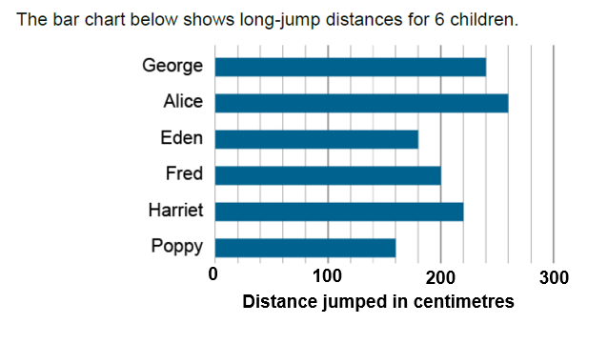
From the guidance document Y5
What will the unmarked divisions be now?
Notes:
This is the distance marked in cm for the pupils to consider what the gaps represent now.
9

Slide 10
From the guidance document Y5
How far did the winning child jump?
How many children jumped over 2 metres?
What was the difference between the two shortest jumps?
Notes:
These are some questions which could be asked about the data presented.
It is important to include questions which look at the data as a whole rather than just individual bars.
You could use sentence stems such as “All of the children …” and “None of the children …”
10

Slide 11
From the guidance document Y5
If you had jumped 75cm further than Eden, how far would you have jumped?
Notes:
The aim of this sort of question is to encourage pupils to think about adding information to the scale.
11

Slide 12
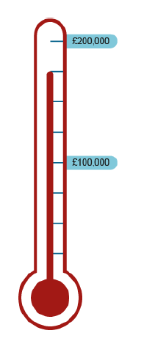
From the guidance document Y6
What could this be showing us?
What can you say about the scale?
Notes:
This example from the Year 6 guidance materials for criteria 6NPV-4 combines the idea of a thermometer with large money values.
Again the first step is to think about what the scale is representing and to give values to the unmarked divisions.
12

Slide 13
From the guidance document Y6
Some children are trying to raise £200,000 for charity.
What do we know from this diagram?
Notes:
This example from the Year 6 guidance materials for criteria 6NPV-4 combines the idea of a thermometer with large money values.
Again the first step is to think about what the scale is representing and to give values to the unmarked divisions.
13

Slide 14
From the guidance document Y6
How much have the children raised?
If they raise another £20,000, will they have reached their target of £200,000?
Notes:
This example from the Year 6 guidance materials for criteria 6NPV-4 combines the idea of a thermometer with large money values.
Again the first step is to think about what the scale is representing and to give values to the unmarked divisions.
14

Slide 15
From the guidance document Y6
If there are 50 children raising money, how much does each child need to raise to reach the target?
Notes:
This involves thinking beyond the original information and involving some other mathematical thinking.
15

Slide 16
Examples of real life scales to explore
Notes:
16

Slide 17
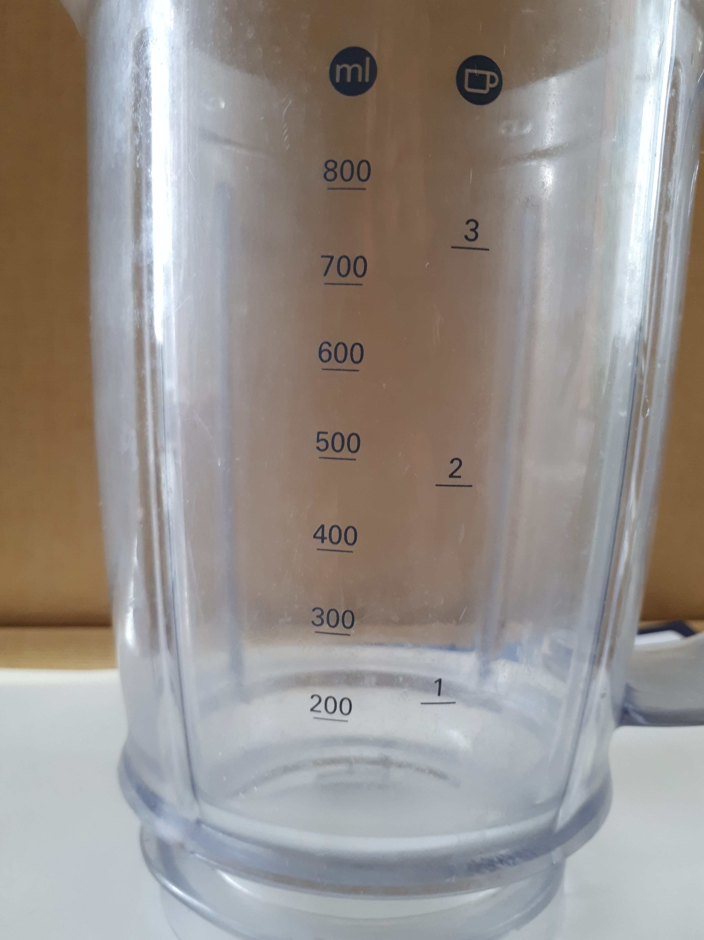
What do you notice about this scale?
Notes:
This is the scale on a liquidiser jug and shows millilitres and cups
There is no 100 marked so this could be a discussion point.
The jug narrows at the bottom so 100ml would not be the same distance below 200 as 300 is above. It is interesting to note this about measuring jugs.
17

Slide 18
What point is marked on this scale?
Notes:
You can move the arrow to different places and ask this question of different amounts.
18

Slide 19
Where is 2.5 cups on this scale?
What would you estimate 2.5 cups to be in ml?
Notes:
Again you can move the arrow and ask different versions of this question.
Looking at the link between the scales is similar to using a double number line which is a representation that will be used in secondary schools in the context of ratio and proportion.
19

Slide 20
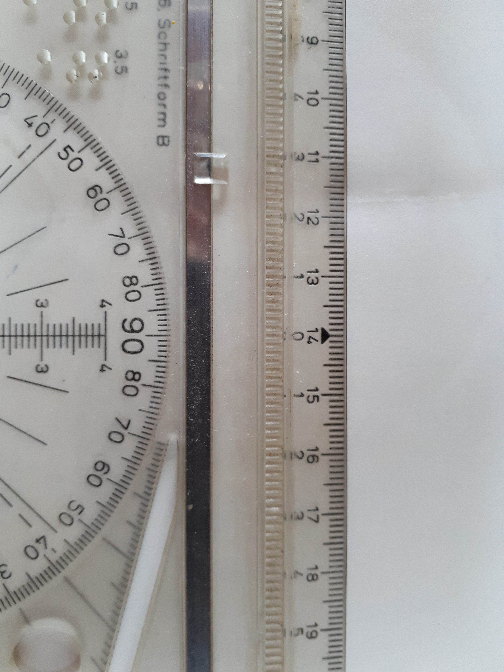
What do you notice about this scale?
Notes:
This is a section of a drawing board ruler.
It might be interesting to discuss why the pupils think there is a zero in the middle of the scale at 14.
20

Slide 21
What point is marked on the scale?
Notes:
This is a centimetre scale but it will obviously appear larger on a screen.
The arrow can be moved to and the question can be asked of different points on the ruler.
21

Slide 22
Where would 10.8cm on this scale?
What other measurement can be read at this point on the scale?
Notes:
This is a centimetre scale but it will obviously appear larger on a screen.
22

Slide 23

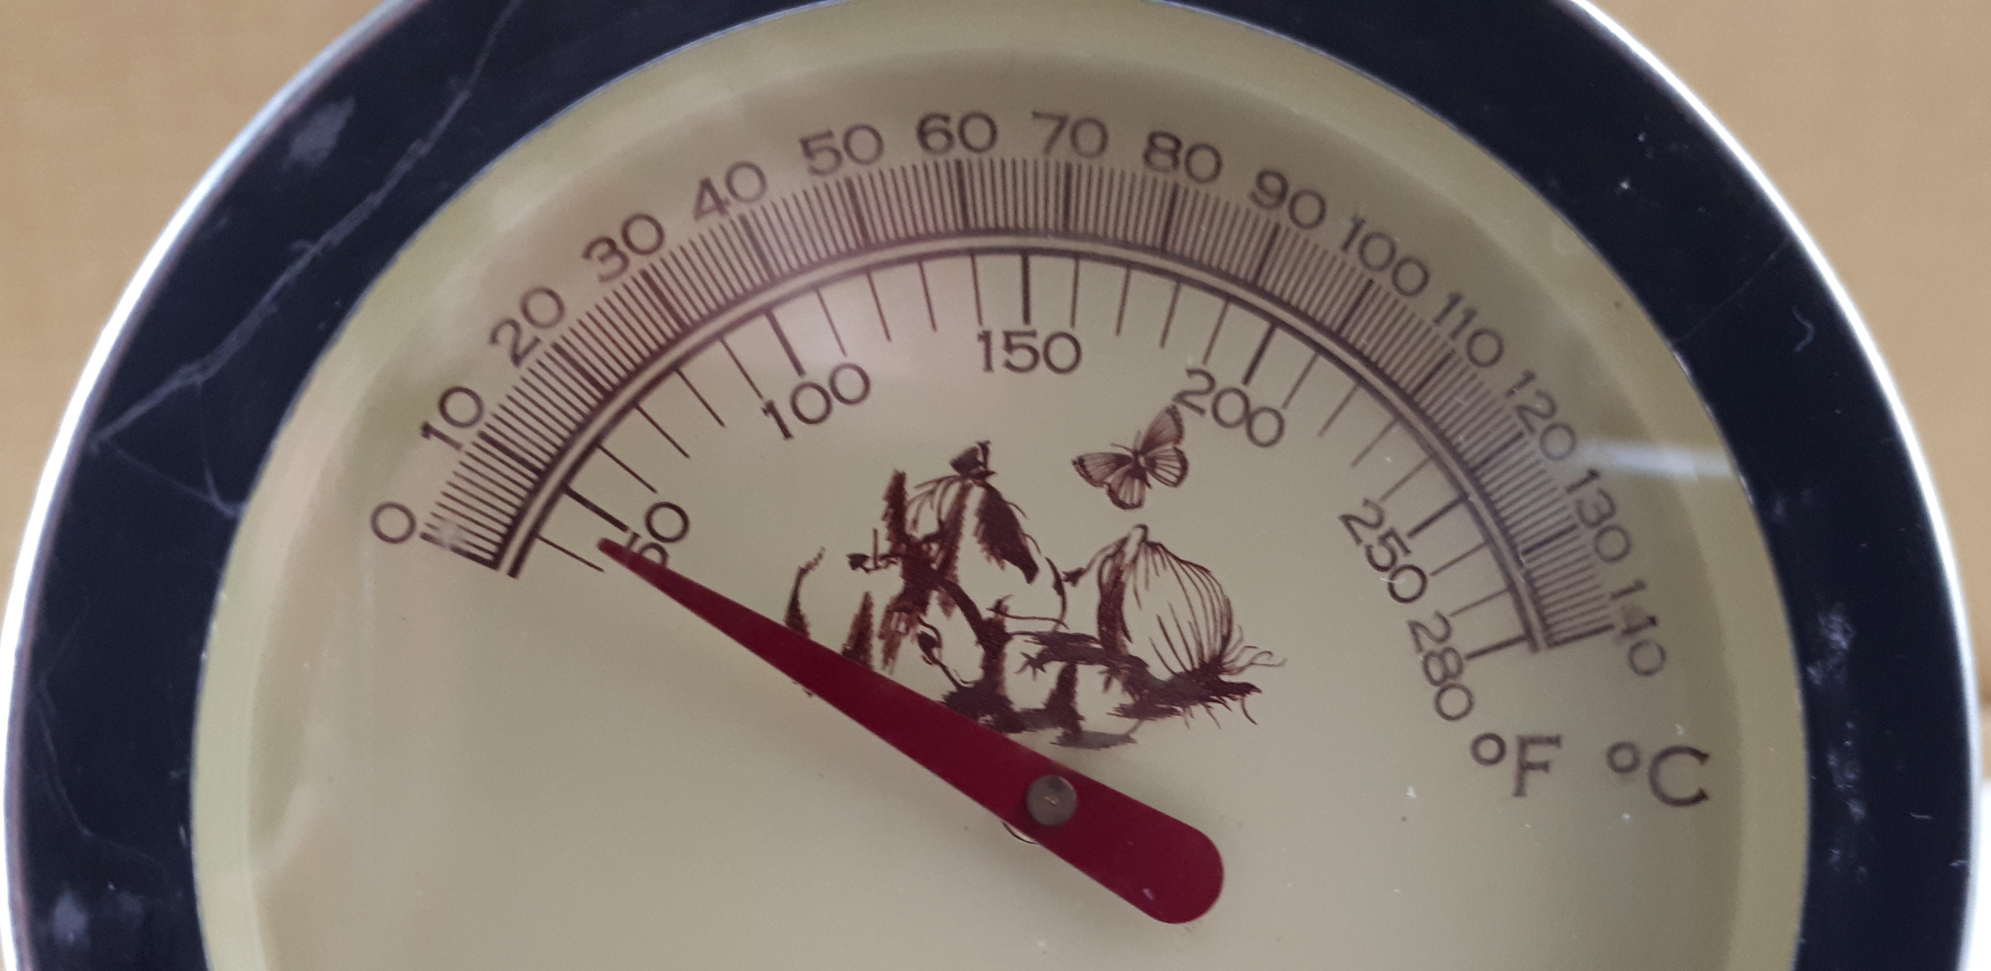
What do you notice about this scale?
Notes:
This is a sugar or jam thermometer with a dual scale in Celsius and Fahrenheit.
There is a section of the scale blown up here so that pupils can see that the unmarked divisions are 1 degree which appears when you click.
23

Slide 24
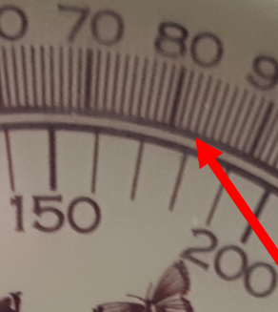
What can you say about the point marked on this scale?
Notes:
A blown up detail of the point marked is animated to appear when you click
24

Slide 25
Where would 105ºC be on this scale? What would it be in F?
Where would 220F be on this scale? What would it be in ºC?
Notes:
A chance for pupils to work out where the markers need to go on the scale and also more experience of what will become a double number line.
25

Slide 26
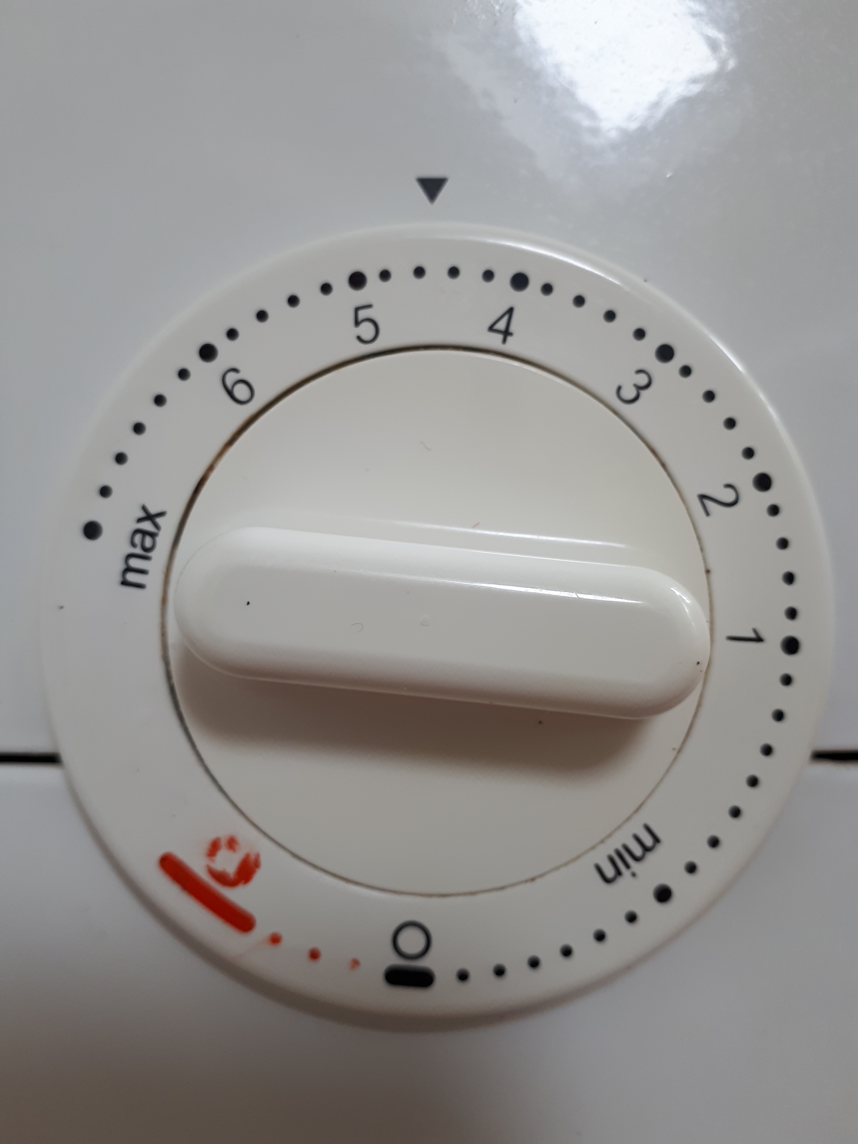
What do you notice about this scale?
Notes:
This is the scale from a food mixer.
Pupils might notice that the numbers seem to go the wrong way as this time the scale moves and the arrow stays in the same place.
The scale also has a much bigger gap between 0 and 1 than 1 and 2.
There is no unit for the scale. There are further prompts for this discussion on the next slide.
26

Slide 27
What speed is the mixer running at?
Notes:
It might be interesting to discuss what the unit might be for this scale.
There is no direct unit but the motor driving the mixer will be working harder as the number increases so a measurement of power could be given but the numbers 0 – 6 are there to help you if a recipe says “Mix at low speed …” or “Beat the egg whites at hight speed …”.
27

Slide 28
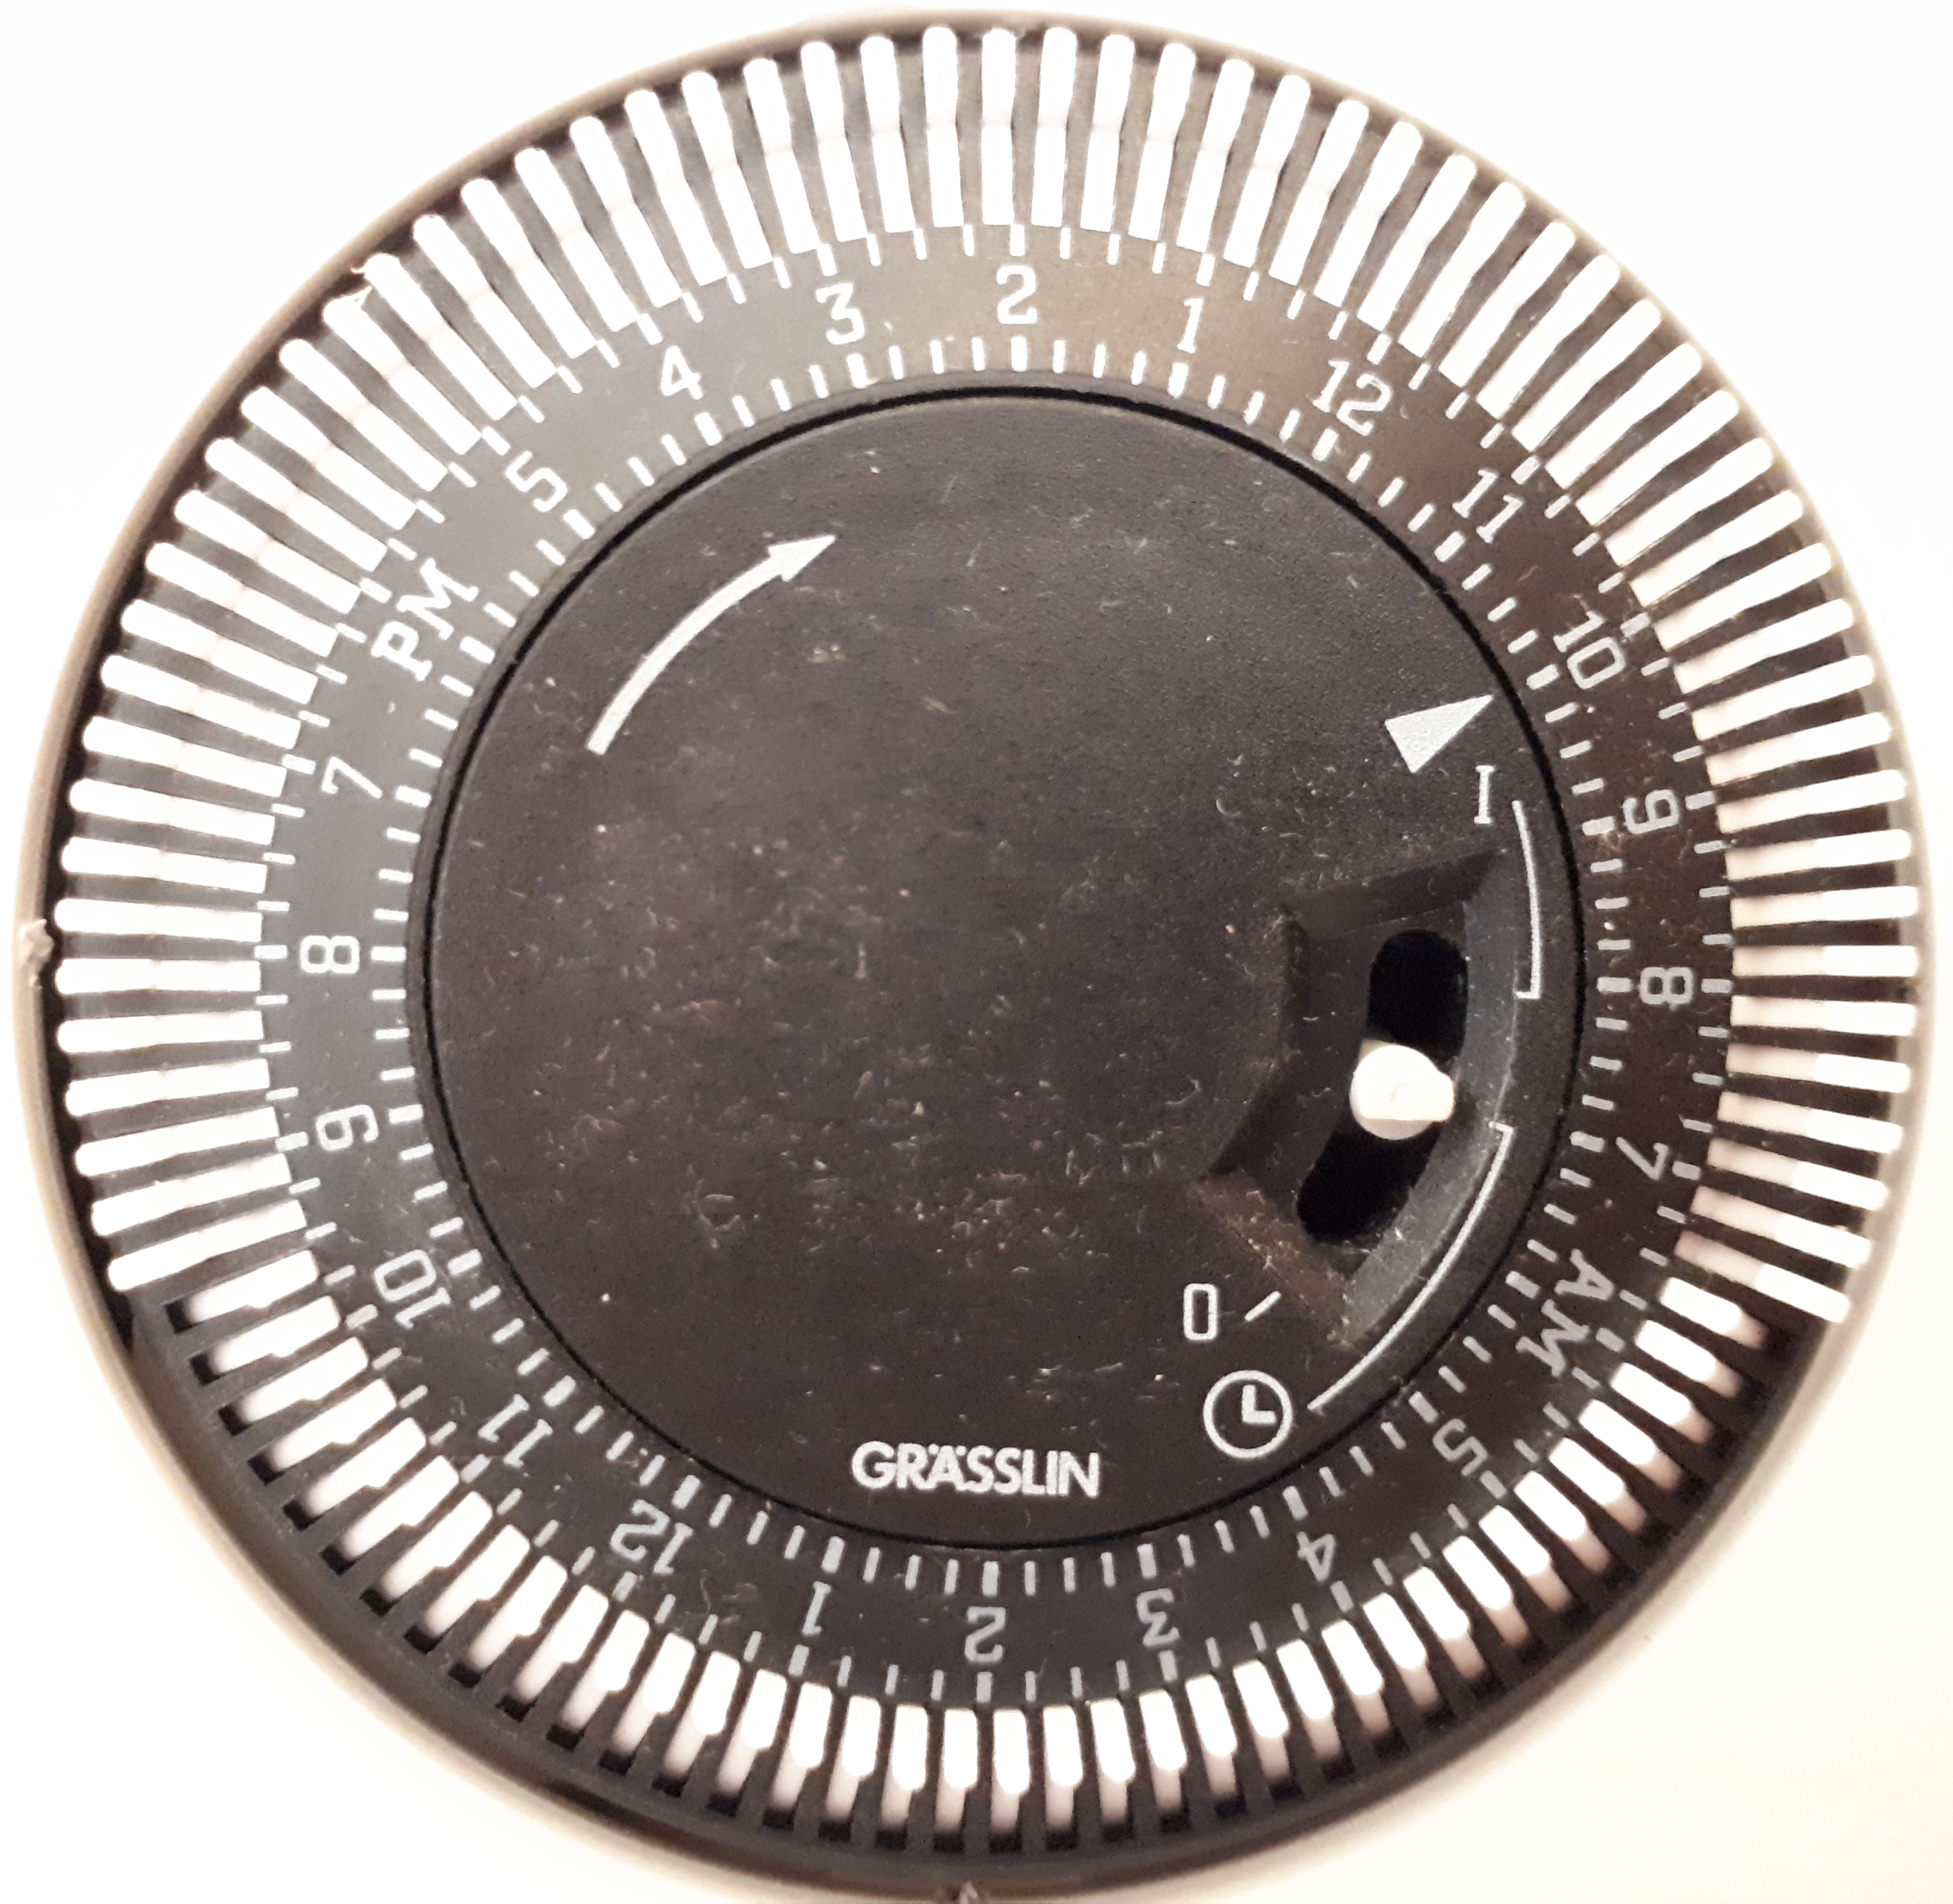
What do you notice about this scale?
Notes:
This is the timer on a central heating boiler so we have 24 hours split into am and pm.
The switches are flipped in where the heating is on.
28

Slide 29
Where would the arrow be for 4:15am?
Notes:
This might take a bit of discussion while pupils work out the am and pm sides of the dial and decide which way the scale is going.
29

