Slide 1
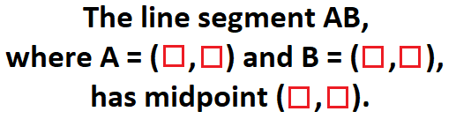
Question 1
The numbers 1, 2, 3, 4, 5 and 6 are placed into the squares below (no repeats!)
in some order in a way that makes a truthful sentence.
What is the largest that the length AB can be?
To get your final answer, multiply your value by 410, add 2 and take the integer part.

Slide 2
Question 2
Bella and Carissa need to travel the same one kilometre on level ground.
They possess a (rather rusty) bicycle. Bella cycles at 6 km/hr, and walks at 4 km/hr, while Carissa cycles at 5 km/hr and walks at 3 km/hr. They set off together; Bella cycles for x km, leaves the bike and walks the rest of the way. Carissa starts off walking, before picking up the bike and cycling the rest of the way.
At time t hours both Bella and Carissa have finished. What is the smallest that t can be?
To get your final answer, multiply your value by 91568000, add 147 and take the integer part.

Slide 3
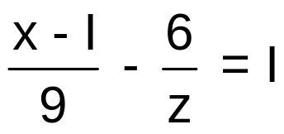
Question 3
Luke wrote down this equation, in variables x and z, on a piece of paper;
He then turned his piece of paper through 180º, revealing a second equation in variables x and z. He decided to solve the two equations together as a pair of simultaneous equations.
If, after doing this, he multiplies all the possible values of x together, what does he get?
To get your final answer, multiply your value by 409501 and then add 57.

Slide 4
Question 4
A right-angled triangle has hypotenuse length 1, which happens to be equal to the sum of the length of one side and the height of the triangle if taking the hypotenuse as the base.
Find the perimeter of the triangle to 3 sig. figs.
Technology may be needed here to find a suitably accurate approximation to the solution of an equation.
To get your final answer, multiply by 979, add 2, and take the integer part.

Slide 5
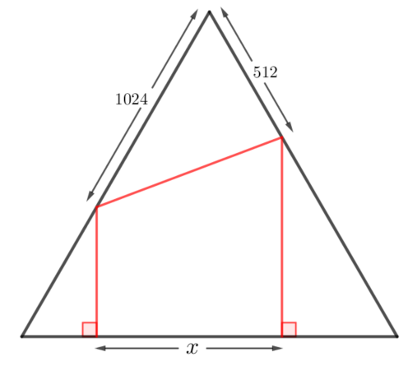
Question 5
The diagram shows an equilateral triangle with
some lengths labelled.
Find x.
To get your final answer, multiply your value by 27775 and then add 22.

Slide 6
Question 6
A tree was planted on April 1st abcd (where a, b, c and d are distinct non-zero digits, see ‘Notation’ below).
The tree will be cut down on April 1st dabc, when its age two years later would have been dcc (using the same ‘digit notation’ as for years).
What is a + b + c + d ?
Notation: pqrs is the year 1234 if and only if p = 1, q = 2, r = 3 and s = 4.
To get your final answer, multiply your value by 56 and add 3.

Slide 7
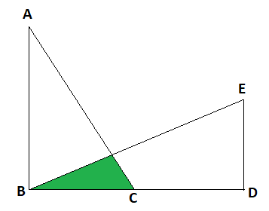
Question 7
The diagram, which is not to scale, shows
triangles ABC and BED.
The length of BC is 6, the length of AB is 8
and the length of AC is 10.
The length of BE is 13, the length of BD is 12
and the length of ED is 5.
What is the shaded area?
To get your final answer, multiply by 229, add 4 and take the integer part.

Slide 8
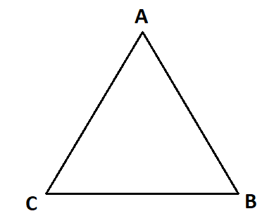
Question 8
Three ants find themselves at A, B and C where ABC is an equilateral triangle
of side 10cm.
At time t = 0, they set off walking along the sides of the triangle; ant A travels
at 1cm/s, ant B travels at 2cm/s, while ant C travels at 3cm/s.
Ant A chooses whether to travel towards B or C at random, and similarly the
other two ants choose randomly from the two directions available to them. When an ant gets to a vertex it continues to travel around the perimeter of the triangle in the direction it is going.
To 3 significant figures, what will be the average (expected) time in seconds that elapses before the first collision between two ants?
To get your final answer, multiply your value by 812, add 4 and take the integer part.

Slide 9
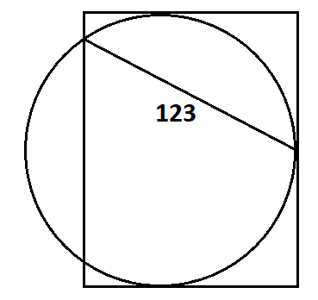
Question 9
You are given a circle with a rectangle that touches the circle on three sides.
You are also given one measurement as in the diagram.
What is the area of the rectangle?
To get your final answer, multiply by 1461 and add 9763.

Slide 10
Question 10
Planet Zog has exactly 60 seconds in a minute, 60 minutes in an hour, 24 hours in a day and 365 days in a year. It uses the same system of months, days and years that we do in a non-leap year (leap years don’t exist on planet Zog). Given a number x with at least 10 digits, x-time on Zog is given from the first 10 digits of x (ignoring any decimal places) as follows:
Day Month Year Year Year Year Sec Sec Min Hour
For example, since π = 3.1415926536…., π-time is the 3rd day of January, 4159, 26 seconds and five minutes past 3am (so no rounding).
For some numbers x with at least 10 digits, x-time will not exist, e.g. for 9.012345678 (there is no month 0).
There are times which are not x-time for any value of x (e.g. any time in October, or any time in the afternoon).
Find, in seconds, the time elapsed on Zog between φ-time and e-time, where φ is the golden ratio.
To get your final answer, multiply your value by 0.04, add 1689093 and take the integer part.

Slide 11
Question 11
Two rectangles P and Q are said to be friendly if the size of the area of P equals the size of the perimeter of Q, and also the size of the perimeter of P equals the size of the area of Q. If P and Q are friendly, we say P*Q; if P*P we say P is self-friendly.
Find all friendly pairs of rectangles and all self-friendly rectangles in which all sides are positive integers. List all the side lengths you have found. You may use the fact that all these values are less than 100.
Remove repeats of any numbers in your list and add up the list of distinct numbers you have left.
You may find technology helpful for working on this problem.
To get your final answer, multiply your value by 6 and add 129.

Slide 12
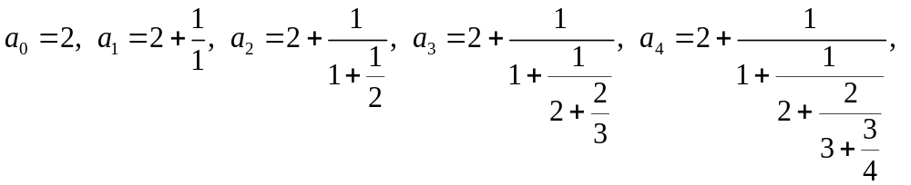
Question 12
The sequence of fractions below tends towards the number e
Calculate the value of a₆.
To three significant figures, what is the size of the percentage error in this estimate of e?
To get your final answer, multiply your value by 4604411, add 1 and take the integer part.
.

Slide 13
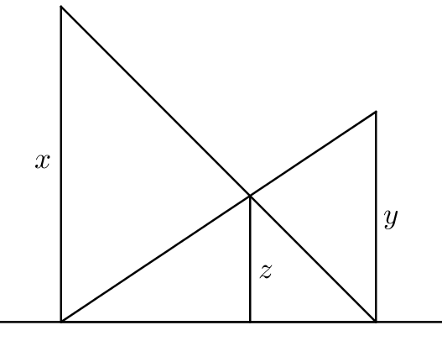
Question 13
Find z in terms of x and y. (This is just for interest!)
Annie takes 7 hours to complete a painting job, while Leroy takes 8 hours to do the same job. How long in minutes should they take working together?
To get your final answer, multiply by 5 and add 111.
What is the connection between parts a) and b)? (This is just for interest!)

Slide 14
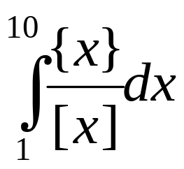
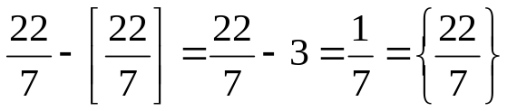
Question 14
Find .
Notation: considering the case when x is positive,
[x] is the integer part of x, so [3.2] = 3, while [3] = 3
{x} is the “fractional part” of x, so {3.2} = 0.2, while {3} = 0
you can see that x – [x] = {x}, so .
To get your final answer, multiply your value by 871 take the integer part.

Slide 15
Question 15
In 2020, four English football teams make it to the last eight of the Champions League.
The draw for the next round is made at random. ‘Home’ and ‘Away’ can be ignored.
What is the probability that exactly one pairing features two English teams?
To get your final answer, multiply your value by 4536, add 1, and take the integer part.

Slide 16
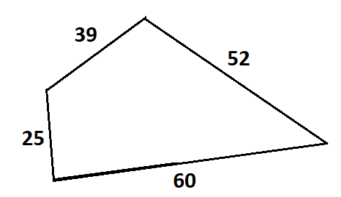

Question 16
What is the maximum possible area of a
quadrilateral with these sides?
You may find technology helpful for working on this problem.
To get your final answer, multiply your value by 12535 and add 491.

Slide 17
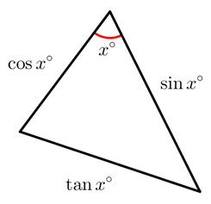
Question 17
With reference to triangle in the diagram, to three significant figures, what is x?
You may find technology helpful for working on this problem.
To get your final answer, multiply your value by 80 and add 3.

Slide 18
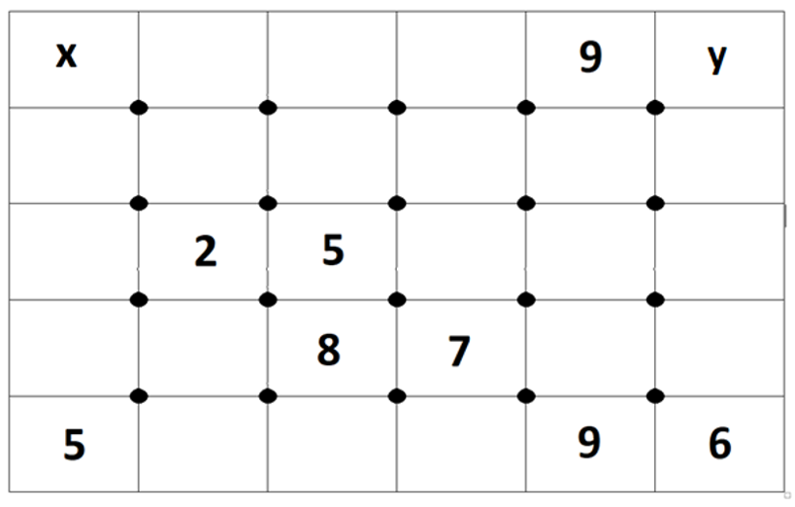
Question 18
Each rectangle contains a number; some numbers are hidden (i.e. they are not shown).
The sum of the numbers in the four rectangles around a dot is the same for all twenty dots.
What is the value of xy?
x
y
To get your final answer, multiply your value by 107 and add 23.

Slide 19
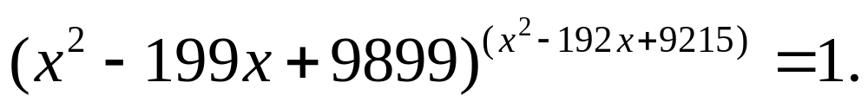
Question 19
Add together all the positive integer values of x that satisfy this equation;
To get your final answer, multiply your value by 2 and add 253.

Slide 20
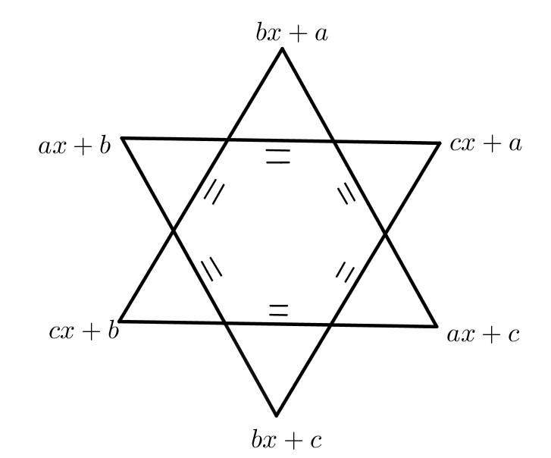
Question 20
You pick three distinct numbers a, b and c. The diagram
now gives you six equations to solve for x.
For example,
ax + b = cx + a and bx + a = ax + c.
The solution to one of the equations is x = 3.
What is the sum of the squares of the solutions to
the six equations?
To get your final answer, multiply your value
by 194, add 7 and take the integer part.

Slide 21




Question 21
A sequence starts with the terms 10, 20.
Rule 1: to get the next term, divide the previous term by the one before that.
With this rule the third term in the sequence would be
Rule 2: to get the next term, add 1 to the previous term and then divide by the
term before that. With this rule the third term would be
Applying Rule 1 repeatedly gives you one sequence,
while applying Rule 2 repeatedly gives you another,
What is the first value of n greater than 1 such that u_{n} = v_{n} and u_{n +1} = v_{n +1}?
To get your final answer, multiply your value by 74 and add 28.

Slide 22

Question 22
What is the sum of the infinite series:
a + 2ar + 3ar² + 4ar³ + …
when a = r = ?
To get your final answer, multiply your value by 8091, add 1 and take the integer part.

Slide 23
Question 23
A 900 × 2250 rectangle is divided into a grid of 2 025 000 squares,
each of side 1.
How many of the 1 × 1 squares does a diagonal of the rectangle pass through?
Note: going through the corner of a square does not count as passing through the square.
To get your final answer, multiply your value by 8193 and add 113.

Slide 24
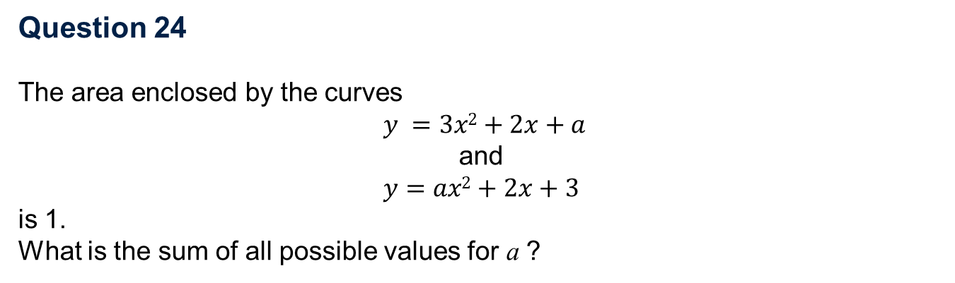
Question 24
The area enclosed by the curves
$y =3x2+2x+a$
and
$$y=ax2+2x+3$$
is 1.
What is the sum of all possible values for a ?
To get your final answer, multiply by 221 and add 5.

Slide 25
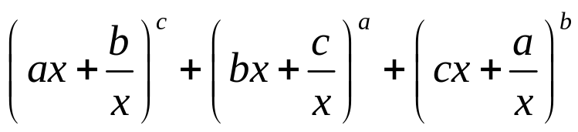
Question 25
In the expression
a, b and c are consecutive positive integers with a < b < c.
The value of the constant term when the three brackets are expanded and all the resultant terms are added is 1102707270.
What is a?
To get your final answer, multiply your value by 474 and add 4.

Slide 26
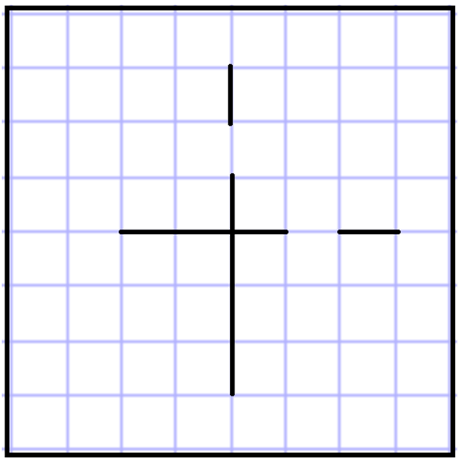
Final question (starter)
Place your 25 answers to the first 25 questions into the grid. Answers run down or to the right in the grid and don’t cross the bold lines.
Create a new 8-digit number abcdefgh by taking the diagonal from bottom left to top right.
Input this 8-digit number at https://integralmaths.org/ritangle/answer/ to release
the main part of the final question.

Slide 27
Question A
You are given two biased dice, each bearing the numbers from 1 to 6.
For the first dice; the probability of scoring x when the dice is rolled is proportional to x.
For the second dice; the probability of scoring x when the dice is rolled is inversely proportional to x.
The dice are rolled together; what (to 3 s.f.) is the probability
that they both show a prime number? Note; 1 is not a prime number.
To get your final answer, multiply by 89562001 and take the integer part
to get an 8-digit number abcdefgh.
Now visit https://integralmaths.org/ritangle/abcdefgh.html

Slide 28
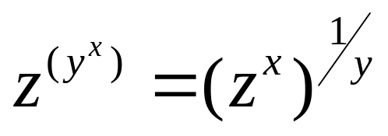
Question B
You are given that for three positive numbers x, y and z,
What is the largest that y can be?
A graphing program may be needed here to find a maximum point.
To get your final answer, multiply by 24896101 and take the integer part to get an 8-digit number abcdefgh.
Now visit https://integralmaths.org/ritangle/abcdefgh.html

Slide 29
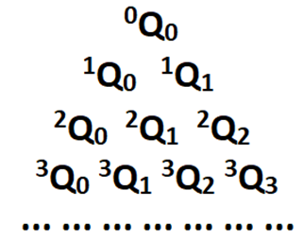
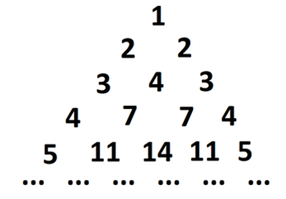
Question C
Pasquale says that Pasquale’s Triangle is created as below;
If we write the triangle as
then what is ¹⁰⁰Q₉₉?
To get your final answer, multiply by 2365 to get an 8-digit number abcdefgh.
Now visit https://integralmaths.org/ritangle/abcdefgh.html

Slide 30



Question D
The number are consecutive positive whole numbers.
The lines and meet at B, the lines y = bx + c and y = cx + a meet at C, and the lines y = cx + a and y = ax + b meet at A. What is the area of triangle ABC?
To get your final answer, multiply by 12345969 and take the integer part
to get an 8-digit number abcdefgh.
Now visit https://integralmaths.org/ritangle/abcdefgh.html
$$a, b, c$$
$$y=ax+b$$
$$y=bx+c$$

Slide 31
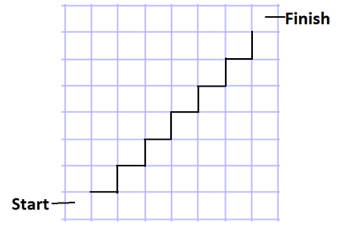
Question E
A rook starts from the bottom left corner of a chess board, and journeys to the top right corner. It can only travel north or east, and it cannot cross the given thick line.
How many possible journeys are there?
To get your final answer, multiply by 25641 to get an 8-digit number abcdefgh.
Now visit https://integralmaths.org/ritangle/abcdefgh.html

Slide 32


Question F
There are two values of x for which the tangents to the cubic curves
and
are parallel.
These four tangents create a parallelogram; what (to 3 s.f.) is the x-coordinate of its centre?
To get your final answer, multiply by 5987365 and take the integer part to get an 8-digit number abcdefgh.
Now visit https://integralmaths.org/ritangle/abcdefgh.html

Slide 33
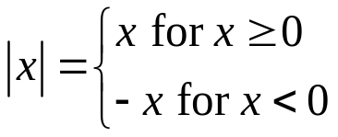

Question G
The function |x| means ‘the positive size of x’, so |5| = 5, |-5| = 5.
Explicitly,
The curve consists of two infinite half-lines that meet at the origin. If a is positive, and the two half-lines are perpendicular, what is a?
Add together all possible values for a and round to 3s.f.
To get your final answer, multiply by 21589460 and take the integer part to get an 8-digit number abcdefgh.
Now visit https://integralmaths.org/ritangle/abcdefgh.html

Slide 34
Question H
The last time I stayed in a hotel, I was given the room number 316.
‘That’s an interesting number,’ I thought, ‘since 316 = 100 + 216 = 10² + 6³.’
Now 1 = 1² + 0³ = 1³ + 0².
So 1 can be written as the sum of a square and a cube in more than one way. What is the sum of all the numbers from 0 to 99 that can be written as the sum of a square and a cube in more than one way?
Note; both the cube and the square need to be non-negative.
You may find Excel useful to you in this problem.
To get your final answer, multiply by 69534 to get an 8-digit number abcdefgh.
Now visit https://integralmaths.org/ritangle/abcdefgh.html

Slide 35
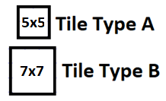
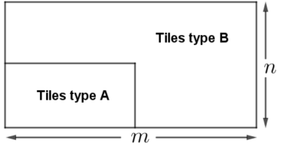
Question I
You are given many copies of two kinds of tile, 5x5 and 7x7;
The tiles are used to cover a rectangular n x m floor without gaps like so; tiles of type A fill the bottom left rectangle as shown, while tiles of type B cover the remainder of the m x n rectangle.
The ‘Tiles Type A’ rectangle is a x b, where 0 ≤ a ≤ m, 0 ≤ b ≤ n. If m = 98 and n = 126,
what is the largest total number of tiles that could be used to cover the floor
completely?
To get your final answer, multiply by 56248 to get an 8-digit number abcdefgh.
Now visit https://integralmaths.org/ritangle/abcdefgh.html

Slide 36
Question J
A triangle has two angles x and 2x (measured in degrees).
The side opposite the angle size x is of length x + 20 cm, the side opposite the angle size 2x is of length 2x + 20 cm.
Find the length of the third side in cm (to 3 sig figs).
To get your final answer, multiply by 40907110 and take the integer part to get an 8-digit number abcdefgh.
A graphing program may be needed to solve an equation here.
Now visit https://integralmaths.org/ritangle/abcdefgh.html

Slide 37
Tiebreaker Question
A computer prints out the days of the year in the 21st century in the form day-month-year without any leading zeroes, so that the tenth of October 2054 is 10-10-54 and the first of July 2002 is 1-7-2. One day the computer is asked to print out all the days from 1-1-1 to 31-12-99, but due to a glitch, it omits the hyphens. For some dates, this does not really matter; 111 can only be 1-1-1, and 311299 must be 31-12-99 (such dates are called CLEAR). But some dates are ambiguous; 11211 could be 1-12-11 or 11-2-11 (such dates are called UNCLEAR). How many unclear dates are printed by the computer?
(The number 11211, for example, will appear twice, and will be counted twice in your count.)
To get your final answer, multiply by 12345.678 and take the integer part
to get an 8-digit number abcdefgh.
Now go to https://integralmaths.org/ritangle/finalanswer.html

