Slide 2
Prime Time
Puzzle Picks!

Slide 3
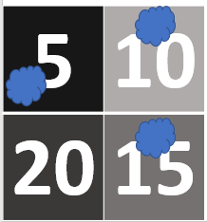
Target Board
Imagine that you are throwing 3 beanbags onto this target and they all land on a number.
You score the total of the numbers where the beanbags land.
What could you score?
5 | 10
20 | 15
I’ve scored 30!

Slide 4
Target Board
Here are some other questions to investigate:
What is the lowest score you could get?
What is the highest score you could get?
Can you make all the scores in between?
What scores and impossible to make and why?
Can any scores can be made in more than one way?
Can all scores be made in more than one way?
5 | 10
20 | 15

Slide 5
Target Board
Here are some other target boards to investigate:
5 | 4
6 | 3
4 | 6
2 | 8
5 | 3
1 | 7

