Slide 1


Slide 2
Delete this slide
These slides form an approximately hour-long presentation for students about the Level 3 Core Maths qualification
Please add, remove or change the order of the content to suit your talk/event.
It includes information on Core Maths, as well as a series of activities that give a flavour of what studying Core Maths can be like. These activities have been designed for students in Key Stage 4 and do not require any mathematics beyond GCSE to access them.

Slide 3

An Introduction to Core Maths

Slide 4
Produce the following by folding
A
B
C
D

Slide 5
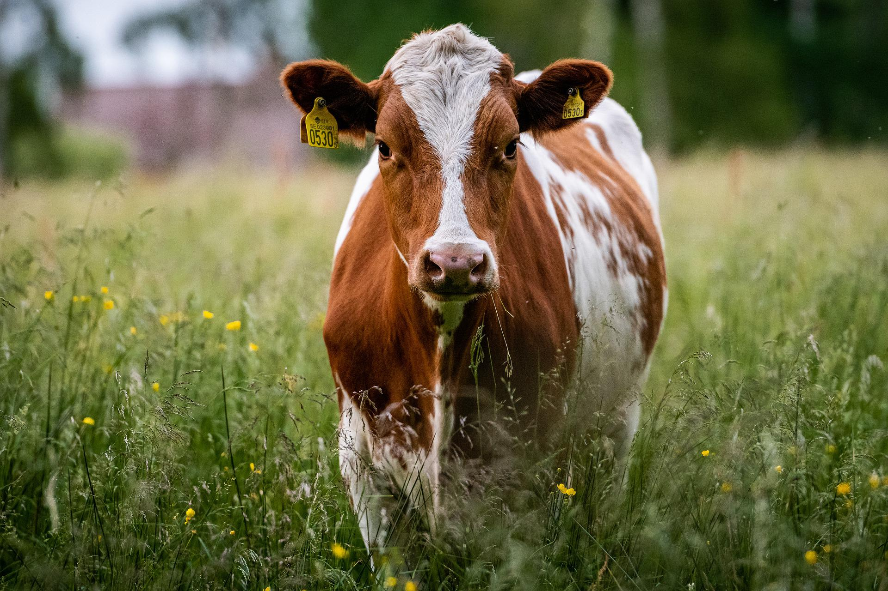
Which of these is the most accurate:
The number of quarter pounder burgers that can be made from one cow is:
180
1 800
18 000
180 000

Slide 6
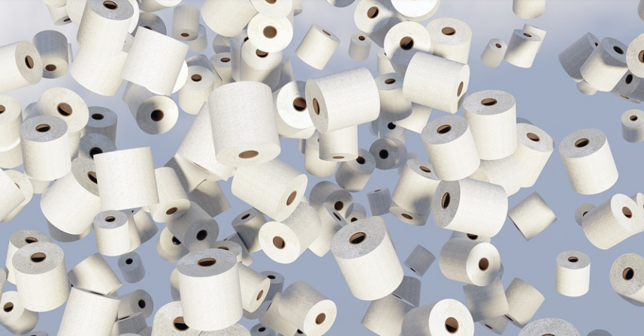
Which of these is the most accurate:
The length of toilet roll used every day worldwide is:
51 300 km
513 000 km
5 130 000 km
51 300 000 km

Slide 7

Which of these is the most accurate:
The number of tennis balls used at Wimbledon each year is:
540
5 400
54 000
540 000
Notes:
Correct answer – C

Slide 8

Which of these is the most accurate:
In the UK how many people over the age of 100 hold a valid driving licence?
25
250
2500
25000

Slide 9
Genuine job and university interview questions:
How many black cabs are there in London?
How many M&Ms can you fit in this room?
How many computers are there in the UK?
How many trees are there in Canada?

Slide 10
Why are these questions used in interviews?
Skills valued in 1985:
  Knowledge
  Following instructions
  Reliability and accuracy
Skills valued today:
  Application
  Innovation
  Communication
  Problem solving

Slide 11
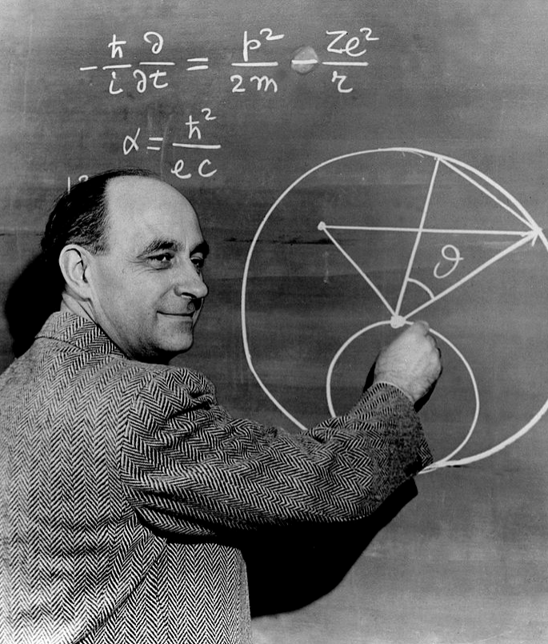
What are ‘Fermi’ estimations?
Enrico Fermi:
Italian physicist who was awarded the Nobel Prize in 1938
Created the world’s first nuclear reactor and developed a theory that we are alone in the universe.
Encouraged his students to use estimation
Used this method to determine the size of the first atomic blast by watching paper blow around his office from the atomic wind

Slide 12

How many hours to read a novel?
1
10
100
d) 1000

Slide 13
A Core Maths exam-style question
A newspaper has the following headline:
“Chilcot Report will contain 2 million words”
Estimate how many days it takes to read 2 million words. Show your reasoning.
5 minutes to answer this question.

Slide 14
Outline mark scheme
1 word per second 2 million ÷ 60 [=33 333] minutes 555 hours Reading 16 hours a day About 35 days | Time taken to read a number of words Rounds to 1 to 5 words per second Change to minutes Change to hours No of hours reading a day between 8 and 24 Answer correctly obtained from previous correct working

Slide 15
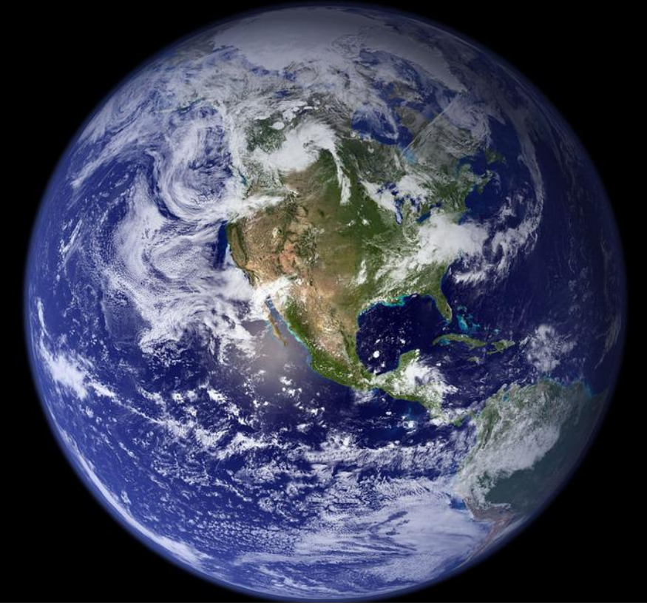

Extension
How many times around the world do you walk in your lifetime?
If a tunnel was dug through the centre of the Earth, and a car was driven through it at 60mph, it would take five and a half days to complete the journey
10mph is about 16km/h
C = 2$π$r

Slide 16
My solution:
Approximately 10,000 steps a day. Each step about 0.5m
Average daily distance walked ≈ 5 km.
Annual distance walked ≈ 5 x 365 = 1825 km
Lifetime distance walked = 70 x 1825 = 127,750km

Slide 17
I got 127,750 km walked in a lifetime ≈ 130,000km
What’s the circumference of the Earth?
D = speed x time
D = 60 x 132
D = 7920 miles

Slide 18
Convert 7920 miles into km:
D = 7920 ÷ 10 x 16 = 12,672 km
Circumference of the Earth = 2πr
= π x D
= π x 12,672
≈ 40,000 km

Slide 19
Number of times you walk around the Earth in a lifetime
= 130,000 ÷ 40,000
= 3.25 times

Slide 20


What is Core Maths?
Versatile qualification equal in size to an AS level
Maths of life and the workplace
Excellent preparation for university
Supports the maths in other courses
A course that develops valuable mathematics skills
Relevant to the world we live in
For any student with at least a GCSE Mathematics grade 4

Slide 21


Main content of Core Maths
Financial Maths
Statistics & Probability
Critical analysis of information (e.g. newspaper headlines, misleading graphs)
Spreadsheets and solving ‘real-life’ problems
Estimation
Notes:
https://pixabay.com/photos/money-finance-mortgage-loan-2696229/
https://pixabay.com/illustrations/dices-over-newspaper-profit-2656028/

Slide 22
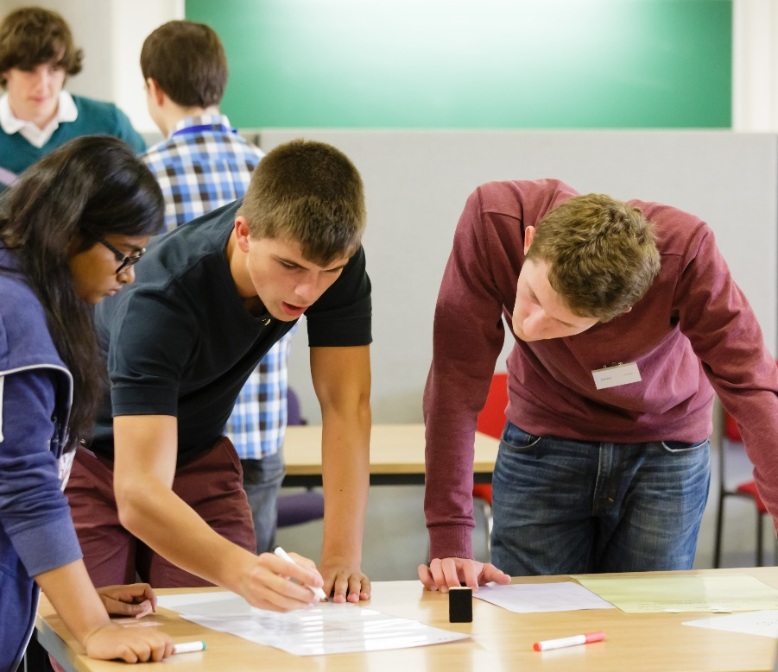
Why study Core Maths?

Slide 23
You’ll learn how to:
Use mathematics to deepen your understanding of the world around you.
Use mathematics to help you make the best decisions.
Perform important mathematical processes used in many other A level and vocational subjects.

Slide 24





Maths content in other A levels
Geography
(no specific percentage but geographical skills include quantitative and qualitative skills equally)
£
Economics
(at least 20%)
Biology
(at least 10%)
Business
(at least 10%)
Psychology
(at least 10%)
PE
(at least 5%)
(no specific percentage but you will be analysing data)
Sociology

Slide 25
Exemplar University Alternative Offers
University of Bath
Applies to all degrees that do not require A level Maths
For students achieving a grade B or A in Core Maths
Or grade B in AS or A level Maths or AS or A level Statistics if studied in addition to 3 subjects.
Typical offer A level | Alternative offer A level
A*AA | AAA
AAA or A*AB | AAB
AAB | ABB
Courses: Architecture, Business Courses, Biosciences, Chemistry, Pharmacy, Education, Health and Sport degrees, Languages, Politics, Psychology, and Social Sciences

Slide 26
The University of Sheffield
If we offer you a place on certain courses with a GCSE Maths requirement, and you're taking a Core Maths qualifications, we'll make you an alternative offer equivalent to one A Level grade below the standard entry requirements for your course, subject to you achieving a specific grade in Core Maths.
Taken from https://www.sheffield.ac.uk/undergraduate/apply/access#
Notes:
Taken from https://www.sheffield.ac.uk/undergraduate/apply/access#

Slide 27
The University of Sheffield
BSc Psychology: AAB including 1 specified science, or ABB, including 1 specified science + A in Core Maths
BSc Quantitative Social Sciences: ABB or BBB + B in Core Maths
BA Architecture: AAA or AAB + B in Core Maths
BSc Biomedical Science: AAB, including two science subjects, or ABB, including two science subjects + B in Core Maths
Notes:
Taken from: https://www.sheffield.ac.uk/prospectus/courseDetails.do?id=C8002020#qualificationsand https://www.sheffield.ac.uk/prospectus/courseDetails.do?id=L4352020#qualifications

Slide 28
The University of York
If you achieve B or higher in Core Maths, you may be eligible for an alternative offer up to one A level grade (or equivalent) below our typical offer.
This applies to a wide range of courses including Biology, Business and Management, History of Art, Midwifery Practice, Music, Philosophy, Social Work

Slide 29
Studying Core Maths at ……..
Here you will study Core Maths in 1 year 2 years
You will get …. hours of Core Maths time per week
Your exams will be in May of year 12 year 13

Slide 30
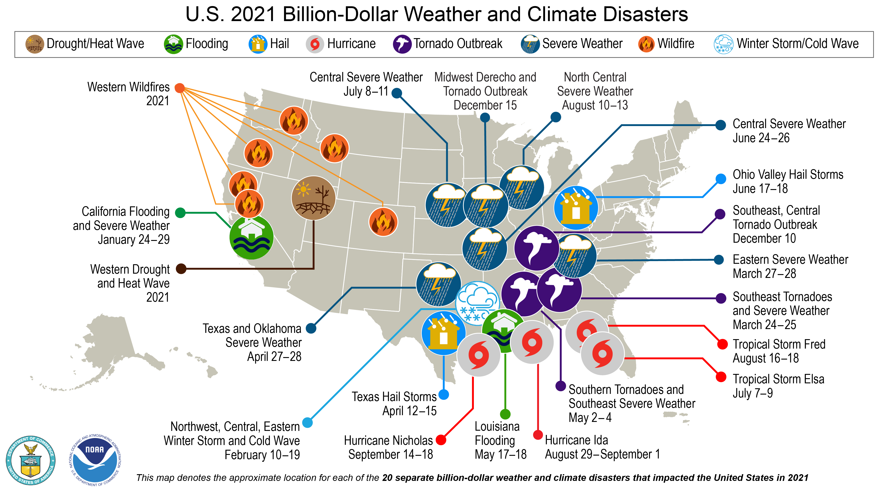
What do you notice? What do you wonder?

Slide 31
About the AMSP
A government-funded initiative, managed by MEI, providing national support for teachers and students in all state-funded schools and colleges in England.
It aims to increase participation in AS/A level Mathematics and Further Mathematics, and Core Maths, and improve the teaching of these qualifications.
Additional support is given to those in priority areas to boost social mobility so that, whatever their gender, background or location, students can choose their best maths pathway post-16, and have access to high quality maths teaching.

Slide 32




Contact the AMSP
01225 716 492
admin@amsp.org.uk
amsp.org.uk
Advanced_Maths

Slide 33
Copyright attributions
Picture of cow by Christoffer Borg Mattisson from Pixabay
Picture of toilet rolls by Nigel Durrant from Pixabay
Picture of tennis balls by Zoltan Matuska from Pixabay
Picture of car driver by Michael Kauer from Pixabay
Picture of Fermi has no known copyright restrictions https://commons.wikimedia.org/wiki/File:Enrico_Fermi_at_the_blackboard.jpg
Picture of man reading book by Pexels from Pixabay
Picture of the world by WikiImages from Pixabay
Picture of alarm clock and money https://pixabay.com/photos/money-finance-mortgage-loan-2696229/
Picture of word cubes https://pixabay.com/illustrations/dices-over-newspaper-profit-2656028/
US climate disasters from https://www.climate.gov/news-features/blogs/beyond-data/2021-us-billion-dollar-weather-and-climate-disasters-historical Anything credited to NOAA Climate.gov can be freely re-used with proper attribution.

