Slide 2

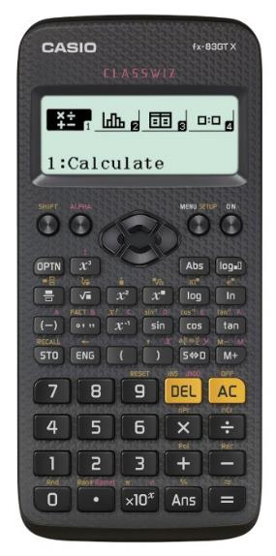


Year 6 Get Calculating Growing Patterns
Notes:
Images from Casio – a non and a scientific calculator
Images of calculator keys to use on different slides

Slide 3


Getting to know your calculator
Look at your calculator
Have you got any questions about any of the keys?

Slide 4


Getting to know your calculator
Look at your calculator
What is the difference between the C and AC or the DEL and AC?

Slide 5
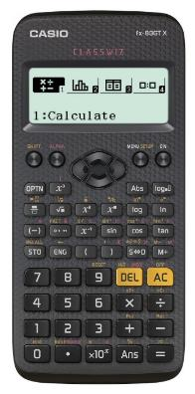
Getting to know your calculator
AC is ‘All Clear’ and clears everything you have keyed in
C/DEL only clears the last key press or number you keyed in
Have a go at getting 3 + 5 wrong by keying in 3 + 4. Press the C/DEL and see what happens.

Slide 6
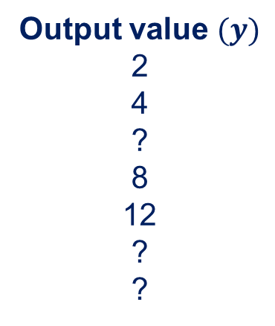
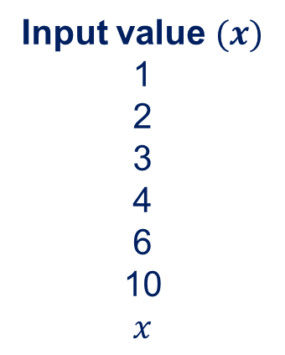
Function Machines
This function machine is doing something to the numbers.
The input values are changed into the output values
What is changing?
What function is the machine performing?
Input value $(x)$
1
2
3
4
6
10
$$x$$
Output value $(y)$
2
4
?
8
12
?
?
Function
-o-matic!
The input has been _____ to produce the output value
Use the ‘I think ….’ prompts as you discuss your work with a partner
Notes:
The machine is doubling – a simple start to re-introduce the idea of a function machine as they may not have come across one for a while.
The function machine is not adding the input number again as this means that the function is changing each time so the function must be $×2$

Slide 7
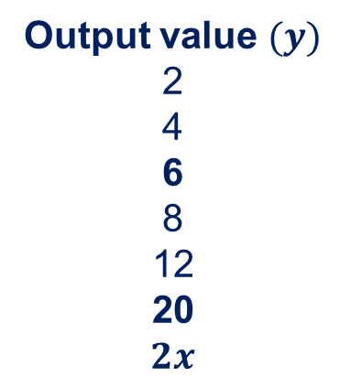

Function Machines
This function machine is doing something to the numbers.
The input values are changed into the output values
What is changing?
What function is the machine performing?
Input value $(x)$
1
2
3
4
6
10
$$x$$
Output value $(y)$
2
4
6
8
12
20
$$2x$$
Multiply by 2
The input has been multiplied by 2 to produce the output value
Can you change your calculator into the function machine?
Use the ‘I think ….’ prompts as you discuss your work with a partner
Notes:
The machine is doubling – a simple start to re-introduce the idea of a function machine as they may not have come across one for a while.
The function machine is not adding the input number again as this means that the function is changing each time so the function must be $×2$

Slide 8
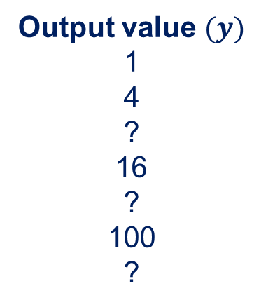

Function Machines 2
This ‘Function-o-matic’ has been reprogrammed.
What function is the machine performing this time?
Input value $(x)$
1
2
3
4
6
10
$$x$$
Output value $(y)$
1
4
?
16
?
100
?
Function
-o-matic!
The input has been _____ to produce the output value
Use the ‘I think ….’ prompts as you discuss your work with a partner
Notes:
Squaring the input number

Slide 9
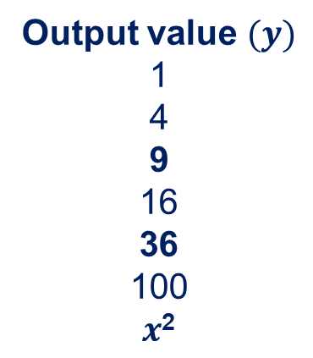
Function Machines 2
This ‘Function-o-matic’ has been reprogrammed.
What function is the machine performing this time?
Input value $(x)$
1
2
3
4
6
10
$$x$$
Output value $(y)$
1
4
9
16
36
100
$x$²
Input squared
The input has been squared to produce the output value
Can you make your calculator do the same as the function machine?
Notes:
Squaring the input number

Slide 10
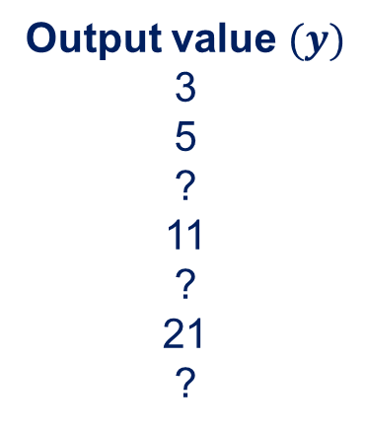

Function Machines 3
This ‘Function-o-matic’ has been reprogrammed again.
What function is the machine performing?
It is a two step function this time.
Input value $(x)$
1
2
4
5
6
10
$$x$$
Output value $(y)$
3
5
?
11
?
21
?
Function
-o-matic!
Function
-o-matic!
The input has been ___________________________ to produce the output value
Use the ‘I think ….’ prompts as you discuss your work with a partner
Notes:
This time the function machine is doubling and adding 1 each time $×2+1$
The $+ 1$ is ok here as it is always adding one and not adding a different value each time.

Slide 11
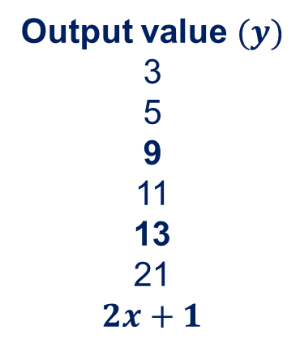
Function Machines 3
This ‘Function-o-matic’ has been reprogrammed again.
What function is the machine performing this time?
It is a two step function this time.
Input value $(x)$
1
2
4
5
6
10
$$x$$
Output value $(y)$
3
5
9
11
13
21
$$2x+1$$
Multiply by 2
Add 1
The input has been ___________________________ to produce the output value
Use the ‘I think ….’ prompts as you discuss your work with a partner
Notes:
This time the function machine is doubling and adding 1 each time $×2+1$
The $+ 1$ is ok here as it is always adding one and not adding a different value each time.

Slide 12
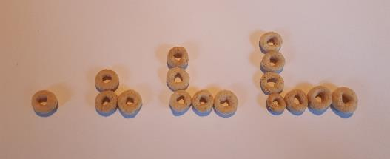
Growing a Pattern
Have a go at growing this pattern.
Use whatever you have to hand to make the pattern
I used some breakfast cereal!

Slide 13
Growing a Pattern
How can you describe the pattern?
What does it look like?
What changes from one to the next?
Explain to someone how you would create the next pattern in the sequence

Slide 14
Growing a Pattern
Explain how the sequence is growing
How many dots will there be in the next arrangement?
If we say that pattern number 1 has just one dot, how many dots will there be in pattern number 10?
Use the ‘I think ….’ prompts as you discuss your work with a partner

Slide 15
Growing a Pattern
Pattern number 1 2 3 4
Pattern number | 1 | 2 | 3 | 4 | 5 | 6 | 7 | 8 | 9 | 10
Number of dots | 1 | 3 | 5 | 7
Complete the table.
Explain what is happening with the numbers.

Slide 16
Growing a Pattern
Pattern number 1 2 3 4
Pattern number | 1 | 2 | 3 | 4 | 5 | 6 | 7 | 8 | 9 | 10
Number of dots | 1 | 3 | 5 | 7 | 9 | 11 | 13 | 15 | 17 | 19
How does this relate to the function machine?

Slide 17
Growing a Pattern
Pattern number 1 2 3 4
Input | 1 | 2 | 3 | 4 | 5 | 6 | 7 | 8 | 9 | 10
Output | 1 | 3 | 5 | 7 | 9 | 11 | 13 | 15 | 17 | 19
What would the function machine be doing for these inputs and outputs?
Notes:
The function machine would be doubling the input and subtracting 1
This relates to the way the pattern grows if you think about each arm of the ‘L’ as having the ‘pattern number’ of dots, there are two arms but one of the dots is repeated so you subtract 1
2 arms and take away the one that is in both hence $2x −1$ as the algebraic generalisation of the sequence

Slide 18
Growing a Pattern
Pattern number 1 2 3 4
Pattern number (input) | 1 | 2 | 3 | 4 | 5 | 6 | 7 | 8 | 9 | 10
Number of dots (output) | 1 | 3 | 5 | 7 | 9 | 11 | 13 | 15 | 17 | 19
To find the number of dots for any pattern number you _________ the pattern number ______ and _________
Notes:
The function machine would be doubling the input and subtracting 1
This relates to the way the pattern grows if you think about each arm of the ‘L’ as having the ‘pattern number’ of dots, there are two arms but one of the dots is repeated so you subtract 1
2 arms and take away the one that is in both hence $2x −1$ as the algebraic generalisation of the sequence

Slide 19
Growing a Pattern
Pattern number 1 2 3 4
Pattern number (input) | 1 | 2 | 3 | 4 | 5 | 6 | 7 | 8 | 9 | 10
Number of dots (output) | 1 | 3 | 5 | 7 | 9 | 11 | 13 | 15 | 17 | 19
To find the number of dots for any pattern number you multiply the pattern number by 2 and subtract 1
Notes:
The function machine would be doubling the input and subtracting 1
This relates to the way the pattern grows if you think about each arm of the ‘L’ as having the ‘pattern number’ of dots, there are two arms but one of the dots is repeated so you subtract 1
2 arms and take away the one that is in both hence $2x −1$ as the algebraic generalisation of the sequence

Slide 20
Explaining the rule
To find the number of dots for any pattern number you multiply the pattern number by 2 and subtract 1
For pattern number 4 there are two sets of four dots
When the dots meet, one is repeated
We subtract 1 so that the dot is not counted twice
Notes:
This animated slide shows the two sets of 4 dots coming together and the one to be subtracted being removed

Slide 21
Using the calculator
Pattern number 1 2 3 4
Pattern number (input) | 1 | 2 | 3 | 4 | 5 | 6 | 7 | 8 | 9 | 10
Number of dots (output) | 1 | 3 | 5 | 7 | 9 | 11 | 13 | 15 | 17 | 19
To find the number of dots for any pattern number you multiply the pattern number by 2 and subtract 1
How could you use the calculator to work out how many dots are needed for the 387th pattern in this sequence?
Which pattern number would need 271 dots?
Notes:
The function machine would be doubling the input and subtracting 1
This relates to the way the pattern grows if you think about each arm of the ‘L’ as having the ‘pattern number’ of dots, there are two arms but one of the dots is repeated so you subtract 1
2 arms and take away the one that is in both hence $2x −1$ as the algebraic generalisation of the sequence

Slide 22
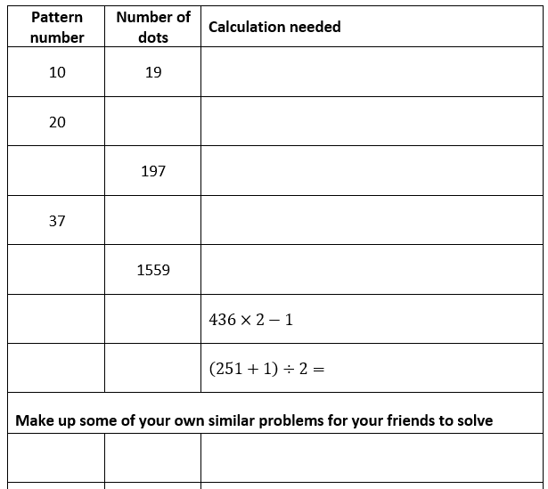
Appendix 1 activity
Complete the table
Think about the calculation you need to enter into the calculator.
Are the brackets important?
Make up some similar problems to challenge your friends

Slide 23
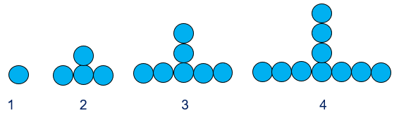
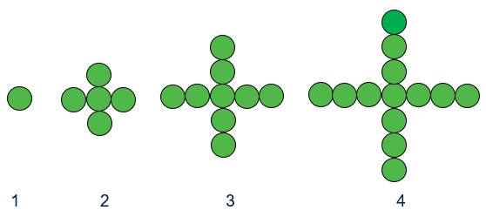
Extra challenges
The following slides allow you to explore other growing patterns and to think about the way that they grow and how you can explain it.

Slide 24
Growing a different Pattern
Instead of an ‘L’ shape we now have an upside-down ‘T’
How does this pattern grow?
Explain how to make the next pattern in the sequence
1 2 3 4
Pattern number (input) | 1 | 2 | 3 | 4 | 5 | 6 | 7 | 8 | 9 | 10
Number of dots (output) | 1
Notes:
The function machine would be doubling the input and subtracting 1
This relates to the way the pattern grows if you think about each arm of the ‘L’ as having the ‘pattern number’ of dots, there are two arms but one of the dots is repeated so you subtract 1
2 arms and take away the one that is in both hence $2x −1$ as the algebraic generalisation of the sequence

Slide 25
Growing a different Pattern
What would the function machine be doing to turn the input value into the output value this time?
To find the number of dots for any pattern number you _________ the pattern number _________ and _________
1 2 3 4
Pattern number (input) | 1 | 2 | 3 | 4 | 5 | 6 | 7 | 8 | 9 | 10
Number of dots (output) | 1 | 4 | 7 | 10 | 13 | 16 | 19 | 22 | 25 | 28
Notes:
This time there are 3 ‘legs’ to the pattern so the pattern number is multiplied by 3 and then 2 is subtracted because the dot in the middle at the bottom only counts once and has to be removed from the other two repeats $3x −2$
You can also think of three times the pattern number minus 1, then add one for the central dot $3\left(x−1\right)+1$ which expands to $3x −3+1=3x −2$

Slide 26
Growing a different Pattern
What would the function machine be doing to turn the input value into the output value this time?
To find the number of dots for any pattern number you multiply the pattern number by 3 and subtract 2
1 2 3 4
Pattern number (input) | 1 | 2 | 3 | 4 | 5 | 6 | 7 | 8 | 9 | 10
Number of dots (output) | 1 | 4 | 7 | 10 | 13 | 16 | 19 | 22 | 25 | 28
Notes:
This time there are 3 ‘legs’ to the pattern so the pattern number is multiplied by 3 and then 2 is subtracted because the dot in the middle at the bottom only counts once and has to be removed from the other two repeats $3x −2$
You can also think of three times the pattern number minus 1, then add one for the central dot $3\left(x−1\right)+1$ which expands to $3x −3+1=3x −2$

Slide 27
Explaining the rule
To find the number of dots for any pattern number you multiply the pattern number by 3 and subtract 2
For pattern number 4 there are three sets of four dots
When the dots meet, one is repeated in all three sets
We only need to count that dot once
We subtract 2 so that the dot is only counted once and not 3 times
Notes:
This animated slide shows the three sets of 4 dots coming together and the two to be subtracted being removed

Slide 28
Growing a different Pattern
1 2 3 4
Pattern number (input) | 1 | 2 | 3 | 4 | 5 | 6 | 7 | 8 | 9 | 10
Number of dots (output) | 1 | 4 | 7 | 10 | 13 | 16 | 19 | 22 | 25 | 28
To find the number of dots for any pattern number you multiply the pattern number by 3 and subtract 2
How could you use the calculator to work out how many dots are needed for the 296th pattern in this sequence?
Which pattern number would need 472 dots?
Notes:
This time there are 3 ‘legs’ to the pattern so the pattern number is multiplied by 3 and then 2 is subtracted because the dot in the middle at the bottom only counts once and has to be removed from the other two repeats $3x −2$
You can also think of three times the pattern number minus 1, then add one for the central dot $3\left(x−1\right)+1$ which expands to $3x −3+1=3x −2$

Slide 29
Growing yet another pattern
What do you think the rule will be for working out the sequence for this pattern?
1 2 3 4
Pattern number (input) | 1 | 2 | 3 | 4 | 5 | 6 | 7 | 8 | 9 | 10
Number of dots (output) | 1
Think about what the function machine would be doing this time
Think about how you could use the calculator to be the function machine
Notes:
The function machine would be doubling the input and subtracting 1
This relates to the way the pattern grows if you think about each arm of the ‘L’ as having the ‘pattern number’ of dots, there are two arms but one of the dots is repeated so you subtract 1
2 arms and take away the one that is in both hence $2x −1$ as the algebraic generalisation of the sequence

Slide 30
Explaining the rule
To find the number of dots for any pattern number you multiply the pattern number by 4 and subtract 3
For pattern number 4 there are four sets of four dots
When the dots meet, one is repeated in all three sets
We only need to count that dot once
We subtract 3 so that the dot is only counted once and not 3 times
Notes:
This animated slide shows the four sets of 4 dots coming together and the three repeated dots being subtracted

Slide 31
I think ….
When you are working with a friend, use these to explain what you are thinking …
To make the next one in the sequence you have to …
I think the next one will have ____ dots because …..
I wonder what will happen if …
I know this so …
It could be this because …
It can’t be this because …

Slide 32
About MEI
Registered charity committed to improving mathematics education
Independent UK curriculum development body
We offer continuing professional development courses, provide specialist tuition for students and work with employers to enhance mathematical skills in the workplace
We also pioneer the development of innovative teaching and learning resources

