Slide 2

MEI Securing Key Skills
Intervention materials to supping students with key areas of the maths curriculum
Place value
Measures
2D shape
Fractions decimals and percentages
Mental calculations
Representing problems

Slide 3
Relevant at different stages of their school career
Securing key skills
upper KS2 preparing for transition
starting KS3
preparing for GCSE
securing key areas for GCSE resit
securing key areas for Functional Skills

Slide 4
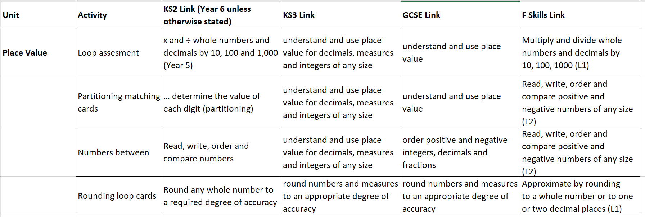
Guidance to target support
Securing key skills
Notes:
A spreadsheet shows how the different units and activities can support students from KS2 through to GCSE and Functional Skills so you can match the activities to the needs of your students

Slide 5
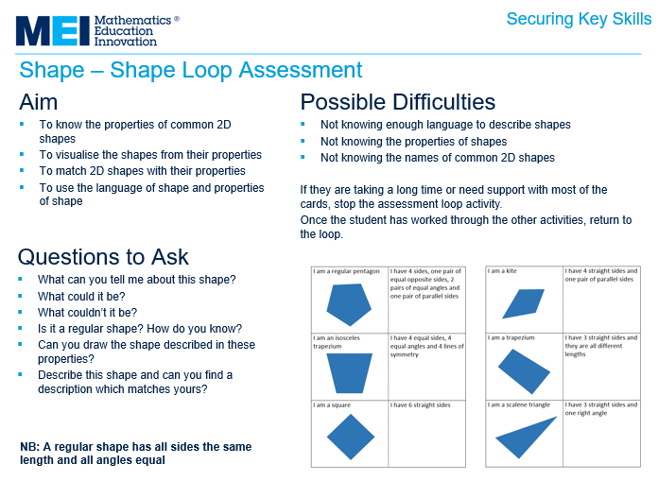
Guidance for all activities
Securing key skills
Notes:
A spreadsheet shows how the different units and activities can support students from KS2 through to GCSE and Functional Skills so you can match the activities to the needs of your students

Slide 6
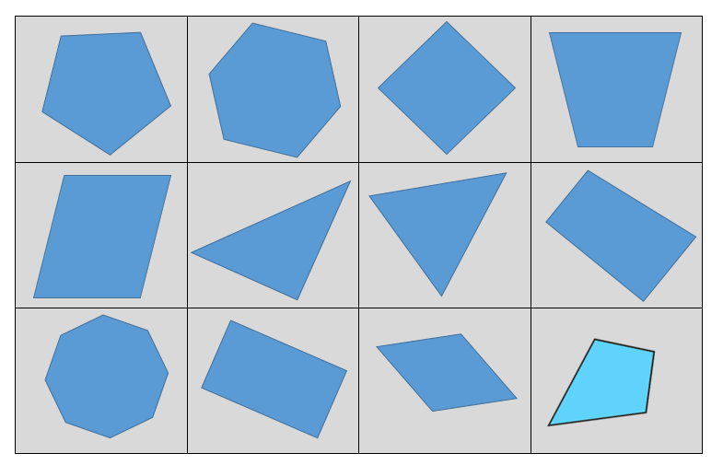
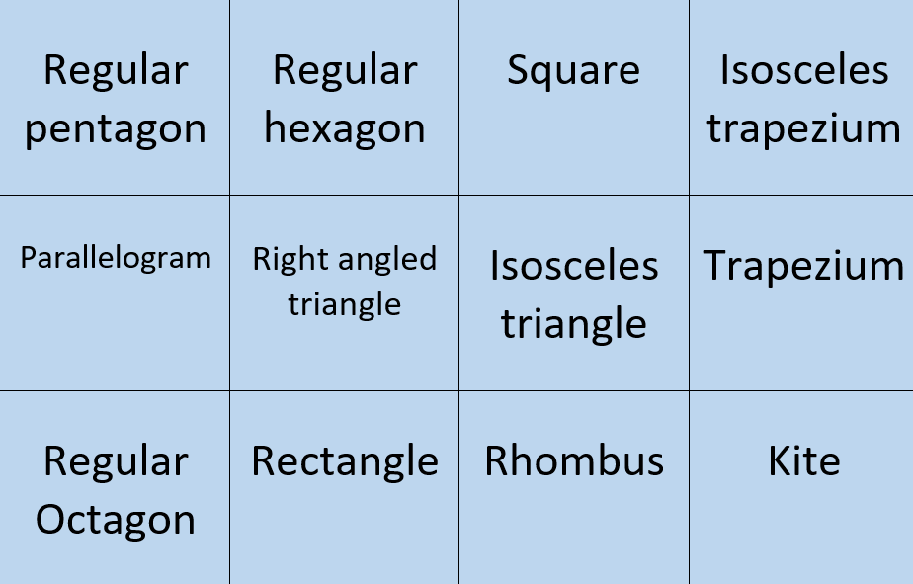
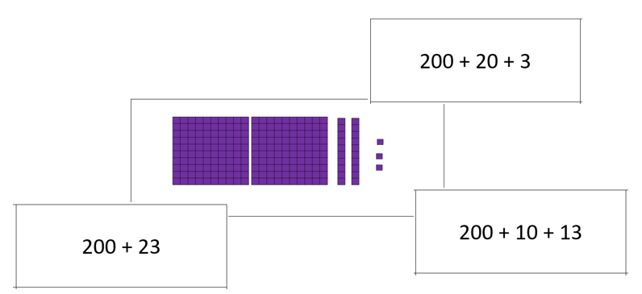
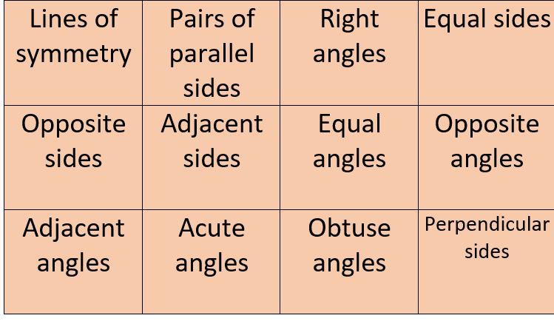
Simple but engaging activities
Securing key skills
Card sorts
Notes:
A spreadsheet shows how the different units and activities can support students from KS2 through to GCSE and Functional Skills so you can match the activities to the needs of your students

Slide 7
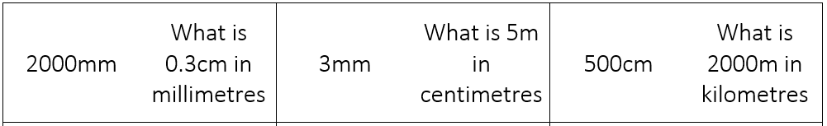
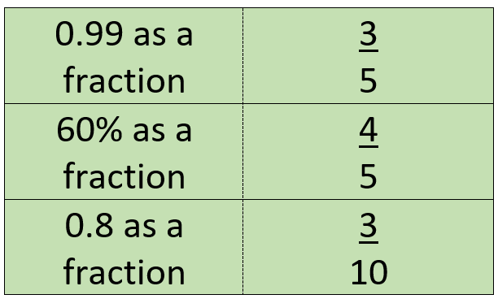
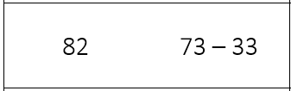
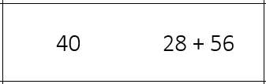
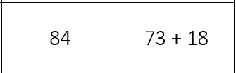
Securing key skills
‘Follow me’/loop cards

Slide 8
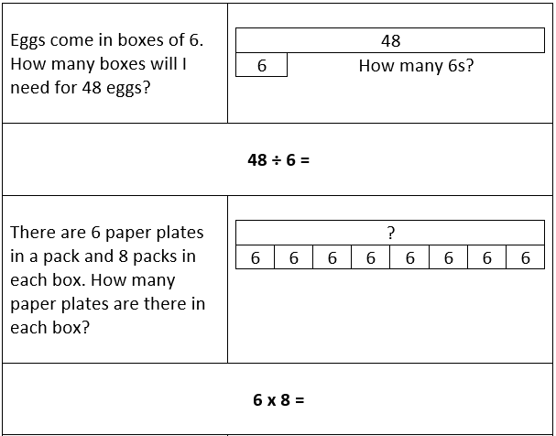
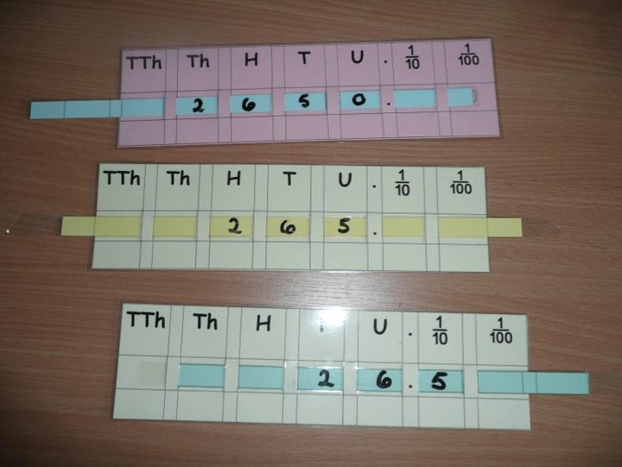


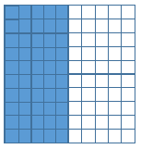
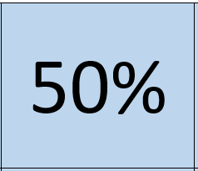
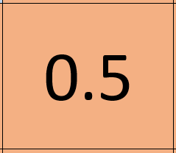
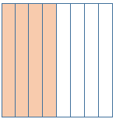



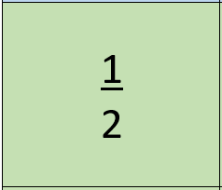
Use of representations
Securing key skills
Notes:
A spreadsheet shows how the different units and activities can support students from KS2 through to GCSE and Functional Skills so you can match the activities to the needs of your students

Slide 9
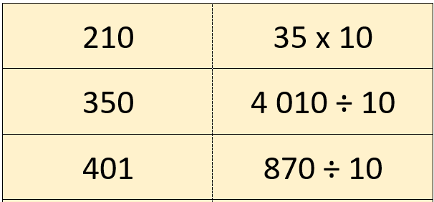
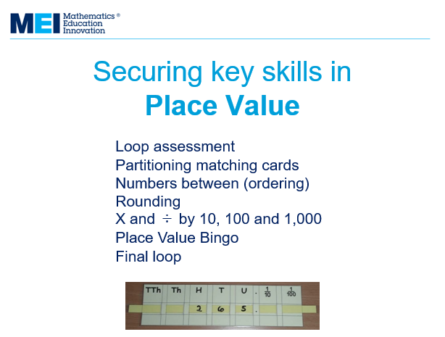
Assessing progress?
Securing key skills
‘Follow me’/loop cards
Notes:
Loop cards are used in many units and also form a means of assessing progress as the loop is used at the start and at the end of the unit. Increased speed in completing the loop will indicate the progress that has been made.
The guides show the order in which activities should be introduced in order to build confidence, knowledge and skills. Activities can of course be repeated but it is advisable to introduce them in the order shown on the guides.

Slide 10
Further information
Securing key skills
www.mei.org.uk
office@mei.org.uk
Notes:
Loop cards are used in many units and also form a means of assessing progress as the loop is used at the start and at the end of the unit. Increased speed in completing the loop will indicate the progress that has been made.
The guides show the order in which activities should be introduced in order to build confidence, knowledge and skills. Activities can of course be repeated but it is advisable to introduce them in the order shown on the guides.

Slide 11
About MEI
Registered charity committed to improving mathematics education
Independent UK curriculum development body
We offer continuing professional development courses, provide specialist tuition for students and work with employers to enhance mathematical skills in the workplace
We also pioneer the development of innovative teaching and learning resources

