Slide 2
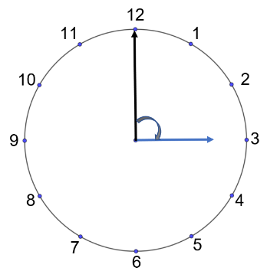
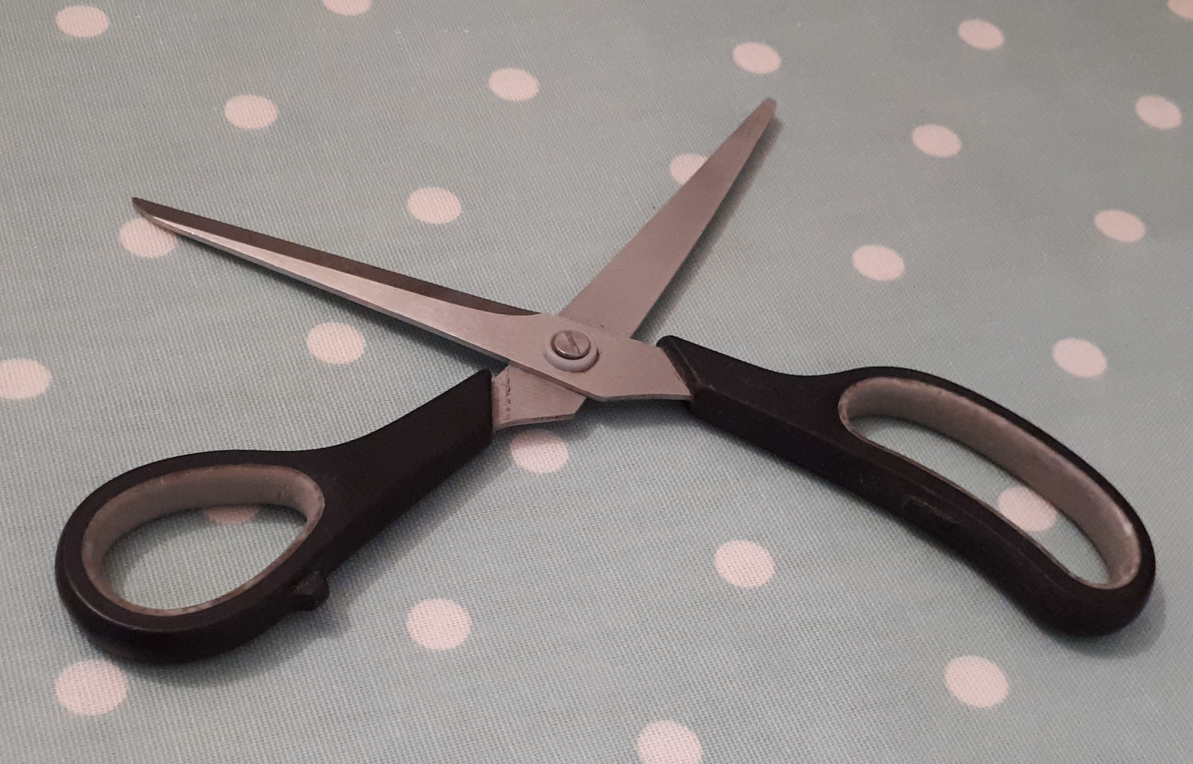


Angle-poise Year 6 Angles around us

Slide 3
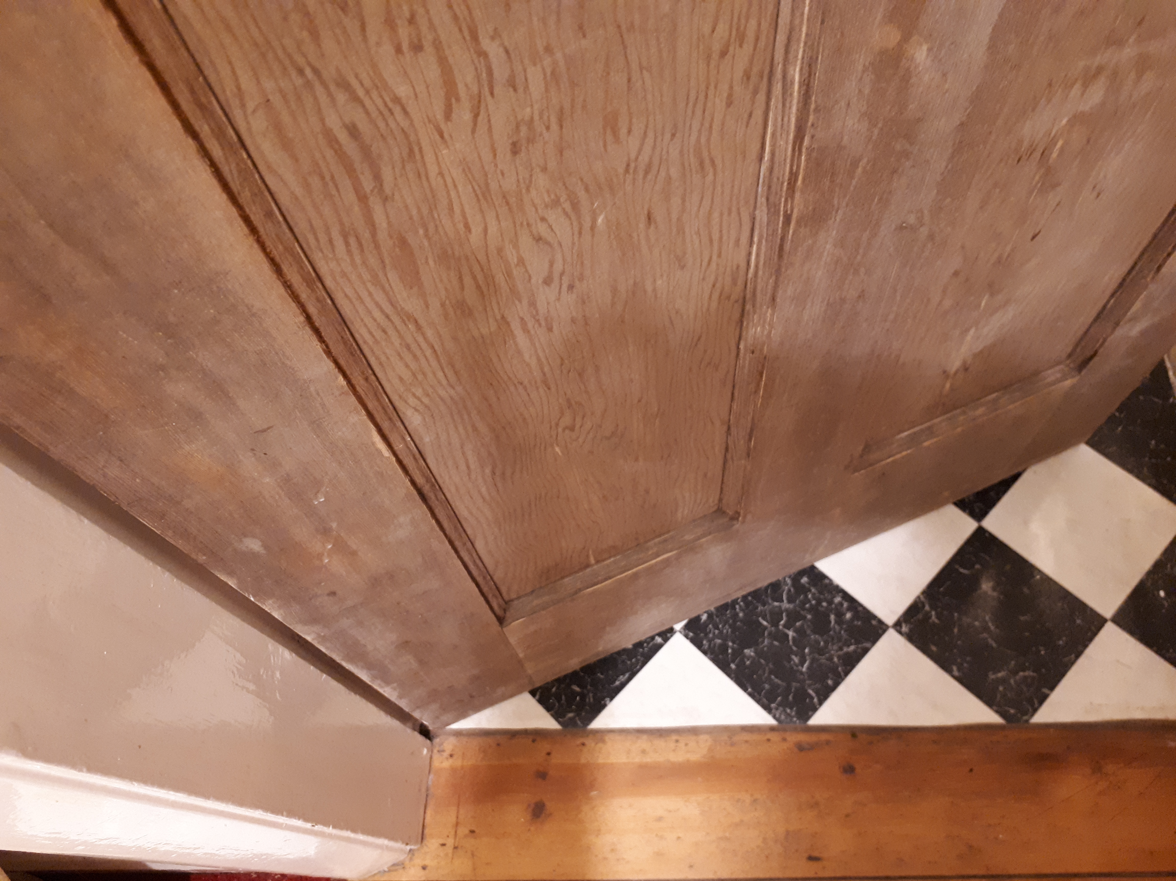
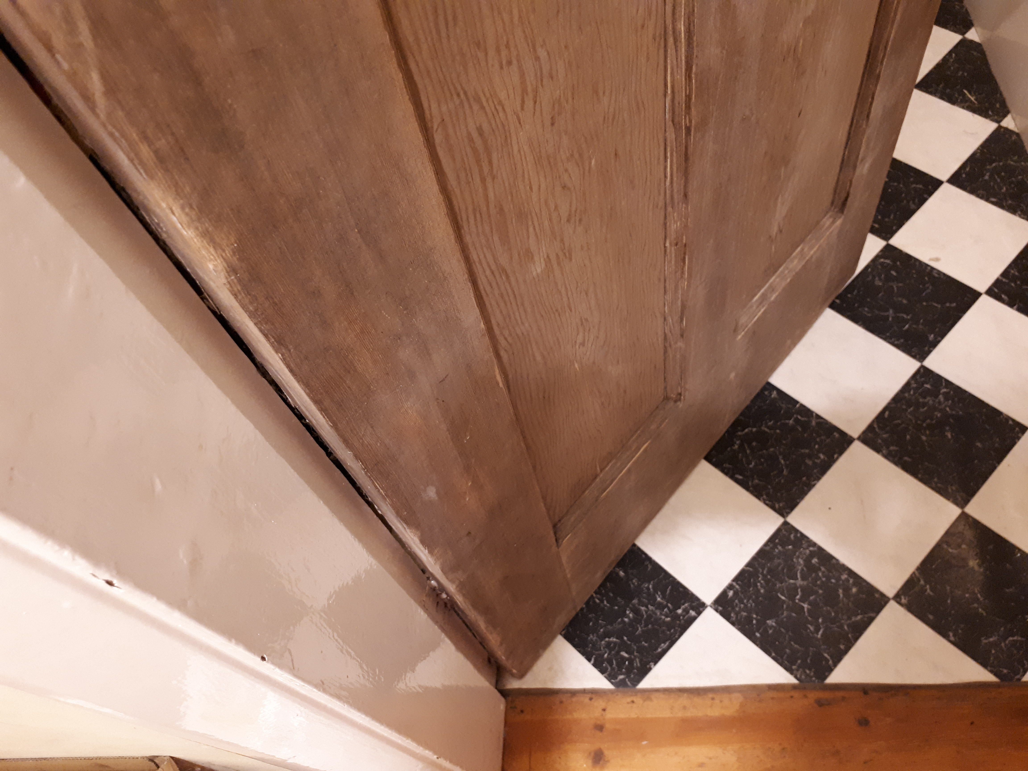
Angles around us
Which angle changes in these images?
How does it change?
Notes:
In the door frame there are right angles at the corners but there is also the angle between the frame and the door as it swings

Slide 4
Angles around us
Which angle changes in these images?
How does it change?
Notes:
In the door frame there are right angles at the corners but there is also the angle between the frame and the door as it swings

Slide 5
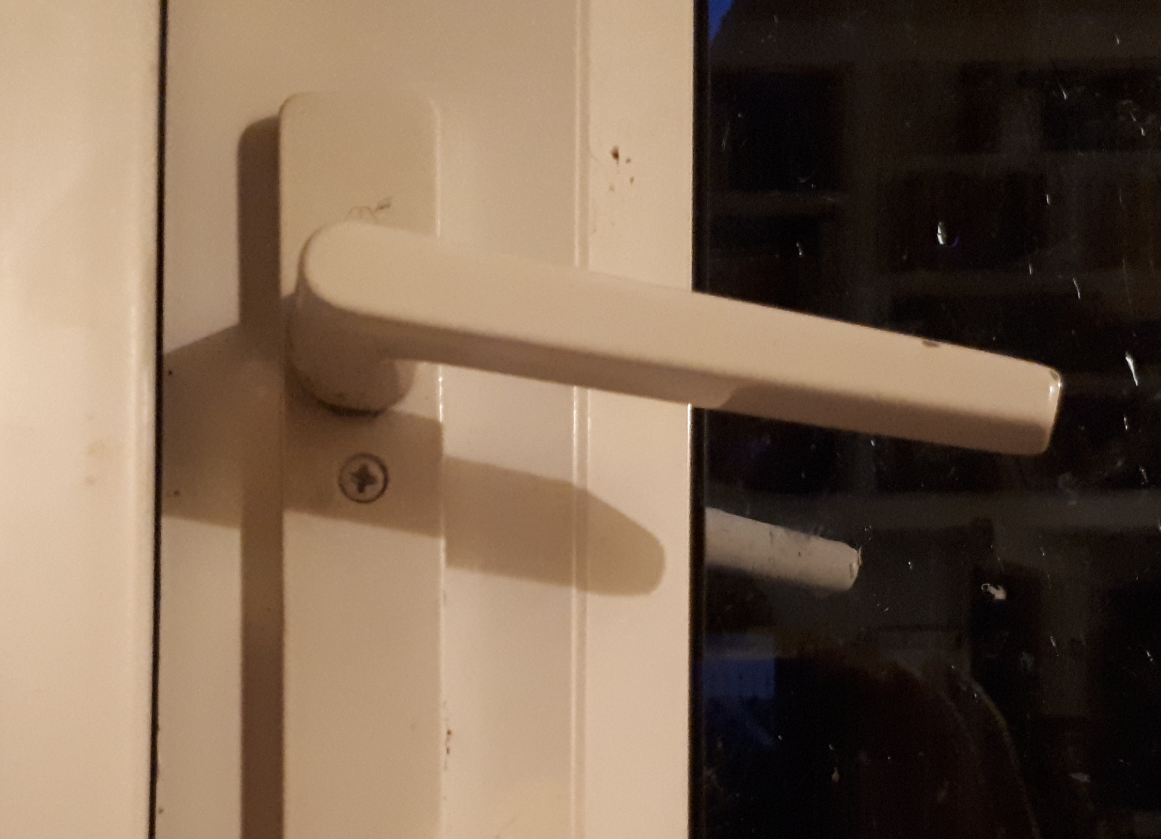
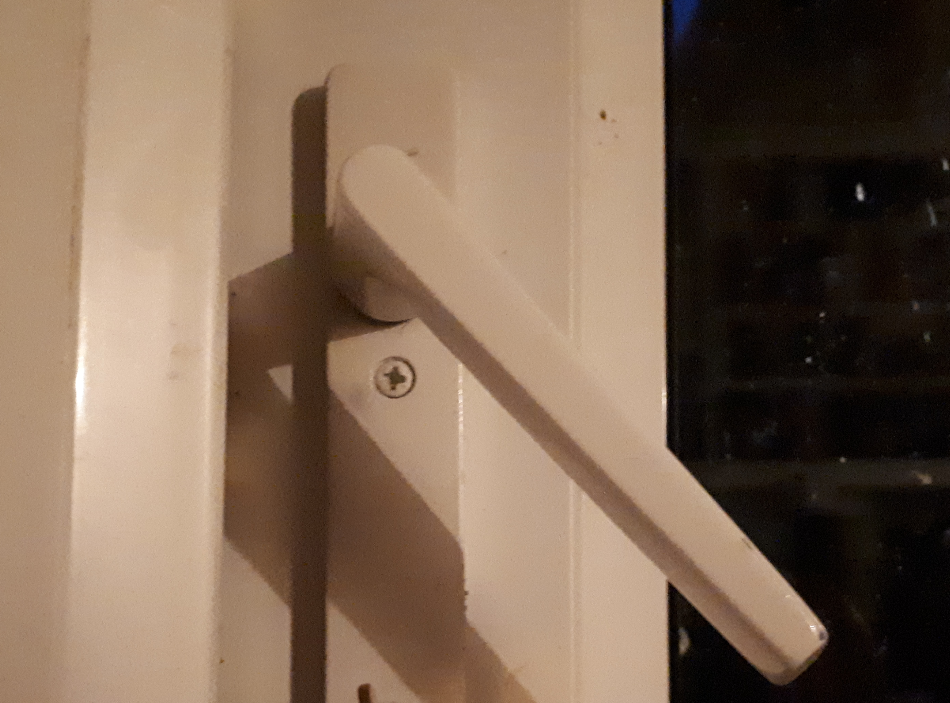
Angles around us
Which angle changes in these images?
How does it change?
Notes:
In the door frame there are right angles at the corners but there is also the angle between the frame and the door as it swings

Slide 6
Angles around us
Which angle changes in these images?
How does it change?
What is different about the angle in this image?
Notes:
In the door handle image, there is only one arm of the angle and the it moves to form the other arm in its new position

Slide 7
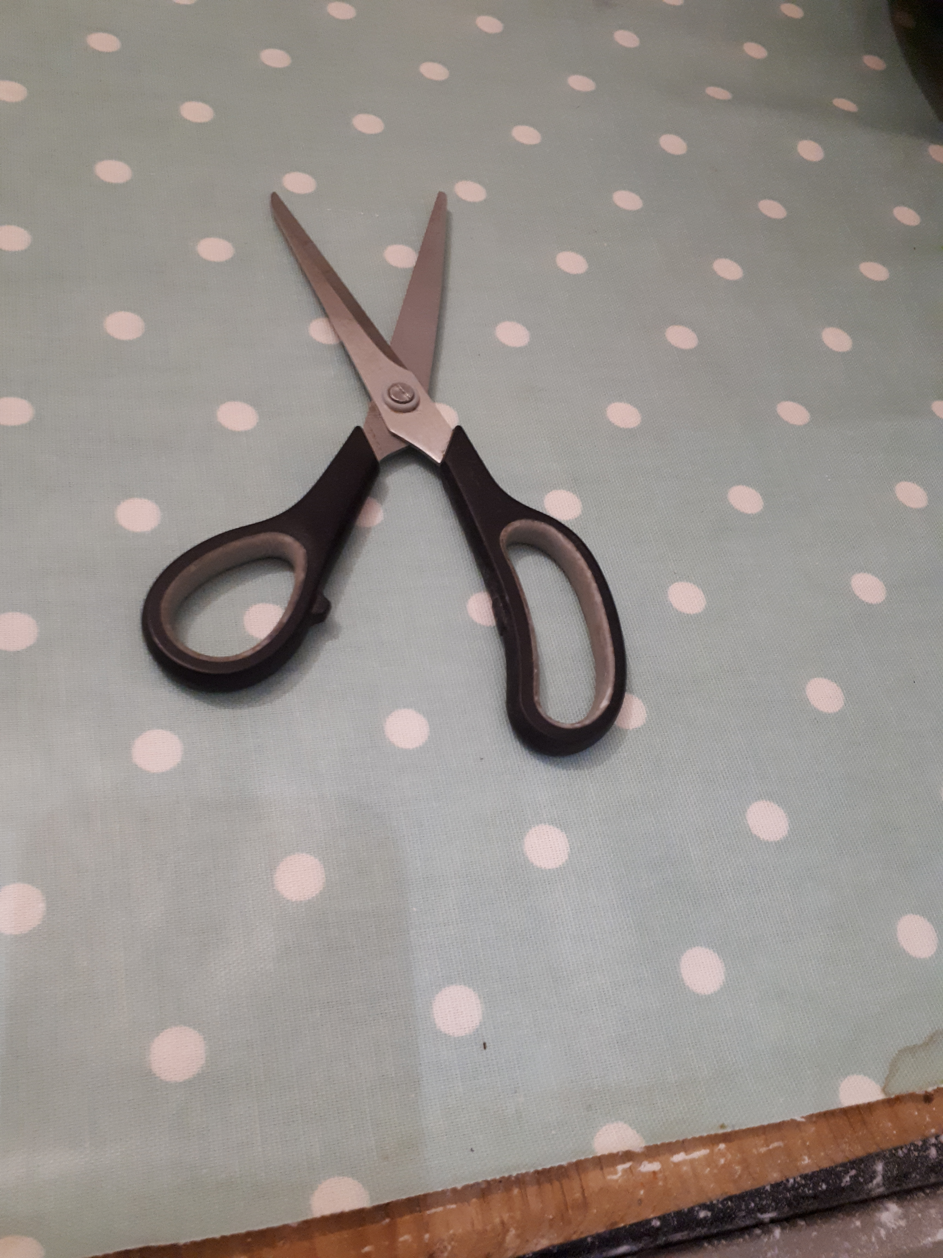
Angles around us
Where are the angles in these images and how have they changed?
Notes:
In the door frame there are right angles at the corners but there is also the angle between the frame and the door as it swings
In the door handle image, there is only one arm of the angle and the it moves to form the other arm in its new position
The fan blades rotate to create the angles
The arms of the angle in the slide image are the ground and the slide
The pair of scissors is an X hinge and can be used to explore angles around a point.

Slide 8
Angles around us
Where are the angles in these images and how have they changed?
Notes:
The pair of scissors is an X hinge and can be used to explore angles around a point.
There could be a discussion around whether angles are increasing or decreasing
You could also ask pupils what they notice about the angles on a straight line. This could lead to a discussion about the opposite angles.

Slide 9
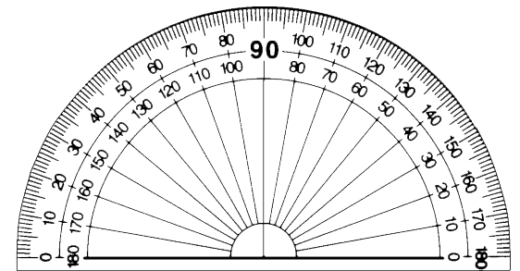
Angles around us
These are the lines that were drawn on the scissors.
What do you notice about the angles?
Notes:
The pair of scissors is an X hinge and can be used to explore angles around a point.
There could be a discussion around whether angles are increasing or decreasing
You could also ask pupils what they notice about the angles on a straight line. This could lead to a discussion about the opposite angles.

Slide 10
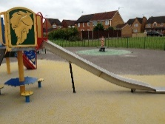
Angles around us
What interesting angles can you find around you?
Look for things which spin and turn or are on a slope
Where are the angles?
Notes:
This could be done within the school using cameras/tablets to capture images.
Finding a way of capturing the images

Slide 11
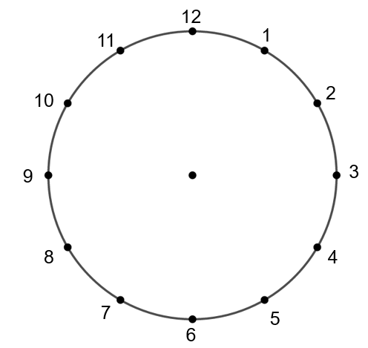
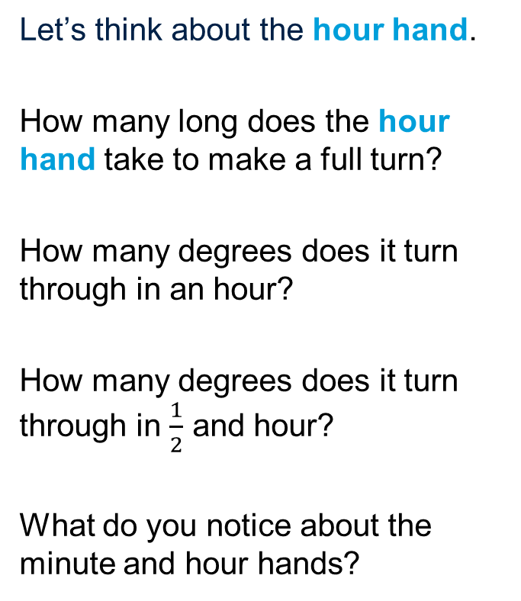
Clock Face Angles
Let’s think about the hour hand.
How many long does the hour hand take to make a full turn?
How many degrees does it turn through in an hour?
How many degrees does it turn through in $\frac{1}{2}$ and hour?
What do you notice about the minute and hour hands?
Notes:
The hour hand can be moved on an interactive board or from the computer.

Slide 12

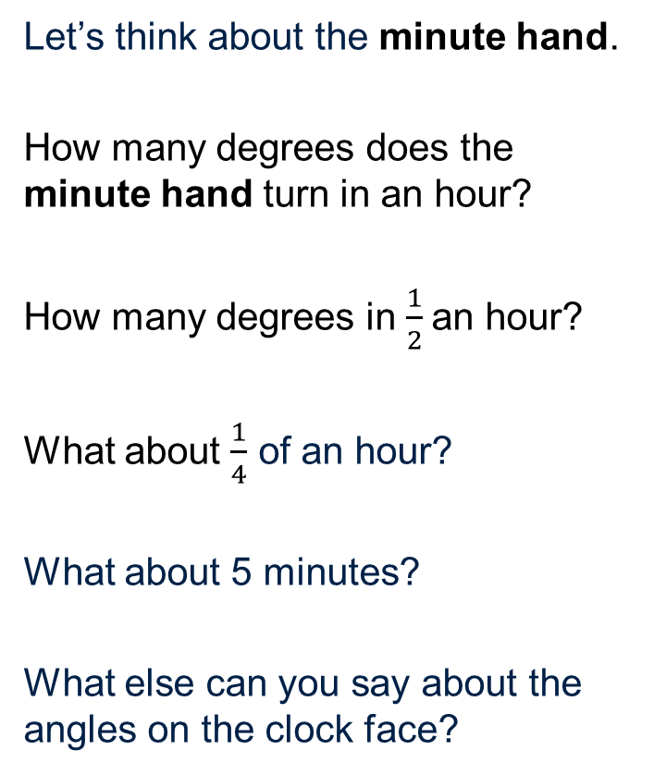
Clock Face Angles
Let’s think about the minute hand.
How many degrees does the minute hand turn in an hour?
How many degrees in $\frac{1}{2}$an hour?
What about $\frac{1}{4}$ of an hour?
What about 5 minutes?
What else can you say about the angles on the clock face?
Notes:
The hour hand is separate to the clock face so you can move it from an interactive whiteboard or the computer.
Encourage pupils to think about 1 minute and 5 minutes as well.

Slide 13
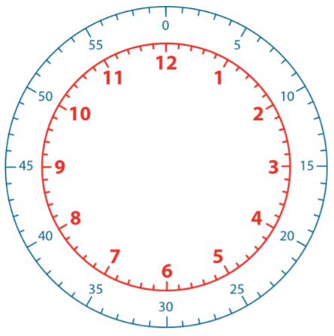
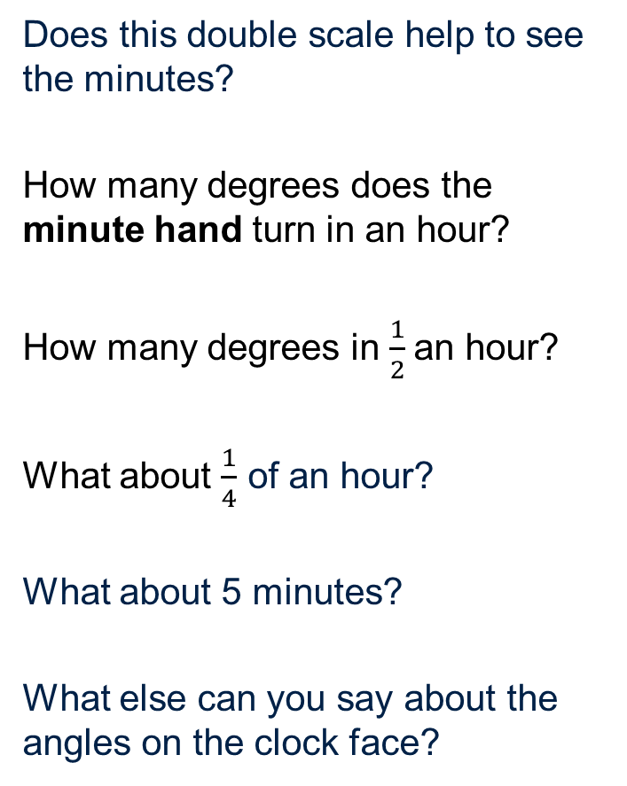
Clock Face Angles
Does this double scale help to see the minutes?
How many degrees does the minute hand turn in an hour?
How many degrees in $\frac{1}{2}$an hour?
What about $\frac{1}{4}$ of an hour?
What about 5 minutes?
What else can you say about the angles on the clock face?
Notes:
The hour hand is separate to the clock face so you can move it from an interactive whiteboard or the computer.
Encourage pupils to think about 1 minute and 5 minutes as well.

Slide 14
Clock Face Angles
What is the angle between the minute hand and the hour hand?

Slide 15
Clock Face Angles
What is the angle between the minute hand and the hour hand?

Slide 16
Clock Face Angles
What is the angle between the minute hand and the hour hand?
How much has it changed?

Slide 17
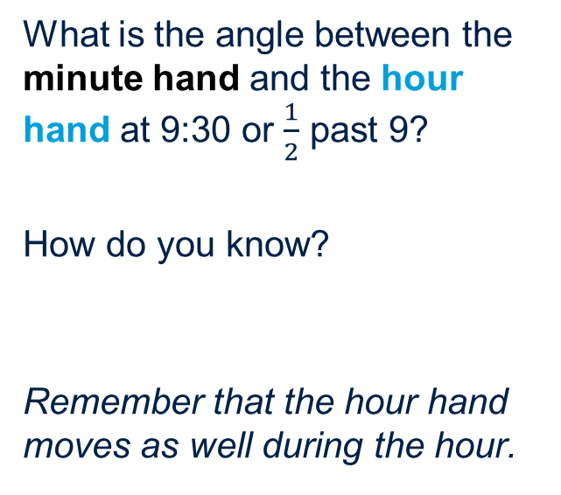
Clock Face Angles
What is the angle between the minute hand and the hour hand at 9:30 or $\frac{1}{2}$ past 9?
How do you know?
Remember that the hour hand moves as well during the hour.

Slide 18
Clock Face Angles
What about the angle on the other ‘side’ of the hour and minute hands?

Slide 19
Clock Face Angles
Using a calculator, can you work out the angle between the hands at any time?
What about:
1:15 (¼ past 1)
11:20 (20 past 11)
6:10 (10 past 6)
Notes:
Solutions:
52.5 degrees
140 degrees
125 degrees

Slide 20
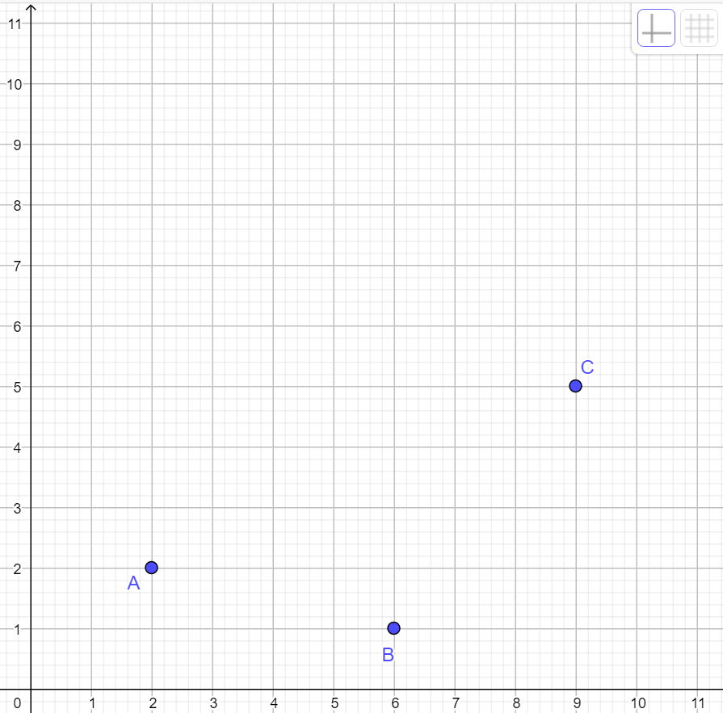
Missing the point
What are the coordinates of points A, B and C?

Slide 21
Missing the point
Add in a Point D to form a quadrilateral.
What can you say about the shape you have created.

Slide 22
Missing the point
What can you say about the angles in this shape?
What can you say about the angles in the shape you have created.
Estimate the size of the angles then measure them with a protractor.
D

Slide 23
Missing the point
Can you add in a Point D to form a quadrilateral so that:
All the angles are acute
All the angles are different
Two of the angles are obtuse
There is a right angle

Slide 24
About MEI
Registered charity committed to improving mathematics education
Independent UK curriculum development body
We offer continuing professional development courses, provide specialist tuition for students and work with employers to enhance mathematical skills in the workplace
We also pioneer the development of innovative teaching and learning resources

