Slide 2

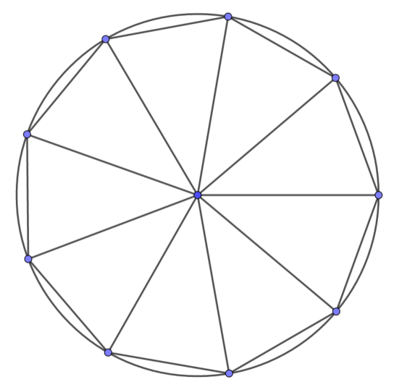

Year 6 Get Calculating Construction Site Part 3
Notes:
Images from Casio – a non and a scientific calculator
Images of calculator keys to use on different slides
I will add photographs of my own maths equipment to avoid copyright issues – just waiting for a new protractor to be delivered!!

Slide 3
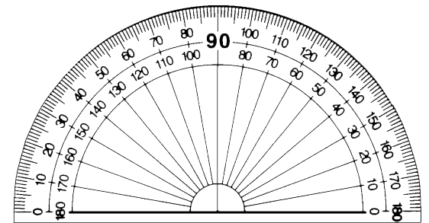



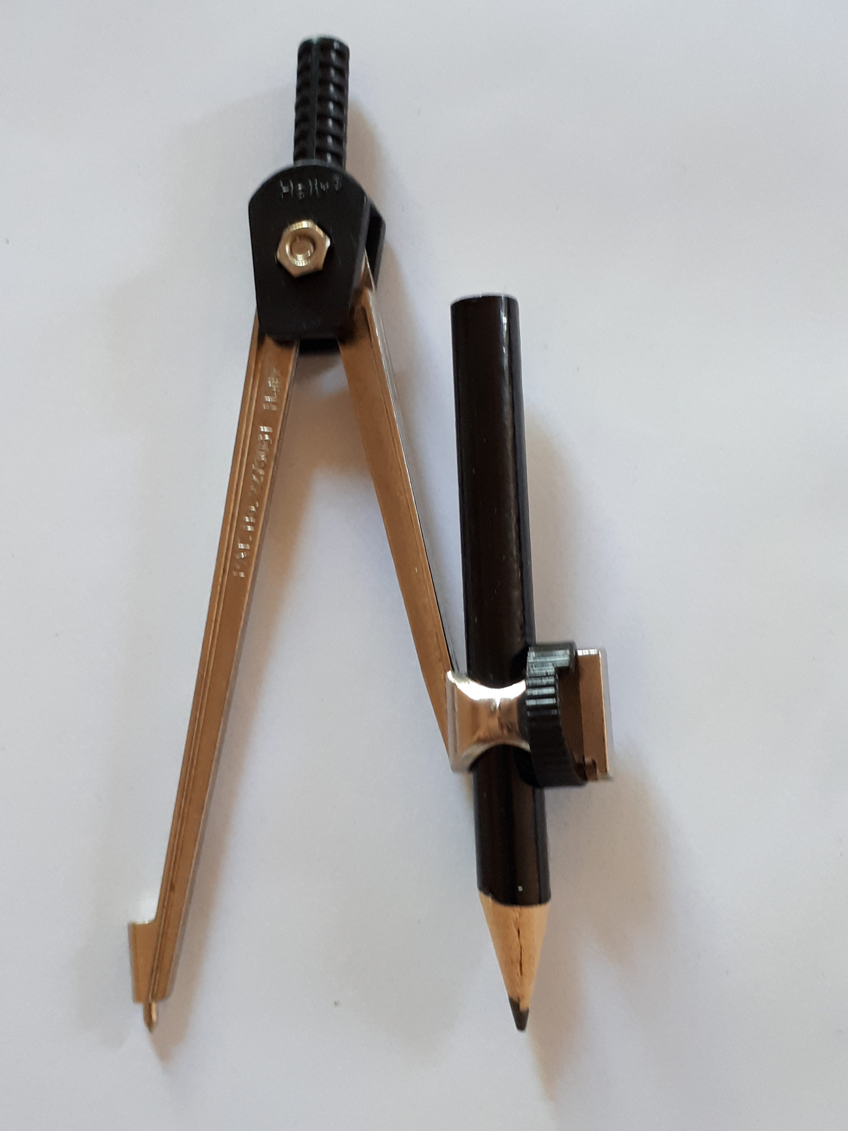
The equipment
What can each piece of equipment do?
Notes:
Appendix 1

Slide 4
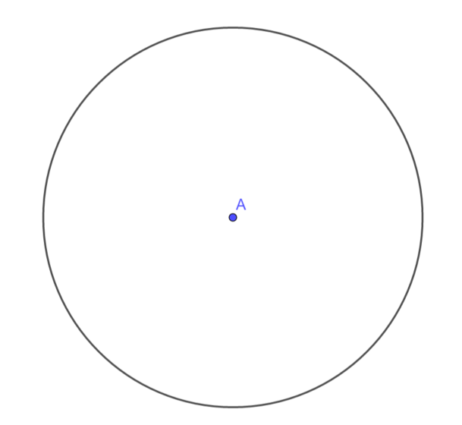

Constructing shapes in a circle
Construct a circle with a radius of $5cm$
Remember your ‘Top Tips’ from Part 2

Slide 5
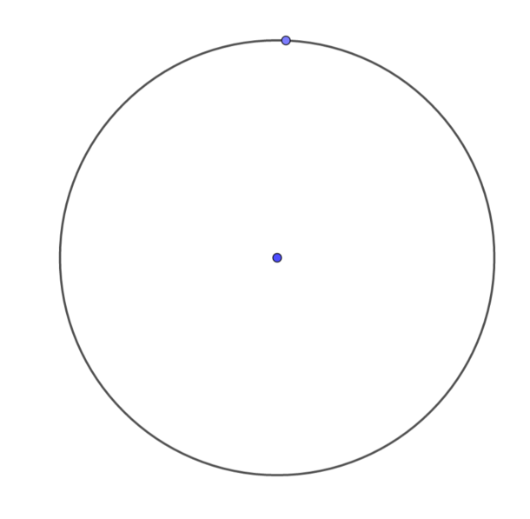
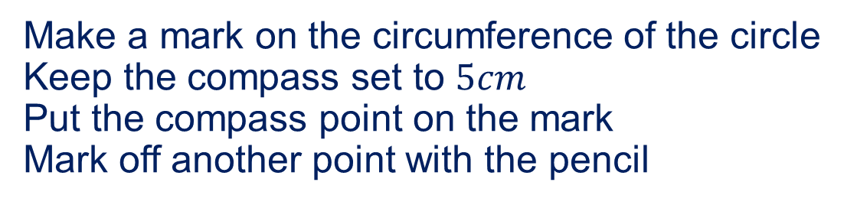
Constructing shapes in a circle
Make a mark on the circumference of the circle
Keep the compass set to $5cm$
Put the compass point on the mark
Mark off another point with the pencil

Slide 6
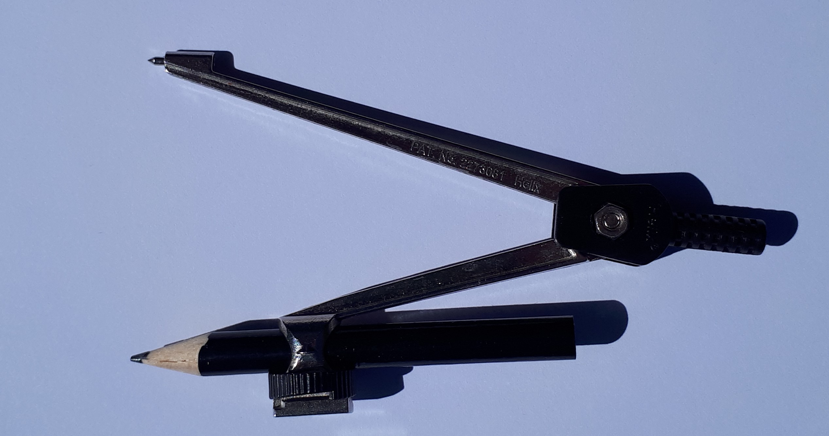
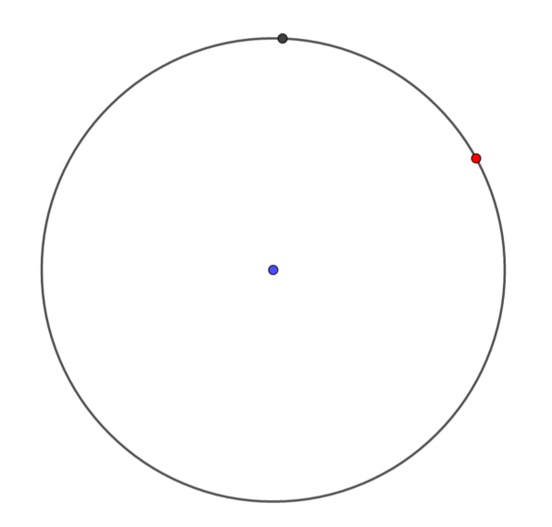
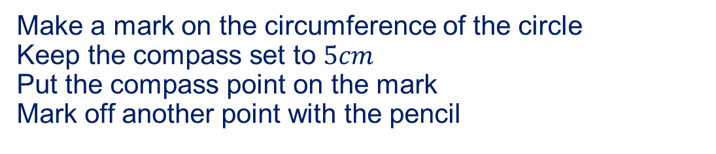
Constructing shapes in a circle
Make a mark on the circumference of the circle
Keep the compass set to $5cm$
Put the compass point on the mark
Mark off another point with the pencil

Slide 7
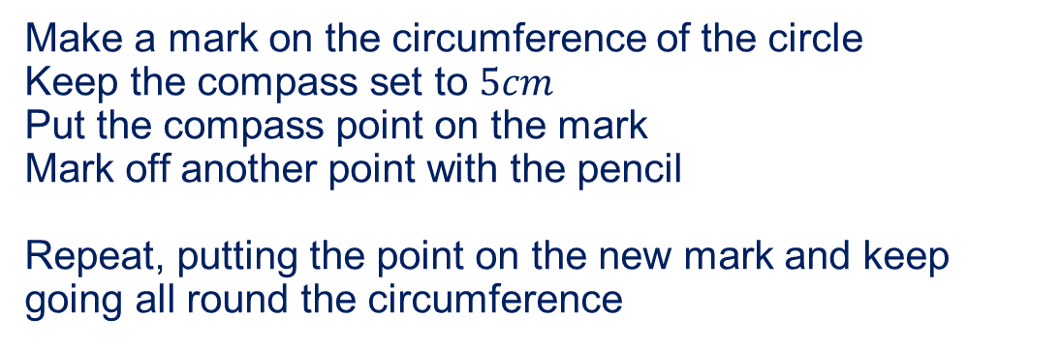
Constructing shapes in a circle
Make a mark on the circumference of the circle
Keep the compass set to $5cm$
Put the compass point on the mark
Mark off another point with the pencil
Repeat, putting the point on the new mark and keep going all round the circumference

Slide 8
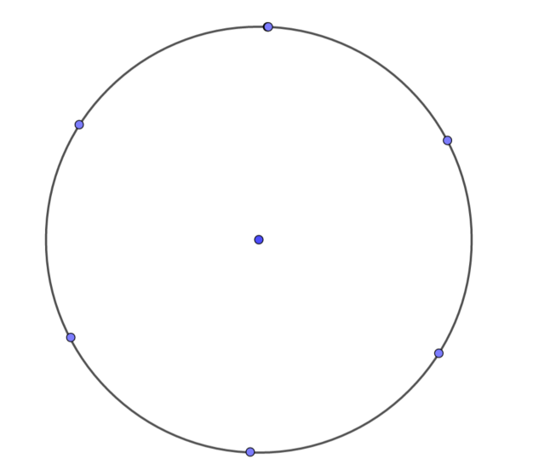
Constructing shapes in a circle
Have you ended up where you started?

Slide 9
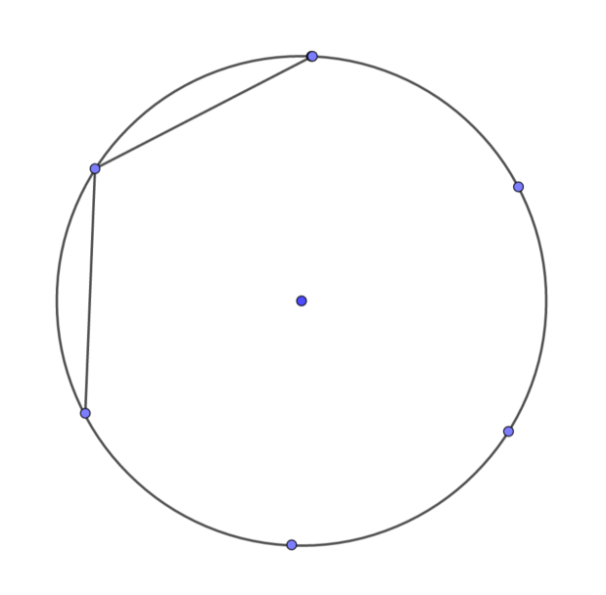
Constructing shapes in a circle
Have you ended up where you started?
Use a ruler to join the dots
What shape have you created?

Slide 10
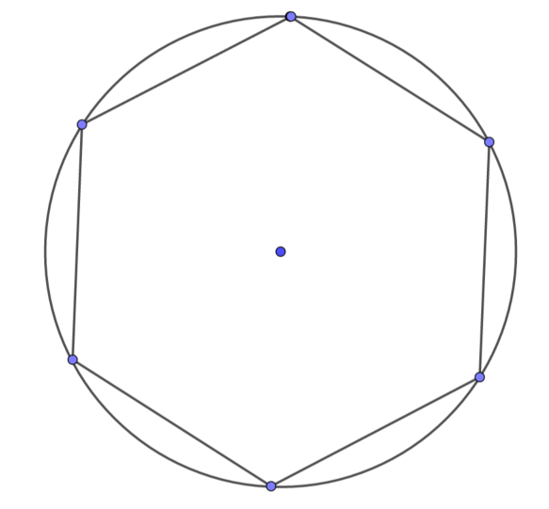
Constructing shapes in a circle
What shape have you created?
Why did this work?

Slide 11
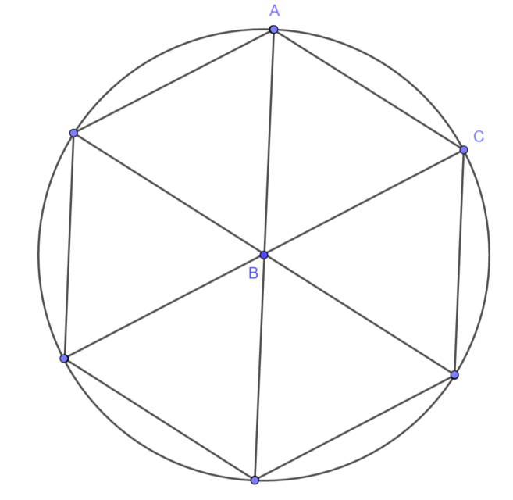
Constructing shapes in a circle
What can you say about the triangles?
Does this help to explain how you created
a regular hexagon?
How big is the angle at B (angle ABC)?
Can you work it out?
What calculation do you need to do?

Slide 12
Constructing shapes in a circle
To construct other shapes in a circle, we need to think angles …
How would you construct a pentagon in a circle?
What does a pentagon look like?
Can you use triangles to help you?

Slide 13
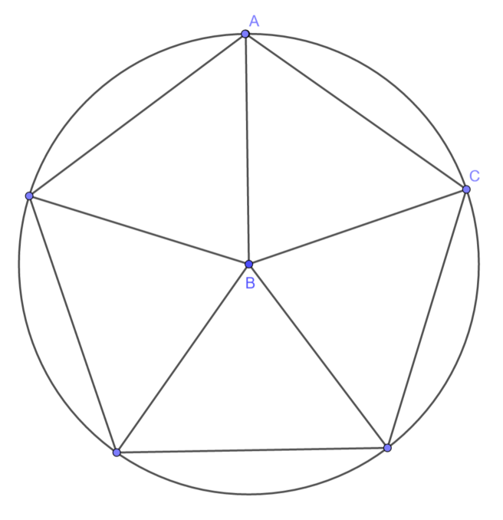
Constructing shapes in a circle
To construct other shapes in a circle, we need to think angles …
How would you construct a pentagon in a circle?
What does a pentagon look like?
Can you use triangles to help you?
How big is the angle at B (angle ABC)?
Can you work it out?
What calculation do you need to do?

Slide 14
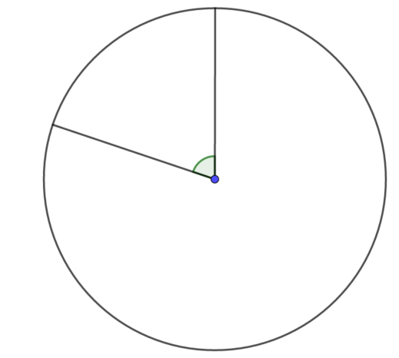
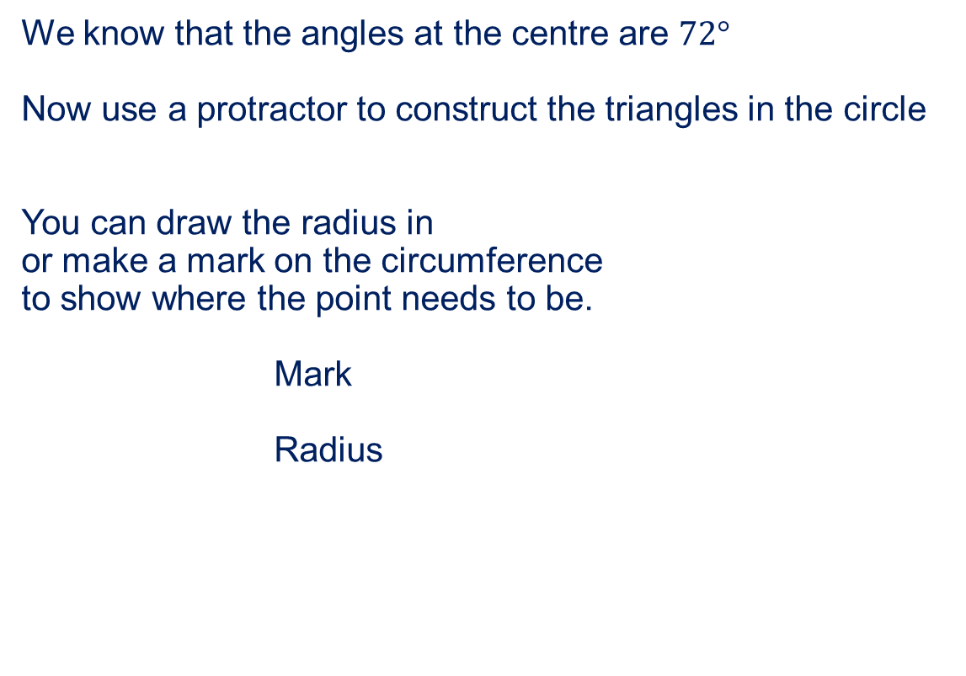
Constructing shapes in a circle
We know that the angles at the centre are $72°$
Now use a protractor to construct the triangles in the circle
You can draw the radius in
or make a mark on the circumference
to show where the point needs to be.
Mark
Radius
Remember your ‘Top Tips’ from Part 1

Slide 15
Constructing shapes in a circle
What other regular shapes can you construct in a circle using your compass, ruler and protractor?

Slide 16
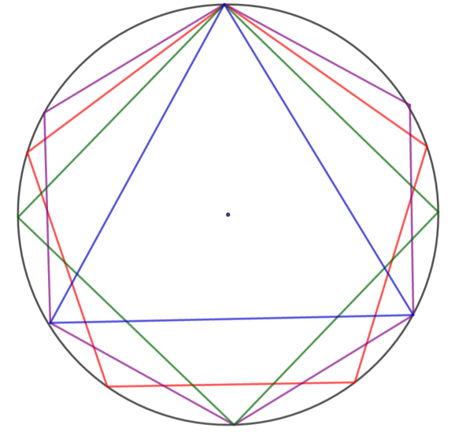
Constructing shapes in a circle
Try drawing lots of shapes in the same circle
These all start with the same point on the circumference
What if they all start in a
different place?

Slide 17
Constructing shapes in a circle
Write instructions to help someone recreate your favourite construction
How did you make use of the equipment?

Slide 18

About MEI
Registered charity committed to improving mathematics education
Independent UK curriculum development body
We offer continuing professional development courses, provide specialist tuition for students and work with employers to enhance mathematical skills in the workplace
We also pioneer the development of innovative teaching and learning resources

