Slide 2



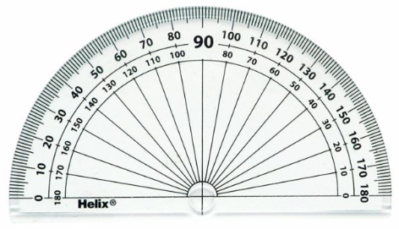
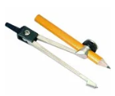


Year 6 Get Calculating Construction Site Part 2
Notes:
Images from Casio – a non and a scientific calculator
Images of calculator keys to use on different slides
I will add photographs of my own maths equipment to avoid copyright issues – just waiting for a new protractor to be delivered!!

Slide 3
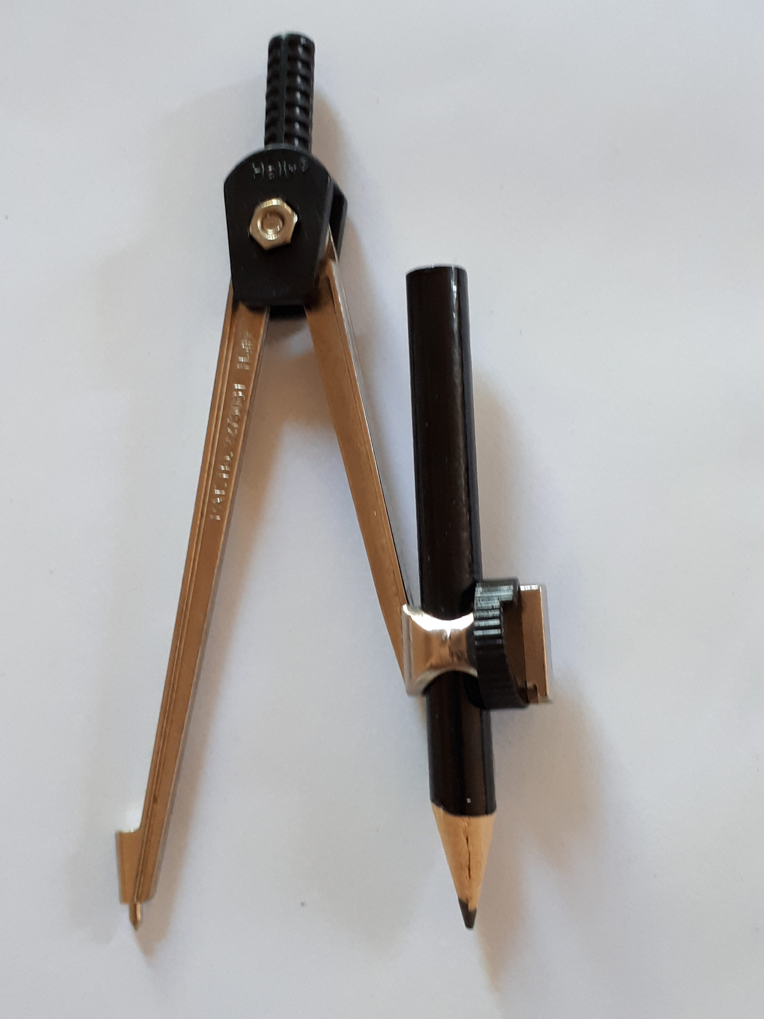
Getting to know them
Look at your pair of compasses
What do you notice?
What do they do?
How do they do it?
Any questions?
Notes:
Appendix 1

Slide 4
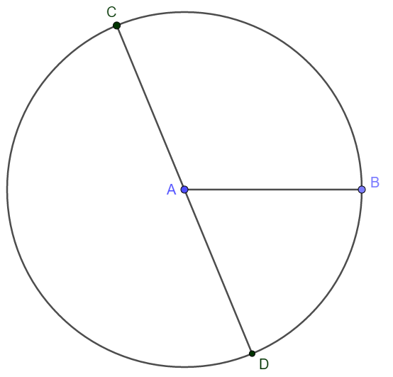
Parts of a circle
What can you say about the circle?

Slide 5
Parts of a circle
Can you label:
Point A
The line AB
The line CD
The curved line

Slide 6
Parts of a circle
Can you label these using the words below:
Point A
The line AB
The line CD
The curved line
Perimeter
Centre
Circumference
Diameter
Radius

Slide 7
Parts of a circle
Point A
The line AB
The line CD
The curved
line
Centre
Radius
Diameter
Circumference
Perimeter

Slide 8
Drawing a circle
Centre
Radius
Diameter
Circumference
How would you use a pair of compasses to draw a circle?

Slide 9
Drawing a circle
Which part of the compasses relates to:
The centre of the circle;
The radius;
The circumference;
The diameter?

Slide 10
Drawing a circle
The centre of the circle
The point of the compass
The radius
The distance between the point and the pencil
The circumference
The line that the pencil draws
The diameter
Double the distance between the point and the pencil

Slide 11
Top Tips
Keep the compass is upright
Make sure the pencil is securely fitted
Keep the distance between the point and the pencil the same
Move the compasses and not the paper

Slide 12
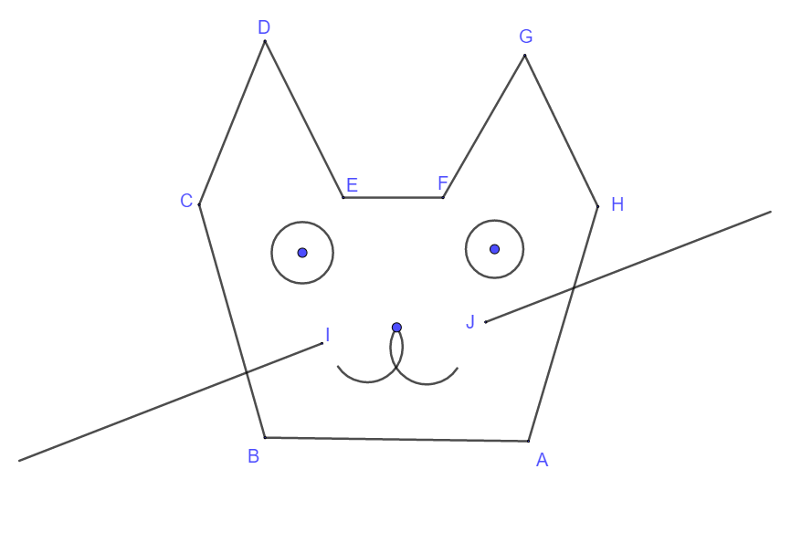
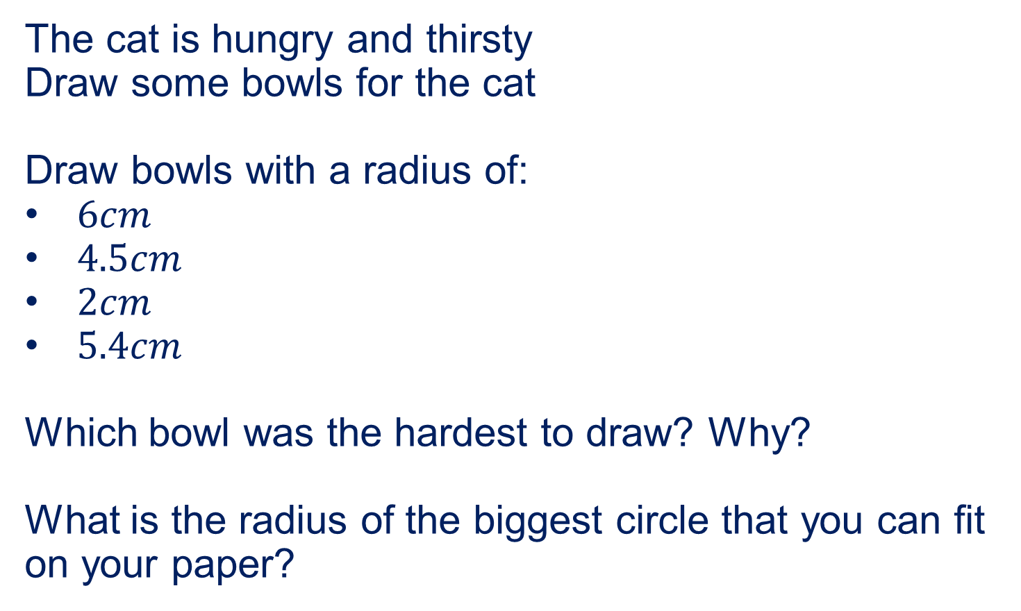
Feeding the cat!
The cat is hungry and thirsty
Draw some bowls for the cat
Draw bowls with a radius of:
$6cm$
$4.5cm$
$2cm$
$5.4cm$
Which bowl was the hardest to draw? Why?
What is the radius of the biggest circle that you can fit on your paper?

Slide 13
Top Tips
Is there anything to add?
Keep the compass is upright
Make sure the pencil is securely fitted
Keep the distance between the point and the pencil the same
Move the compasses and not the paper

Slide 14
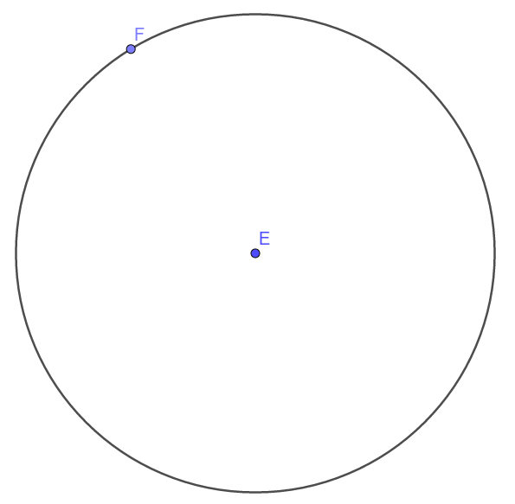
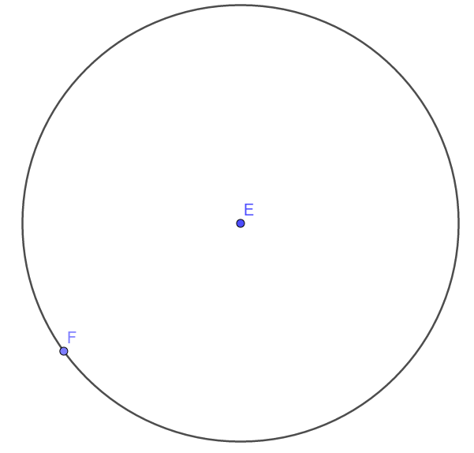
Parts of a circle
What can you say about the distance between points E and F?
What if point F moves?

Slide 15
Parts of a circle
The circumference of the circle is the trace (locus) of a point a constant distance away from the centre.

Slide 16

About MEI
Registered charity committed to improving mathematics education
Independent UK curriculum development body
We offer continuing professional development courses, provide specialist tuition for students and work with employers to enhance mathematical skills in the workplace
We also pioneer the development of innovative teaching and learning resources

