Slide 2



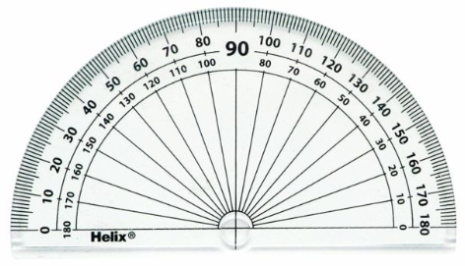
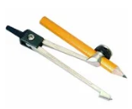


Year 6 Get Calculating Construction Site Part 1
Notes:
Images from Casio – a non and a scientific calculator
Images of calculator keys to use on different slides
I will add photographs of my own maths equipment to avoid copyright issues – just waiting for a new protractor to be delivered!!

Slide 3
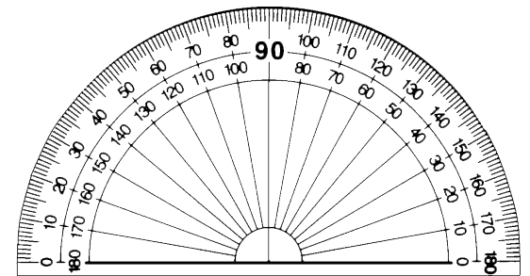
Getting to know your protractor
Look at your protractor
What do you notice?
What does a protractor do?
How does it do it?
Any questions?
Notes:
Appendix 1

Slide 4
Positioning your protractor
T-shape
Point of turn (vertex)
Position the ‘T-shape’ accurately on the point of turn (vertex)
Notes:
Appendix 1

Slide 5

Getting to know your protractor
$35°$ or $145°$?
How do you know?
Notes:
Appendix 1

Slide 6
Getting to know your protractor
2
1
3
Will all these give the same angle measurement?

Slide 7
Getting to know your protractor
What are your top tips for using a protractor?
Notes:
Appendix 1

Slide 8
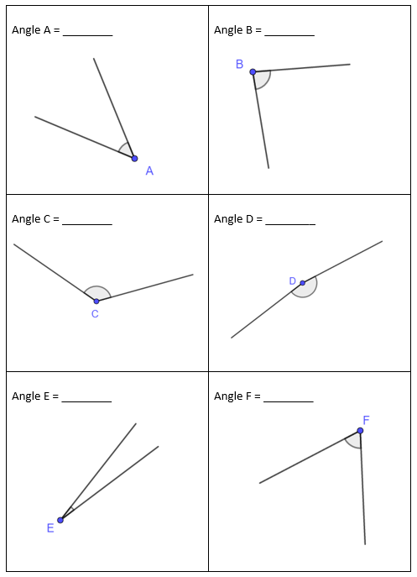
Measuring Angles 1
Use your ‘Top Tips’ to measure the angles [Appendix 2]

Slide 9
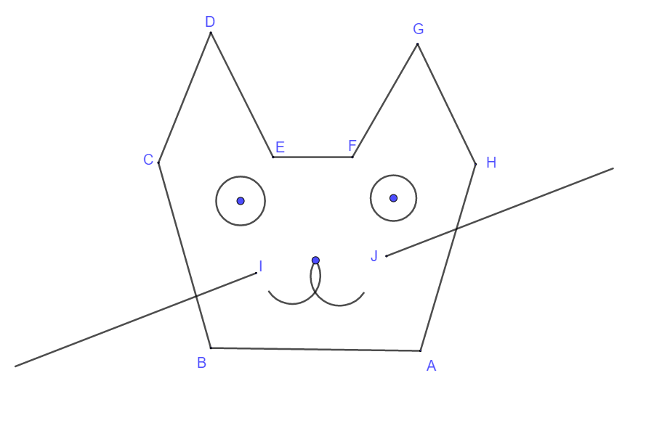
Measuring Angles 2
Use a protractor to measure the internal angles*
at points A to H [Appendix 3]
Were your ‘Top Tips’ good?
Is there anything you need to add after the activity?
*The angles inside the cat’s face

Slide 10
Constructing Angles
Will your ‘Top Tips’ work when using a protractor to construct angles?
Notes:
Appendix 1

Slide 11
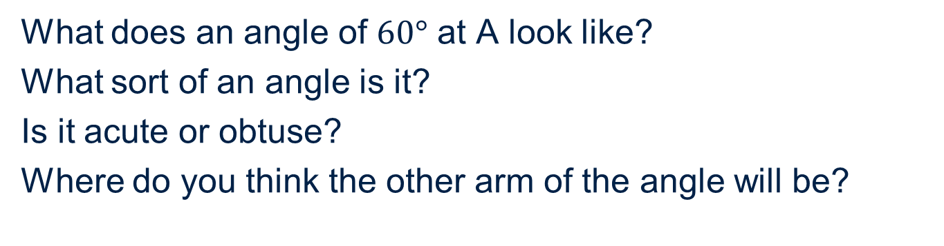
Constructing Angles
What does an angle of $60°$ at A look like?
What sort of an angle is it?
Is it acute or obtuse?
Where do you think the other arm of the angle will be?
A
Notes:
Appendix 1

Slide 12
Constructing angles
Construct an angle of $60°$ at A
2
1
A
A
3
4
A
A
Which of these is going to work?
What do you need to do to check?

Slide 13
Constructing Angles
Construct an angle of $60°$ at A?
1
2
A
Which mark is in the right place?
Why?
Notes:
Appendix 1

Slide 14
Constructing angles
Do you need to add anything to your ‘Top Tips’?
Notes:
Appendix 1

Slide 15
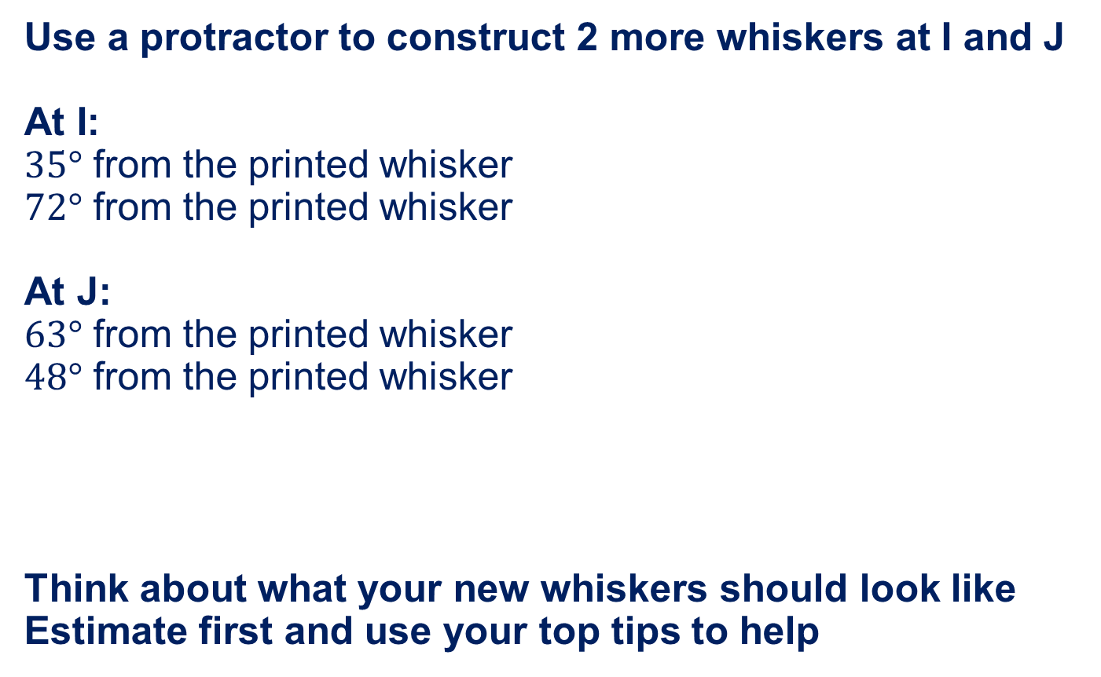
Constructing Angles
Use a protractor to construct 2 more whiskers at I and J
At I:
$35°$ from the printed whisker
$72°$ from the printed whisker
At J:
$63°$ from the printed whisker
$48°$ from the printed whisker
Think about what your new whiskers should look like
Estimate first and use your top tips to help

Slide 16
I think ….
Put these top tips in order of importance …
Decide which scale to read
Imagine what the angle will look like
Put the ‘T-Shape’ on the protractor on the vertex
Estimate the size of the angle
Find the vertex of the angle
Are there any that need to be added?

Slide 17

About MEI
Registered charity committed to improving mathematics education
Independent UK curriculum development body
We offer continuing professional development courses, provide specialist tuition for students and work with employers to enhance mathematical skills in the workplace
We also pioneer the development of innovative teaching and learning resources

