Slide 2



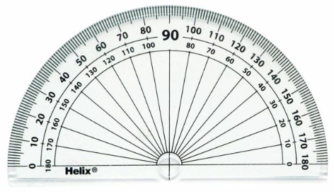
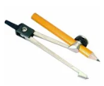

Year 7 Get Calculating Construction Site Part 4
Notes:
Images from Casio – a non and a scientific calculator
Images of calculator keys to use on different slides
I will add photographs of my own maths equipment to avoid copyright issues – just waiting for a new protractor to be delivered!!

Slide 3
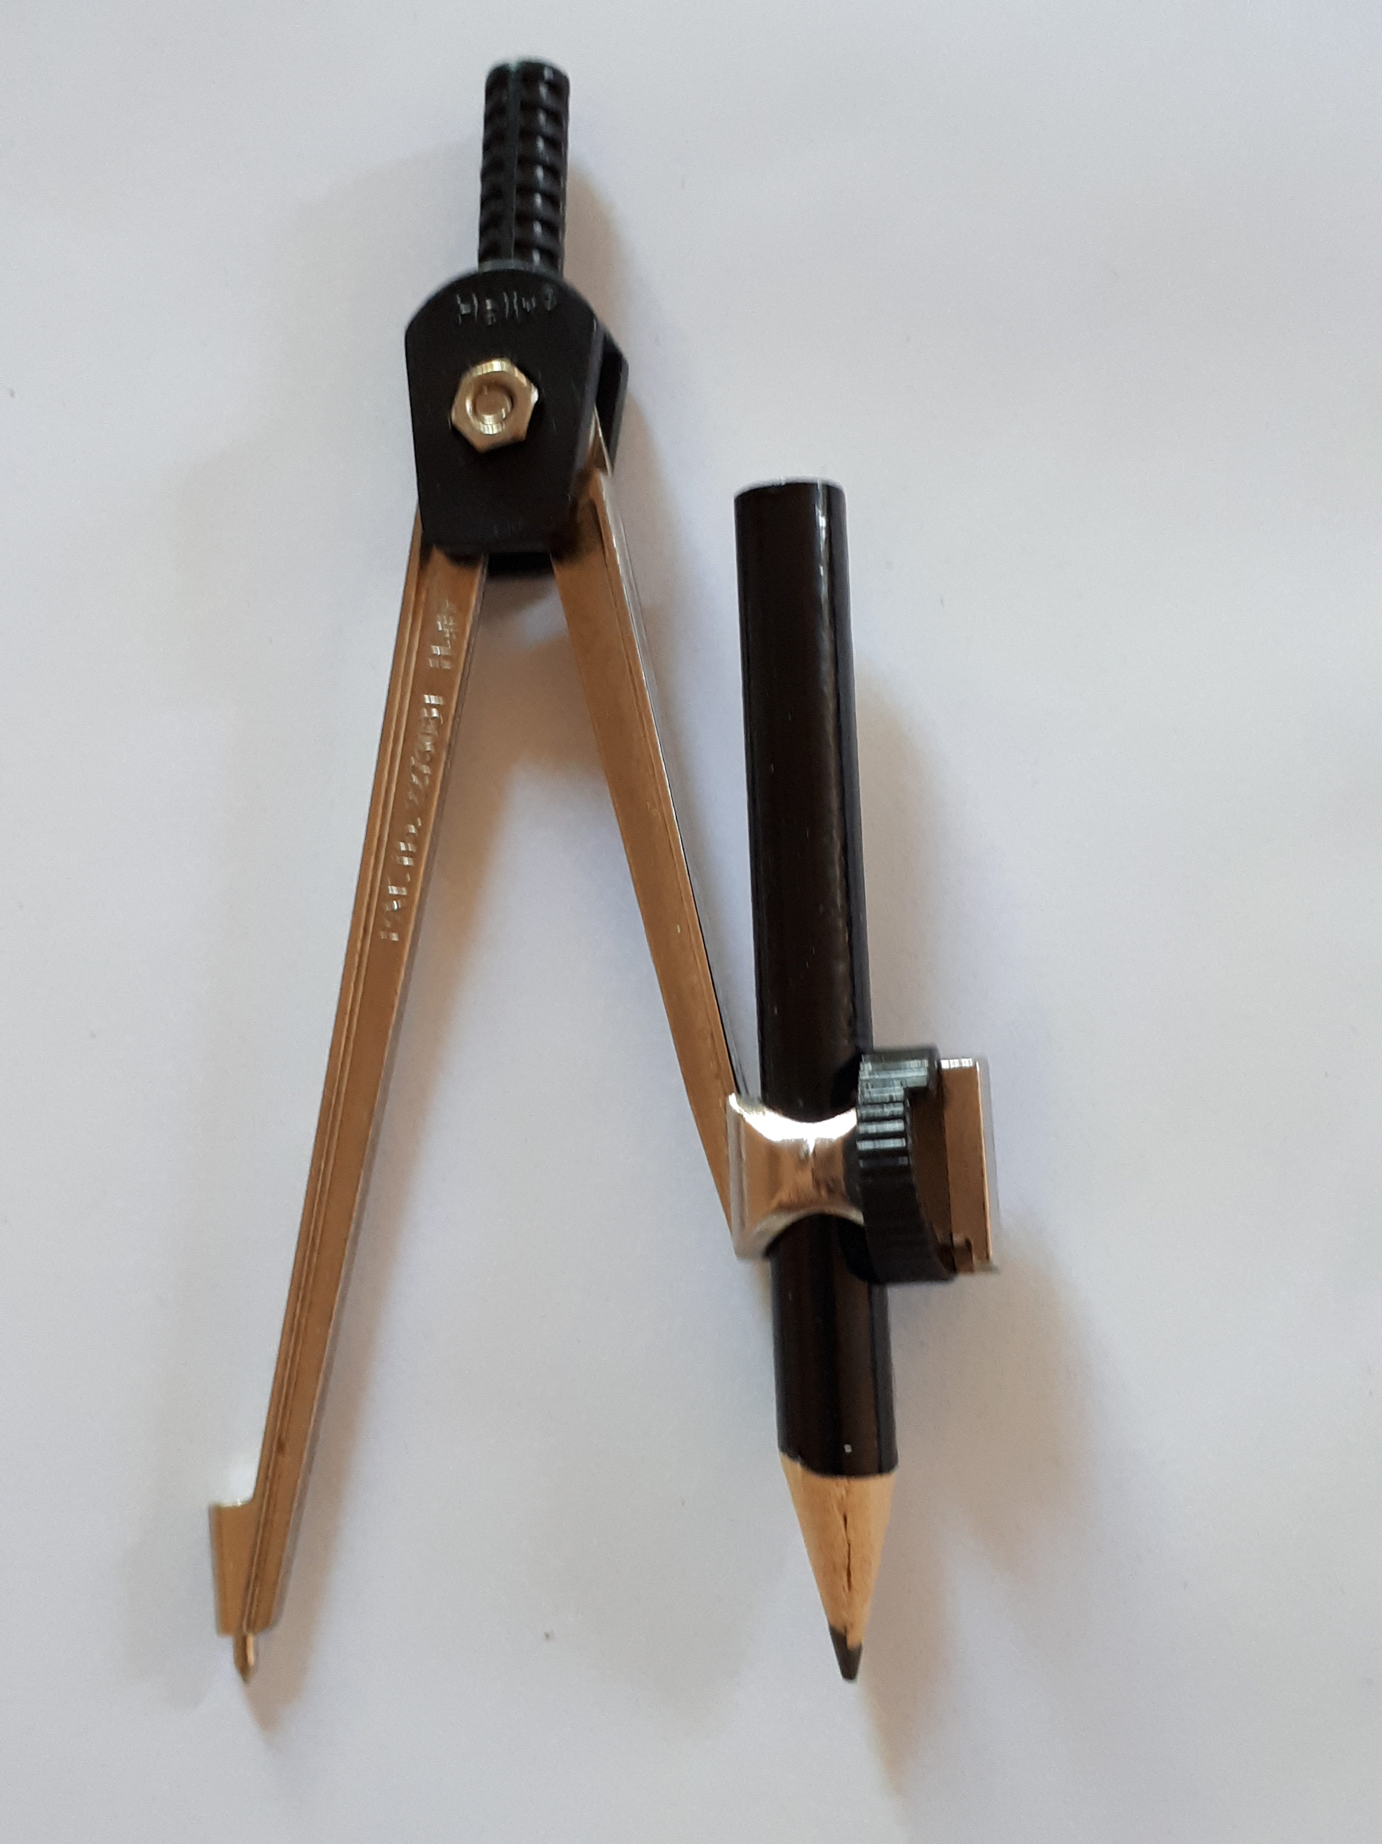
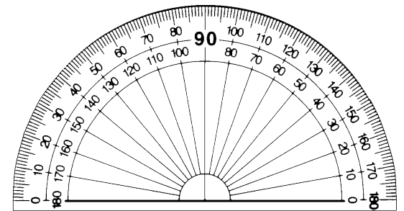
The equipment
What can each piece of equipment do?
How could you draw a very big circle?
Notes:
Appendix 1

Slide 4
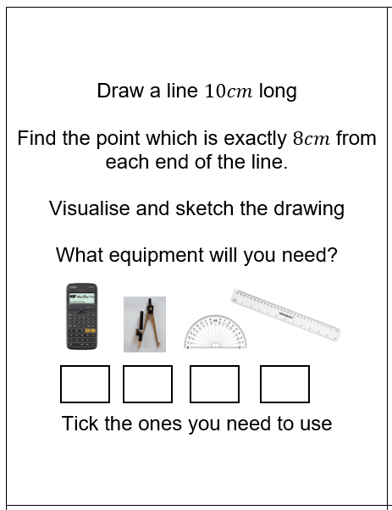
Choosing the equipment to use 1
What equipment do you need to follow these instructions?
Is there more than one way to do this?
Notes:
Appendix 1

Slide 5
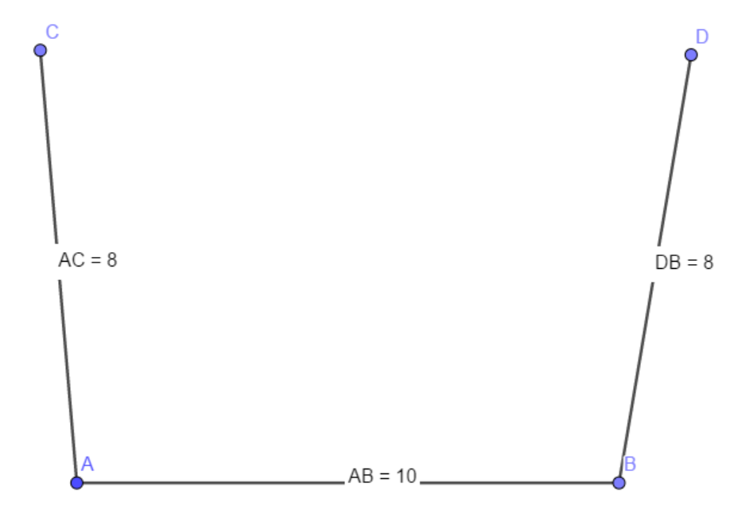
Choosing the equipment to use 1
What equipment do you need to follow these instructions?
Notes:
Appendix 1

Slide 6
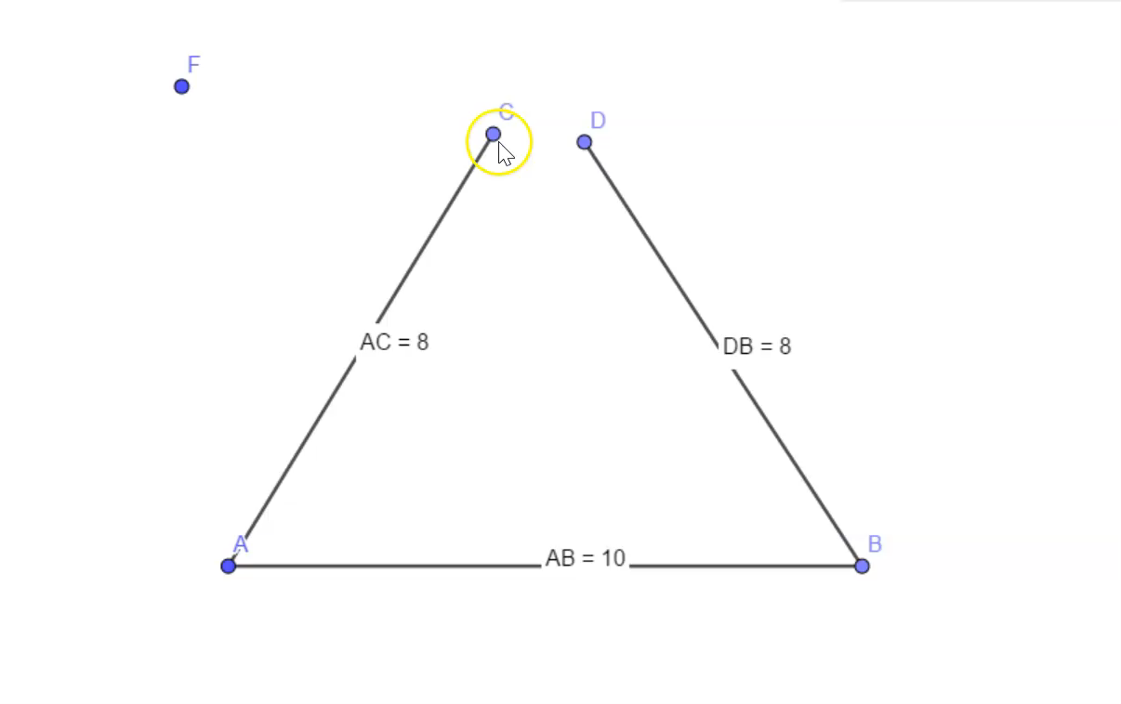
Choosing the equipment to use 1
What equipment will allow you to do this?
Notes:
Appendix 1

Slide 7
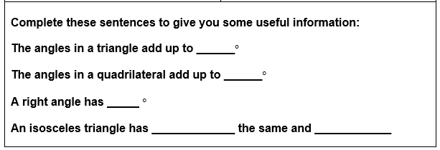
Choosing the equipment to use 2
This information will help with the constructions in Appendix 3
Notes:
Appendix 1

Slide 8
Summary – Top Tips
What are your ‘Top Tips’ for using the equipment from this lesson?
Notes:
Appendix 1

Slide 9

About MEI
Registered charity committed to improving mathematics education
Independent UK curriculum development body
We offer continuing professional development courses, provide specialist tuition for students and work with employers to enhance mathematical skills in the workplace
We also pioneer the development of innovative teaching and learning resources

