Slide 2



Year 7 ‘Get Calculating’ More Growing Patterns
Notes:
Images from Casio – a non and a scientific calculator
Images of calculator keys to use on different slides

Slide 3

Getting to know your calculator
Look at your calculator
Have you got any questions about any of the keys?

Slide 4

Getting to know your calculator
Look at your calculator
Find the bracket keys
When would you need to use these keys?

Slide 5
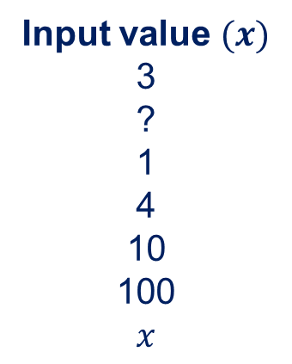
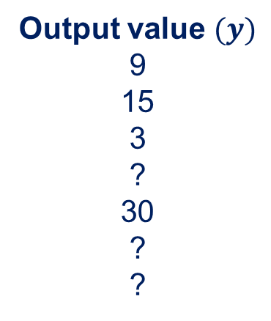
Function Machines
This function machine is doing something to the numbers.
The input values are changed into the output values
What is changing?
What function is the machine performing?
Input value $(x)$
3
?
1
4
10
100
$$x$$
Output value $(y)$
9
15
3
?
30
?
?
Function
-o-matic!
The input has been _____ to produce the output value
Notes:
The machine is doubling – a simple start to re-introduce the idea of a function machine as they may not have come across one for a while.
The function machine is not adding the input number again as this means that the function is changing each time so the function must be $×2$

Slide 6
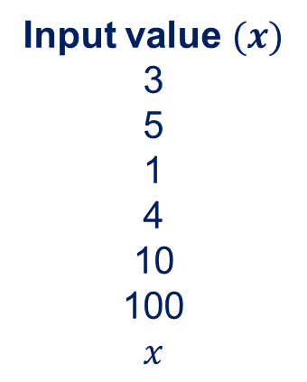
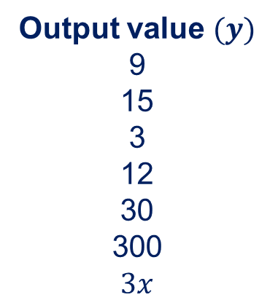
Function Machines
The input has been multiplied by 3 to produce the output value
Input value $(x)$
3
5
1
4
10
100
$$x$$
Output value $(y)$
9
15
3
12
30
300
$$3x$$
Multiply by 3
Can you make your calculator do the same as the function machine?
Notes:
The machine is doubling – a simple start to re-introduce the idea of a function machine as they may not have come across one for a while.
The function machine is not adding the input number again as this means that the function is changing each time so the function must be $×2$

Slide 7
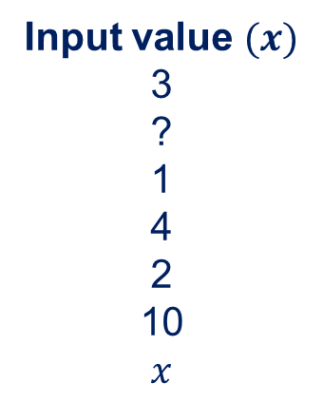
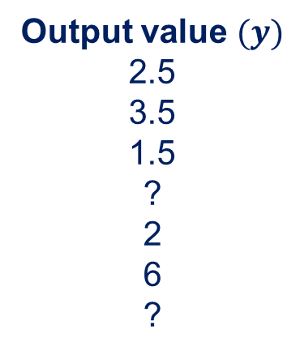
Function Machines
This double function machine is doing something to the numbers.
The input values are changed into the output values
What is changing?
What functions is the machine performing?
Input value $(x)$
3
?
1
4
2
10
$$x$$
Output value $(y)$
2.5
3.5
1.5
?
2
6
?
Function-o-matic!
Function-o-matic!
The input has been _______________ to produce the output value
Notes:
The machine is doubling – a simple start to re-introduce the idea of a function machine as they may not have come across one for a while.
The function machine is not adding the input number again as this means that the function is changing each time so the function must be $×2$

Slide 8
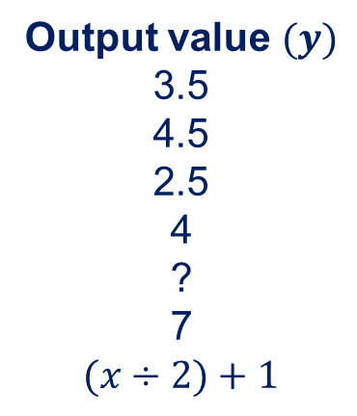
Function Machines
The input has been divided by 2 and 1 added to produce the output value
Input value $(x)$
3
?
1
4
2
10
$$x$$
Output value $(y)$
3.5
4.5
2.5
4
?
7
$$(x÷2)+1$$
Divide by 2
Add 1
Can you make your calculator do the same as the function machine?
Notes:
The machine is doubling – a simple start to re-introduce the idea of a function machine as they may not have come across one for a while.
The function machine is not adding the input number again as this means that the function is changing each time so the function must be $×2$

Slide 9
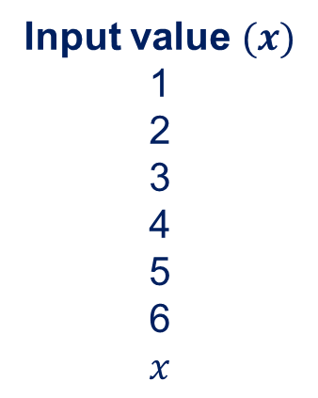

Function Machines
This function machine is doing something to the numbers.
What function is the machine performing?
Create your own function (or double function) and a list of output values
Find someone to work out what your function machine is doing to the input values.
Input value $(x)$
1
2
3
4
5
6
$$x$$
Output value $(y)$
Function
-o-matic!
The input has been ___________ to produce the output value
Can you make your calculator do the same as the function machine?
Notes:
The machine is doubling – a simple start to re-introduce the idea of a function machine as they may not have come across one for a while.
The function machine is not adding the input number again as this means that the function is changing each time so the function must be $×2$

Slide 10
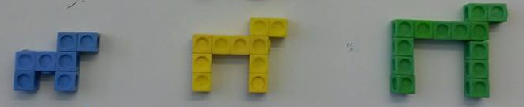
Growing an animal
Have a go at growing this pattern.
Use whatever you have to hand to make the pattern
I used some cubes

Slide 11
Growing an animal
Describe what is happening as the animal grows
Let’s call these numbers 1, 2 and 3 in the pattern
How would you explain how to make the animal which is number 4 in the sequence?
1 2 3
Pattern number

Slide 12
Growing an animal
Work out how many cubes are needed to make the next animals and record the answers in the table
Pattern number | 1 | 2 | 3 | 4 | 5 | 6 | 7 | 8 | 9 | 10
Number of cubes | 7 | 10 | 13
1 2 3
Pattern number

Slide 13
Growing an animal
What patterns can you see in the table?
Pattern number | 1 | 2 | 3 | 4 | 5 | 6 | 7 | 8 | 9 | 10
Number of cubes | 7 | 10 | 13 | 16 | 19 | 22 | 25 | 28 | 31 | 34
1 2 3
Pattern number

Slide 14
Growing an animal
How do the colours help you to explain how the pattern is growing?
1 2 3
Pattern number
Notes:
$$3x+4$$

Slide 15
Growing an animal
Explain how you work out the number of ‘cubes’ needed to make each animal in the pattern.
1 2 3
Pattern number
__________________ the pattern number (input) by __________
and ______________________________ to work out the number
of cubes needed (output)

Slide 16
Growing an animal
What if the pattern number was the input of the function machine and the number of cubes was the output?
What would the function machine be doing to the numbers?
Pattern number – Input | 1 | 2 | 3 | 4 | 5 | 6 | 7 | 8 | 9 | 10
Number of cubes – Output | 7 | 10 | 13 | 16 | 19 | 22 | 25 | 28 | 31 | 34
Input
Function
-o-matic!
Output
1 2 3
Pattern number

Slide 17
Growing an animal
1 2 3
Pattern number
Does this statement explain how the animal grows?
Multiply the pattern number by 3 and add 4 to work out the
number of cubes.
Multiply by 3 and add 4
Input
Output
Notes:
$y=3x+4$ where $x$ is the pattern number and $y$ is the number of cubes needed to create the pattern.

Slide 18
Growing an animal
Does this statement work for all the values in the table?
1 2 3
Pattern number
Multiply the pattern number by 3 and add 4 to work out the
number of cubes.
Pattern number (input) | 1 | 2 | 3 | 4 | 5 | 6 | 7 | 8 | 9 | 10
Number of dots (output) | 7 | 10 | 13 | 16 | 19 | 22 | 25 | 28 | 31 | 34
Multiply by 3 and add 4
Input
Output
Notes:
$y=3x+4$ where $x$ is the pattern number and $y$ is the number of cubes needed to create the pattern.
Appendix 1 for activity to work out other input and output values

Slide 19
Growing an animal
Is there another way to think about making the pattern grow?
1 2 3
Pattern number

Slide 20
Growing an animal
How do these colours explain how the pattern grows?
1 2 3
Pattern number

Slide 21
Growing an animal
How do these colours explain how the pattern grows?
1 2 3
Pattern number
2 legs which are one more than the pattern number
1 back which is the pattern number
Add another 2 for the head
Notes:
Pattern number is $x$
$$2\left(x+1\right)+x+2=2x+2+x+2=3x+4$$

Slide 22
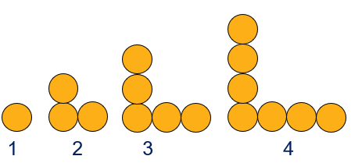
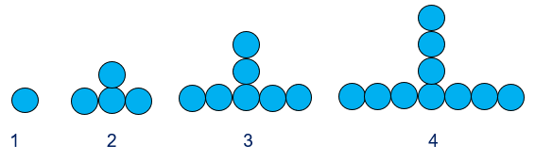
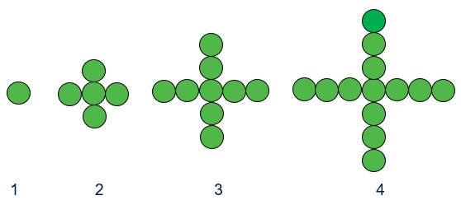
Other growing patterns
How could you explain how these patterns grow?
Notes:
These patterns can be found in the Year 6 ‘Get Calculating’ lesson plan ‘Growing Patterns’.

Slide 23
About MEI
Registered charity committed to improving mathematics education
Independent UK curriculum development body
We offer continuing professional development courses, provide specialist tuition for students and work with employers to enhance mathematical skills in the workplace
We also pioneer the development of innovative teaching and learning resources

