Slide 1

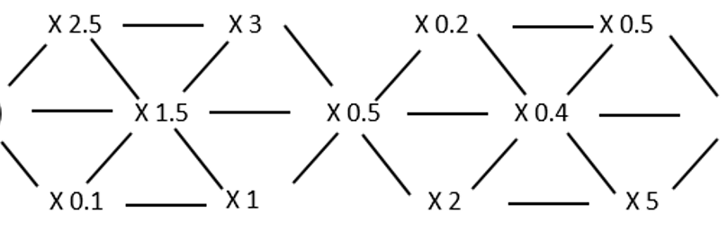

Day 9
A-maze your friends!
Start with the number on your calculator.
Find a route through the grid from left to right only visiting each multiplier once.
?
X 0.6
X 0.8
How many different outcomes are there for the maze with a start number of 20?
Can you find a whole number start value and a route which gives a final outcome of 1?
Set a target for a friend to make
Notes:
V2 incorporating Bernard’s ideas

