Slide 1

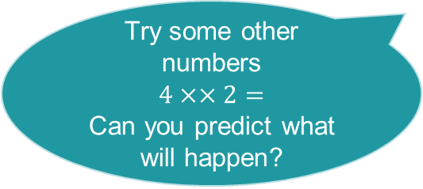
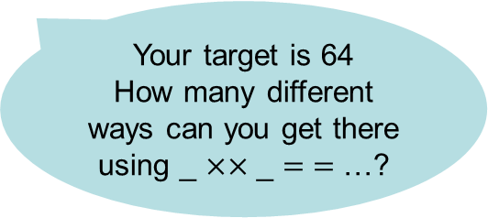
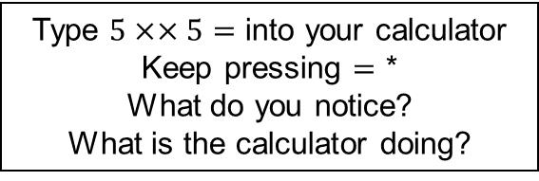
Day 7
Constant function challenges
Try some other numbers
$$4××2=$$
Can you predict what will happen?
Type $5××5=$ into your calculator
Keep pressing $=$ *
What do you notice?
What is the calculator doing?
Your target is 64
How many different ways can you get there using _ $××$ _ $= =$ …?
Can you create a sequence of only odd numbers?
Can you create a sequence which alternates between odd and even numbers?
Can you set a challenge for us?
*If your calculator doesn’t allow the instructions above, the sequence is 25, 125, 625, 3,125 …
Notes:
64
2 xx 2
4 xx 2
8 xx 2
4 xx 4

