Slide 1

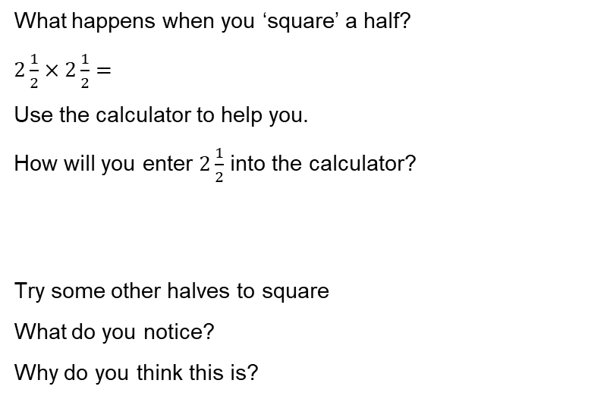
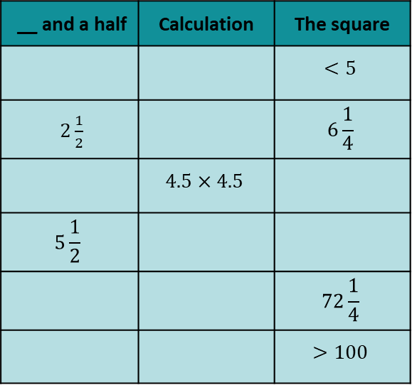
Day 4
Squaring halves
What happens when you ‘square’ a half?
$2\frac{1}{2}×2\frac{1}{2}=$
Use the calculator to help you.
How will you enter $2\frac{1}{2}$ into the calculator?
Try some other halves to square
What do you notice?
Why do you think this is?
__ and a half | Calculation | The square
 |  | $$<5$$
$2\frac{1}{2}$ |  | $$6\frac{1}{4}$$
 | $$4.5×4.5$$
$$5\frac{1}{2}$$
 |  | $$72\frac{1}{4}$$
 |  | $$>100$$

