Slide 1

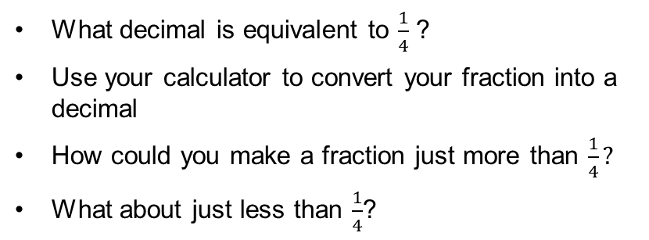

Day 3
It’s a game of four quarters
Choose 4 digits from 1 to 9 and use them to create a fraction
There are lots of ways to make $\frac{1}{4}$. Can you find them all?
How do you know if a fraction is equal to $\frac{1}{4}$?
1 | 2 | 3
4 | 5 | 6
7 | 8 | 9
What decimal is equivalent to $\frac{1}{4}$ ?
Use your calculator to convert your fraction into a decimal
How could you make a fraction just more than $\frac{1}{4}?$
What about just less than $\frac{1}{4}$?
How can you use the calculator to convert your fractions to decimals?
Notes:
Divide the numerator by the denominator to convert a fraction to a decimal.
How close is your answer to 0.25?
Encourage the thinking that if the denominator is 4 times the numerator then the fraction will be equal to a quarter.

