Slide 1



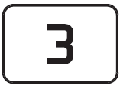
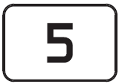
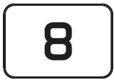

Day 1
Save the Bees!
Type 5338 into your calculator and turn it upside down.
Did you find the ?
How many different ways can you get the answer 5338?
How creative can you be (or bee!)?
1 |  | 2
3 |  | 4
5 |  | 6
7 |  | 8
9 |  | 10
Green using + and -
Amber without using + and -
Red 1 or without using
Red 2 using a mixture of operations, brackets, squares and square roots

