Slide 2

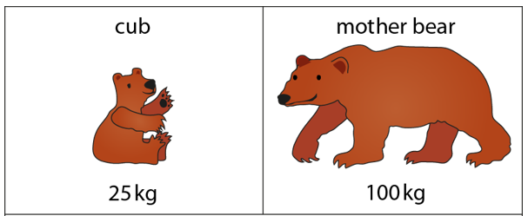
Year 6 Get Calculating!
It’s all a matter of scale …
Notes:
Image from NCETM Primary Mastery PD Materials Segment 2.17 Representations

Slide 3
True or false?
3 is the scale factor
three times
A dog is as tall as a cat
What does this mean?
What would this look like?
Where is the ‘three times’ in your drawing?
How tall might the dog and cat be?
What do we call the ‘three times’?
A cat is …
one third as tall as a dog

Slide 4
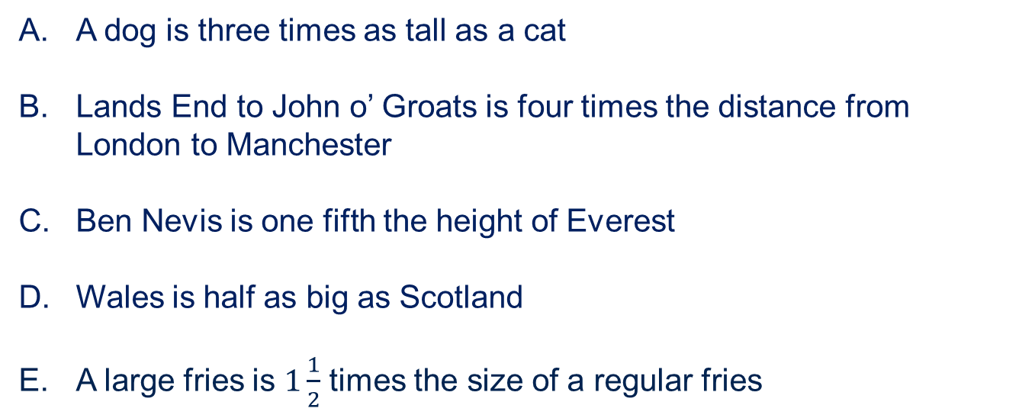
How many times bigger?
True, false or it could be – What do you think?
A dog is three times as tall as a cat
Lands End to John o’ Groats is four times the distance from London to Manchester
Ben Nevis is one fifth the height of Everest
Wales is half as big as Scotland
A large fries is $1\frac{1}{2}$ times the size of a regular fries
How will you find out if you are right?
What do we mean by ‘the size’?

Slide 5
How many times bigger?
True, false or it could be – What do you think?
Lands End to John o’ Groats is four times the distance from London to Manchester
What do you need to know?
Could you look at a map?
What calculation could you do to check?
Notes:
You might want to include an image of a map of the UK with the places marked

Slide 6
How many times bigger?
True, false or it could be – What do you think?
Ben Nevis is one fifth the height of Everest
What do you need to know?
What do you think?
Could pictures of the mountains help you to decide?
What calculation could you do to check?
Notes:
You might want to add images of Ben Nevis and Everest and ask if these help with working out if it is true or false

Slide 7
How many times bigger?
True, false or it could be – What do you think?
Wales is half as big as Scotland
What do you need to know?
Would it be useful to look at a map?
What do we mean by ‘half as big’?
Where are Wales and Scotland and what do they look like?
What do you think?
What calculation could you do to check?
Notes:
A map of the UK with Wales and Scotland identified would support thinking

Slide 8
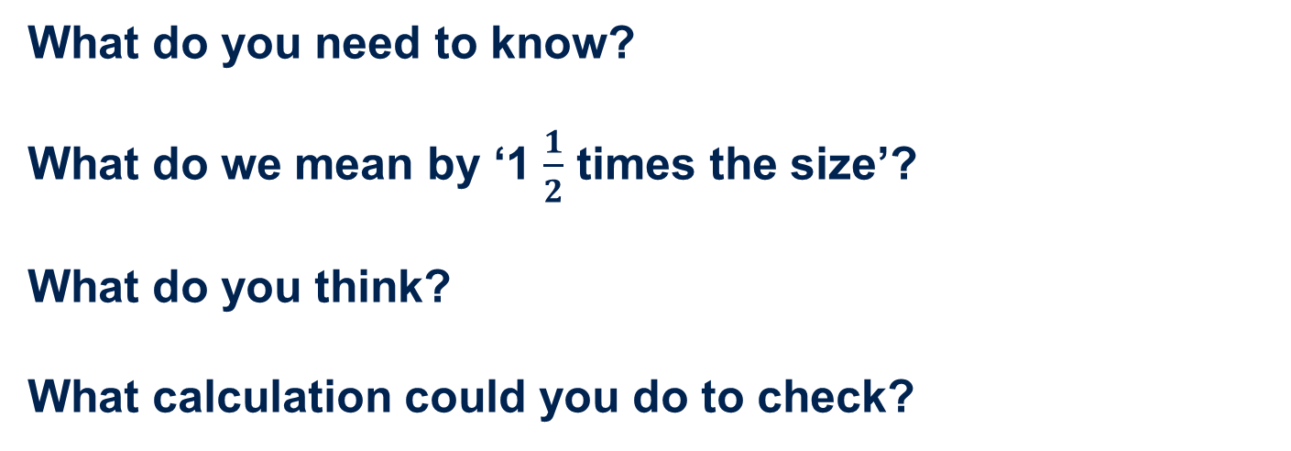
How many times bigger?
True, false or it could be – What do you think?
A large fries is $1\frac{1}{2}$ times the size of a regular fries
What do you need to know?
What do we mean by ‘1 $\frac{1}{2}$ times the size’?
What do you think?
What calculation could you do to check?
Notes:
https://abcnews.go.com/Business/mcdonalds-rationing-french-fries-japan/story?id=27638403

Slide 9
Fact File
Average cat height 24cm
Average dog height 56cm
Land’s End to John o’ Groats 874 miles
London to Manchester 211 miles
Height of Everest 8 848 metres
Height of Ben Nevis 1 345 metres
Area of Wales 20 735 km²
Area of Scotland 80 077 km²
Length of Wales 170 miles
Length of Scotland 274 miles
Large fries 150 grams
Regular fries 114 grams
Cost of large fries £1.39
Cost of regular fries £1.09

Slide 10
























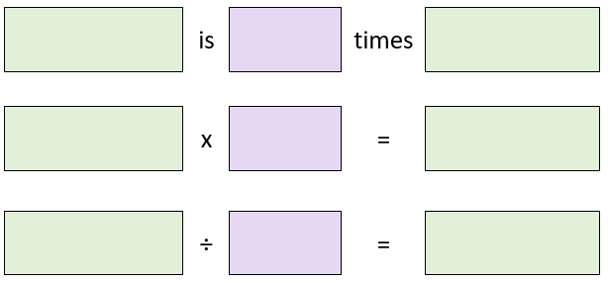
Matching triples Version A

Slide 11
























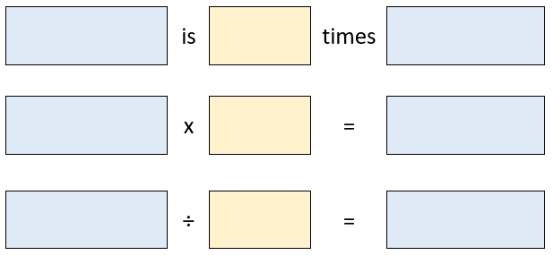
Matching triples Version B

Slide 12
I think ….
When you are discussing your work, use these to explain what you are thinking …
It could be this because …
It can’t be this because …
This answer represents …
If we do this then …
I wonder what will happen if …
I know this so …
‘… is … times bigger than …’
‘… is … a [fraction] the size of …’
The scale factor is …

Slide 13
About MEI
Registered charity committed to improving mathematics education
Independent UK curriculum development body
We offer continuing professional development courses, provide specialist tuition for students and work with employers to enhance mathematical skills in the workplace
We also pioneer the development of innovative teaching and learning resources

