Slide 2
International Day of Mathematics:
Mathematics for a Better World
Chocolate Miles
How far does your favourite snack travel?
Notes:
Session 2 14 January

Slide 3
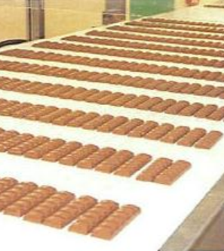
We love chocolate!
What is your favourite chocolate bar?
How is it made?
How does it get to you?
What else would you like to find out?

Slide 4
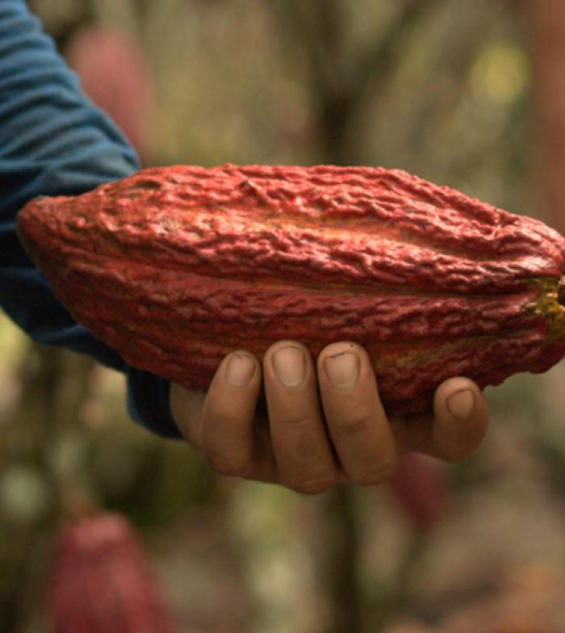
How far does your chocolate travel?
Where is your chocolate grown?
Where is it made into your favourite bars?
What other ingredients are used?
How many miles has it travelled before it gets to you?
Notes:
Image from https://www.mars.com/sustainability-plan/cocoa-for-generations

Slide 5
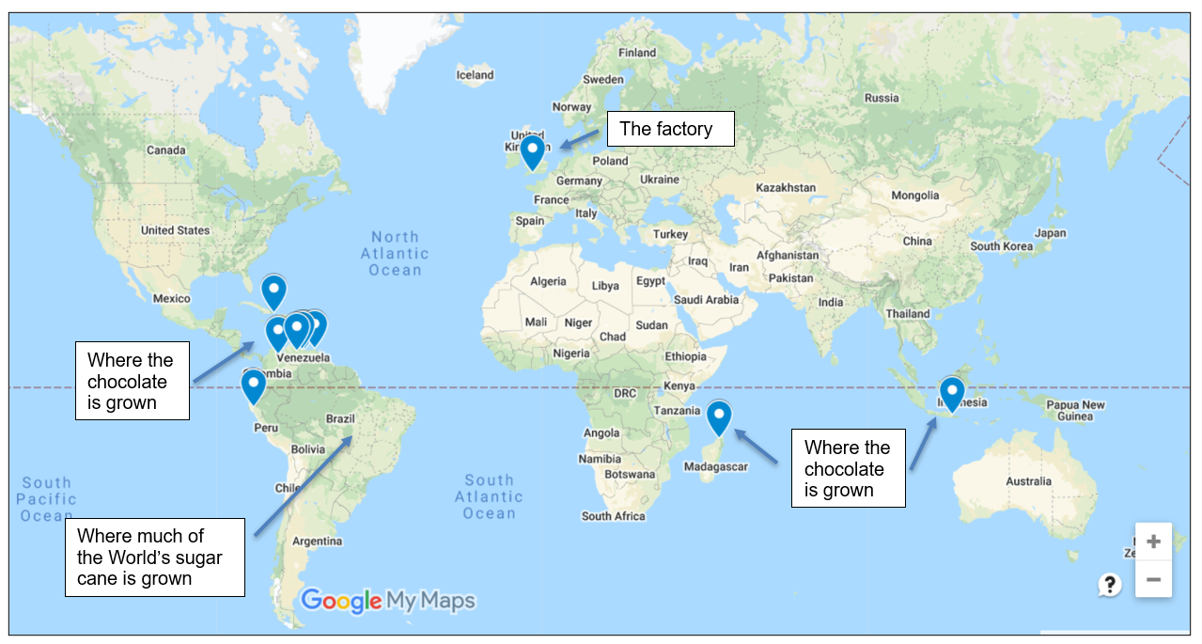
How many chocolate miles do we use:
Ourselves?
Our class?
Our school?
How will you work this out?
What information do you need to collect?
What do you need to do with the information?

Slide 6
How many chocolate miles do we use:
On average in a week in our class?
On average in a month in our school?
Can we compare them?
How will you work this out?
What information do you need to collect?
What do you need to do with the information?

Slide 7
What do we mean by average?

Slide 8

These are the chocolate bars that 5 friends eat in a week
Ali
Nic
Jo
Ed
Taz

Slide 9
How many bars should the local shopkeeper buy for each person every week?
Ali
Nic
Jo
Ed
Taz

Slide 10
What would you say if you had to give one number of bars for all of them?
Describe what happened
Ali
Nic
Jo
Ed
Taz

Slide 11
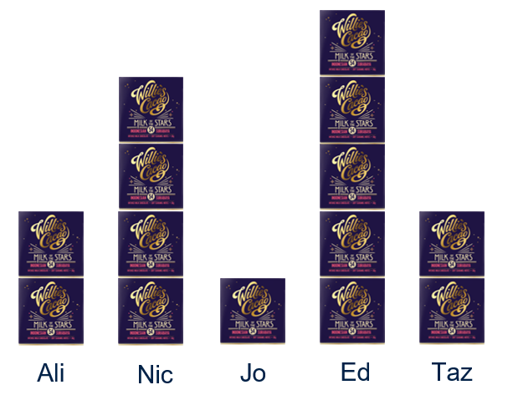
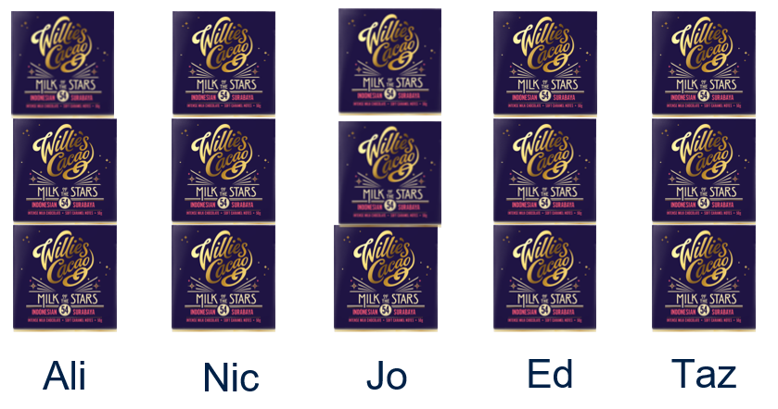
Before and after
What is the same and what is different?

Slide 12
The mean average
15 bars in total divided between the 5 friends
3 bars each
3 is the mean average number of bars eaten by each person

Slide 13
What would the mean average be for these four?
Nic
Jo
Ed
Taz

Slide 14
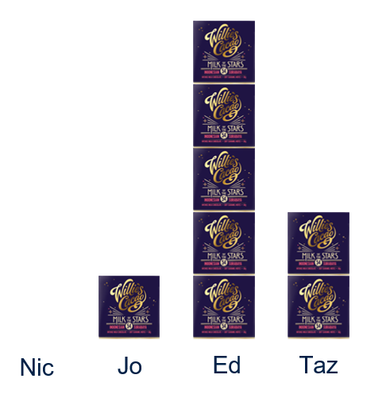

What would the mean average be for these four?
8 bars in total divided between the 4 friends
2 bars each
2 is the mean average number of bars eaten by each person

Slide 15
What would the mean average be for these friends
Ali
Nic
Jo
Ed

Slide 16
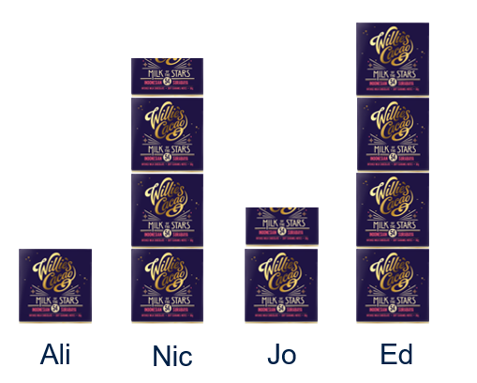
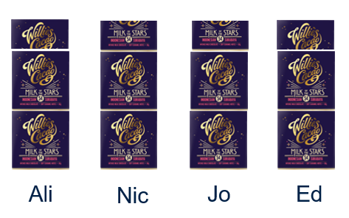
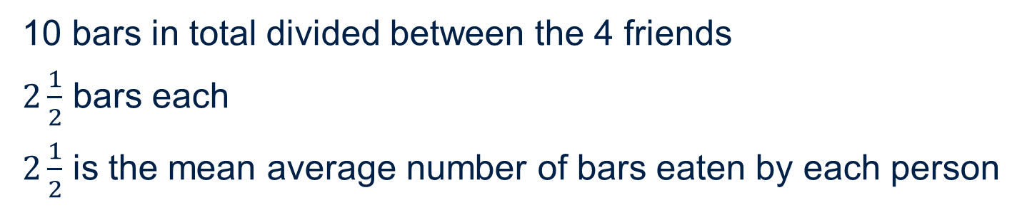
What would the mean average be for these friends
10 bars in total divided between the 4 friends
$2\frac{1}{2}$ bars each
$2\frac{1}{2}$ is the mean average number of bars eaten by each person

Slide 17
Do we snack responsibly?
Could we make some changes and help the environment?
What would you suggest?
How could you persuade others to make changes to their snack habits?

Slide 18
About MEI
Registered charity committed to improving mathematics education
Independent UK curriculum development body
We offer continuing professional development courses, provide specialist tuition for students and work with employers to enhance mathematical skills in the workplace
We also pioneer the development of innovative teaching and learning resources

