Slide 1
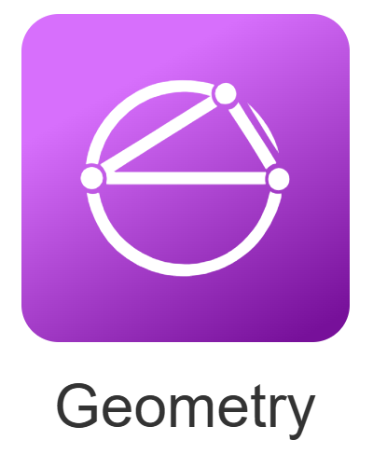

Using the Desmos Geometry tool
Natalie Vernon & Tom Button
We will start at 9am

Slide 2
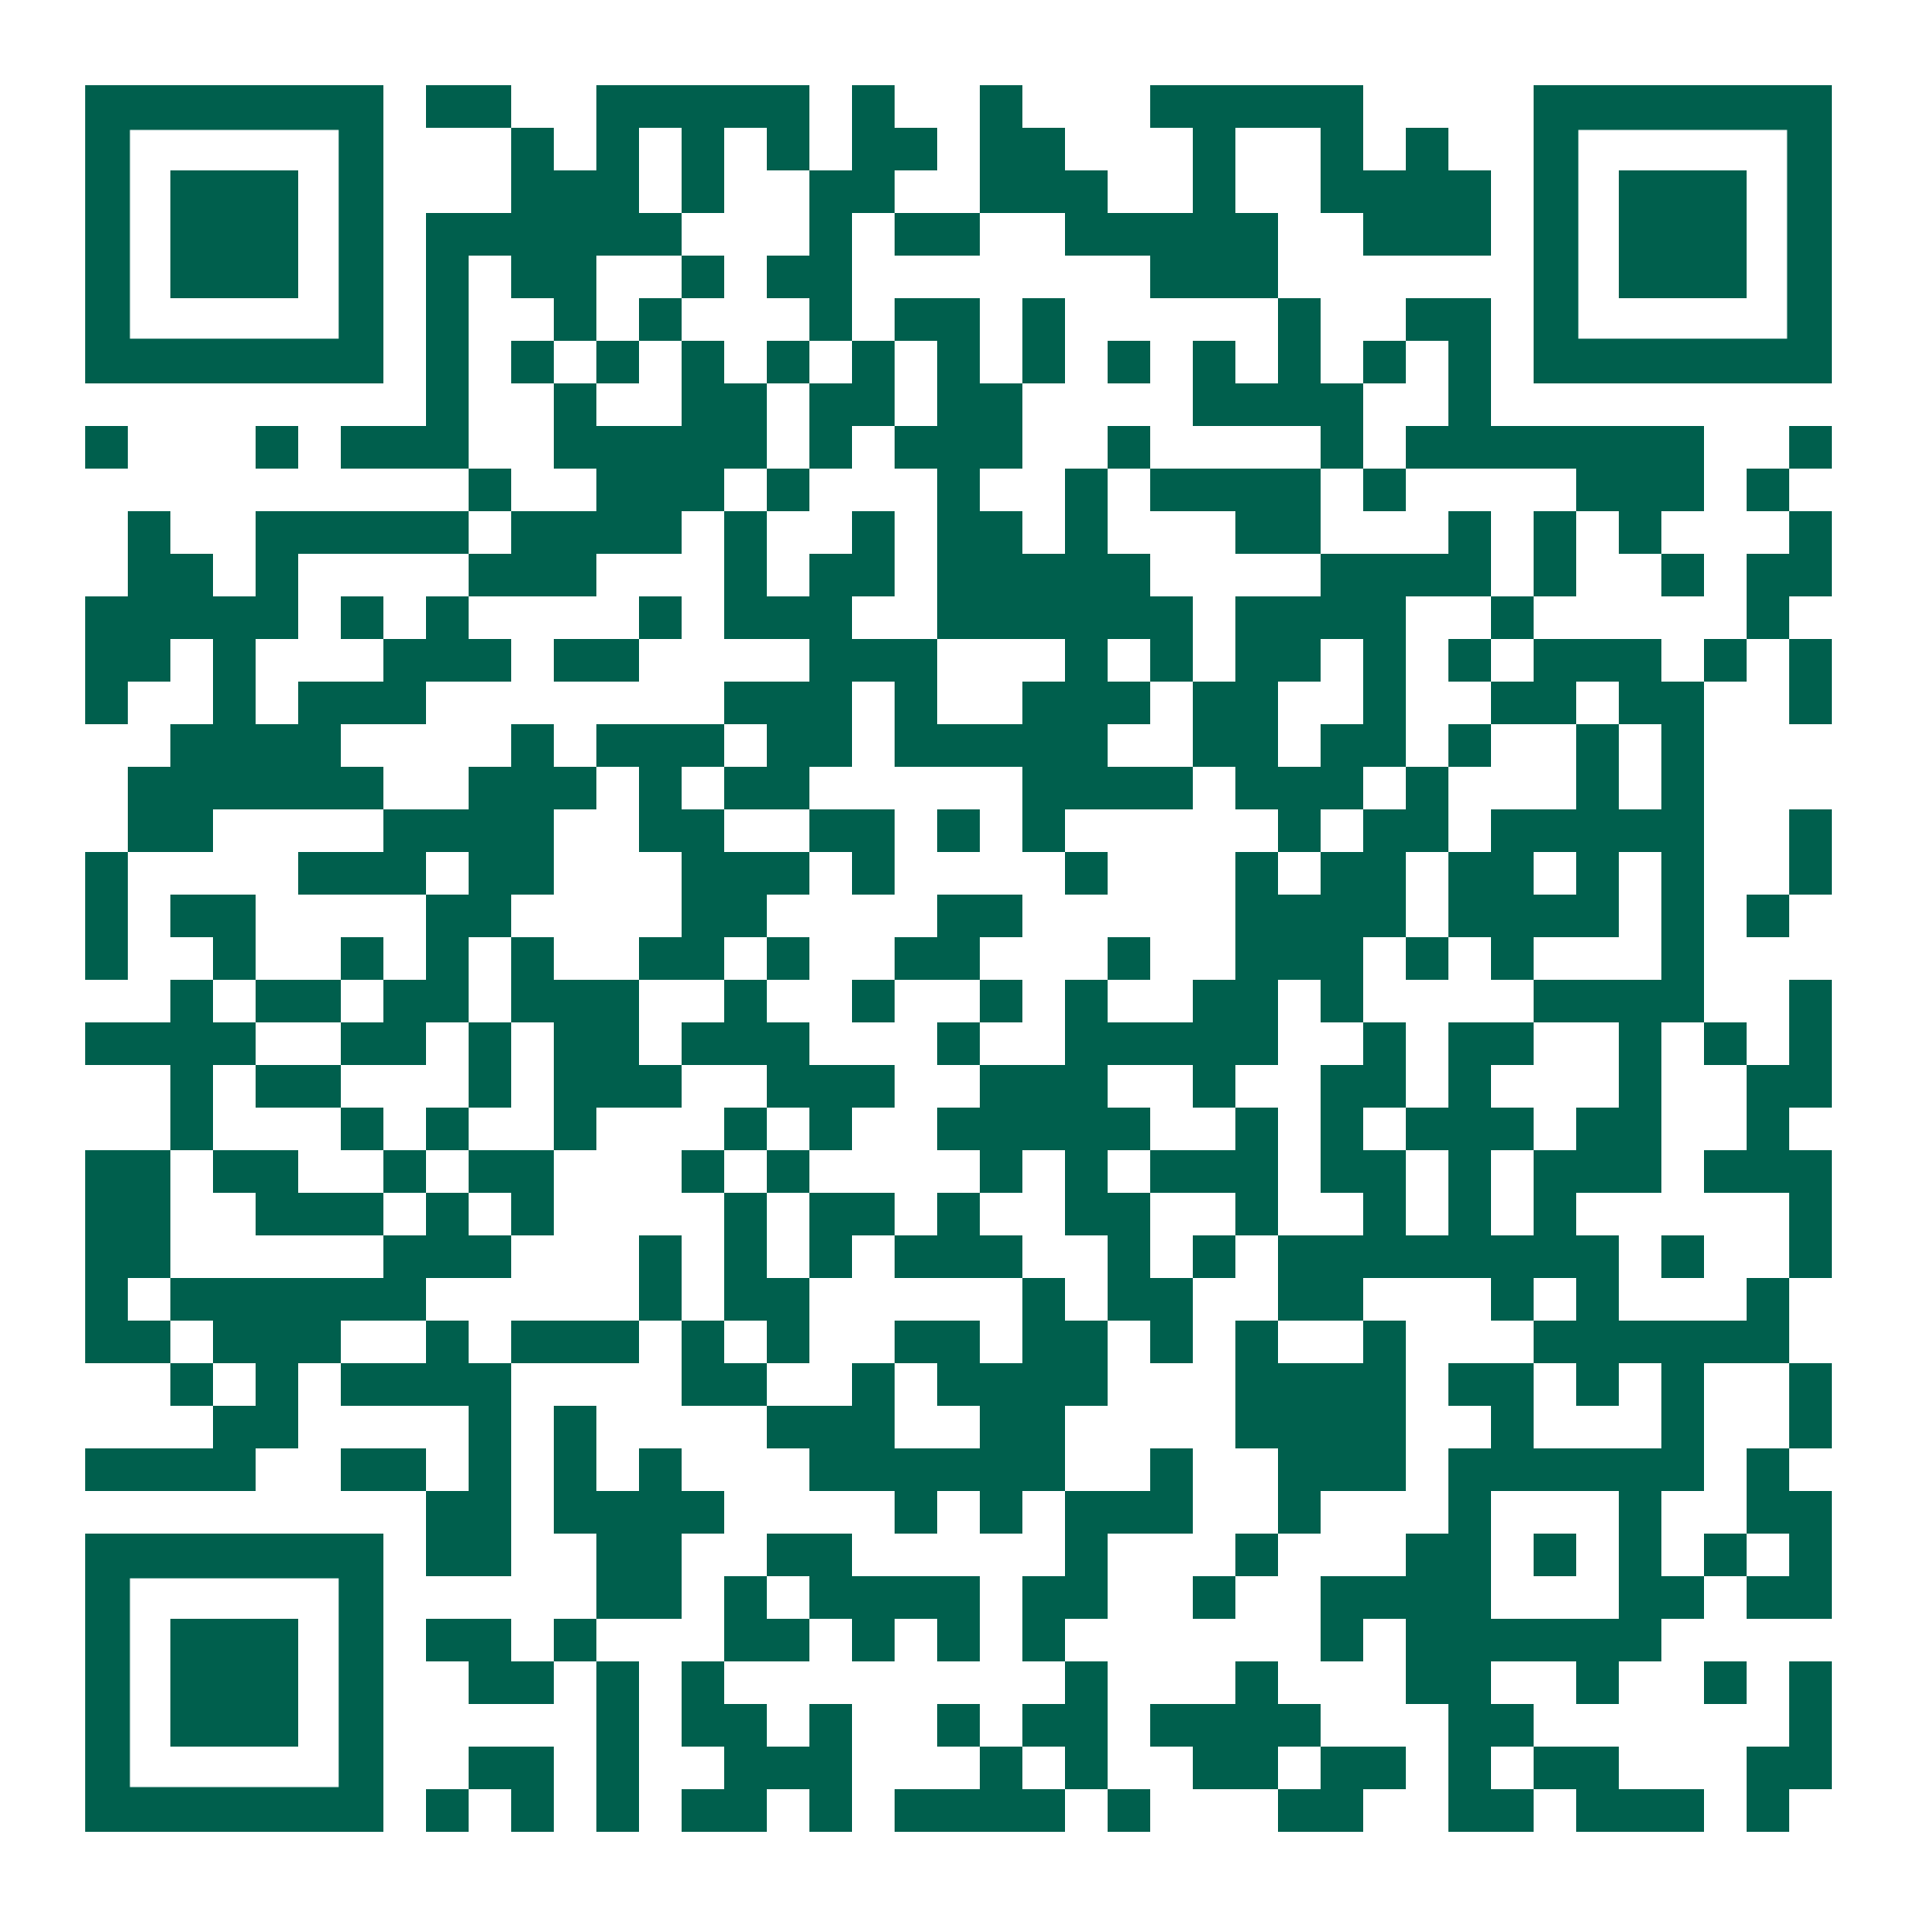
Using the Desmos Geometry tool
Getting started
Transformations
Sliders & lists
Support
tinyurl.com/Conf2551
Notes:
https://tinyurl.com/Conf2551

Slide 3
Getting Started

Slide 4
Creating dynamic families
Use of dynamic representations allow you to ‘see’ entire families of geometric objects
Consider your questions as carefully as you think about your Desmos file!
Getting started
Transformations
Sliders & lists
Further support
Notes:
Past approach: create a sub-set of this family – 1 student, 1 element/shape and collate class info. Difficulties included: inaccuracy of data!, slow, only a subset – often had to be simplified to work as a classroom activity
Now: create dynamic version displaying property you are interested in
Show full family or have each student experience full family to allow for more confident generalisations

Slide 5

Motivating question
What do the angles inside a triangle add up to?
Getting started
Transformations
Sliders & lists
Further support
Notes:
Open blank geometry page and demonstrate – teachers to watch then they will have time to work through the instructions afterwards

Slide 6
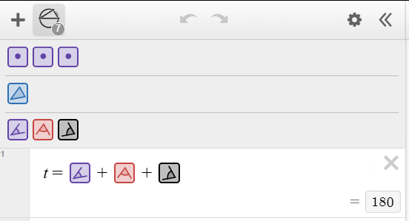
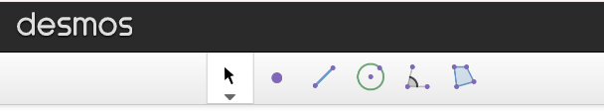
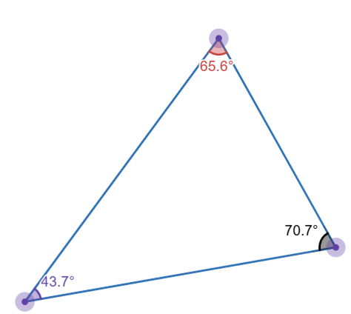
Layout
Tokens
Toolbar
Getting started
Transformations
Sliders & lists
Further support
Notes:
https://www.desmos.com/geometry/h4604zvkqy

Slide 7

Create your own polygons
Work through page 1 of the handout to create your own file for finding the angle sum of a triangle.
Repeat this process to create a similar construction for a quadrilateral.
Getting started
Transformations
Sliders & lists
Further support

Slide 8
Design principles from Desmos
Click to select – objects can be clicked to reference them. Hold down shift to allow selection of any object.
Transformations as functions – drag down from the token menu to see the details
Informal to formal
Getting started
Transformations
Sliders & lists
Further support

Slide 9
Transformations

Slide 10
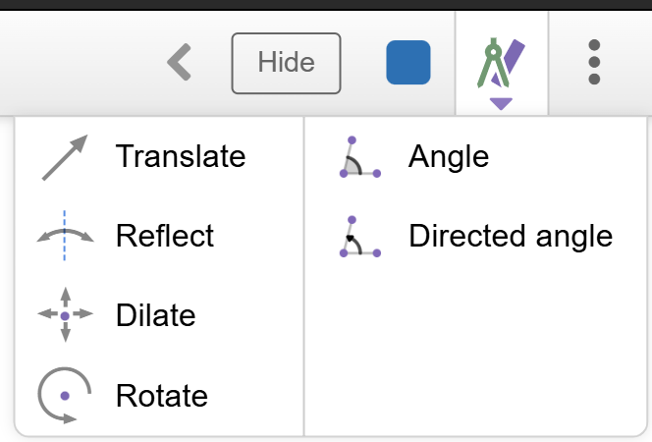
Transformations
This menu appears when you select an existing object
Construct the ‘scaffold’ items first e.g.
  for a reflection, you will need a mirror line
  for a rotation, you need a centre
  Work through page 2 of the handout on reflecting a polygon
Getting started
Transformations
Sliders & lists
Further support
Notes:
Show delegates how to reflect polygon –then get them to work through it themselves

Slide 11
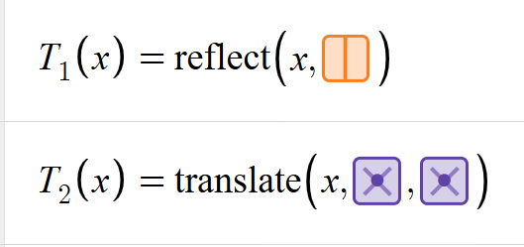
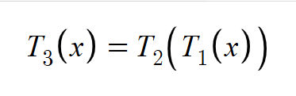
Transformations as functions
When you drag a transformation token down you can see that it is defined as a function:
This means you can create composite functions that apply multiple transformations:
Getting started
Transformations
Sliders & lists
Further support
Notes:
https://www.desmos.com/geometry/duz84qwugo Final file
Starting point: https://www.desmos.com/geometry/1kbtyc6b41

Slide 12
Sliders & lists

Slide 13
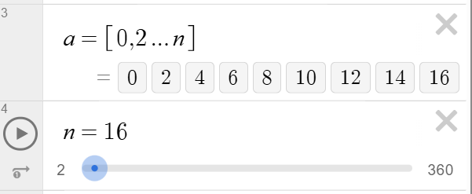
Sliders & lists
You can use sliders to replace numerical values – this offers you the option to animate to create dynamic files
Lists allow you to see several values at once
These can be combined!
Work through page 3 of the handout on creating a trace
Getting started
Transformations
Sliders & lists
Further support

Slide 14
Support

Slide 15
Further support
AMSP Teaching with Desmos webinars
Getting Started Desmos Geometry
Introduction webinar from Desmos
tinyurl.com/Conf2551
Getting started
Transformations
Sliders & lists
Further support
Notes:
TWD Geometry session: https://amsp.org.uk/teachers/teaching-with-desmos-webinars/
Desmos getting started: https://help.desmos.com/hc/en-us/articles/15316366009997-Getting-Started-Desmos-Geometry
Intro webinar by Desmos: https://www.youtube.com/live/WrzlHvl83m0?si=YysPr6_9_eULPv-J

