Slide 1

Welcome to the
MEI Conference 2025

Slide 2
Significant Figures
The good, the bad and the invisible

Slide 3
Significant Figures
Think about the:
KS3 / 4 Programme of Study
Core Maths curriculum
A level Maths & Further Maths curriculum
Which mathematicians are named in each of these?
Note down their names on Post Its (one name per Post It)
Cat van Saarloos & Sarah Denison

Slide 4
European
1600 onwards
Male
Notes:
As you arrived…

Slide 5
European
1600 onwards
Descartes (via cartesian)
Mathematicians in KS3&4
programmes of study
Venn
Pythagoras
Fibonacci
Male
Notes:
The directly referenced sources in the KS3/4 PoS are limited to 4 mathematicians – not really a rich and diverse heritage!
Note: Descartes isn’t named but is referenced through the use of ‘cartesian coordinates’
Though of course many teachers may well be using a much wider breadth of sources in addition to these within their own classrooms.

Slide 6
Mathematicians in AS/A level Maths and
Core Maths specs
European
1600 onwards
Descartes (via cartesian)
Venn
Raphson
Newton
Pythagoras
Spearman
Pearson
Fibonacci
Fermi
Male
Notes:
Spearman, Pearson and Fermi are Core Maths.
So end of A level 6 mathematicians
End of Core Maths 7 mathematicians
All men, all European, almost all 1600 onwards
And what do we say about them? Pearson was a Eugenicist – today described as scientific racism

Slide 7
European
1600 onwards
Euler
Runge
Kutta
Fermat
Wilson
Pell
Hooke
Poisson
Pearson
Spearman
Wilcoxon
Lamy
Caylay
Hamilton
Lagrange
Bernoulli
Djikstra
Kuratowski
L’Hopital
Descartes
Venn
Newton
Raphson
Argand
De Moivre
Maclaurin
Simpson
Mathematicians in AS/A level
Further Maths spec
Prim
Fibonacci
Pythagoras
Kruskal
Diophantus
Male
Not claiming this is exhaustive!
Notes:
Now that Further Maths is included (especially statistics and discrete maths) the breadth of references to mathematicians increases, ranging from about 500BC to the early 21st century (Kruskal, for example, died in 2010). But, the same lack of diversity continues. Prim & Kruskal from USA so not European but definitely ‘Western’!
Out of interest, Diophantus of Alexandria lived in Alexandria, Egypt, but was probably Greek (European)

Slide 8
The Diverse Curriculum
“The curriculum can be a window into the world…a way for our students to see the joy, the invention, the knowledge, the tragedy, the oppression, the victories, the ideas and creations of people of all backgrounds and identities.”
“The mirror is the way in which we make sense of knowledge – how it applies to us, how it tells our story…The curriculum that is a mirror helps us find our worth”
Bennie Kara
The Diverse Curriculum
2025
Notes:
But Bennie also says it should be a mirror,,,,

Slide 9
What remit do we have to address this issue?
“Pupils told us that not being able to see themselves in the content they learn, or encountering negative portrayals, can be disempowering and demotivating.”
“As well as making sure that children and young people can see themselves represented in the curriculum, it will be important that we also make sure they encounter the unfamiliar, and have their horizons stretched and broadened”
Curriculum and Assessment Review Interim Report
March 2025
Curriculum and Assessment Review: Interim report
Notes:
From the interim curriculum report

Slide 10
Galton
Notes:
We tend to associate eugenics with Nazi Germany and the Holocaust, but it was in fact developed in London. Its founder was Francis Galton, who established a laboratory at UCL in 1904.
Galton’s seductive promise was of a bold new world filled only with beautiful, intelligent, productive people. The scientists in its thrall claimed this could be achieved by controlling reproduction, policing borders to prevent certain types of immigrants, and locking away “undesirables”, including disabled people.
by the standards of today, Galton does resemble a monster. He was a brilliant statistician but also a racist (not just my assessment, but that of Veronica van Heyningen, the current president of the Galton Institute). He was obsessed with human difference, and determined to remove from British society those he considered inferior.
In the early 20th century, a surprisingly broad roster of public figures aligned themselves with Galton’s vision. It attracted people on the left and right, prominent writers and intellectuals, leading scientists and politicians. Virginia Woolf, TS Eliot, DH Lawrence, Julian Huxley, Winston Churchill, Marie Stopes – all held eugenic views. Churchill was vice-president of the first International Eugenics Conference, held in London in 1912. Although there were notable critics, to be a eugenicist was to be firmly in the mainstream.
Eugenics made it into government policy: the Mental Deficiency Act of 1913 institutionally separated those whom the state considered “mentally feeble” or “morally defective” from the rest of society, effectively preventing them from having children.

Slide 11
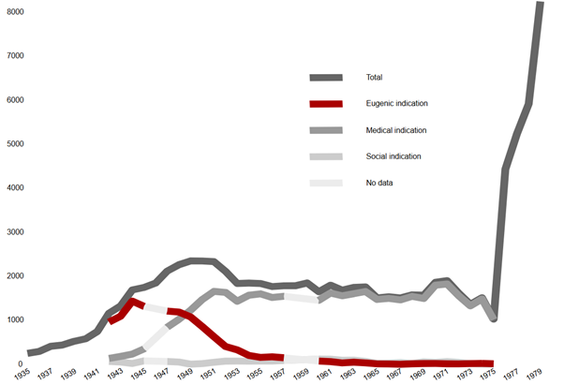
Number of sterilisations reported to Swedish Board of Health 1935–1979
Notes:
Medical, if a pregnancy could pose a risk to life or good health of a woman with chronic illness or permanently weakened constitution.
Eugenic, which allowed sterilising people considered insane or with severe illness or with a physical disability, so that these traits are not passed on the offspring.
Social, which allowed sterilising people deemed unsuitable to foster a child due to mental illness, being feebleminded or having an antisocial lifestyle.

Slide 12


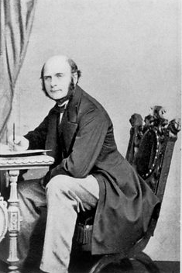
Francis Galton
1822 | Year of birth | 12/20 | Fame Factor
12/20 | Impact | 10/20 | Integrity
SIGNIFICANT FIGURES
Explorer, Anthropologist and Statistician
Francis Galton was a half cousin of Charles Darwin and a Victorian scientist. He made important contributions to social science. Galton invented weather maps and questionnaires and was influential in the development of the forensic use of fingerprints.
However, there is a darker side to his history. Galton’s big idea was ‘Eugenics’ - encouraging the “right people” to breed and discouraging the “wrong people” from breeding. This led to the systematic extermination of millions in the Nazi death camps.
Notes:
Mathematician image link: https://www.lookandlearn.com/history-images/YW021166L/Francis-Galton-aged-42-seated
Flag image link: https://pixabay.com/vectors/united-flag-kingdom-british-great-28519/
Find out more
Information source: https://www.ucl.ac.uk/statistics/our-early-history
Listen to BBC Bad Blood podcast: https://www.bbc.co.uk/programmes/m001fd39
Watch 12 minute video from CrashCourse: https://www.youtube.com/watch?v=JeCKftkNKJ0
Watch 7 minute video on the myth of race: https://www.youtube.com/watch?v=926PqQUOVOg

Slide 13
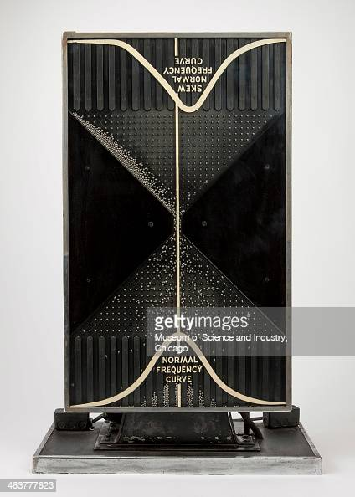
Francis Galton
Francis Galton invented the Galton Board
Run this simulation to see how it works
Why do more balls end up in the middle sections than the end sections?
Notes:
Image: https://www.gettyimages.co.uk/detail/news-photo/an-image-of-a-quincunx-or-probability-machine-from-the-1933-news-photo/463777623?adppopup=true
Simulation: https://phet.colorado.edu/sims/html/plinko-probability/latest/plinko-probability_en.html

Slide 14
The pegs on the Galton board are arranged in a triangular pattern.
As each ball hits a peg, there is a 50% chance of it going left or right.

Slide 15
Imagine there were only two rows of pegs.
How many different ways are there for the yellow ball to reach this position?

Slide 16
There are two ways to reach this position.
The numbers below show how many ways to reach those positions.
1
2
1

Slide 17

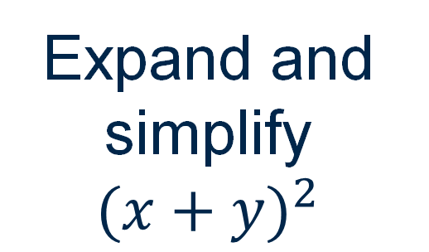





$$x$$
?
$$x$$
$$y$$
?
Expand and simplify ${(x+y)}^{2}$
$$x$$
?
1
2
1
$$y$$
$$y$$
?
Can you make any connections?
Notes:
The idea from this slide is to get students to start making connections between probability and expansion of binomials.
They should spot that there are two “ways” to get xy

Slide 18
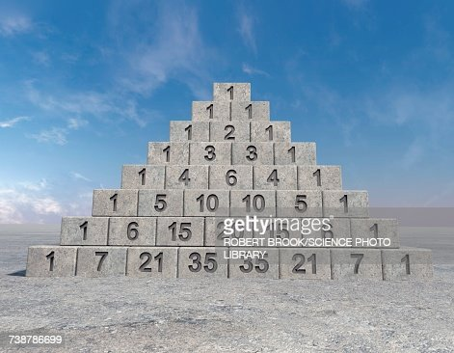
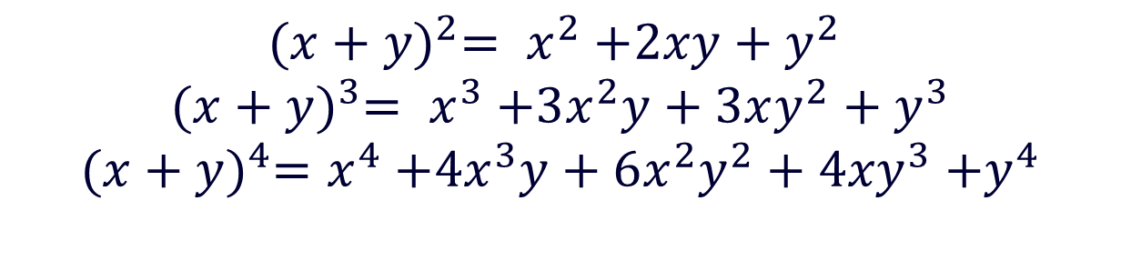
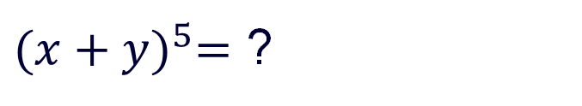
$${(x+y)}^{2}= x^{2}{+2xy+y}^{2}$$
$${(x+y)}^{3}= x^{3}{+3x^{2}y+3xy^{2}+y}^{3}$$
${(x+y)}^{4}=$ $x^{4}{+4x^{3}y+6x^{2}y^{2}+4xy}^{3}{+y}^{4}$
${(x+y)}^{5}=$ ?
${(x+y)}^{5}=$ ${x^{5}+6x}^{4}y{+15x^{3}y^{2}+20x^{2}y^{2}+15xy}^{4}{+y}^{5}$
What do you notice?
Notes:
Image: https://www.gettyimages.co.uk/detail/illustration/pascals-triangle-royalty-free-illustration/738786699?phrase=pascal%20triangle&adppopup=true
Rather than students having to expand 5 brackets, they can use the pattern to work out what the next row will be.

Slide 19
Vaughan

Slide 20
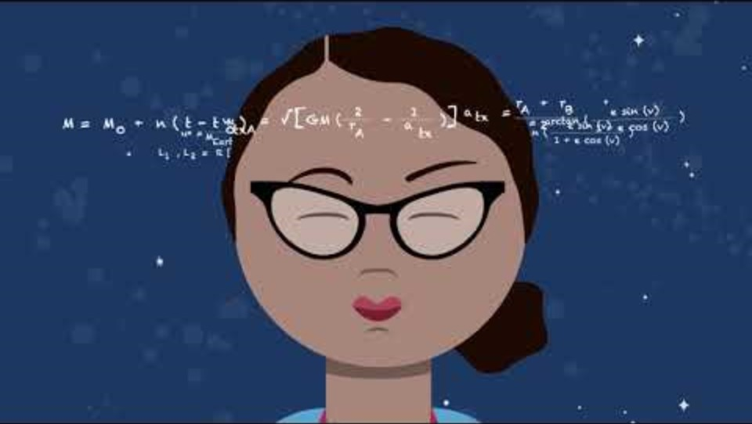

Slide 21

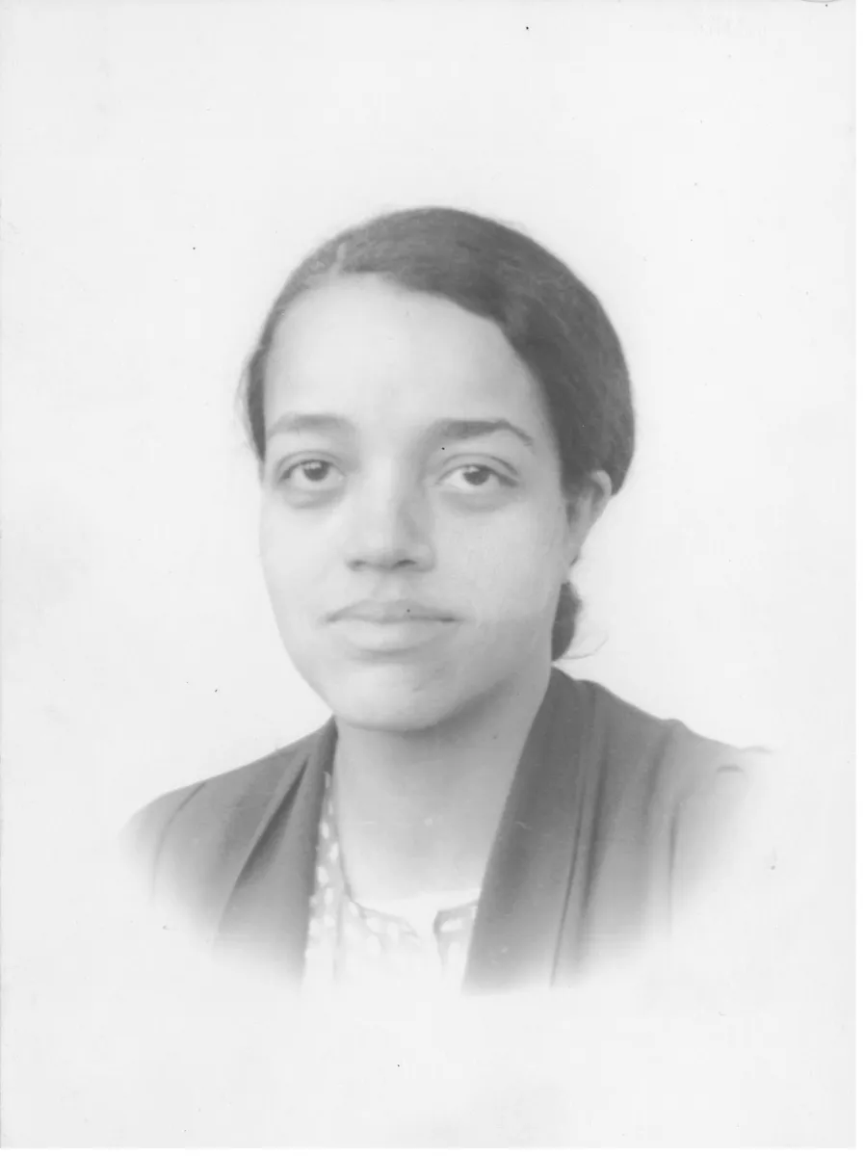
Dorothy Vaughan
1910 | Year of birth | 16/20 | Fame Factor
20/20 | Impact | 20/20 | Integrity
SIGNIFICANT FIGURES
Mathematician at NASA
Dorothy was a talented mathematician and computer programmer.
She spent 11 years as a teacher and homemaker before moving to work as a mathematician at National Advisory Committee for Aeronautics (later NASA).
She was the NACA’s first black supervisor, and one of the NACA’s few female supervisors.
Vaughan became an expert FORTRAN programmer, and she also contributed to the Scout Launch Vehicle Program.
She worked closely with Katherine Johnson and Mary Jackson on the launch of astronaut John Glenn into orbit.
Notes:
Flag image link: https://pixabay.com/vectors/united-flag-states-america-26177/
Mathematician image link: https://www.nasa.gov/people/dorothy-vaughan/
Find out more:
https://www.nasa.gov/centers-and-facilities/langley/dorothy-j-vaughan/Hidden Figures Film
https://podcasters.spotify.com/pod/show/thedoublexeffect/episodes/Dorothy-Vaughan-eih9sp
Hidden Figures: The real story https://www.bbc.co.uk/programmes/p04t7hcx

Slide 22
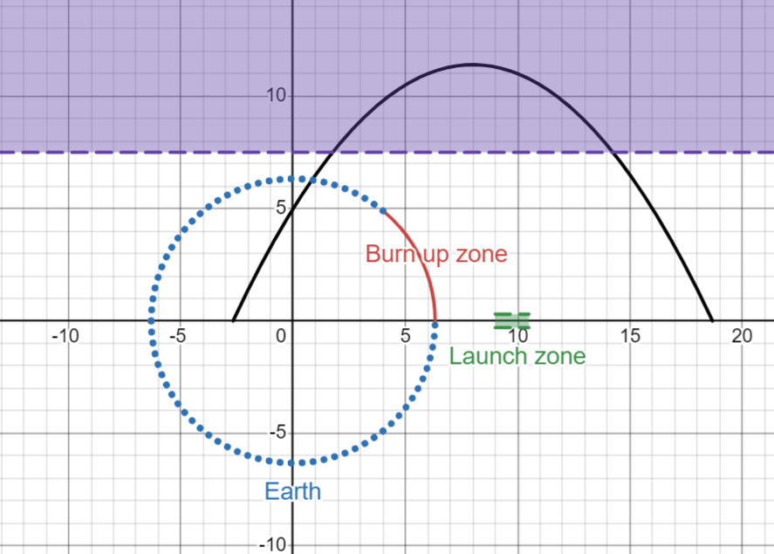
Landing back on Earth
Notes:
Follow this link https://www.desmos.com/calculator/pkn3m0m9mx or click the image on the slide to open the Desmos activity. Changing the sliders will change the trajectory. In the left hand panel are the criteria you need to meet (these are also pasted below)
Can you return the spacecraft safely to Earth?
You must land the spacecraft on the Earth by passing the black quadratic graph through the blue dots.
Launch path (black) must start within the green launch zone.
You cannot land in the red section of Earth as you would burn up.
You cannot enter the purple region (y>7.5) as you would remain in orbit.
Move the sliders so you can successfully land the spacecraft.

Slide 23
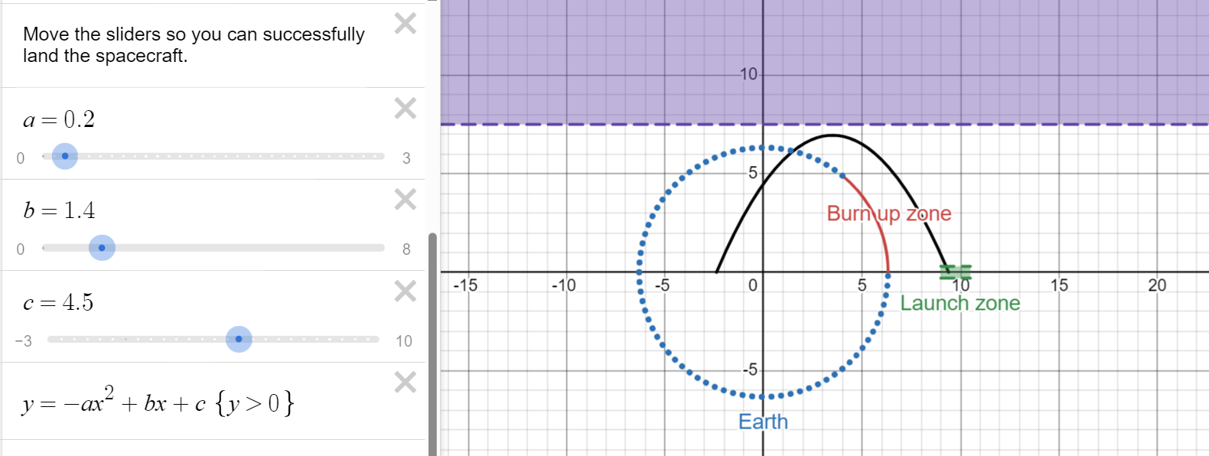
Landing back on Earth – a solution
Notes:
Follow this link https://www.desmos.com/calculator/pkn3m0m9mx or click the image on the slide to open the Desmos activity. Changing the sliders will change the trajectory. In the left hand panel are the criteria you need to meet (these are also pasted below)
Can you return the spacecraft safely to Earth?
You must land the spacecraft on the Earth by passing the black quadratic graph through the blue dots.
Launch path (black) must start within the green launch zone.
You cannot land in the red section of Earth as you would burn up.
You cannot enter the purple region (y>7.5) as you would remain in orbit.
Move the sliders so you can successfully land the spacecraft.

Slide 24
Explore the materials
Notes:
Time now for them to find and download the ppt (or we give it to them)?
And then they find one which is suitable for a class they have next year – when and how might they use it? Would they adapt/extend?
End of session – who is missing? Any feedback on them?

