Slide 2
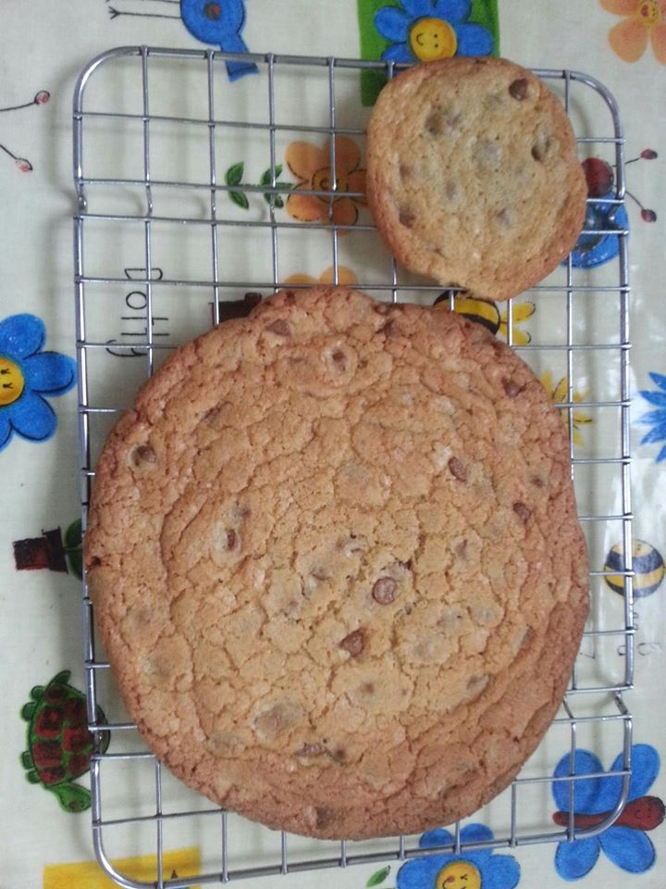


Divide and Conquer with biscuits!

Slide 3
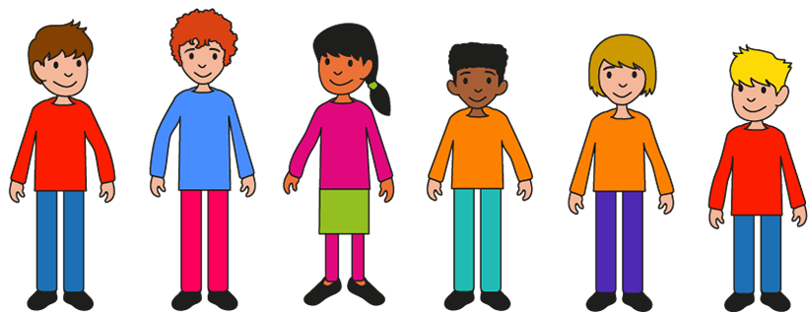

Groups of students have baked giant rectangular biscuits.
They need to share them fairly

Slide 4
Giant bake-off!
Group 1
This group of 3 baked 2 biscuits between them

Slide 5
Giant bake-off!
Group 2
This group of 5 baked 3 biscuits between them

Slide 6
Giant bake-off!
Group 3
This group of 4 baked 3 biscuits between them

Slide 7
Giant bake-off!
Group 4
This group of 3 baked 4 biscuits between them

Slide 8
Giant bake-off!
Group 5
This group of 4 baked 5 biscuits between them

Slide 9
Giant bake-off!
Group 6
This group of 2 baked 3 biscuits between them

Slide 10
Pattern spotting
What do you notice about the answers?
Have you written your answers as fractions?

Slide 11
Pattern spotting
What do you notice about the fractions?
What do you notice about the numerator and the denominator in the fraction of a biscuit that each person gets?

Slide 12
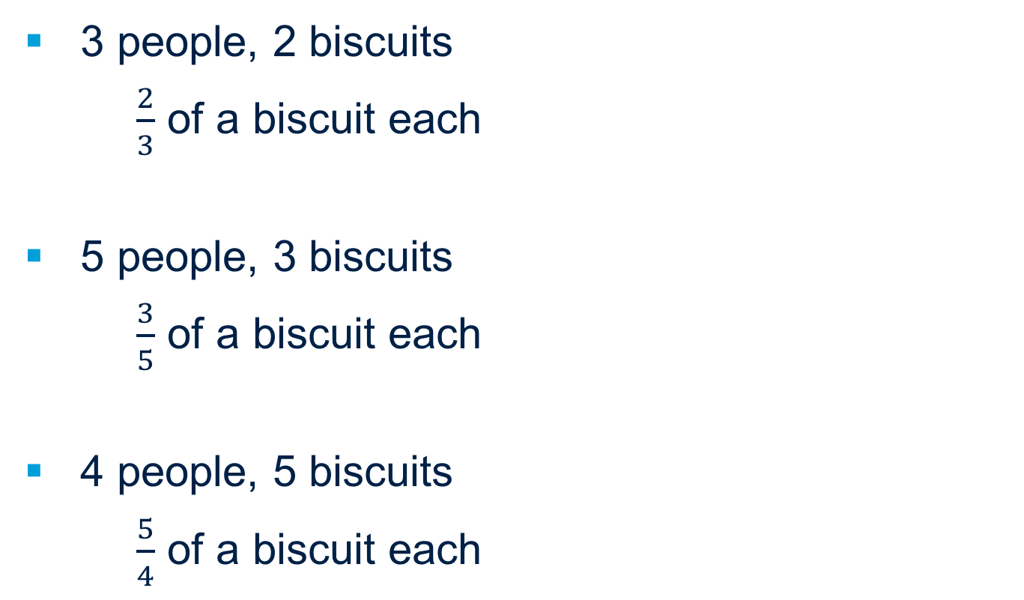
Pattern spotting
3 people, 2 biscuits
$\frac{2}{3}$ of a biscuit each
5 people, 3 biscuits
$\frac{3}{5}$ of a biscuit each
4 people, 5 biscuits
$\frac{5}{4}$ of a biscuit each
What do you notice about the answers?

Slide 13
Pattern spotting
3 people, 2 biscuits
$\frac{2}{3}$ of a biscuit each
5 people, 3 biscuits
$\frac{3}{5}$ of a biscuit each
4 people, 5 biscuits
$\frac{5}{4}$ of a biscuit each
What do you notice about the answers?
What do you notice about the numerator and the denominator in the fraction of a biscuit that each person gets?

Slide 14
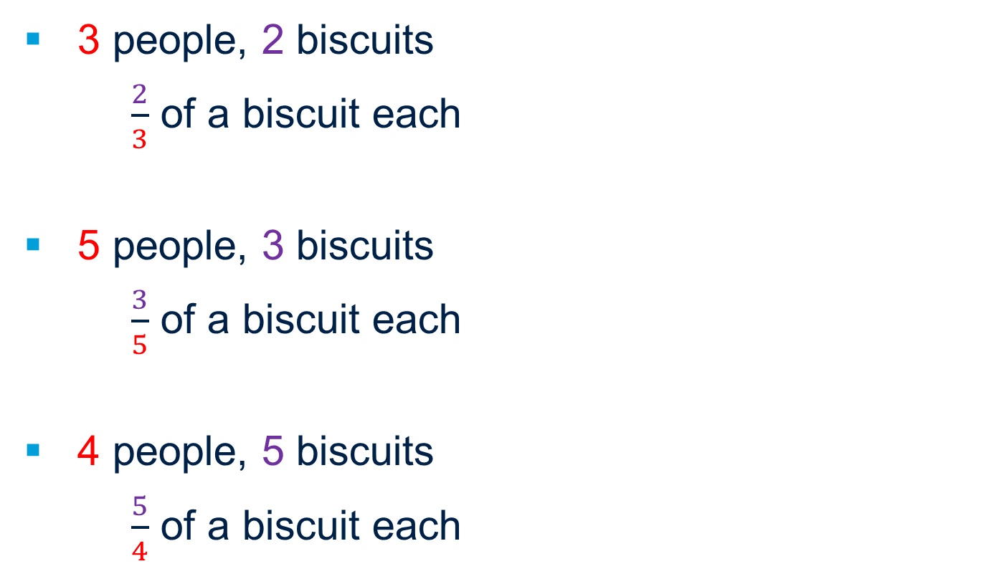
Pattern spotting
What does the numerator represent?
What does the denominator represent?
What does the fraction represent?
3 people, 2 biscuits
$\frac{2}{3}$ of a biscuit each
5 people, 3 biscuits
$\frac{3}{5}$ of a biscuit each
4 people, 5 biscuits
$\frac{5}{4}$ of a biscuit each
The numerator is __ which is the number of biscuits in the whole
The denominator is __ which is the number they are shared between.

Slide 15
Pattern spotting
What does the numerator represent?
What does the denominator represent?
What does the fraction represent as the answer?
3 people, 2 biscuits
$\frac{2}{3}$ of a biscuit each
5 people, 3 biscuits
$\frac{3}{5}$ of a biscuit each
4 people, 5 biscuits
$\frac{5}{4}$ of a biscuit each
The numerator is __ which is the number of parts of a whole biscuit each person gets.
The denominator is __ which is the number of pieces each biscuit has been divided into.

Slide 16
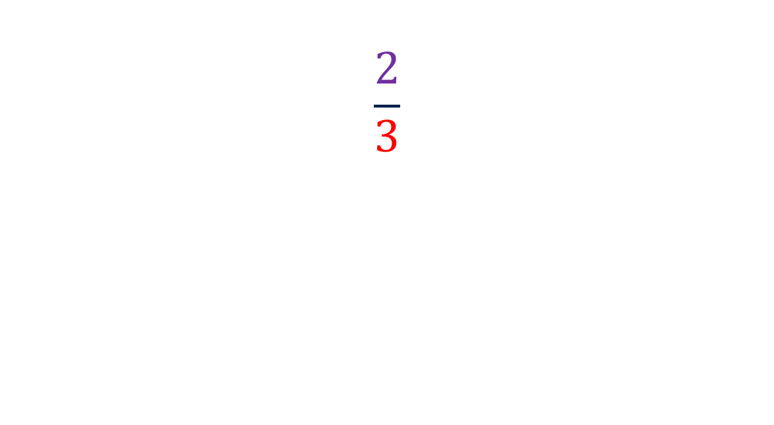
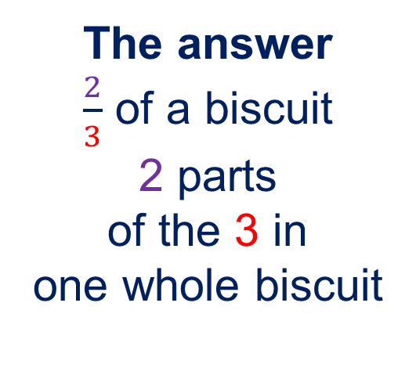
One fraction; two interpretations
$$\frac{2}{3}$$
The answer
$\frac{2}{3}$ of a biscuit
2 parts
of the 3 in
one whole biscuit
The division
2 biscuits
divided between
3 people

Slide 17
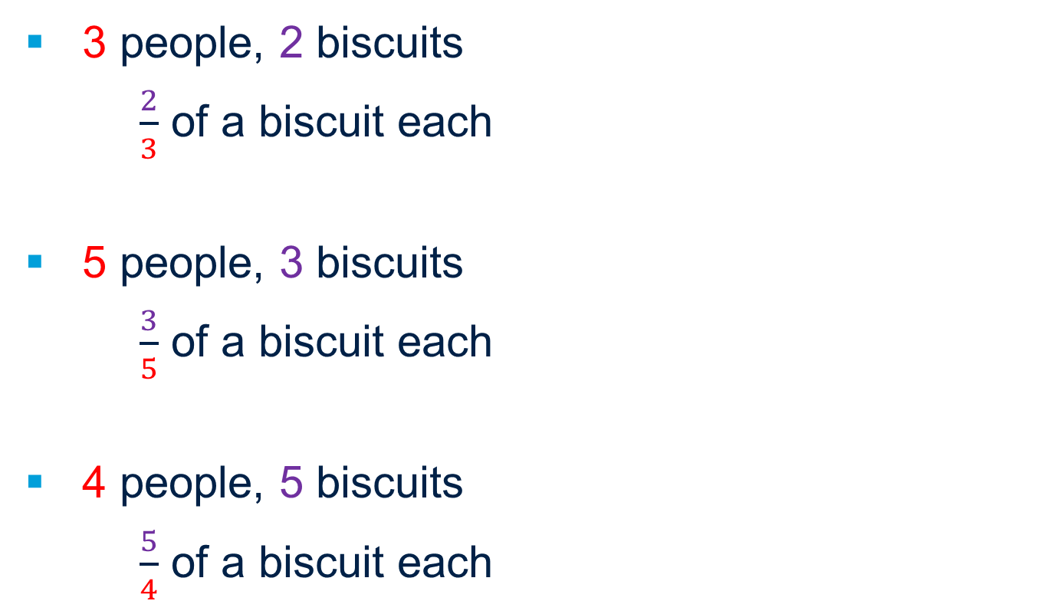
Fair shares?
3 people, 2 biscuits
$\frac{2}{3}$ of a biscuit each
5 people, 3 biscuits
$\frac{3}{5}$ of a biscuit each
4 people, 5 biscuits
$\frac{5}{4}$ of a biscuit each
How can you describe what is happening to the biscuits?
Shared
Split
Divided?
Numerator
Denominator

Slide 18
Using a calculator
3 people, 2 biscuits
$\frac{2}{3}$ of a biscuit each
5 people, 3 biscuits
$\frac{3}{5}$ of a biscuit each
4 people, 5 biscuits
$\frac{5}{4}$ of a biscuit each
What calculation would you enter into the calculator to work out how much biscuit each person gets?

Slide 19
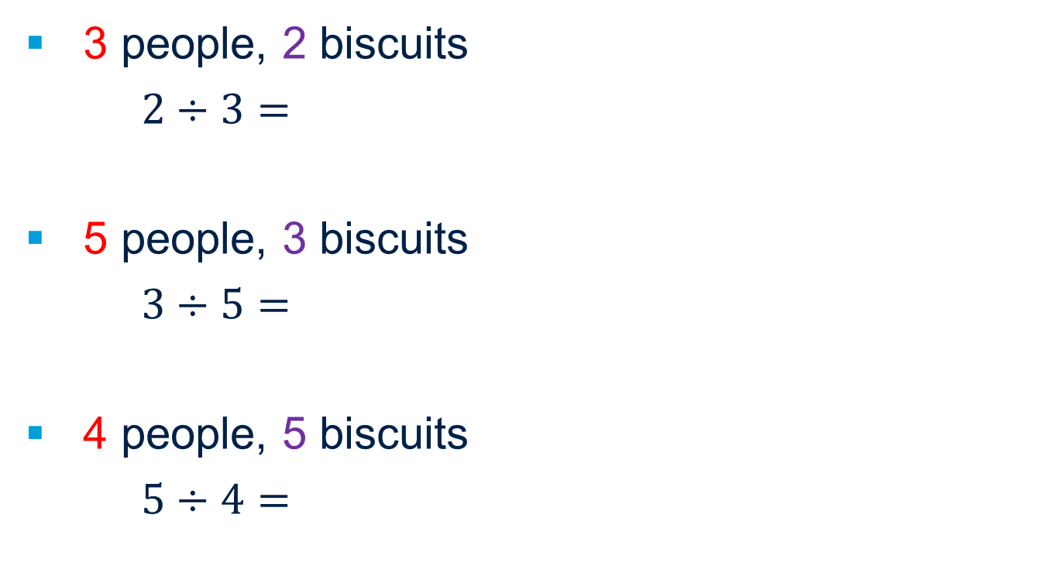
Fractions and division?
3 people, 2 biscuits
$2÷3=$
5 people, 3 biscuits
$3÷5=$
4 people, 5 biscuits
$5÷4=$
How is this the same as the fraction?
Enter the calculation on the calculator.

Slide 20

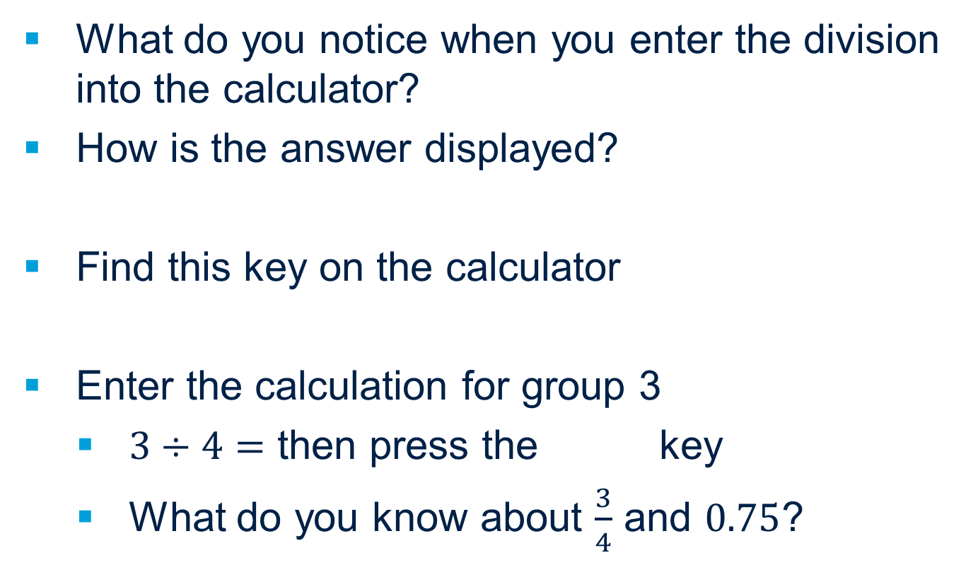
Converting between fractions and decimals
What do you notice when you enter the division into the calculator?
How is the answer displayed?
Find this key on the calculator
Enter the calculation for group 3
  $3÷4=$ then press the key
  What do you know about $\frac{3}{4}$ and $0.75$?

Slide 21

Entering fractions
Arrow keys to move around the fraction or mixed number
Shift key to allow mixed numbers
Fraction input key
S-D key to convert between fractions and decimals

Slide 22
Entering fractions on the calculator
Choose a fraction or mixed number
Write a problem that will have the answer of that fraction
Enter the fraction or mixed number into the calculator
Use the key to change it to a decimal and back.
Write the division equation that would solve the problem
Notes:
Match the cards in the columns

Slide 23
We can think of fractions as divisions
In pairs, decide who is A and who is B
A argue that the statement is true
B argue that the statement is false
Who is most convincing?
What do you think?

Slide 24
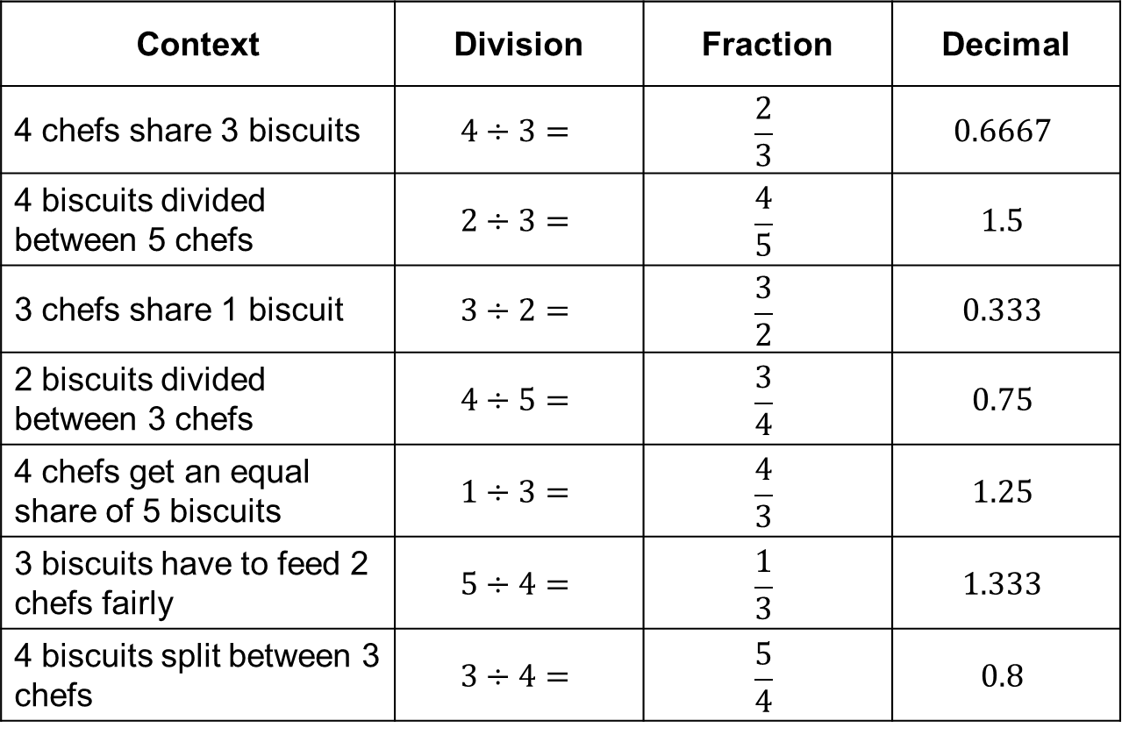
Match the representations
Context | Division | Fraction | Decimal
4 chefs share 3 biscuits | $$4÷3=$$ | $$\frac{2}{3}$$ | $$0.6667$$
4 biscuits divided between 5 chefs | $$2÷3=$$ | $$\frac{4}{5}$$ | $$1.5$$
3 chefs share 1 biscuit | $$3÷2=$$ | $$\frac{3}{2}$$ | $$0.333$$
2 biscuits divided between 3 chefs | $$4÷5=$$ | $$\frac{3}{4}$$ | $$0.75$$
4 chefs get an equal share of 5 biscuits | $$1÷3=$$ | $$\frac{4}{3}$$ | $$1.25$$
3 biscuits have to feed 2 chefs fairly | $$5÷4=$$ | $$\frac{1}{3}$$ | $$1.333$$
4 biscuits split between 3 chefs | $$3÷4=$$ | $$\frac{5}{4}$$ | $$0.8$$
Notes:
Mixed presentation on the screen
Cut up the cards, mix them up and pairs/small groups sort the cards into sets of 4 under the headings

Slide 25
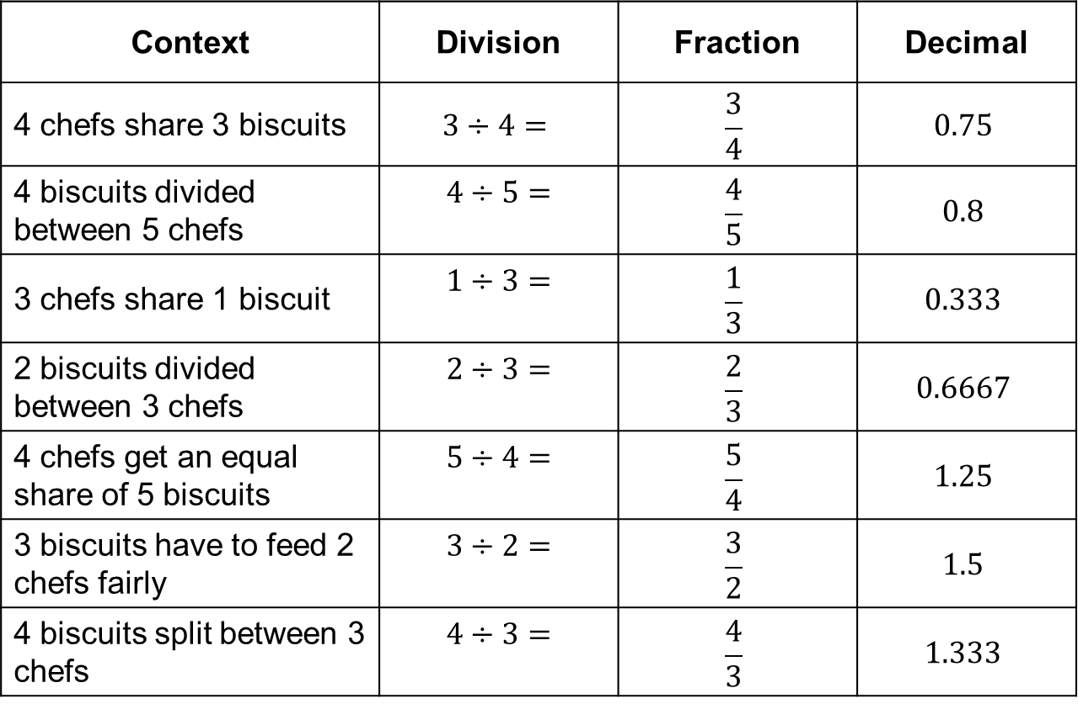
Match the representations
Context | Division | Fraction | Decimal
4 chefs share 3 biscuits | $$3÷4=$$ | $$\frac{3}{4}$$ | $$0.75$$
4 biscuits divided between 5 chefs | $$4÷5=$$ | $$\frac{4}{5}$$ | $$0.8$$
3 chefs share 1 biscuit | $$1÷3=$$ | $$\frac{1}{3}$$ | $$0.333$$
2 biscuits divided between 3 chefs | $$2÷3=$$ | $$\frac{2}{3}$$ | $$0.6667$$
4 chefs get an equal share of 5 biscuits | $$5÷4=$$ | $$\frac{5}{4}$$ | $$1.25$$
3 biscuits have to feed 2 chefs fairly | $$3÷2=$$ | $$\frac{3}{2}$$ | $$1.5$$
4 biscuits split between 3 chefs | $$4÷3=$$ | $$\frac{4}{3}$$ | $$1.333$$
Notes:
The correct matching

Slide 26
About MEI
Registered charity committed to improving mathematics education
Independent UK curriculum development body
We offer continuing professional development courses, provide specialist tuition for students and work with employers to enhance mathematical skills in the workplace
We also pioneer the development of innovative teaching and learning resources

