Slide 2
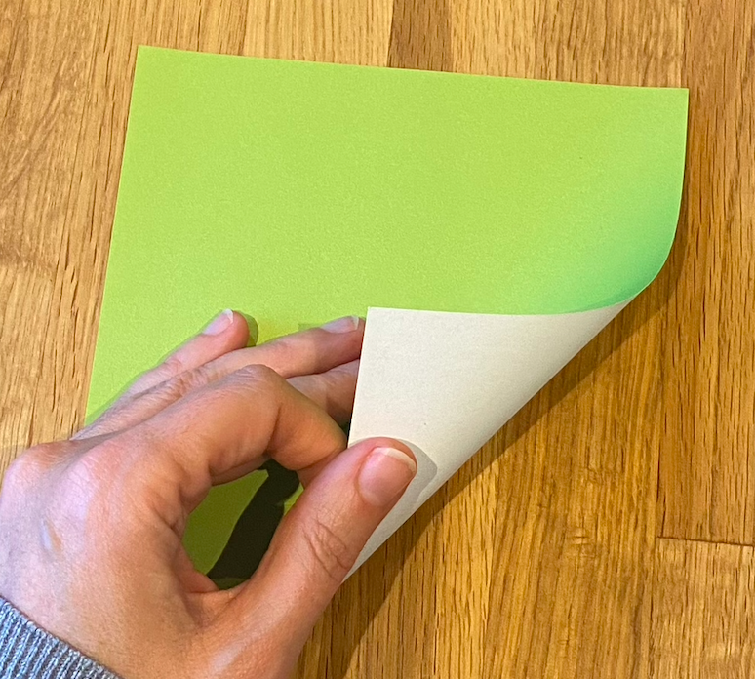
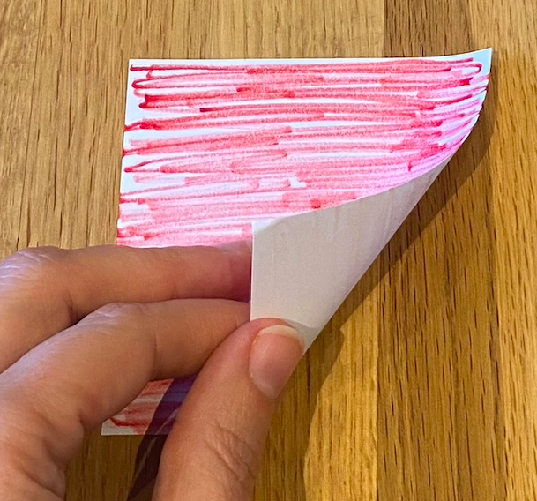
You will need…
Some squares of paper, coloured on one side
You could use coloured pencils to colour your paper

Slide 3
Challenge 1
Can you fold your paper so that there is the same amount of coloured paper showing as white paper?
This is called a 1:1 ratio
Can you do it in more than one way?

Slide 4
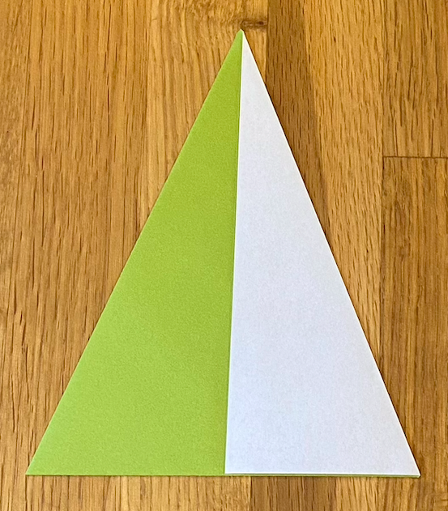
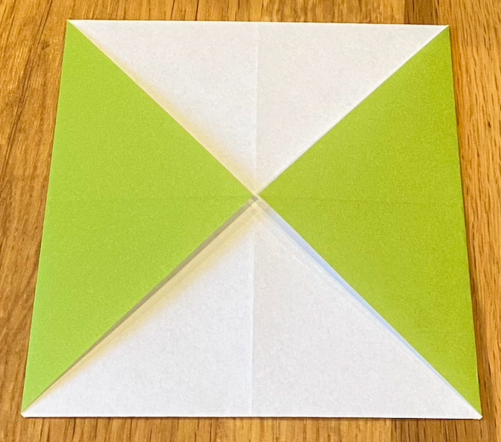
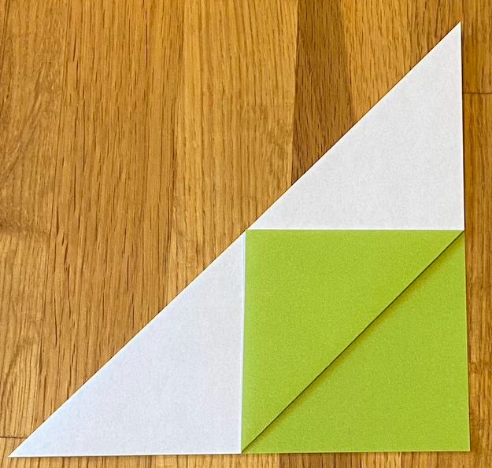
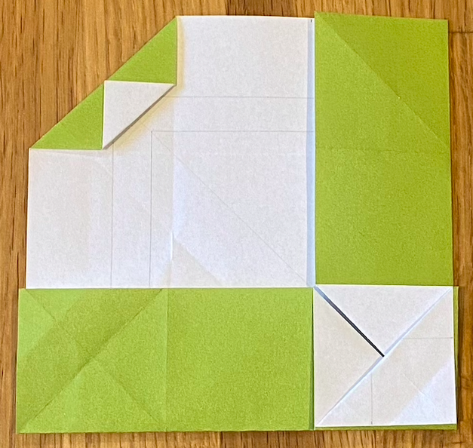
Challenge 1 - Gallery
Here are some examples of patterns with a
1:1 ratio of coloured paper to white paper.
Can you convince someone that each pattern has a 1:1 ratio of coloured paper to white paper?

Slide 5
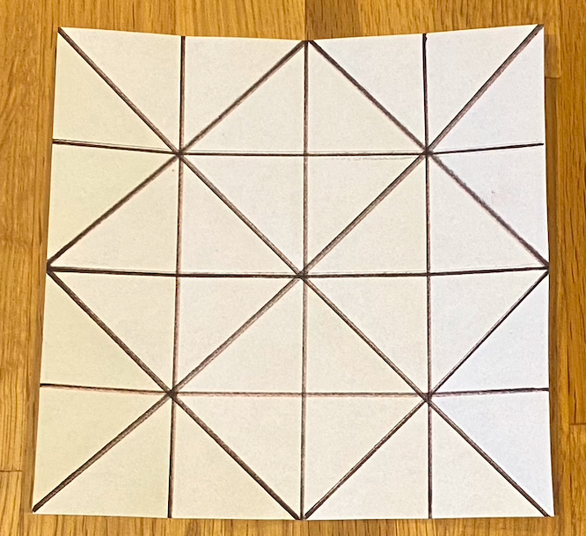
Challenge 2
Take another square of paper, and fold it using these lines to guide you.
What ratios of colour to white can you make by only folding along these lines?

Slide 6
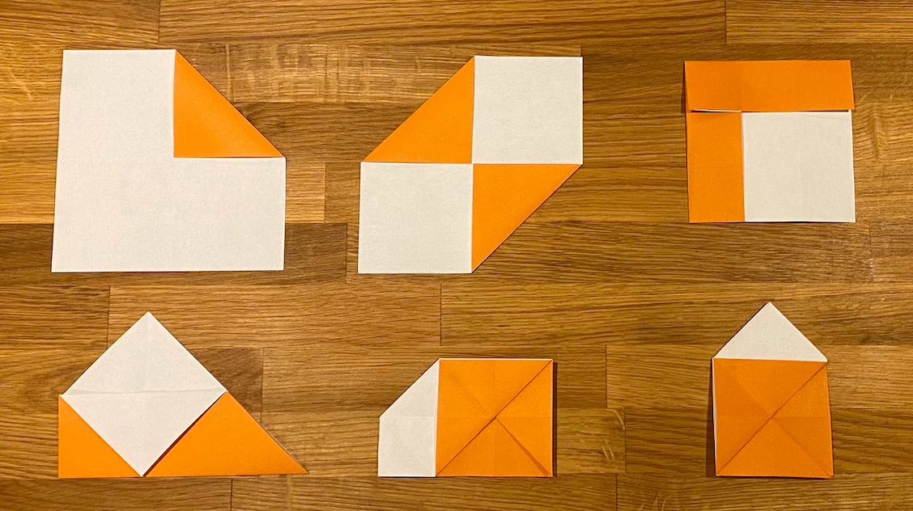
Challenge 2 - Gallery
Can you find the ratio of colour to white in each picture?

Slide 7

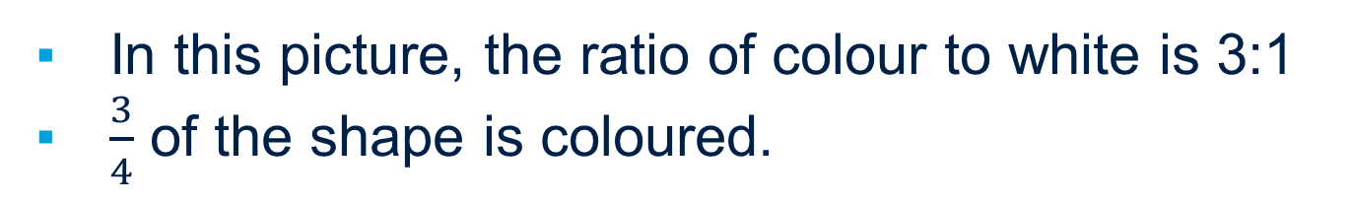
Challenge 3
In this picture, the ratio of colour to white is 3:1
$\frac{3}{4}$ of the shape is coloured.
Can you fold a square of paper to make an
L shape like this?

Slide 8
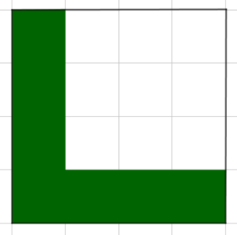
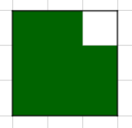
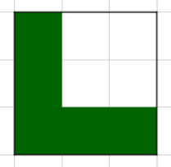
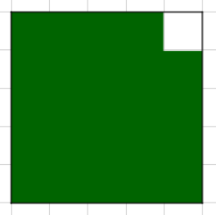
Challenge 3
Can you work out how to fold each L shape?
When you unfold each L, into what ratios do the folds divide the sides of the square?

Slide 9
About MEI
Registered charity committed to improving mathematics education
Independent UK curriculum development body
We offer continuing professional development courses, provide specialist tuition for students and work with employers to enhance mathematical skills in the workplace
We also pioneer the development of innovative teaching and learning resources

