Slide 2

Get Calculating! Lesson 3
Would you rather have …
This percentage or that one?
This fraction or that one?
This percentage or that fraction?

Slide 3
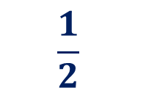
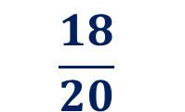
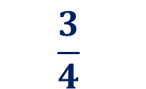
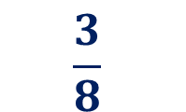
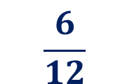
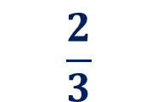
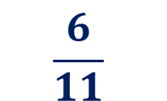
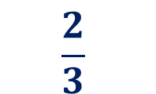
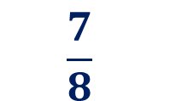

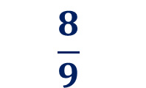
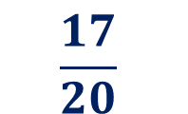
Starter 1
Put the correct symbol in the circle between each pair (< or >)
$$\frac{6}{11}$$
$$\frac{6}{12}$$
$$\frac{17}{20}$$
$$\frac{18}{20}$$
$$\frac{8}{9}$$
$$\frac{7}{8}$$
$$\frac{1}{2}$$
60%
$$\frac{2}{3}$$
$$\frac{3}{8}$$
75%
25%
$$\frac{3}{4}$$
$$\frac{3}{8}$$
$$\frac{2}{3}$$
50%

Slide 4
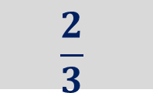
Starter 2
Change either side of each grey one to make the values equal
$$\frac{6}{11}$$
$$\frac{6}{12}$$
$$\frac{17}{20}$$
$$\frac{18}{20}$$
$$\frac{8}{9}$$
$$\frac{7}{8}$$
$$\frac{1}{2}$$
60%
$$\frac{2}{3}$$
$$\frac{3}{8}$$
75%
25%
$$\frac{3}{4}$$
$$\frac{3}{8}$$
$$\frac{2}{3}$$
50%
Notes:
Change either side or encourage pupils to give more than one way of making the statement equal

Slide 5
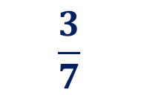
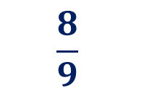
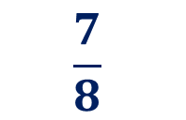
Starter 1 - solution
Put the correct sign between each pair: < or >
$$\frac{6}{11}$$
>
$$\frac{6}{12}$$
$$\frac{17}{20}$$
$$\frac{18}{20}$$
<
$$\frac{7}{8}$$
<
$$\frac{8}{9}$$
$$\frac{1}{2}$$
<
60%
>
$$\frac{2}{3}$$
$$\frac{3}{8}$$
75%
25%
<
$$\frac{3}{7}$$
>
$$\frac{3}{8}$$
$$\frac{2}{3}$$
>
50%

Slide 6
Would you rather have …
20% of £20
10% of £80
or

Slide 7
Would you rather have …
20% of £20
10% of £80
or
What is the whole amount in each case?

Slide 8
Would you rather have …
20% of £20
10% of £80
or
What is the whole amount in each case?
We need to find and compare 20% of £20 with 10% of £80

Slide 9
Would you rather have …
20% of £20
10% of £80
or
What could you draw to represent the whole and then the part you want?

Slide 10
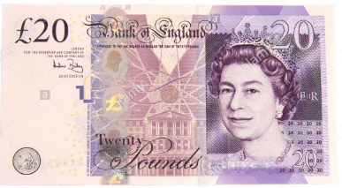
Would you rather have …
20% of £20
10% of £80
or
Does this representation help you to solve the problem?

Slide 11
Would you rather have …
20% of £20
10% of £80
or
What about this?
£20
£80
£20
£20
£20
£20

Slide 12
Would you rather have …
20% of £20
10% of £80
or
How would you show 20% of £20?
How many 20% are there in 100% (the whole)?
£20
How would you show 10% of £80? How many 10% are there in 100%?
£80

Slide 13
Would you rather have …
20% of £20
10% of £80
or
How would you show 20% of £20?
How many 20% are there in 100% (the whole)?
£20
£20
20%
How would you show 10% of £80? How many 10% are there in 100%?
£80

Slide 14
Would you rather have …
20% of £20
10% of £80
or
How would you show 20% of £20?
How many 20% are there in 100% (the whole)?
£20
£20
20%
How would you show 10% of £80? How many 10% are there in 100%?
£80
10%
Notes:
These images are proportional

Slide 15
Would you rather have …
20% of £20
10% of £80
or
How would you show 20% of £20?
How many 20% are there in 100% (the whole)?
Which would you rather have?
How do you know that is the best deal?
£20
£20
20%
How would you show 10% of £80? How many 10% are there in 100%?
£80
10%
Notes:
These images are proportional

Slide 16
What do you notice?
20% of £20
10% of £80
or
£20
20%
£80
10%

Slide 17
What do you notice?
20% of £20
10% of £80
or
£20
20%
£80
10%
This time we have to calculate the percentages as the £20 and £80 are represented by the same sized bar. We can’t just compare the bars.

Slide 18
What do you notice?
20% of £20
10% of £80
or
£20
10% | 10%
20%
£80
10%
This is another way to think about finding 20% of £20 by finding 10% and doubling it.

Slide 19
Would you rather have …
20% of £20 or 12% of £80?
How can we calculate 12% of an amount?
How could we use a calculator to work out 12% of £80?
Which calculations would we need to do?
Is there another way of finding 12%?

Slide 20
Would you rather have …
60% of £20 or 40% of £80?
£20
£80
What does each small section represent?
How would you calculate what that section of the bar is worth?

Slide 21
Would you rather have …
60% of £20 or 40% of £80?
£20
10%
10%
10%
10%
10%
10%
£80
10%
10%
10%
10%
Each small section represents 10%
How many of those sections do we need in each bar?

Slide 22
Would you rather have …
60% of £20 or 40% of £80?
£20
10%
10%
10%
10%
10%
10%
If 10% of £20 is equal to ______
Then 60% is equal to six times _____ which is _______
£80
10%
10%
10%
10%
If 10% of £80 is equal to ______
Then 40% is equal to four times _____ which is _______

Slide 23
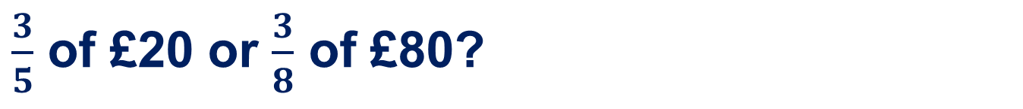
Would you rather have …
$\frac{3}{5}$ of £20 or $\frac{3}{8}$ of £80?
£20
£80
What does each small section represent?
How would you calculate what that section of the bar is worth?

Slide 24

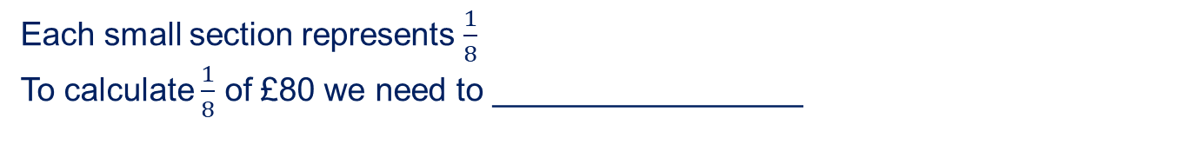
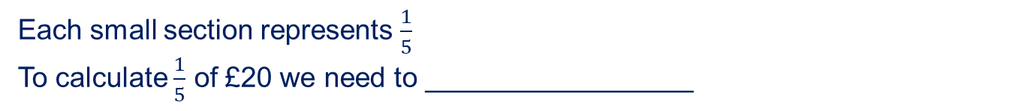
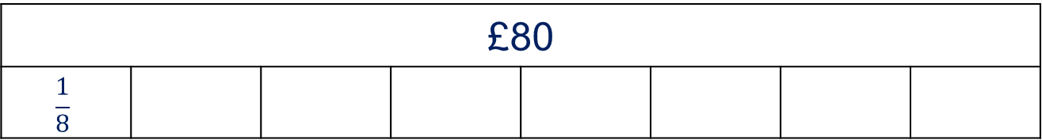
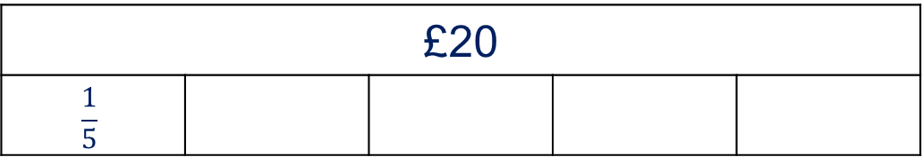
Would you rather have …
$\frac{3}{5}$ of £20 or $\frac{3}{8}$ of £80?
£20
$$\frac{1}{5}$$
Each small section represents $\frac{1}{5}$
To calculate $\frac{1}{5}$ of £20 we need to _________________
£80
$$\frac{1}{8}$$
Each small section represents $\frac{1}{8}$
To calculate $\frac{1}{8}$ of £80 we need to _________________

Slide 25
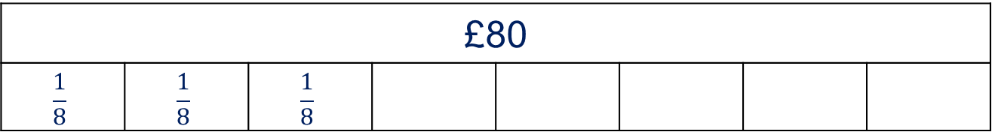
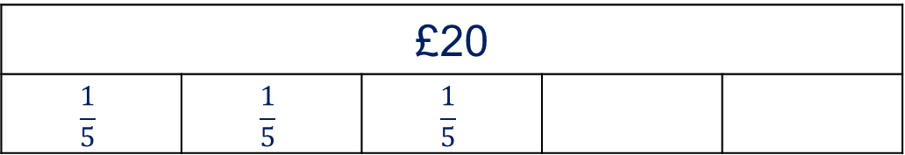
Would you rather have …
$\frac{3}{5}$ of £20 or $\frac{3}{8}$ of £80?
£20
$$\frac{1}{5}$$ | $$\frac{1}{5}$$ | $$\frac{1}{5}$$
If $\frac{1}{5}$ of £20 is equal to _____ then $\frac{3}{5}$ will be three times _____ which is _____
£80
$$\frac{1}{8}$$ | $$\frac{1}{8}$$ | $$\frac{1}{8}$$
If $\frac{1}{8}$ of £20 is equal to _____ then $\frac{3}{8}$ will be three times _____ which is _____

Slide 26
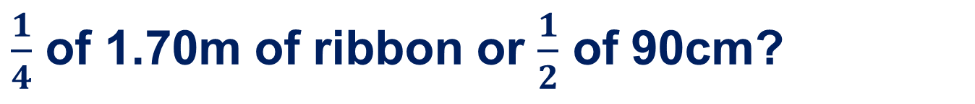
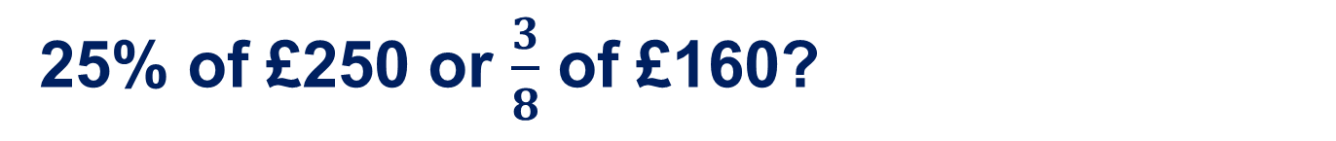
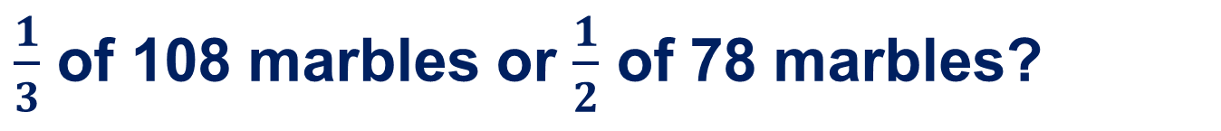
Would you rather have … (1)
20% of £20 or 5% of £80?
$\frac{1}{4}$ of 1.70m of ribbon or $\frac{1}{2}$ of 90cm?
$\frac{1}{3}$ of 108 marbles or $\frac{1}{2}$ of 78 marbles?
25% of £250 or $\frac{3}{8}$ of £160?
What calculations would you have to do on the calculator?
What if the answer is a decimal?
Notes:
Solution:
£4 or £4
42.5cm or 45cm
36 or 39
£62.50 or £60

Slide 27
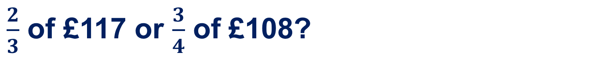
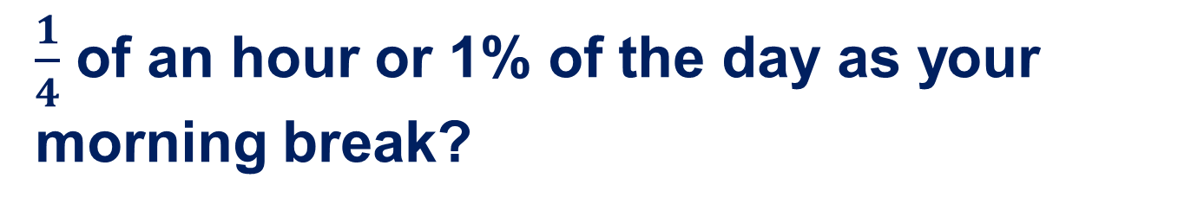
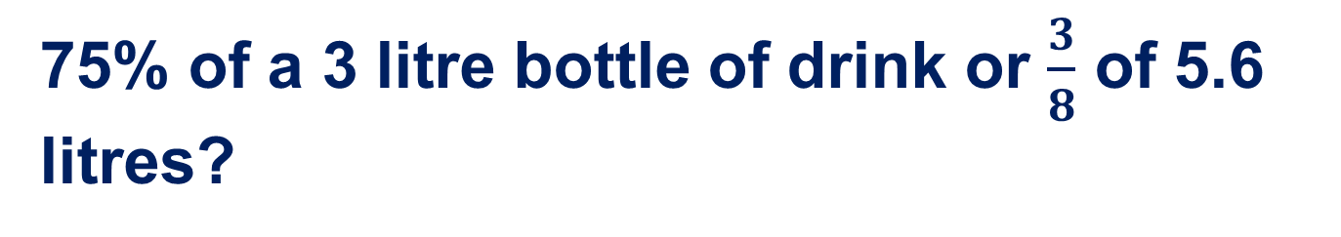
Would you rather have … (2)
20% of 325cm of ribbon or 12% of 5m?
$\frac{1}{4}$ of an hour or 1% of the day as your morning break?
$\frac{2}{3}$ of £117 or $\frac{3}{4}$ of £108?
75% of a 3 litre bottle of drink or $\frac{3}{8}$ of 5.6 litres?
What calculations would you have to do on the calculator?
What if the answer is a decimal?
Notes:
65cm or 60cm
15 mins or 14.4 mins
£78 or £81
2250ml or 2100ml

Slide 28
Bar models

Slide 29
Reflection
What do we calculate when we:
Divide something by 4
Halve a value
Divide by 10 then multiply by 3
Divide by five and then double
Divide by 3
Divide by 100 and then multiply by 10
Divide by 10?

Slide 30
Extra challenge!
Write your own ‘Would you rather have …’ problem
What values will you start with?
How can you make the answers as close together as possible?
Could you work backwards from the answer you want?
How might a bar model help you here?
How can you use the calculator to help you?

Slide 31
I think ….
When you are discussing your work, use these to explain what you are thinking …
It could be this because …
It can’t be this because …
This answer represents …
If we do this then …
The answer has a decimal which means …
Dividing by 4 will calculate …
If we find a tenth or 10% then we can …
This fraction is the same as this percentage so …

Slide 32
About MEI
Registered charity committed to improving mathematics education
Independent UK curriculum development body
We offer continuing professional development courses, provide specialist tuition for students and work with employers to enhance mathematical skills in the workplace
We also pioneer the development of innovative teaching and learning resources

