Slide 2



Year 6 Calculator Challenge Lesson
Notes:
Images from Casio – a non and a scientific calculator
Images of calculator keys to use on different slides

Slide 3
Getting to know your calculator
Look at your calculator
Are the numbers the same as on a phone?
Where else do you see numbers arranged like this?
Any questions?

Slide 4
Is once enough? Warm up
Round these numbers to the nearest …
0.51
150
510
105
10.5
501
1.05
Which of these totals do you think is correct? Why?
1677
1278.06
1087.51
1276.06
What do you notice about these numbers?
What do you estimate the total of all the numbers will be?
How many digits will be after the decimal point?
Use the ‘I think ….’ prompts as you discuss your work with a partner
Notes:
The possible totals appear on a click after the pupils have had a chance to round the numbers in the list

Slide 5
Is once enough?
Estimate the sum of these groups of numbers.
Work it out using a calculator.
How can you be sure you have the right answer?
1 | 2 | 3 | 4 | 5
4.5 3.5 5.5 6.5 0.5 2.5 1.5 | 0.1 0.5 0.7 0.9 0.2 0.4 0.8 | 2005 2050 5002 2500 5020 5200 2500 | 10.3 103 301 3.01 30.1 310 130 | 233 232 323 23.2 22.3 32.2 32.3
Is it: 25 24.5 24.05 23.5 | Is it: 3.8 3.7 3.5 3.6 | Is it: 25,272 24,275 22,277 24,277 | Is it: 914.5 1549 887.41 887.31 | Is it: 898 897.8 1106.8 1898
Use the ‘I think ….’ prompts as you discuss your work with a partner

Slide 6
Take 3!
Using 3 of these numbers and the + operation key, can you complete these calculations?
How may attempts does it take you to get the right combination?
The fewest attempts wins!
47 | 19 | 27 | 33 | 78
____ | + | ____ | + | ____ | = | 144
____ | + | ____ | + | ____ | = | 79
____ | + | ____ | + | ____ | = | 158
____ | + | ____ | + | ____ | = | 130
____ | + | ____ | + | ____ | = | 138
Use the ‘I think ….’ prompts as you discuss your work with a partner

Slide 7

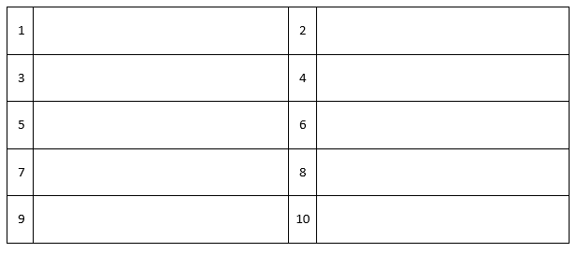

Say ‘hello!’
Typing 0.1134 and turning the calculator upside-down means that you write the word
Write 10 different calculations which will give 0.1134 as an answer.
You must use all of the operations at some point.
Can you combine the operations?
0.1134

Slide 8
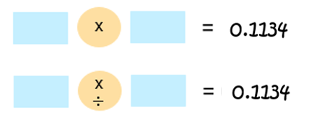
Say ‘hello!’ … again
Given that 1134 = 2 x 3 x 3 x 3 x 3 x 7, how many pairs of numbers can you find that multiply to give 1134?
How can you adapt these pairs to get the answer 0.1134?
Which of these expressions have a value of 0.1134?
Change any which don’t so that they do. Can you write any more?
1.8 x 0.063
0.18 x 0.63
0.09 x 0.126
0.00014 x 81
2.7 x 0.042
14 x 0.0081
Notes:
Change image

Slide 9
I think ….
When you are working with a friend, use these to explain what you are thinking …
It could be this because …
It can’t be this because …
This total is 20 more than this one so …
The sum of these numbers is a multiple of 10 so …
If we do this then …
I wonder what will happen if …
I know this so …
It’s an even number …
It’s bigger than …
… if we multiply by 10 then …
It’s smaller than …
… the answer has to be …
It’s an odd number …

Slide 10
About MEI
Registered charity committed to improving mathematics education
Independent UK curriculum development body
We offer continuing professional development courses, provide specialist tuition for students and work with employers to enhance mathematical skills in the workplace
We also pioneer the development of innovative teaching and learning resources

