Slide 2

Get Calculating! Lesson 4
What is a fraction?
A fraction is a piece of pizza!
Are fractions like division?
Fractions are about equal parts.

Slide 3
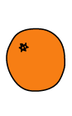
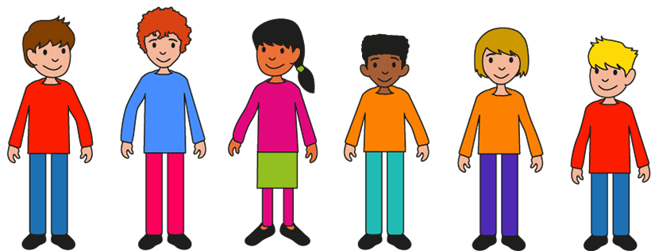
Equal shares – make it fair!
Four friends share four oranges.
How much of an orange do they each get?

Slide 4
Equal shares – make it fair!
Now four friends share three oranges.
What can you say to your partner about the problem now?

Slide 5
Equal shares – make it fair!
Now four friends share three oranges.
How much of an orange do they each get?
How can you use the picture of the oranges to help?
___ oranges shared between ­­­___ friends mean that each person gets ­____ of an orange each.

Slide 6
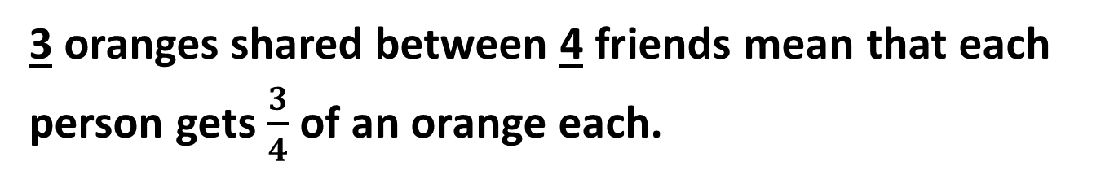
Equal shares – make it fair!
Now Four friends share three oranges.
How much of an orange do they each get?
Does dividing the oranges like this help?
How else could you do it?
3 oranges shared between ­­­4 friends mean that each person gets ­$\frac{3}{4}$ of an orange each.

Slide 7
Equal shares – make it fair!
Now Four friends share three oranges.
How much of an orange do they each get?
Does dividing the oranges like this help?
Explain your thinking to your partner.
3 oranges shared between ­­­4 friends mean that each person gets ­$\frac{3}{4}$ of an orange each.

Slide 8
Equal shares – make it fair!
Choose different numbers of oranges and different numbers of friends (up to 8 for each).
How much do they each get when they divide up the oranges equally?
___ oranges shared between ­­­___ friends mean that each person gets ­____ of an orange each.
How can you use the pictures of the oranges to help you?

Slide 9
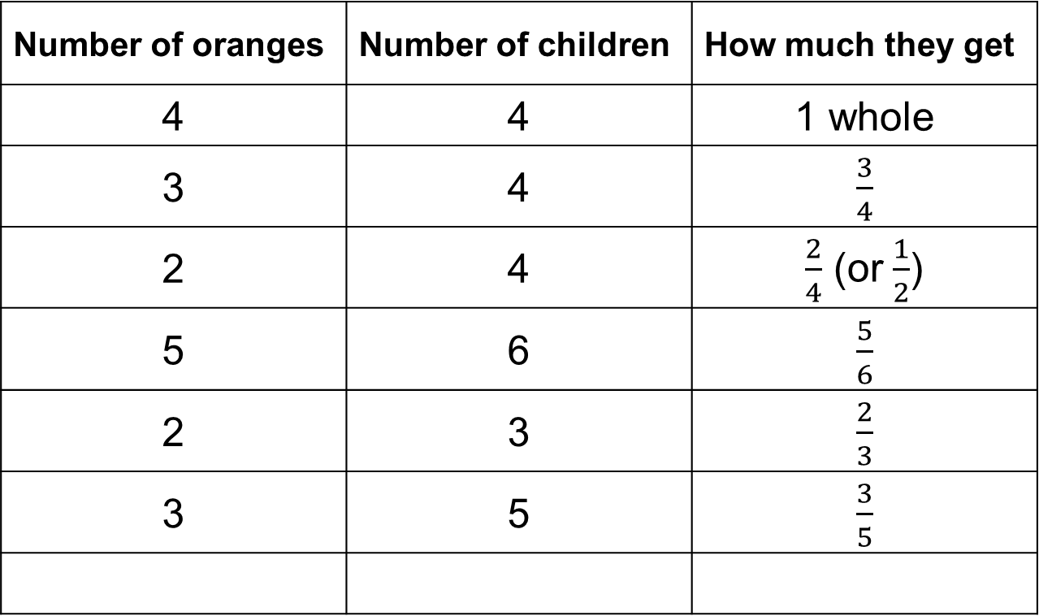
Equal shares – make it fair!
What do we notice?
Number of oranges | Number of children | How much they get
4 | 4 | 1 whole
3 | 4 | $\frac{3}{4}$
2 | 4 | $\frac{2}{4}$ (or $\frac{1}{2}$)
5 | 6 | $\frac{5}{6}$
2 | 3 | $\frac{2}{3}$
3 | 5 | $\frac{3}{5}$

Slide 10
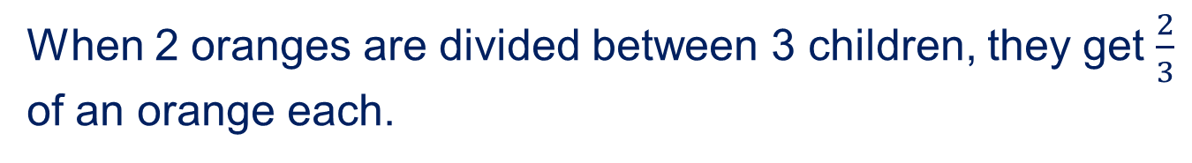
Equal shares – make it fair!
What do we notice?
When 2 oranges are divided between 3 children, they get $\frac{2}{3}$ of an orange each.
2
3

Slide 11

Equal shares – make it fair!
What do we notice?
When 2 oranges are divided between 3 children, they get $\frac{2}{3}$ of an orange each.
2
3
The numerator is ….
The denominator is …

Slide 12



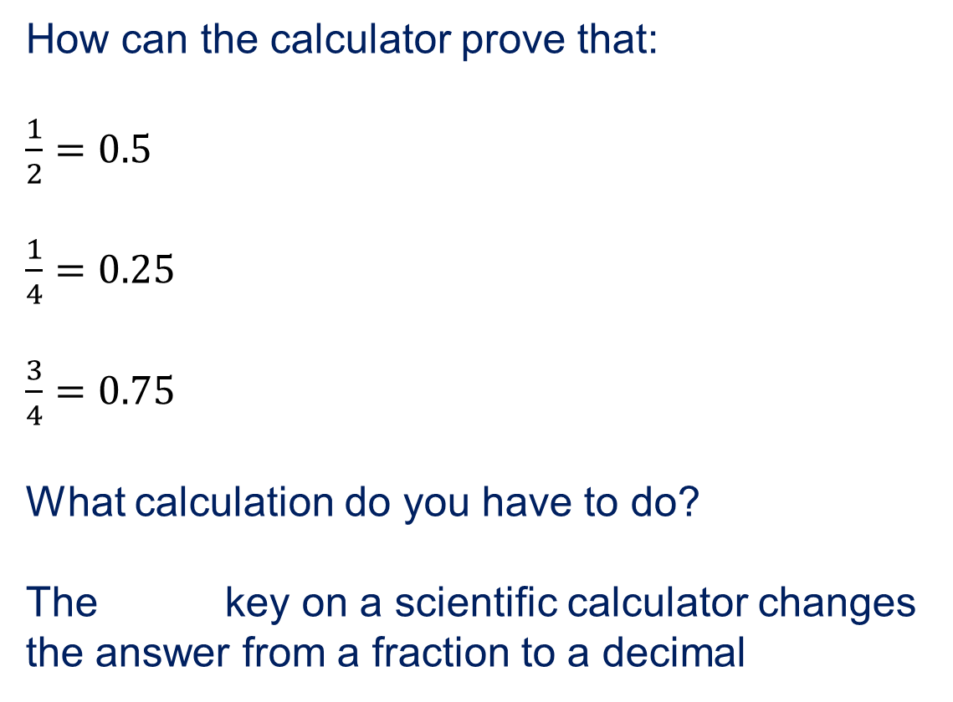
Using a calculator
How can the calculator prove that:
$\frac{1}{2}=0.5$
$\frac{1}{4}=0.25$
$\frac{3}{4}=0.75$
What calculation do you have to do?
The key on a scientific calculator changes the answer from a fraction to a decimal

Slide 13
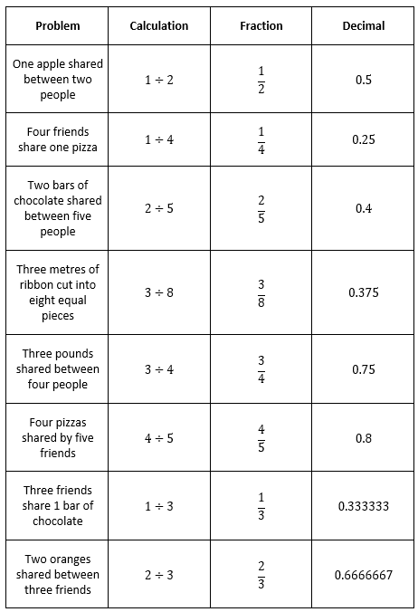
Summary 1 - solutions

Slide 14

Summary 2
Write a story to go with each fraction.
Use words such as:
Shared between, divided between, split into …
$$\frac{5}{9} \frac{1}{4} \frac{2}{3} \frac{3}{7} \frac{5}{6}$$
Order the fractions from smallest to largest.
How could you use a calculator to order the fractions?
Why does this work?

Slide 15
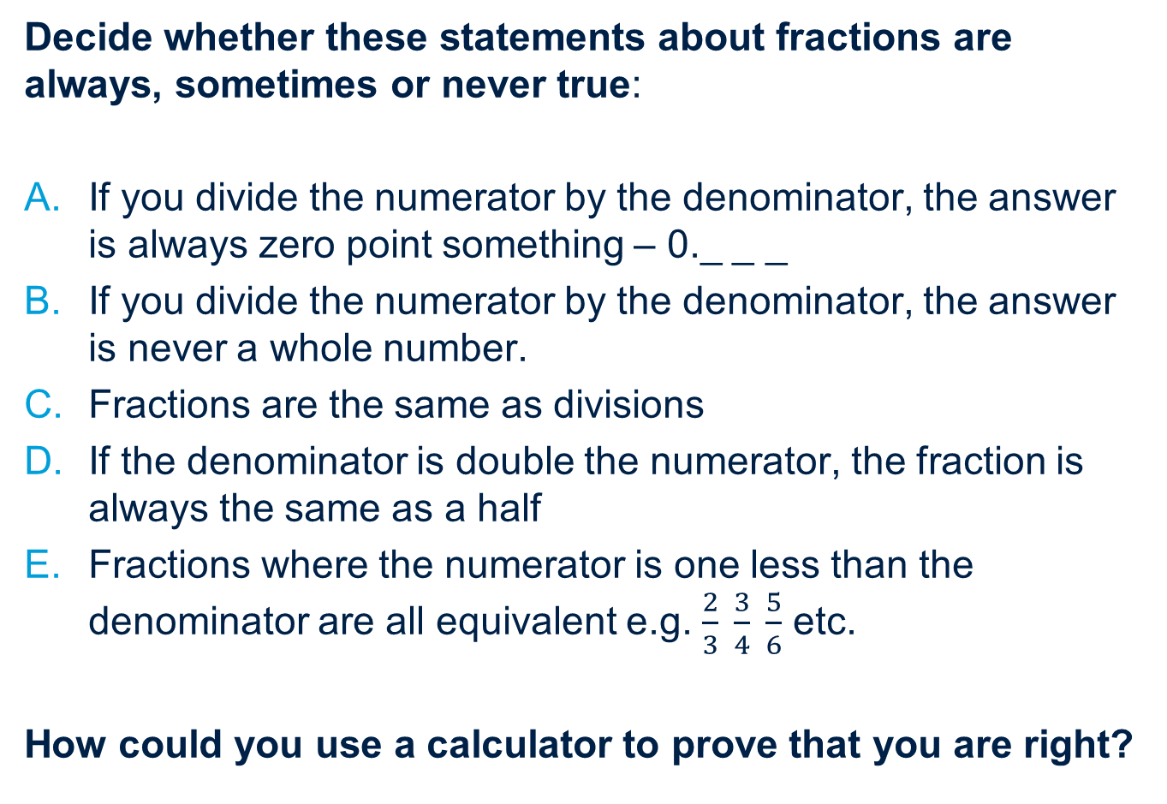
Always, sometimes, never true
Decide whether these statements about fractions are always, sometimes or never true:
If you divide the numerator by the denominator, the answer is always zero point something – 0._ _ _
If you divide the numerator by the denominator, the answer is never a whole number.
Fractions are the same as divisions
If the denominator is double the numerator, the fraction is always the same as a half
Fractions where the numerator is one less than the denominator are all equivalent e.g. $\frac{2}{3} \frac{3}{4} \frac{5}{6}$ etc.
How could you use a calculator to prove that you are right?

Slide 16
Extra challenge!
The Chocolate activity on the NRICH website provides another opportunity to think about fractions as divisions.
https://nrich.maths.org/34

Slide 17
About MEI
Registered charity committed to improving mathematics education
Independent UK curriculum development body
We offer continuing professional development courses, provide specialist tuition for students and work with employers to enhance mathematical skills in the workplace
We also pioneer the development of innovative teaching and learning resources

