Slide 2
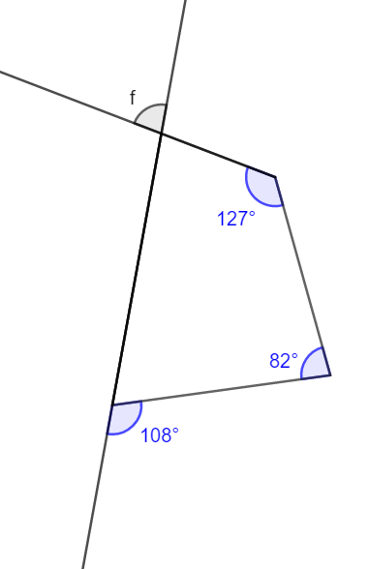



Angle-poise!

Slide 3
Internal Angle Mangle!
Sort the cards into four sets of four that are the internal angles different quadrilaterals and four sets of three that are the internal angles of different triangles.
What do you know about the internal angles of:
Quadrilaterals
Triangles?
How will you go about sorting the cards into sets?

Slide 4
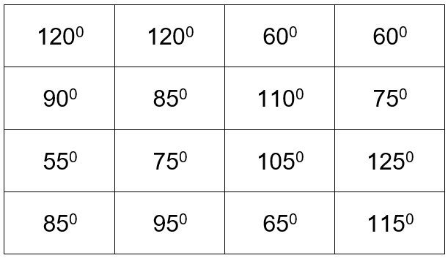
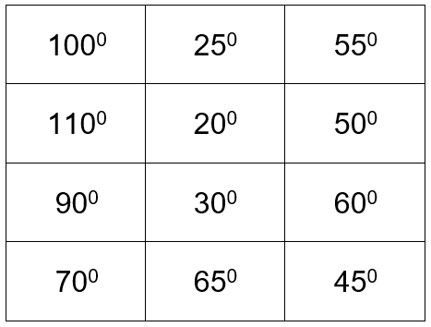
Angles match solutions
Quadrilaterals
Triangles

Slide 5
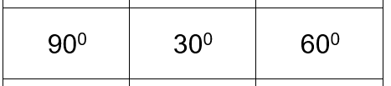
Angles match shapes
What shape could this be?
What shapes could it definitely not be and why?
Sketch the shape you think it is.
Is your sketch the same as everyone else’s?
Can you all be right?
What other information would you need to know that your shape was the correct one?
What about this triangle?

Slide 6
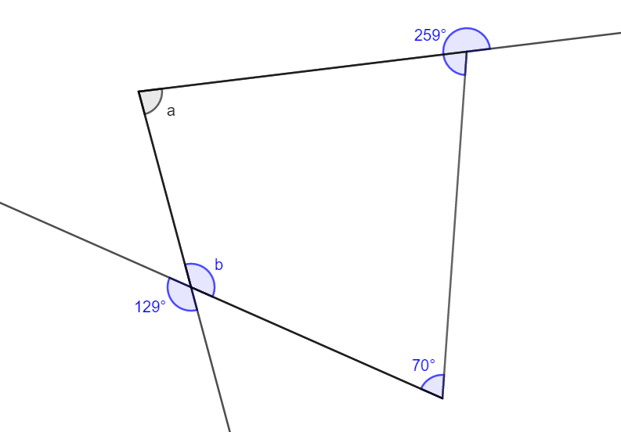
Missing angle expressions
Calculate angle a
What do you know about the shape?
What do you know that can help you to work out the missing angle?
How could you use the calculator to work out angle a in one calculation?
Notes:
360 – (259 – 180) – (70 + 129) =

Slide 7
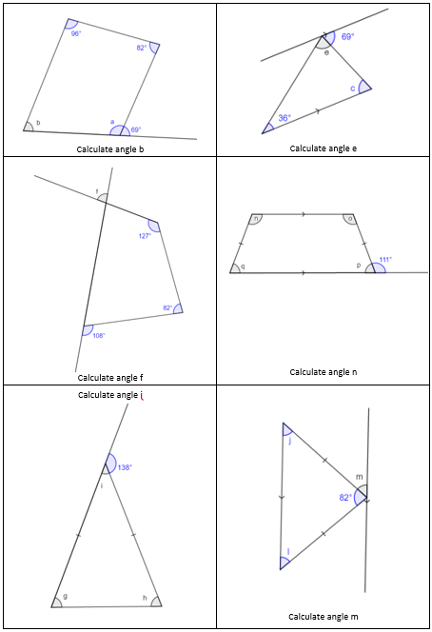
Missing angle expressions
What do you know that will help you to work out the missing angles and calculate the value of each identified angle?

Slide 8
Construction Site
Do you have enough information to construct just one unique shape?
Which angles do you know about?
Which sides do you know about?
Can you sketch the shape and label the sides and angles?
What equipment would you need to construct the shape accurately?
If you can’t construct the shape, what extra information is needed?

Slide 9
About MEI
Registered charity committed to improving mathematics education
Independent UK curriculum development body
We offer continuing professional development courses, provide specialist tuition for students and work with employers to enhance mathematical skills in the workplace
We also pioneer the development of innovative teaching and learning resources

