Slide 2




Year 7 Calculator Lesson
Rec-tangle

Slide 3

Order the shapes by their area and their perimeter
What do you notice?

Slide 4
What is the difference between area and perimeter?
The area of a shape is …
Area is measured in …
The perimeter of a shape is …
Perimeter is measured in …

Slide 5
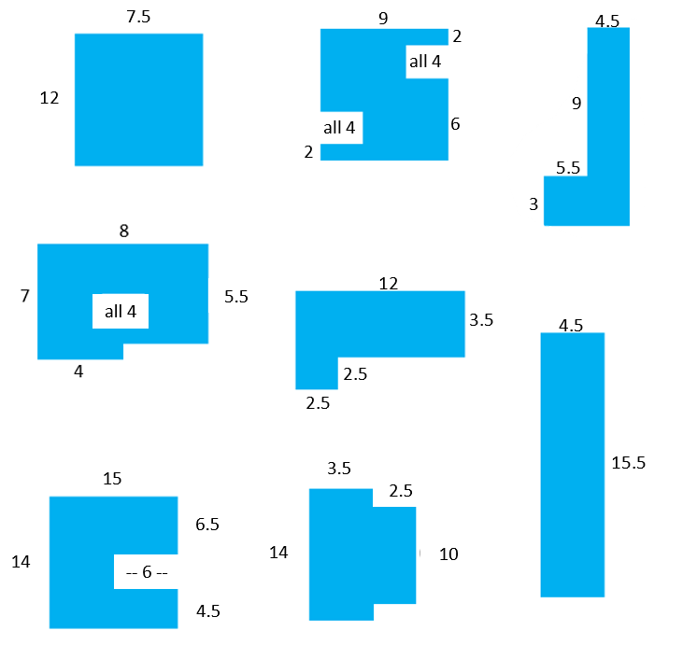
Calculate areas and perimeters

Slide 6
If the area of a rectangle is 48cm², what could the dimensions be?
Same area; different perimeter

Slide 7
If the areas are all 48cm², what could the missing dimensions be?
Same area; different perimeter
1.5 cm
? cm
5 cm
? cm
? cm
Not to scale
7 cm

Slide 8
If the perimeter of a rectangle is 48cm, what could the dimensions be?
What will the area be in each case?
Same perimeter; different area

Slide 9
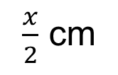
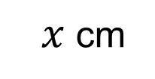
If the perimeter is 48cm, what are the missing values?
Same perimeter; different area
7.5 cm
? cm
? cm²
$x$cm
Not to scale
$\frac{x}{2}$ cm
? cm²

Slide 10
Higher or Lower!
Draw a rectangle with an area of 48cm² and a perimeter of 32cm.
Higher
Lower
Area
Re-draw the rectangle still with an area of 48cm² but with a perimeter of less than 32cm.
Perimeter

Slide 11
I think ….
When you are working with a friend, use these to explain what you are thinking …
It could be this because …
It can’t be this because …
If we do this then …
I wonder what will happen if …
I know this so …
The area will be bigger/smaller because …
The perimeter will be bigger/smaller because …
The calculation we need to do is ____ because …

Slide 12
About MEI
Registered charity committed to improving mathematics education
Independent UK curriculum development body
We offer continuing professional development courses, provide specialist tuition for students and work with employers to enhance mathematical skills in the workplace
We also pioneer the development of innovative teaching and learning resources

