Slide 2

Where’s the maths in that?
London Edition
Notes:
https://pixabay.com/vectors/london-panorama-tower-bridge-311833/

Slide 3
Using the slides
Simply display a photograph and ask
  “Where is the Maths in that?”
  “What do you notice? What do you wonder?”
Let the ideas flow!
There are suggestions in the notes and prompts on the slide following each picture - but these are by no means exhaustive. We’d love to hear your ideas too!

Slide 4
Using the slides
Aim to show…
  Maths is all around us
  Maths is creative
  Maths is not always about being right or wrong
Emphasise…
  Nobody can be wrong
  Just explain your thoughts
  Going further…why not use your own or your students’ photographs?

Slide 5
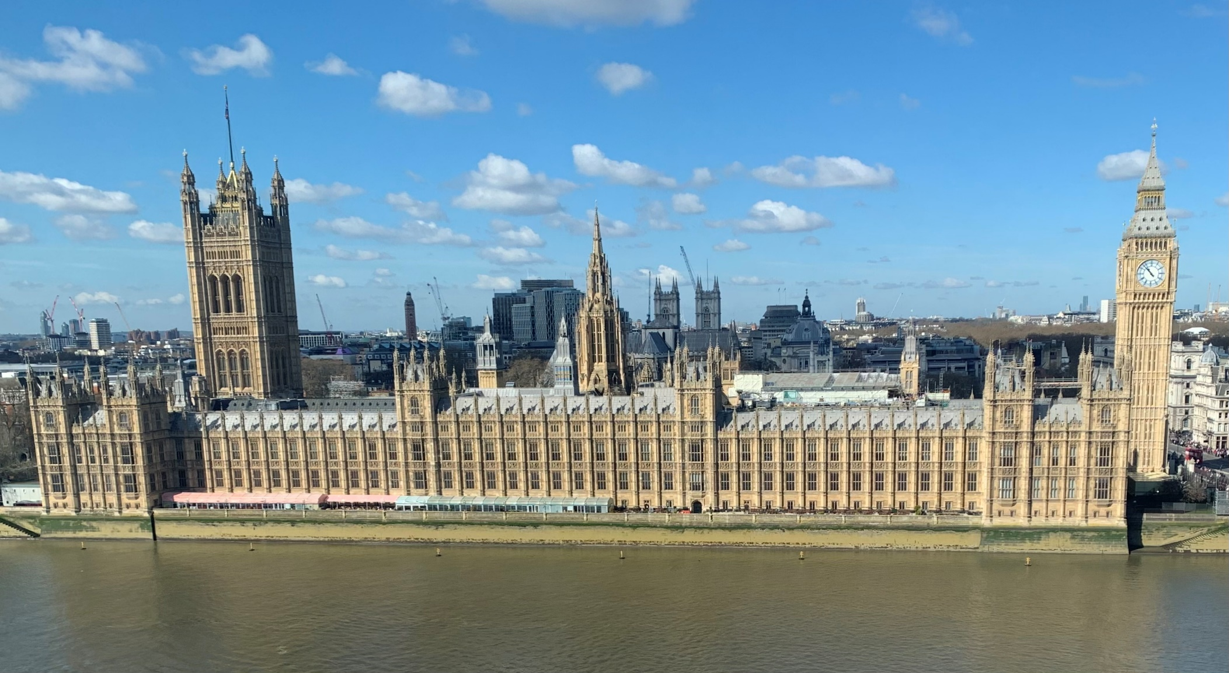
Notes:
The Houses of Parliament and Big Ben (Elizabeth Tower)
Discussion ideas:
Where is this?
How many windows? How long do you think it takes to clean them all?
How does a general election work? Do you think it is a fair method?
How many MPs are there? What is the breakdown by gender, party, ethnicity, age etc
Estimate the dimensions of the buildings
How much do you think upkeep would cost?
How much are the bars/ restaurants subsidized?
How does voting in the house work?

Slide 6
How many windows?
How long does it take to clean them all?
How tall is the Elizabeth Tower (Big Ben)?
How big is the clock face?
How many ‘bongs’ does it do in a day?
How many MPs?
What is the breakdown by gender, ethnicity etc?
How does voting work in the house?
How do elections work?
Is it fair?
Notes:
Discussion ideas:
Where is this?
How many windows? How long do you think it takes to clean them all?
How does a general election work? Do you think it is a fair method?
How many MPs are there? What is the breakdown by gender, party, ethnicity, age etc
Estimate the dimensions of the buildings
How much do you think upkeep would cost?
How much are the bars/ restaurants subsidized?
How does voting in the house work?

Slide 7
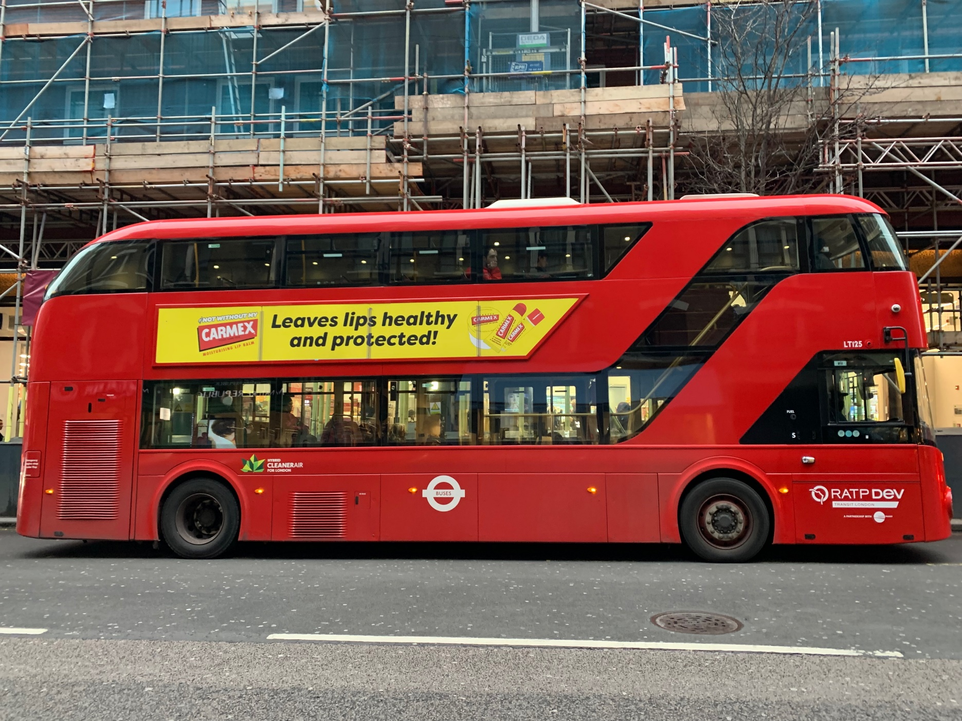
Notes:
Discussion ideas
How long do you think a London bus is?
How many people fit on at a time?
Look at a bus times app and investigate a route.
Use a double-decker bus as a unit of measure eg
How tall is the Elizabeth Tower in double decker buses?
Tim Harford and Matt Parker video: https://youtu.be/esC4HB-AjgI
Fermi estimate – how many buses are there in London?

Slide 8
How many people fit on a double-decker bus?
How long and high do you think a double-decker bus is?
How much money does a bus take in fares each day?
How much do they cost to run?
Notes:
Discussion ideas
How long do you think a London bus is?
How many people fit on at a time?
Look at a bus times app and investigate a route.
Use a double-decker bus as a unit of measure eg
How tall is the Elizabeth Tower in double decker buses?
Tim Harford and Matt Parker video: https://youtu.be/esC4HB-AjgI
Fermi estimate – how many buses are there in London?

Slide 9
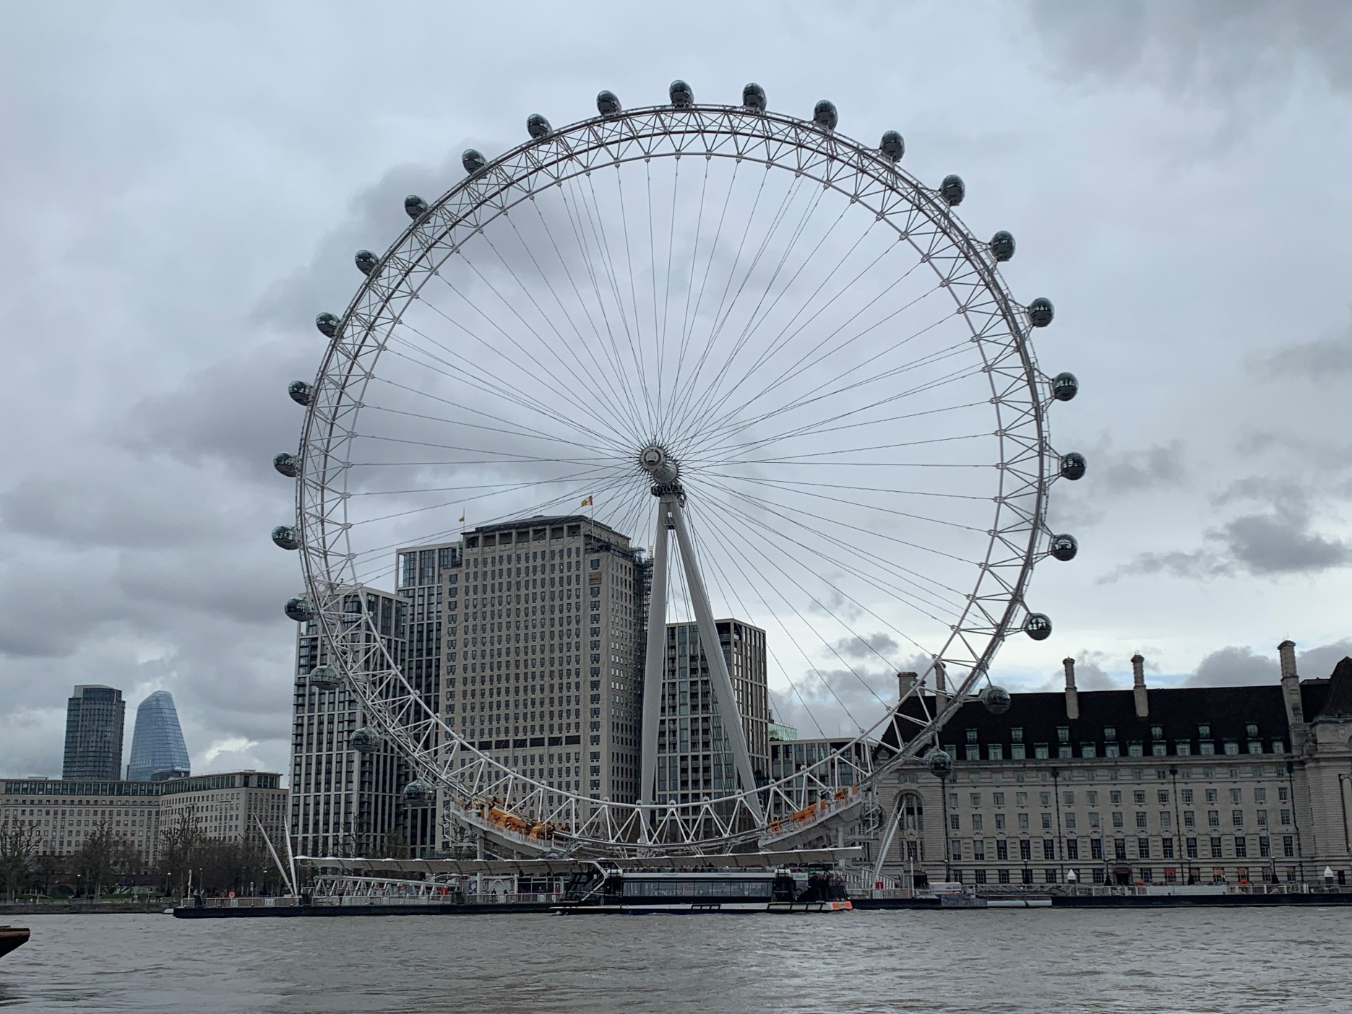
Notes:
The London Eye
Discussion ideas:
How many pods do you think there are?
How long does it take to go round?
How many people fit in a pod? How many people travel in a day.
Radius/ circumference - how far do you travel in a pod?
How many double-decker buses high? (135m)
Costs of tickets and cost to build/maintain
https://www.london-tickets.co.uk/london-eye-facts/

Slide 10
What is the diameter?
How many pods?
How long does a ride take?
How many people travel on it in a day?
Notes:
The London Eye
Discussion ideas:
How many pods do you think there are?
How long does it take to go round?
How many people fit in a pod? How many people travel in a day.
Radius/ circumference - how far do you travel in a pod?
How many double-decker buses high? (135m)
Costs of tickets and cost to build/maintain
https://www.london-tickets.co.uk/london-eye-facts/

Slide 11
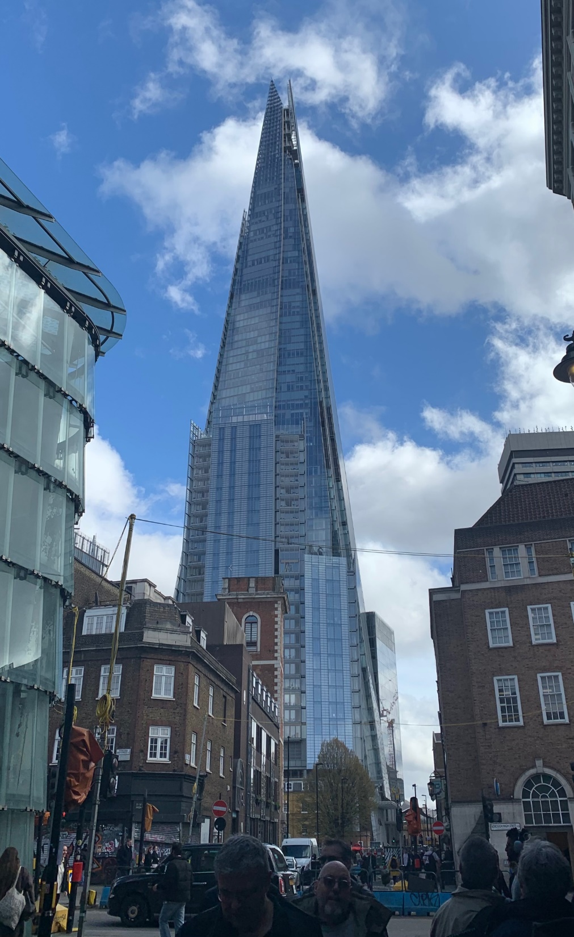
Notes:
Discussion ideas
How high do you think the Shard is? How does it compare to other London landmarks?
How many double-decker buses high?
How much glass do you think there is?
https://londonpass.com/en-us/blog/facts-about-the-shard

Slide 12
How tall is the Shard?
How many windows?
How many floors?
Notes:
Discussion ideas
How high do you think the Shard is? How does it compare to other London landmarks?
How many double-decker buses high?
How much glass do you think there is?
https://londonpass.com/en-us/blog/facts-about-the-shard

Slide 13
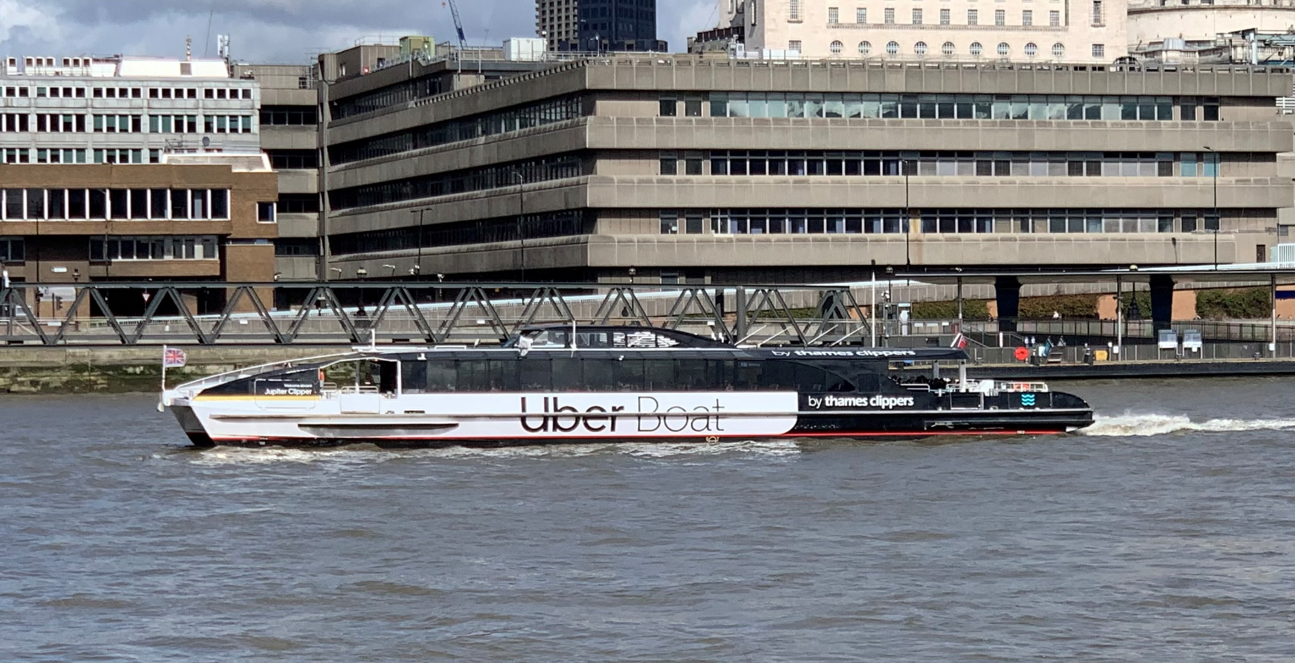
Notes:
Uber Boat
Discussion ideas:
Uber boat. Can link with next slide.
How many people do you think fit on a boat?
How far do you think an Uber boat travels in a day?
How much money does an Uber boat take per day?
How fast does it travel?
How does it compare to other transportation methods?

Slide 14
How fast does an Uber boat travel?
How far does an Uber boat travel in a day?
How does the cost of travelling by Uber boat compare with other methods of transport?
Notes:
Uber Boat
Discussion ideas:
Uber boat. Can link with next slide.
How many people do you think fit on a boat?
How far do you think an Uber boat travels in a day?
How much money does an Uber boat take per day?
How fast does it travel?
How does it compare to other transportation methods?

Slide 15
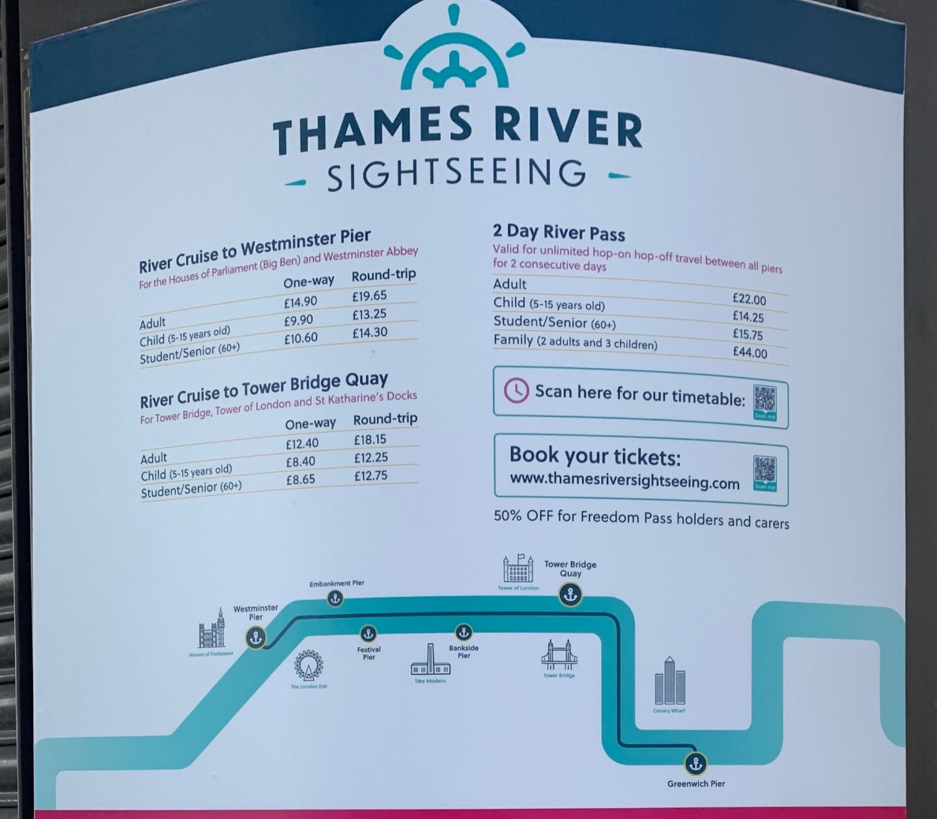

Notes:
Discussion ideas:
What could you do with this information?
What else do you want to know?
Plan a boat trip. Search it up. How long would it take? How much would it cost?

Slide 16
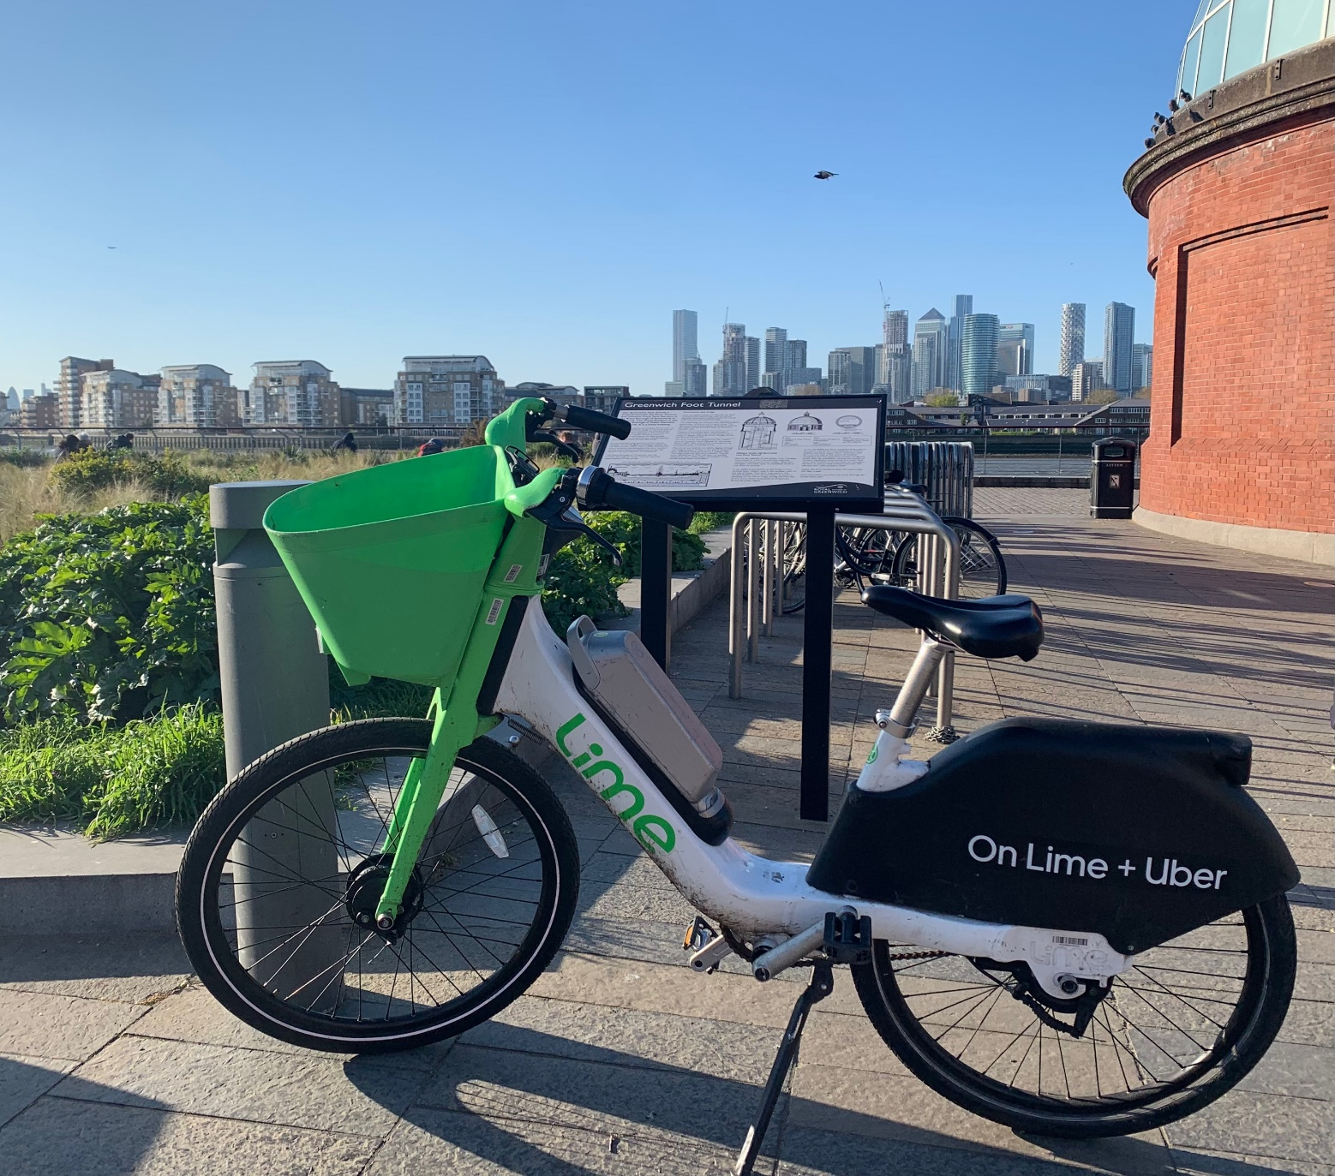
Notes:
Discussion ideas:
(Use with the next slide)
Compare prices of the different bike options
Eg https://www.cyclist.co.uk/reviews/ridden-and-rated-ultimate-guide-to-london-s-bike-sharing-rental-bicycles
How does this compare to costs of other methods of transport?
How much does it help with your carbon footprint travelling by bike?

Slide 17
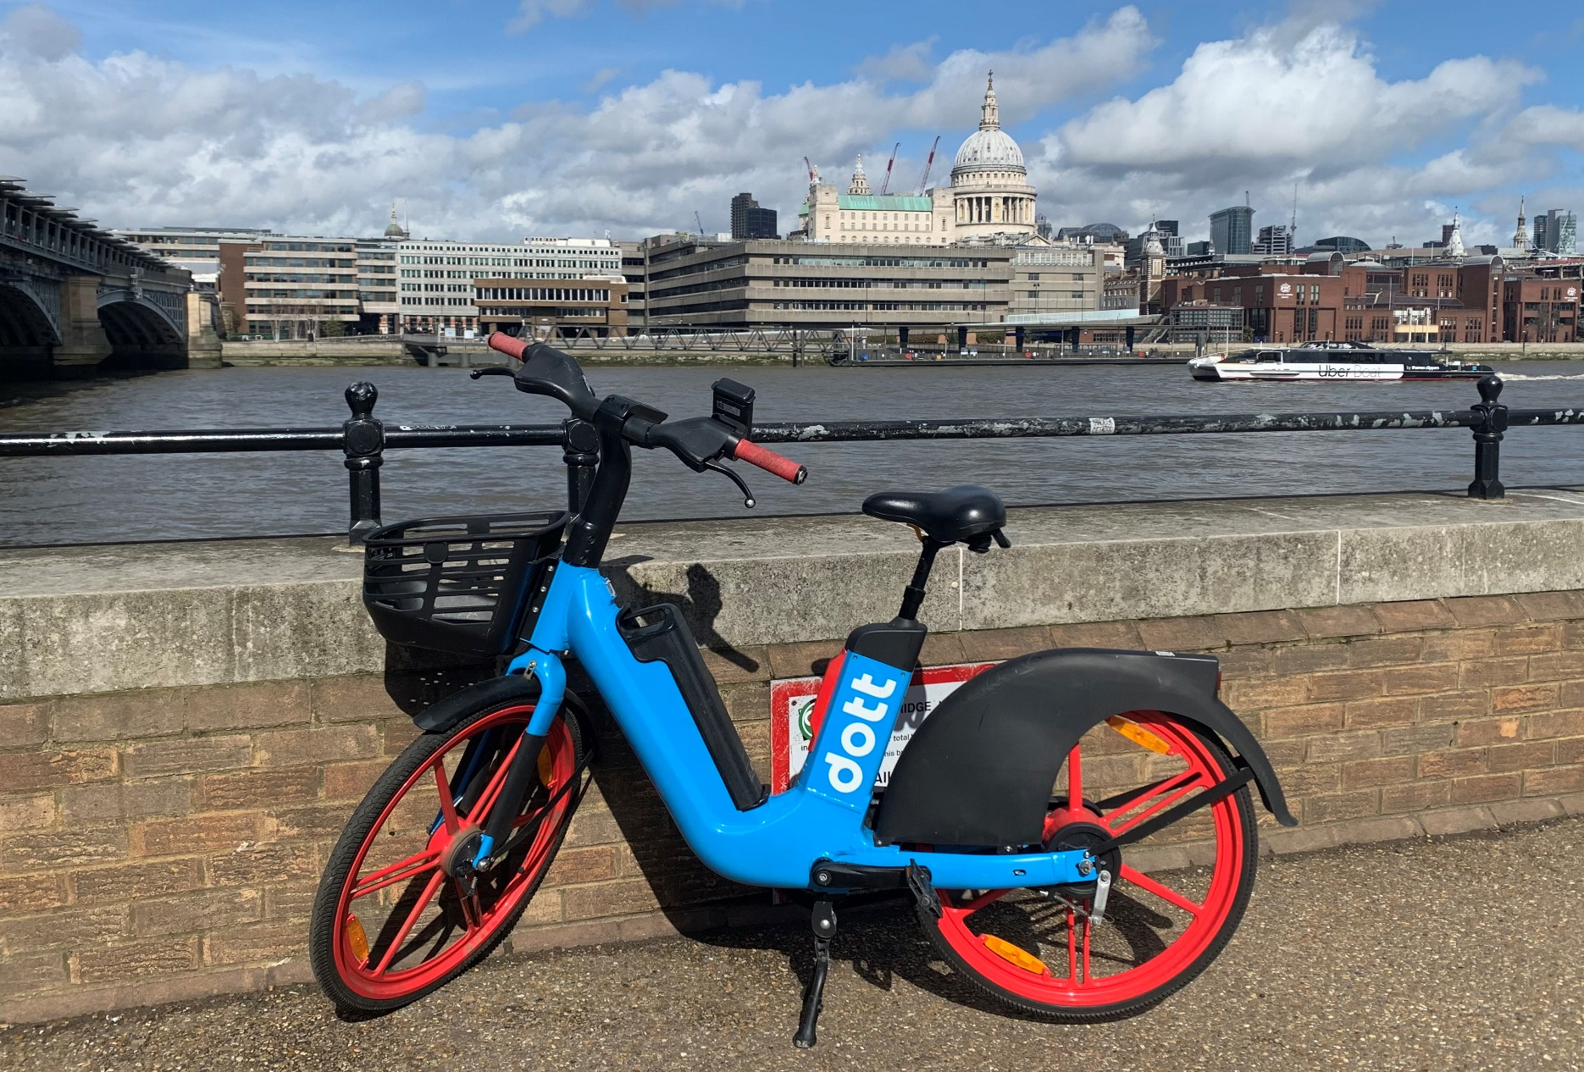
Notes:
Discussion ideas:
(Use with the previous slide)
Compare prices of the different bike options
Eg https://www.cyclist.co.uk/reviews/ridden-and-rated-ultimate-guide-to-london-s-bike-sharing-rental-bicycles
How does this compare to costs of other methods of transport?
How much does it help with your carbon footprint travelling by bike?

Slide 18


How much does each bike cost to hire?
Which is the best value?
How does this compare to other modes of transport?
How does the carbon footprint compare?
Notes:
Discussion ideas:
(Use with the next slide)
Compare prices of the different bike options
Eg https://www.cyclist.co.uk/reviews/ridden-and-rated-ultimate-guide-to-london-s-bike-sharing-rental-bicycles
How does this compare to costs of other methods of transport?
How much does it help with your carbon footprint travelling by bike?

Slide 19
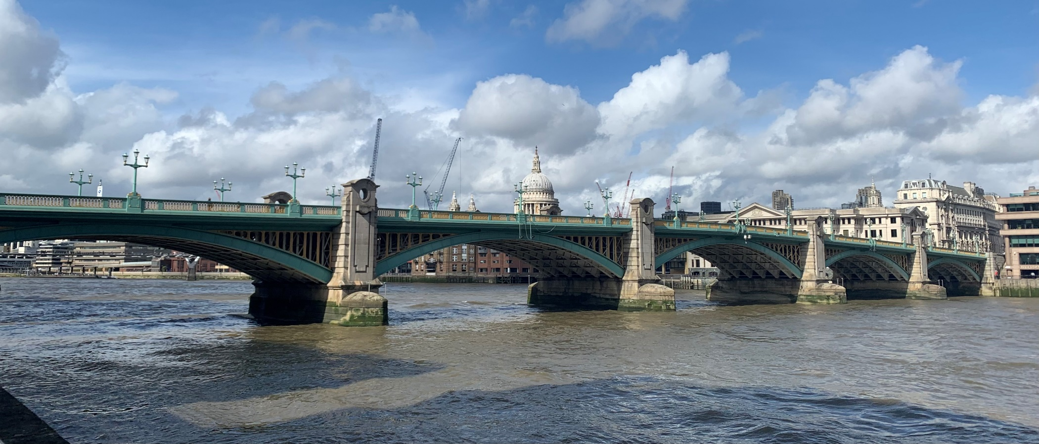
Notes:
Southwark Bridge
Can also be used with Tower Bridge – next slide

Slide 20
How wide is the Thames?
How many cars cross Southwark Bridge in a day?
Notes:
Discussion ideas:
How many bridges across the Thames?
Width/length/volume of the Thames?
Water pollution
Dredging costs
Weight limits
Bridge design

Slide 21
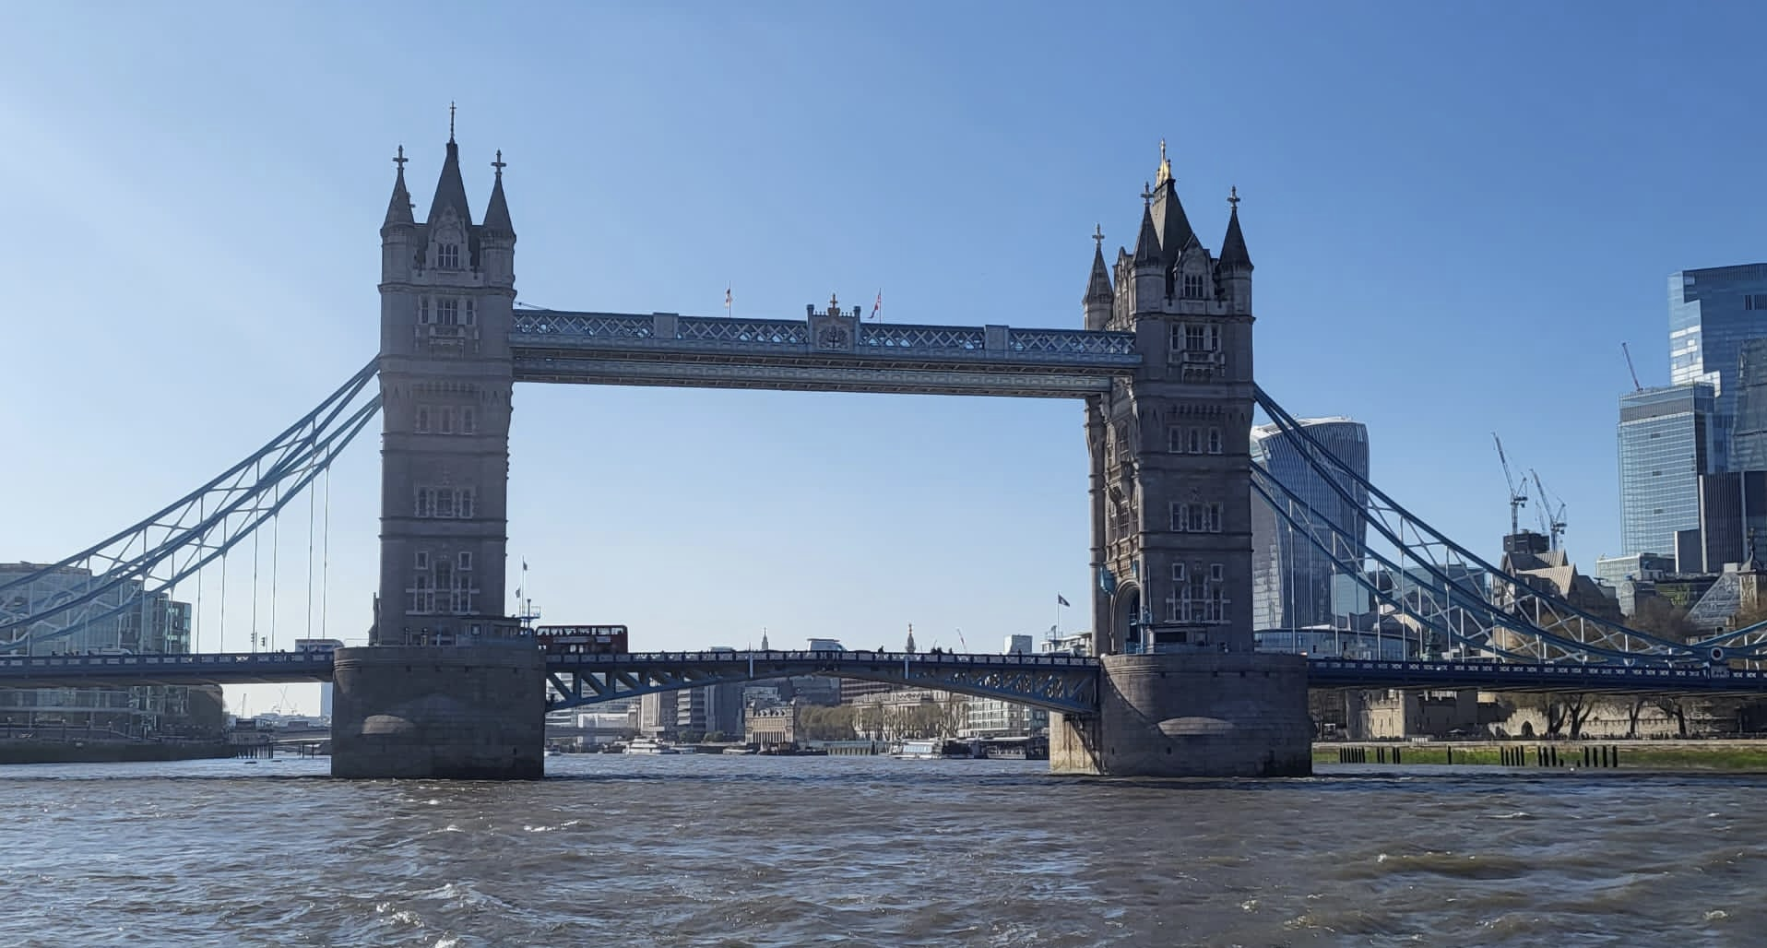
Notes:
Tower Bridge

Slide 22
How tall is London Bridge?
How does it open?
Notes:
Tower Bridge
Discussion ideas:
How many bridges across the Thames?
Width/length/volume of the Thames?
Water pollution
Dredging costs
Weight limits
Bridge design

Slide 23
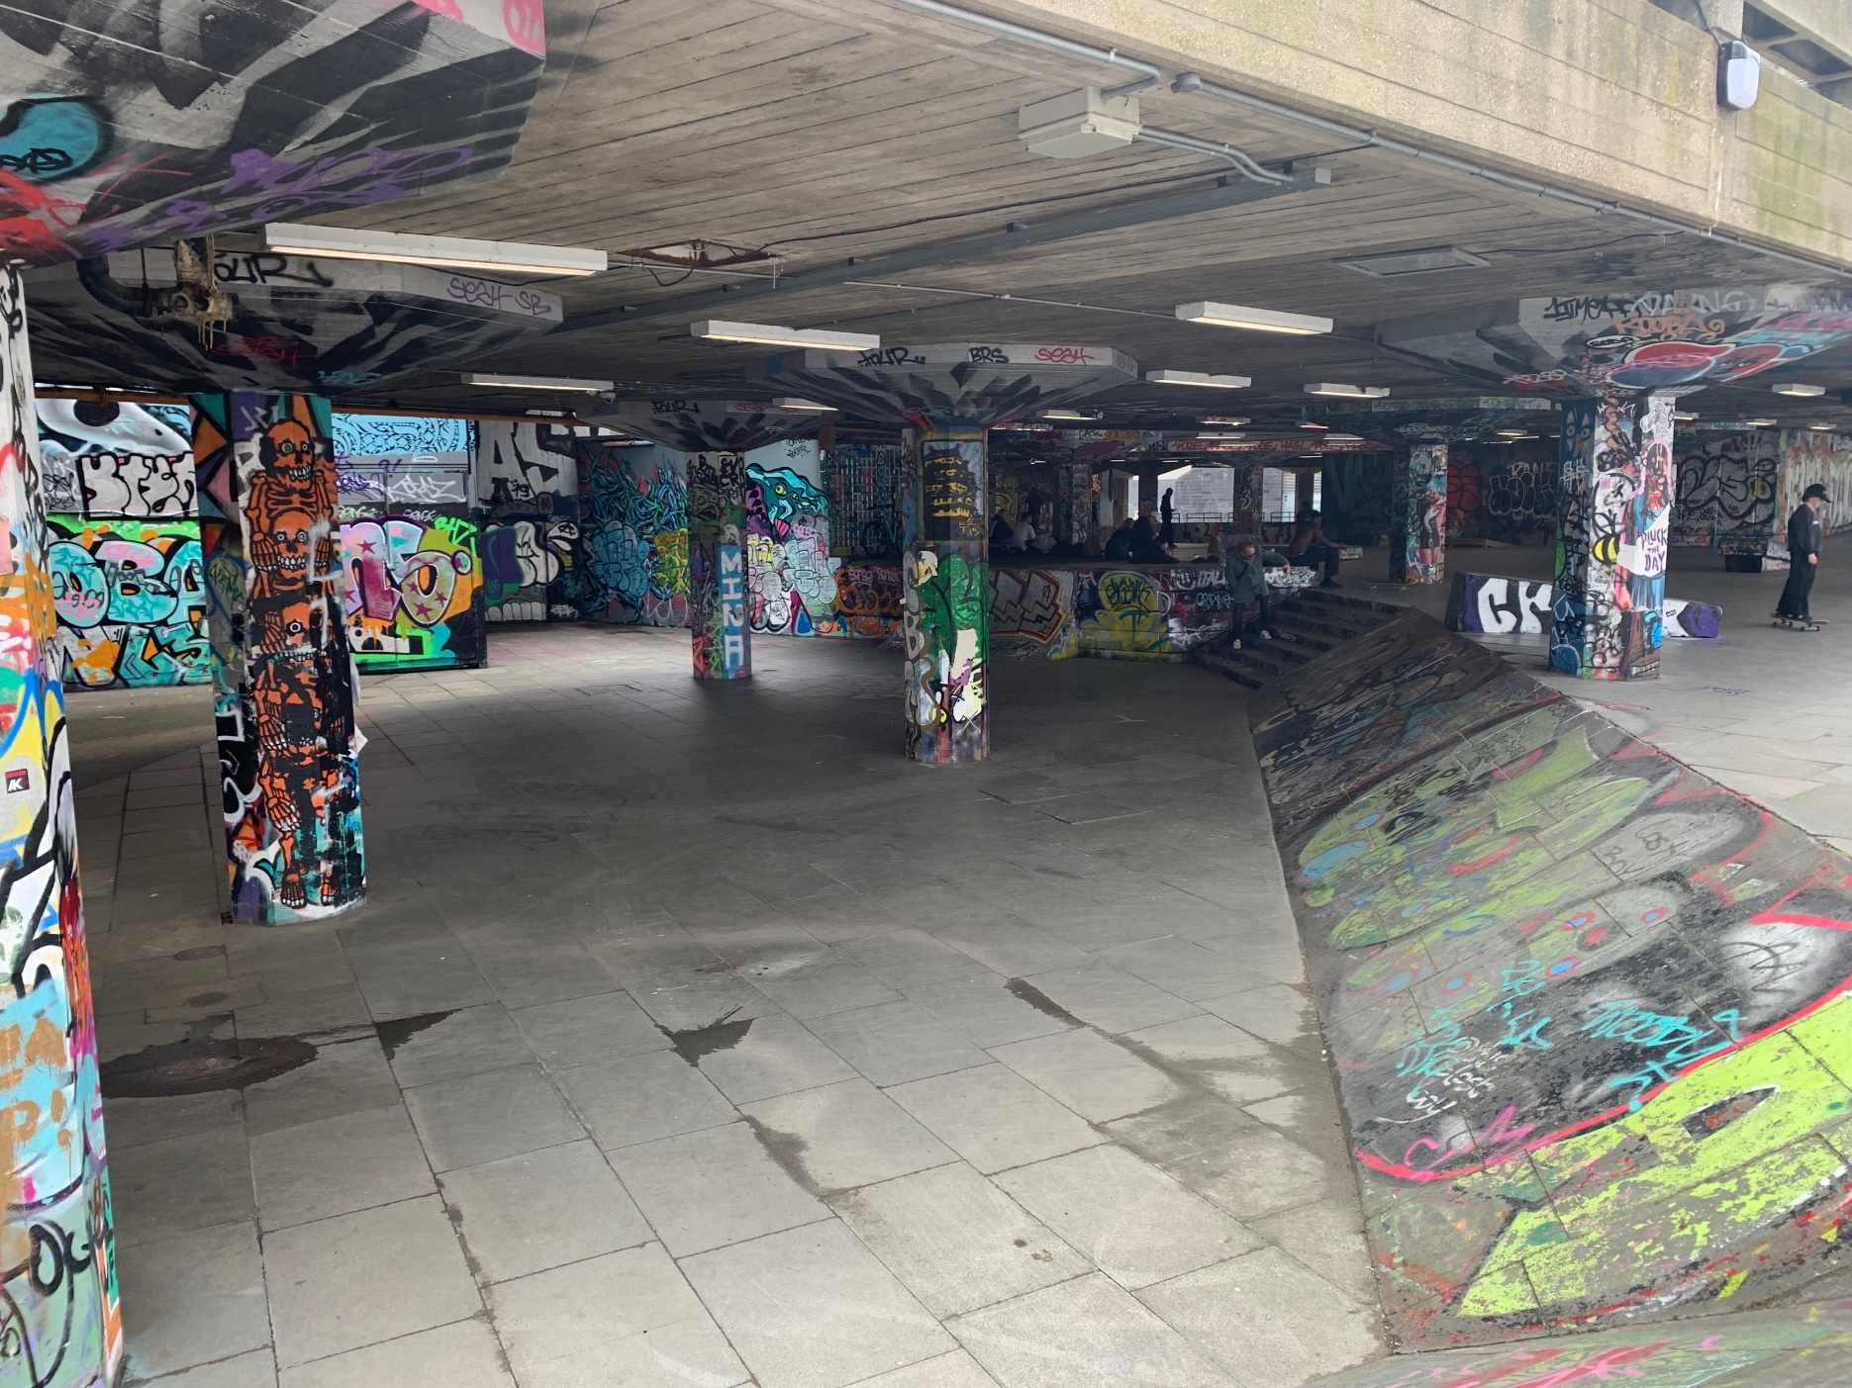
Notes:
Southbank skatepark
Discussion ideas:
Angles, speed, potential & kinetic energy
Design your own skatepark https://www.mathscareers.org.uk/design-skate-park/

Slide 24
Is there an optimum angle for a ramp?
How fast could you go?
Notes:
Southbank skatepark
Discussion ideas:
Angles, speed, potential & kinetic energy
Design your own skatepark https://www.mathscareers.org.uk/design-skate-park/

Slide 25
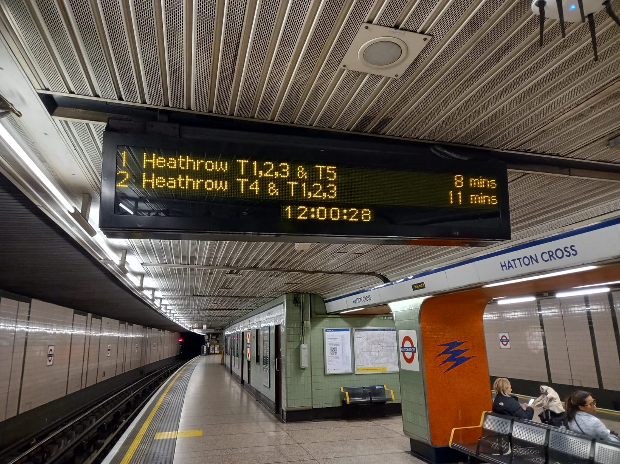
Notes:
Discussion ideas:
Tube stats: https://madeby.tfl.gov.uk/2019/07/29/tube-trivia-and-facts/
Look at tube map, plan a journey. How do costs compare to say travelling by bus?
Core Maths Task – steps and escalators and Pythagoras theorem https://www.stem.org.uk/resources/elibrary/resource/282087/london-underground

Slide 26
How far underground is the tube?
How fast does it go?
Notes:
Discussion ideas:
Tube stats: https://madeby.tfl.gov.uk/2019/07/29/tube-trivia-and-facts/
Look at tube map, plan a journey. How do costs compare to say travelling by bus?
Core Maths Task – steps and escalators and Pythagoras theorem https://www.stem.org.uk/resources/elibrary/resource/282087/london-underground

Slide 27
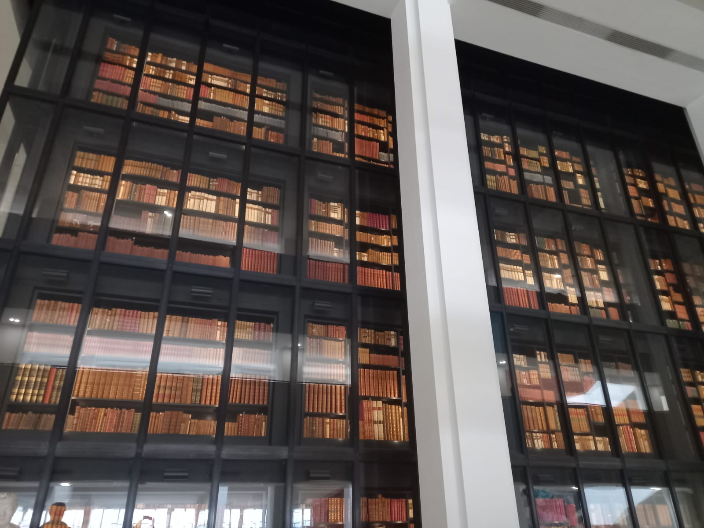
Notes:
The British Library
Discussion ideas:
How many books? How many pages? How many words?
Is it needed now everything is on the internet?
ISBN numbering
Dewey decimal system for cataloguing.

Slide 28
How many books?
How many pages?
How much space would all this information take up on the internet?
Notes:
The British Library
Discussion ideas:
How many books? How many pages? How many words?
Is it needed now everything is on the internet?
ISBN numbering
Dewey decimal system for cataloguing.

