Slide 1
Using the slides
Simply display a photograph
Ask “Where is the Maths in that?”
Let the ideas flow!
Hidden slides have some suggestions but they are in no way exhaustive!

Slide 2
Using the slides
Aim to show
  Maths is all around us
  Maths is creative
  Maths is not always about being right or wrong
  Maths helps us make a difference to the planet
Get involved
  Set your students the challenge of taking their own photographs and link them to maths

Slide 3
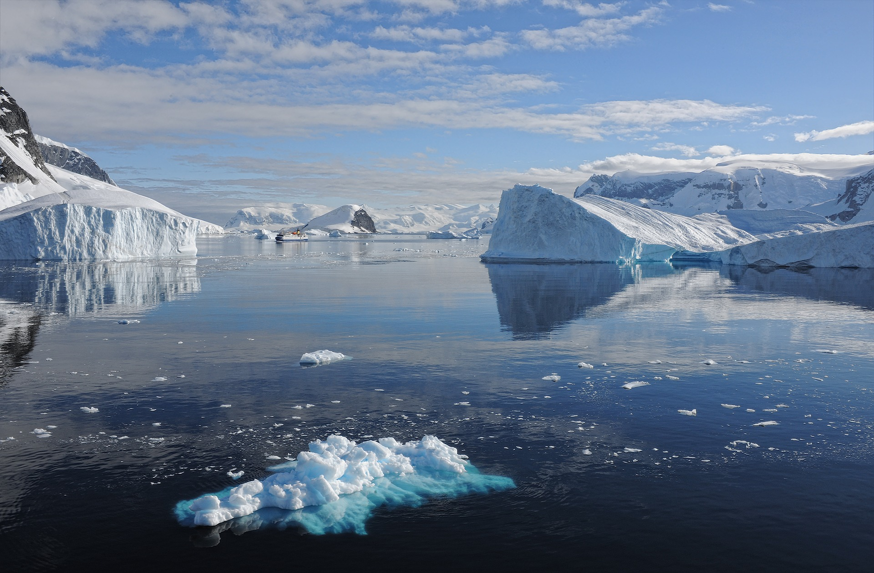
Where is the Maths in that?
Notes:
Pixabay?

Slide 4
Suggestions
Reflection
Temperature (negative numbers)
What shapes can you see?
Fractions/percentages - how much of an iceberg is above water? (approx 10%)
Estimating dimensions and volume of iceberg (use the boat for scale – you might need to zoom in!)
Rate of melting (try an experiment)
Try investigating how maths is used in careers in climate change:
Read: https://www.mathscareers.org.uk/claire-burke-climate-change-attribution-scientist/
Watch: Video with Dr Sammie Buzzard on how maths is essential for her career as a climate scientist (available from end of October 2021)

Slide 5
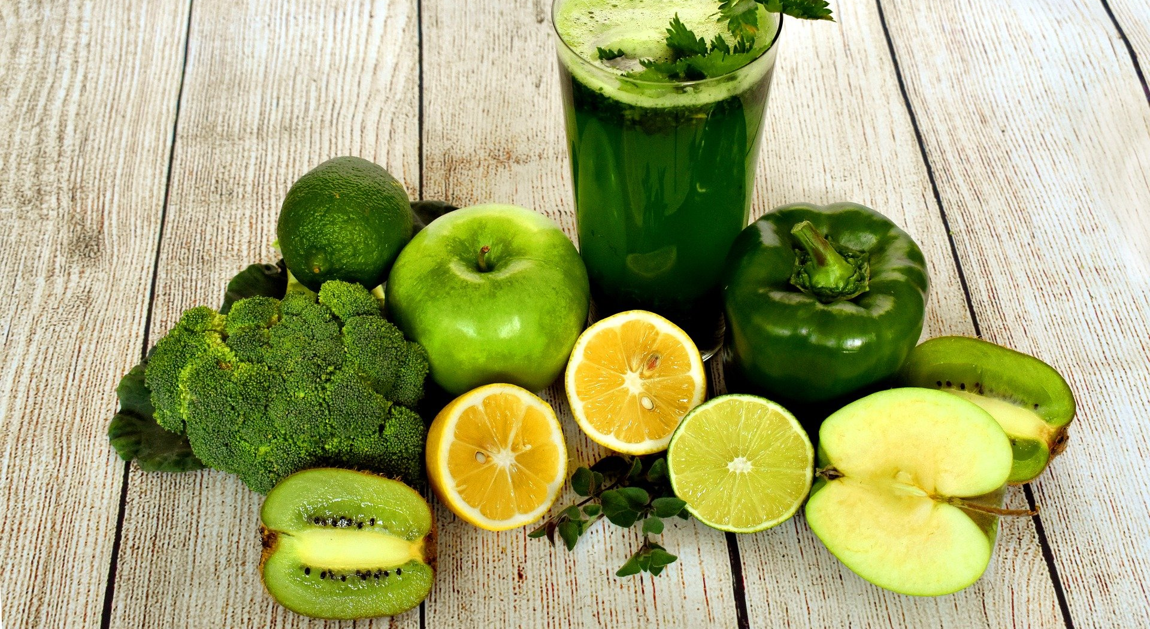
Where is the Maths in that?
Notes:
https://pixabay.com/photos/smoothie-nutrition-detox-juice-3697014/

Slide 6
Suggestions
Fractions
Symmetry
Shapes
  Spheres, hemispheres, cylinders....
Fractals (broccoli)
Volume
Change of state – fruit and vegetables to liquid
Possible activity: Try Your food's carbon footprint - Desmos activity
or Cows or cars from Scotdec
What do you notice? What do you wonder?

Slide 7
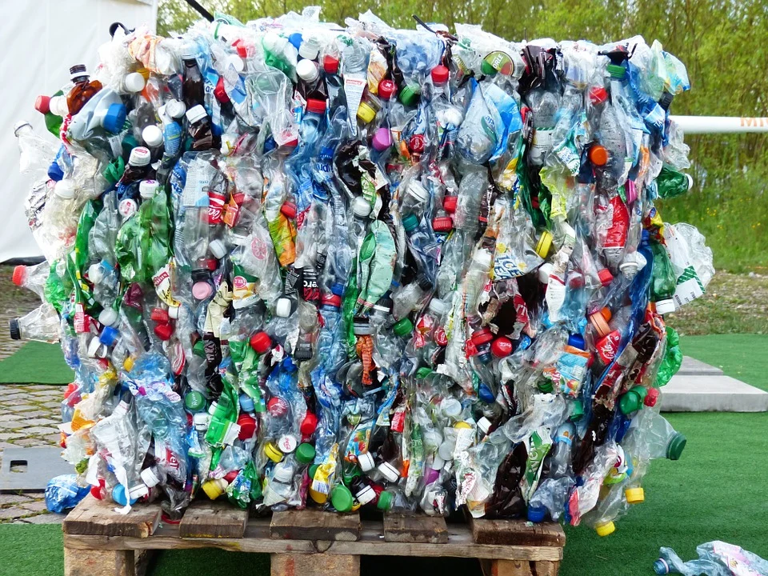
Where is the Maths in that?
Notes:
https://pixabay.com/photos/plastic-bottles-bottles-recycling-115069/

Slide 8
Suggestions
Shapes (2D and 3D)
Estimate
  How high is the pile?
  Number of bottles
  Amount spent on all these drinks
  Dimensions/volume of the pile
  If from one person/ one house/one class... how long to create?
Try watching Ecomaths videos with Stefan Gates (Primary)
The re-cycling episode is embedded on the next slide

Slide 9
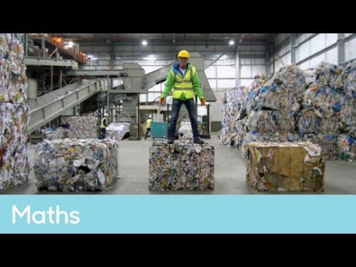
Find out how maths is used to recycle rubbish
Notes:
https://pixabay.com/photos/plastic-bottles-bottles-recycling-115069/

Slide 10
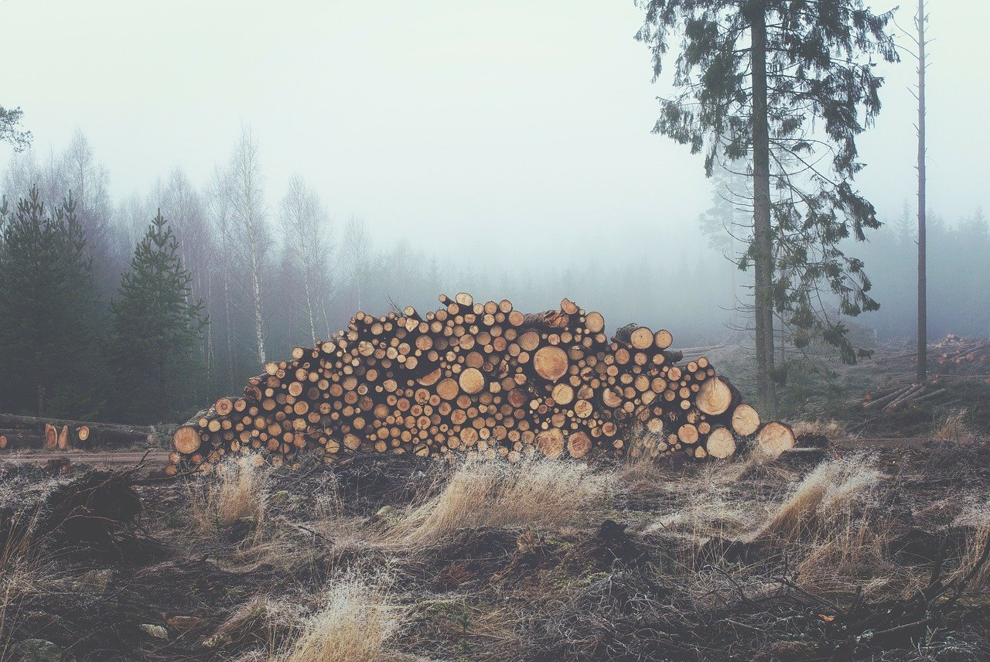
Where is the Maths in that?
Notes:
https://pixabay.com/photos/wood-logs-bole-firewood-336547/
Maybe: https://docs.google.com/document/d/1RIdW5qi_Rddp9T77V6yd8kjWIL65-WIoVTEnK4UsPiI/edit (section 4)

Slide 11
Suggestions
Symmetry
Fractals
Shapes and Curves
  Circles
  Cylinders
  Tessellations
  Quadratics
Estimate
  No of trees in pile
  Height of trees
  Amount of earth covered in trees
  Age of trees
Activities exploring the connections between maths and trees on the next slide

Slide 12
Maths and Trees
Activities to try:​
Symmetry – Primary tree and leaf activities​​
Maths in the forest - primary​
Find the age of a living tree using maths​
Clinometers – use trigonometry to find the height of a tree​
Graceful Trees from Think Maths (graph theory)
How to best plant your orchard? Maths careers ​
Investigate how trees grow (Fibonacci)​​
  Get creative and draw Fibonacci trees and plants​​ (3 videos)

Slide 13
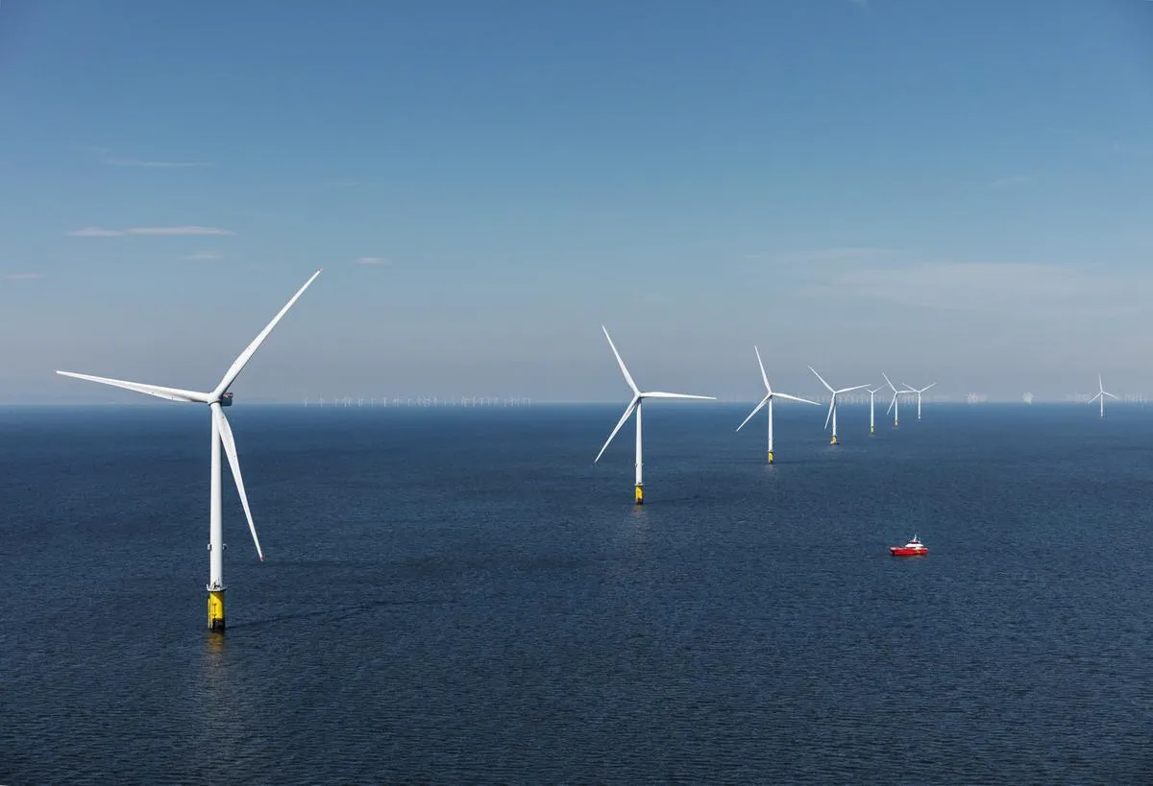
Where is the Maths in that?

Slide 14
Suggestions
  Angles
  Rotational Symmetry
  Straight lines
  Estimate
    Height of turbine (compare to ship in picture)
    Distance between turbines (to optimise generation)
    Amount of energy generated
    No of turbines required (to power where you live)

Slide 15
About the AMSP
A government-funded initiative, managed by MEI, providing national support for teachers and students in all state-funded schools and colleges in England.
It aims to increase participation in AS/A level Mathematics and Further Mathematics, and Core Maths, and improve the teaching of these qualifications.
Additional support is given to those in priority areas to boost social mobility so that, whatever their gender, background or location, students can choose their best maths pathway post-16, and have access to high quality maths teaching.

Slide 16




Contact the AMSP
01225 716 492
admin@amsp.org.uk
amsp.org.uk
Advanced_Maths

