Slide 2
Using the slides
Simply display a photograph
Ask “Where is the Maths in that?”
Let the ideas flow!
Hidden slides have some suggestions
The suggestions are in no way exhaustive. They also range in complexity and so you may consider some to be beyond what you would like to use with your students. Use as many or as few as you wish.

Slide 3
Using the slides
Aim to show…
  Maths is all around is
  Maths is creative
  Maths is not always about being right or wrong
Emphasise…
  Nobody can be wrong
  Just explain your thoughts
Going further…
  Why not use your own or your students’ photographs?

Slide 4
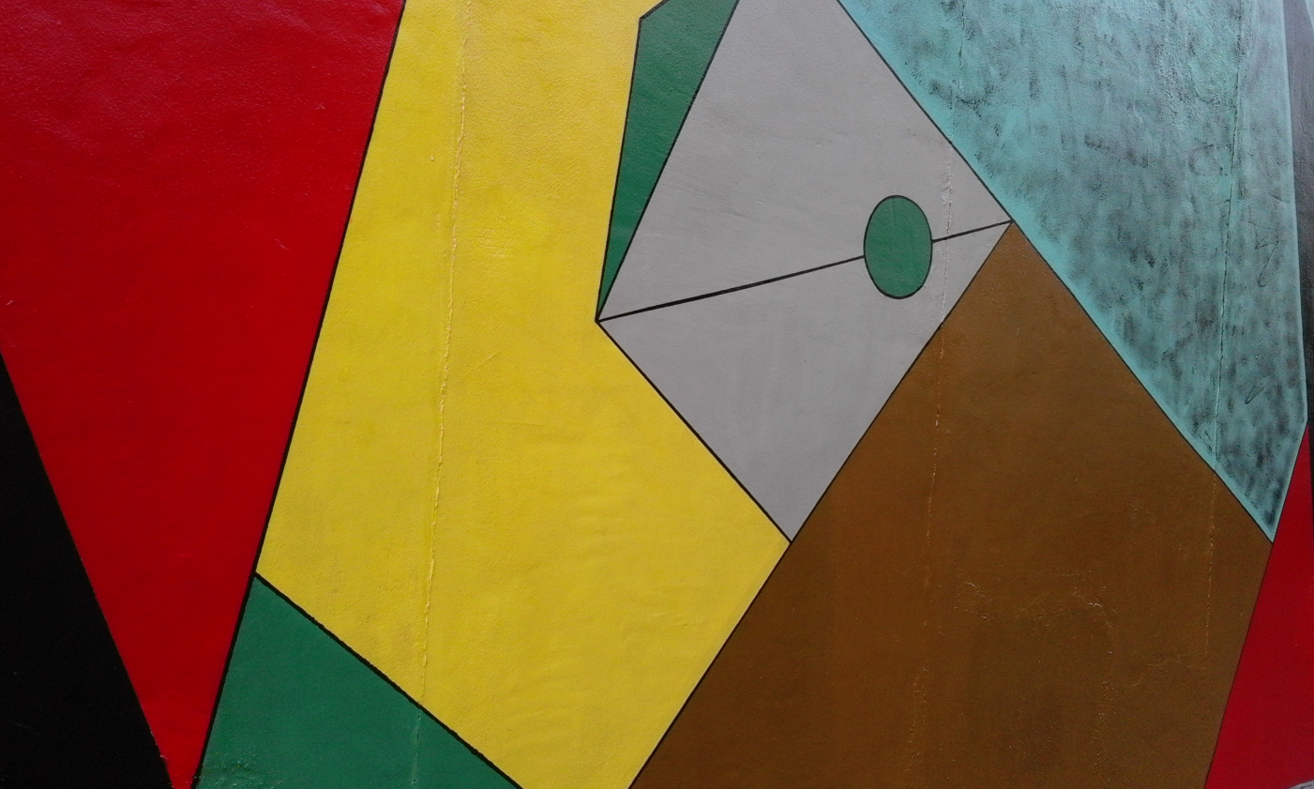
Where is the Maths in that?
Notes:
Photo taken by and property of Cath Moore – permission granted to use.

Slide 5
Suggestions
Name different shapes
Notice they fit together - why?
Different angles?
Minimum number of colours required
  to colour the shapes in the picture so that no two adjacent shapes are the same colour.
Area - of the whole thing?
  Can you find area of each shape?
Lesson idea: 4 colour map theorem https://www.youtube.com/watch?v=ANY7X-_wpNs
What do you notice? What do you wonder?

Slide 6

Where is the Maths in that?
Notes:
https://pixabay.com/photos/money-finance-mortgage-loan-2696229/

Slide 7
Suggestions
Time – units?
  What other measurements use those units?
Money – how much is there?
  how much would you need for a …? House?
Scale – how big would the clock be if the house was full size?
How are all the items connected?
What do you notice? What do you wonder?

Slide 8

Where is the Maths in that?
Notes:
https://pixabay.com/photos/water-drop-liquid-splash-wet-1759703/

Slide 9
Suggestions
Symmetry
Circles
  Formulae
  Look at pattern in sizes
    Ratio of radii of the increasing circles
    Ratio of perimeters of the increasing circles
    Ratio of areas of the increasing circles
    How long will the ripples continue for?
    Does how high the water drop from make a difference?
Reflection
Waves – wavelength, speed….
Surface tension
What do you notice? What do you wonder?

Slide 10

Where is the Maths in that?
Notes:
https://pixabay.com/photos/iphone-smartphone-apps-apple-inc-410311/

Slide 11
Suggestions
Coding
Statistics in design
  The right size for your hand
Screen time data
  Today
  Last 7 days
Battery symbol – visual percentages
Lesson idea: Try https://soundcloud.com/uniofbath/maths-and-the-making-of-the-modern-world Public talks, lectures and workshops: https://people.bath.ac.uk/mascjb/
What do you notice? What do you wonder?

Slide 12
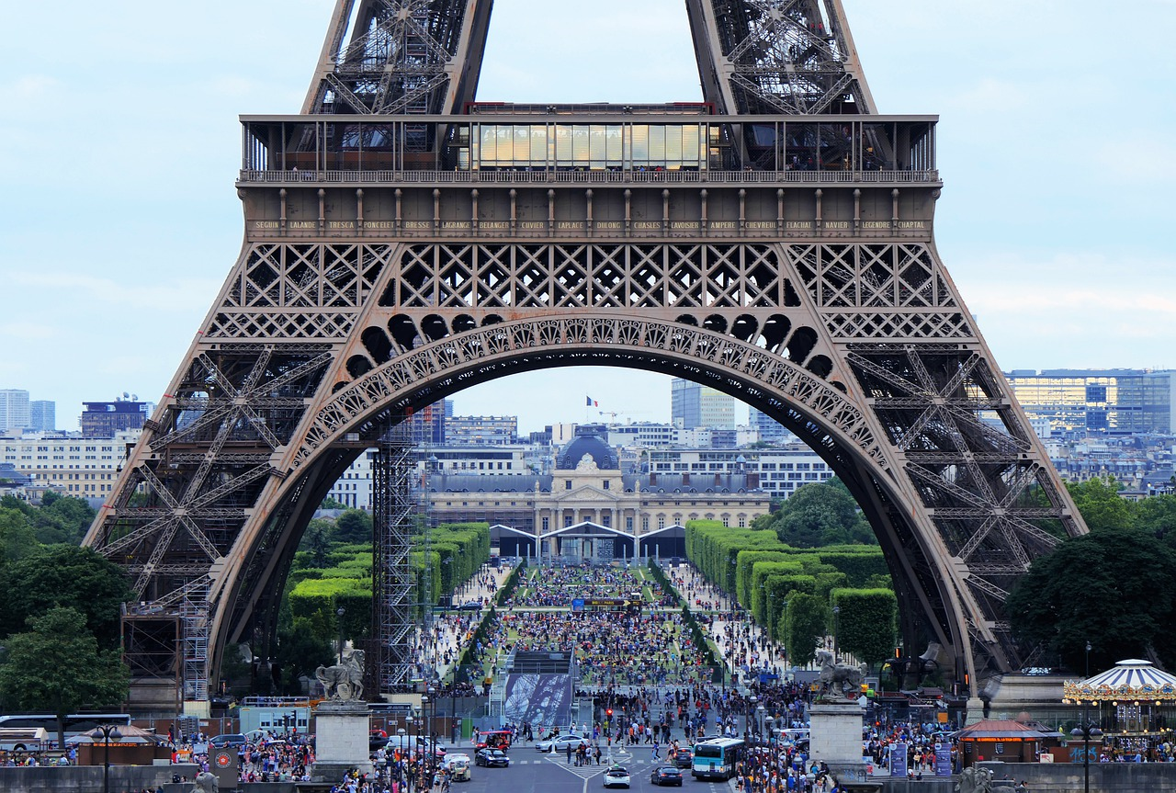
Where is the Maths in that?
Notes:
https://pixabay.com/photos/eiffel-tower-arch-tourism-crowd-4416700/ Image by Phil Riley from Pixabay

Slide 13
Suggestions
Shapes
  Triangles? Semi Circles?
  How many can you see?
Estimate
  How many people are in the photograph?
  Visit in a year…. a day……. an hour?
  How much money taken in a year … a day……an hour?
Crowds
  Density of people per m²
  Flow (*Fluid mechanics)
Look up Dr Aoife Hunt – Associate Director of Movement Strategies
What do you notice? What do you wonder?

Slide 14
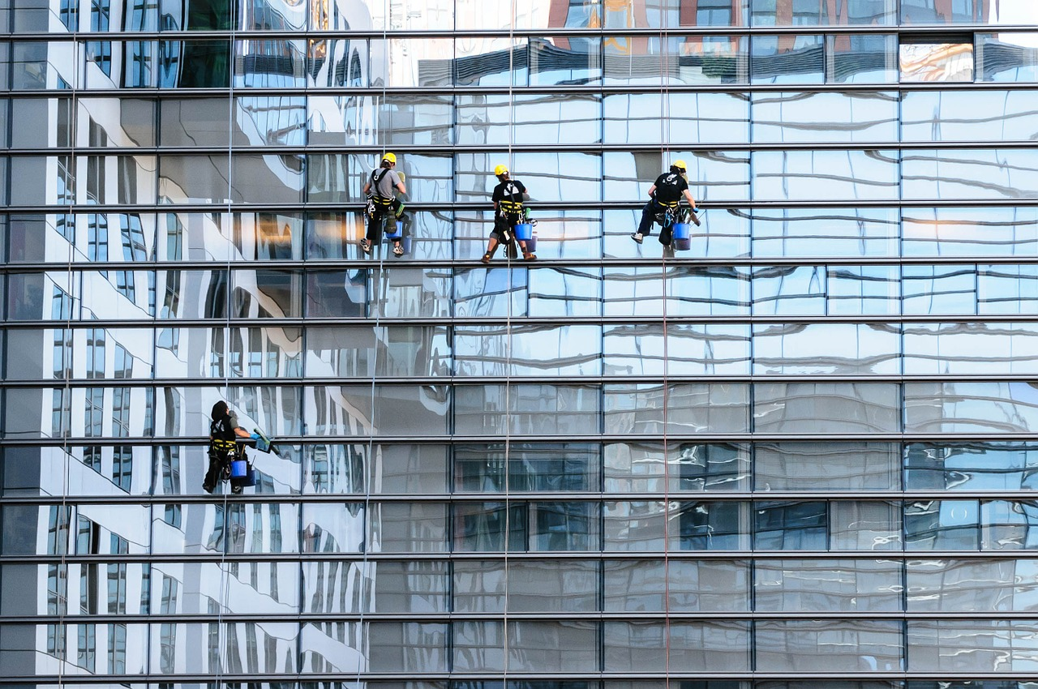
Where is the Maths in that?
Notes:
https://pixabay.com/photos/glass-facade-window-cleaner-facade-817732/ Image by Gerhard Bögner from Pixabay

Slide 15
Suggestions
Rectangles
Tessellation
Reflection
Translation
Amount of water needed?
Cost to clean?
How are the cleaners being held up?
  Force
  Tension
  Mass
What do you notice? What do you wonder?

Slide 16
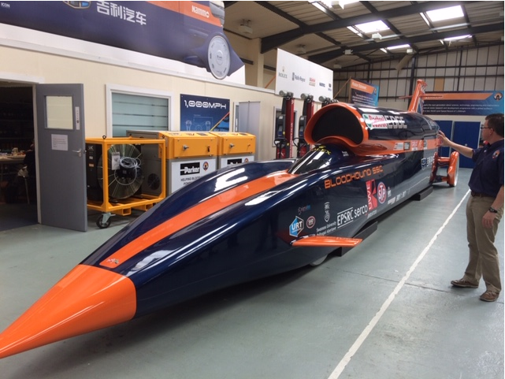
Where is the Maths in that?
Notes:
Photo taken by and property of Rachel Beddoes – permission granted to use
*You could replace this photo with one of Bloodhound with the new livery if you wish

Slide 17
Suggestions
Bloodhound SSC
World speed records? Compare….
  Human
  Animal
  Land
  Water
  Air ………
How fast can it go? Mph? Different units?
Aerodynamics?
Cost of project?
What do you notice? What do you wonder?

Slide 18
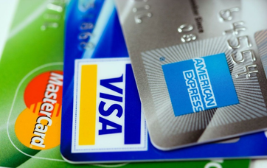
Where is the Maths in that?
Notes:
https://pixabay.com/en/american-express-cards-credit-89024/

Slide 19
Suggestions
What is credit? How does a credit card work?
  Complete an example
Percentages? APR?
Security
  How many combinations
    Pin number (4 digits)
    Security code (3 digits)
  Encryption
    Prime Numbers and cryptography
Try https://www.youtube.com/watch?v=56fa8Jz-FQQ
What do you notice? What do you wonder?

Slide 20
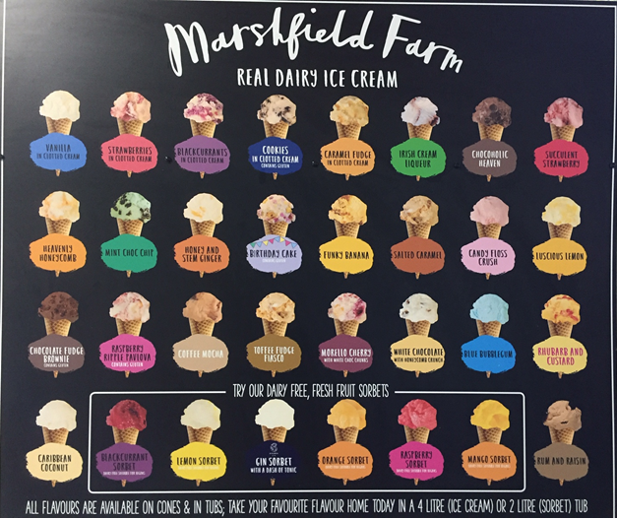
Where is the Maths in that?
Notes:
Photo taken by and property of Rachel Beddoes – permission to use

Slide 21
Suggestions
Volume and net of a Cone
Volume and surface area of a Hemisphere
Combinations of flavours
  Two scoops
  Three scoops …..
Pricing structure
Sketch a graph of sales.. in a year?
Most popular flavours?
  Do a class survey
  Analyse results
What do you notice? What do you wonder?

Slide 22
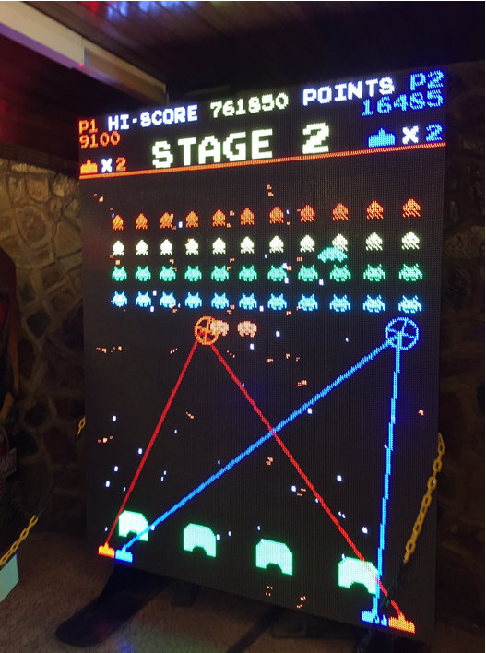
Where is the Maths in that?
Notes:
Photo taken by and property of Rachel Beddoes – permission to use

Slide 23
Suggestions
Angles
  Inc. vertically opposite
Scoring system
Large numbers
Multiplication
Coding/computing
What do you notice? What do you wonder?

Slide 24
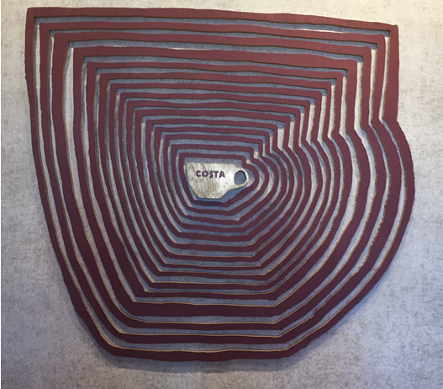
Where is the Maths in that?
Notes:
Photo taken by and property of Rachel Beddoes – permission to use

Slide 25
Suggestions
Enlargement
  Length, area, volume, scale factors.
How many cups of coffee to fill the biggest cup compared to the original cup?
Cost of filling the biggest cup compared to the original cup?
Number of beans needed to fill the biggest cup compared to the original cup?
What do you notice? What do you wonder?

Slide 26
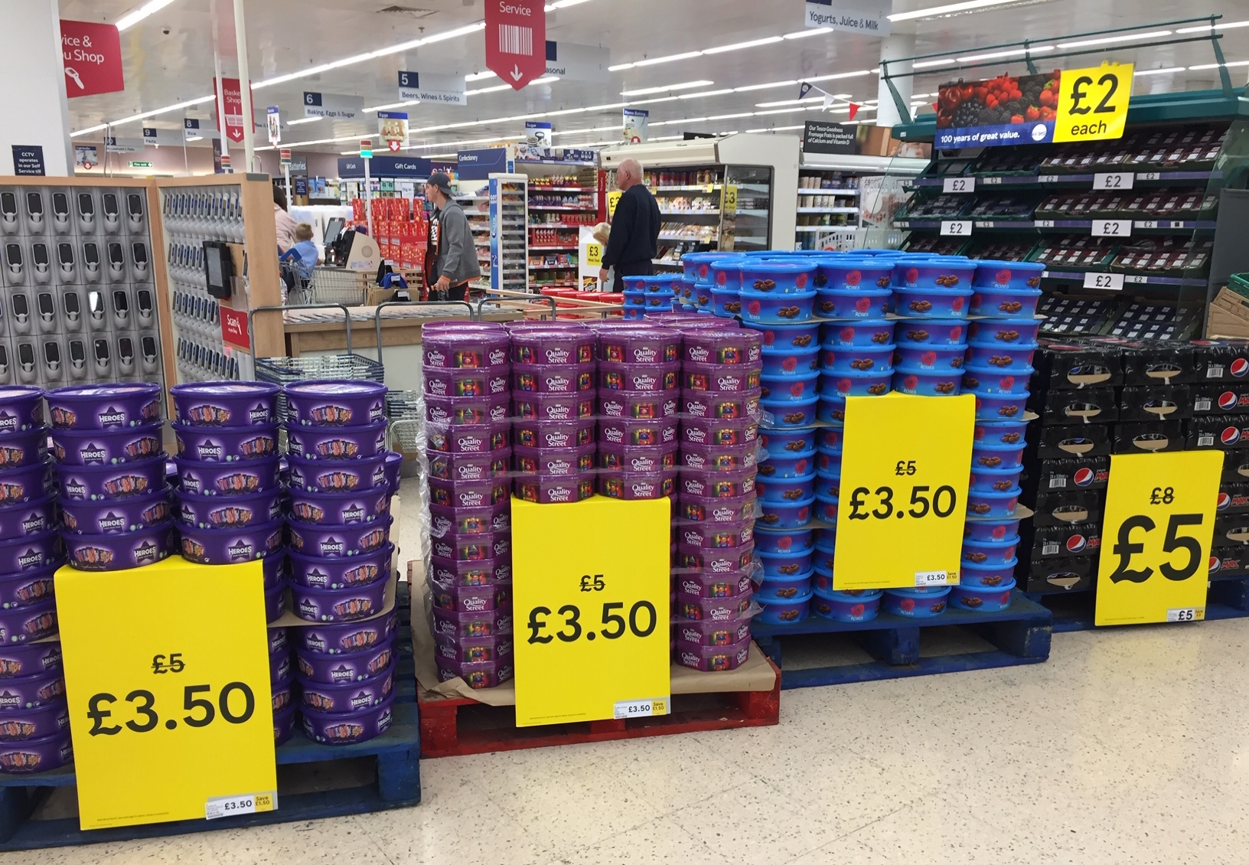
Where is the Maths in that?
Notes:
Photo taken by and property of Rachel Beddoes – permission to use

Slide 27
Suggestions
Estimation of…
  No of tubs
  Total cost of all goods on display
  Total amount saved (with discount)
    Per tub, per chocolate, per gram of chocolate?
  No of sweets in a tub? All the tubs?
  Amount of sugar on display
  How much chocolate is eaten over the Christmas period?
Percentage discount
Ideas to develop further (poss into a lesson) on next 3 slides
What do you notice? What do you wonder?

Slide 28
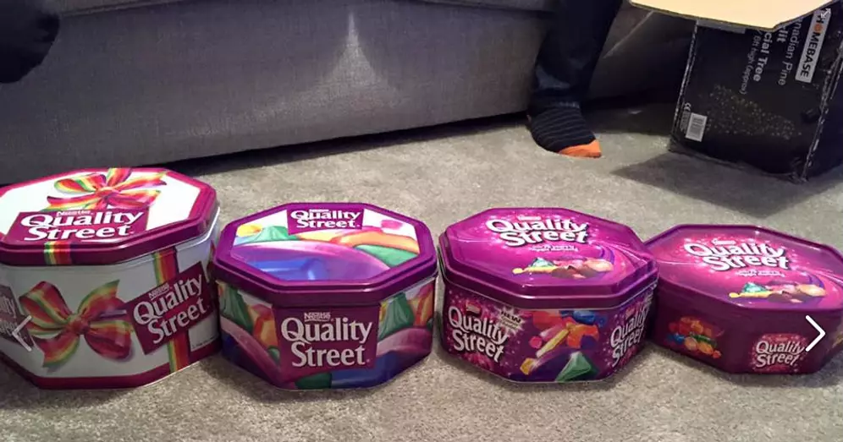
Making the Headlines!
How about ‘doing some maths’ on this data and turning it into a newspaper headline or story?
2015
780g
1985
1.7kg
2017
750g
2015
780g
2018
720g
2019
629g
Notes:
This is just an example you can use to a quick bit of maths to check their understanding of percentage change e.g size of tin shrunk by 54% or over 50% from 1985 – 2015. There is more data you can use on the following two slides and students could come up with their own investigations/presentations of the data. https://www.dailymail.co.uk/news/article-6476653/Quality-Street-tins-shrink-Size-Christmas-favourites-fallen-40-cent-decade.html

Slide 29
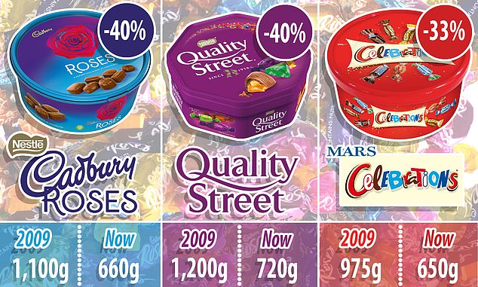
Quality Street, Celebrations and Roses tins shrink AGAIN: Size of Christmas favourites has fallen by 40 per cent in past decade despite price staying almost the same
PUBLISHED: 16:03, 9 December 2018
To read the article click on the date
2018
2018
2018
2019 – 620g
2019 – 629g
2019 – 650g
Continued on next slide
Notes:
https://www.dailymail.co.uk/news/article-6476653/Quality-Street-tins-shrink-Size-Christmas-favourites-fallen-40-cent-decade.html

Slide 30
From Christmas 2017 to 2018 -The standard size tub of Quality Street has been reduced from 750g to 720g and Celebrations tins have shrunk from 680g to 650g.
The company said the equivalent was three sweets.
How many sweets have been lost between Christmas’ …
2018 to 2019?
2017 to 2019?
2015 to 2019?
1985 to 2019?
What other questions would you like to find the answers to?
How are you going to present your findings?

Slide 31
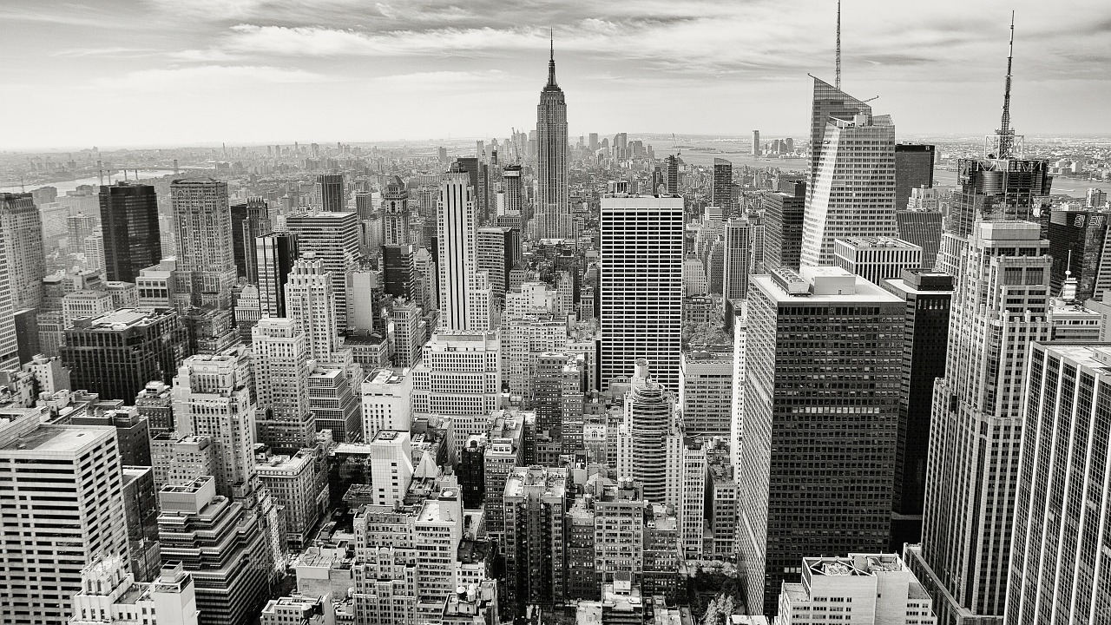
Where is the Maths in that?
Notes:
https://pixabay.com/photos/manhattan-empire-state-building-336708/

Slide 32
Suggestions
How many:
    Buildings
    rooms are there in the buildings you can see?
What is the height of the tallest building?
  Estimate vs actual? In non-standard units e.g.buses?
How many people work in these buildings?
What area do the buildings cover?
How long do you think it would have taken to build all of them?
What do you notice? What do you wonder?

Slide 33
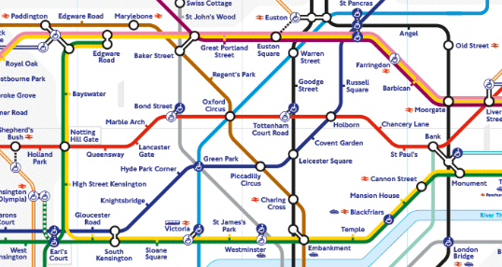
Where is the Maths in that?
Notes:
https://www.flickr.com/photos/anniemole/5574625240
Usage rights: free to use or share

Slide 34
Suggestions
Scale
How many routes from A to B?
Can you get from A to B without changing trains?
What is the quickest way from A to B?
What do you notice? What do you wonder?

Slide 35
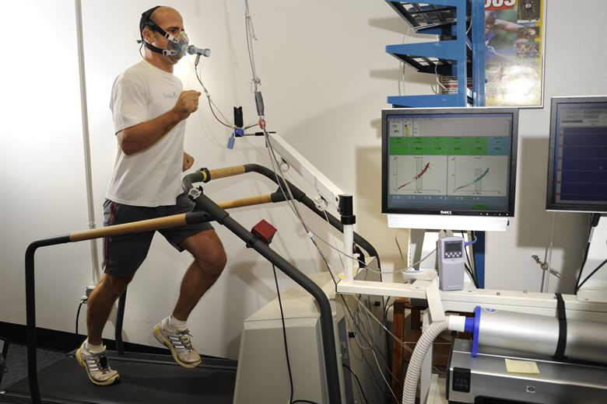
Where is the Maths in that?
Notes:
https://images.app.goo.gl/VL7Ab5QFnyeukmi97
Usage rights: Free to use, modify or share freely

Slide 36
Suggestions
Using data to measure fitness, improve performance
Units
Graphs
Average heart rate, oxygen levels
  compare levels of athletes – non athletes
Steps per day – how far do you travel on 10,000 steps?
What do you notice? What do you wonder?

Slide 37
About the AMSP
A government-funded initiative, managed by MEI, providing national support for teachers and students in all state-funded schools and colleges in England.
It aims to increase participation in AS/A level Mathematics and Further Mathematics, and Core Maths, and improve the teaching of these qualifications.
Additional support is given to those in priority areas to boost social mobility so that, whatever their gender, background or location, students can choose their best maths pathway post-16, and have access to high quality maths teaching.

Slide 38




Contact the AMSP
01225 716 492
admin@amsp.org.uk
amsp.org.uk
Advanced_Maths

