Slide 2
Using the slides
Simply display a photograph
Ask “Where is the Maths in that?”
Let the ideas flow!
Hidden slides have some suggestions
The suggestions are in no way exhaustive. They also range in complexity and so you may consider some to be beyond what you would like to use with your students. Use as many or as few as you wish.

Slide 3
Using the slides
Aim to show…
  Maths is all around is
  Maths is creative
  Maths is not always about being right or wrong
Emphasise…
  Nobody can be wrong
  Just explain your thoughts
Going further…
  Why not use your own or your students’ photographs?

Slide 4
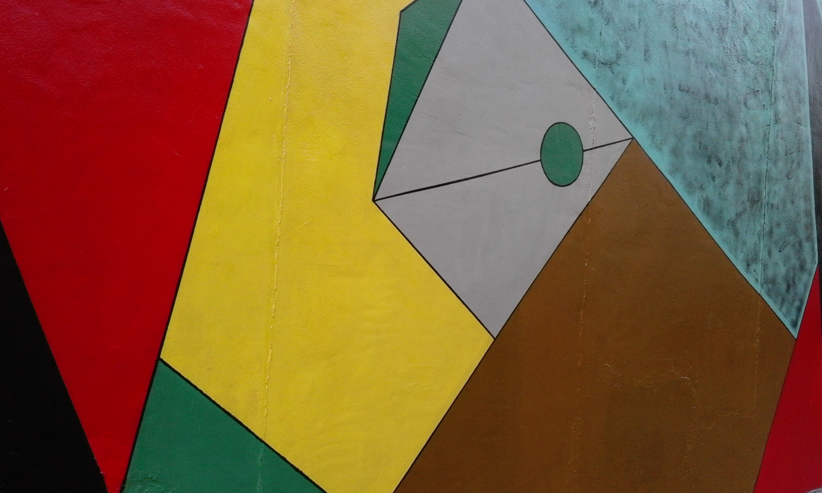
Where is the Maths in that?
Notes:
Photo taken by and property of Cath Moore – permission granted to use.

Slide 5
Suggestions
Name different shapes
Notice they fit together - why?
Different angles?
Minimum number of colours required
  to colour the shapes in the picture so that no two adjacent shapes are the same colour.
Area - of the whole thing?
  Can you find area of each shape?
Lesson idea: 4 colour map theorem https://www.youtube.com/watch?v=ANY7X-_wpNs
What do you notice? What do you wonder?

Slide 6

Where is the Maths in that?
Notes:
https://pixabay.com/photos/money-finance-mortgage-loan-2696229/

Slide 7
Suggestions
Time – units?
  How long does it take you to…..?
Money – how much is there?
  how much would you need for a House?
Scale – how big would the clock be if the house was full size?
……………..
What do you notice? What do you wonder?

Slide 8
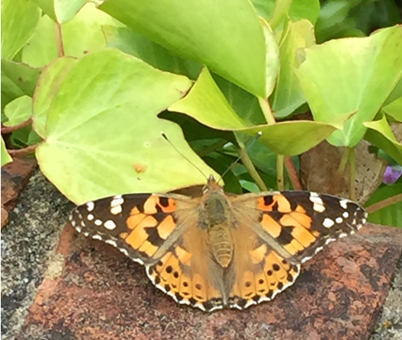
Where is the Maths in that?
Notes:
Photo taken by and property of Rachel Beddoes – permission to use

Slide 9
Suggestions
Shapes/patterns on the butterfly
Symmetry / Reflection
  Look at other butterflies are they all symmetrical?
Counting numbers in habitat
  Change in population over time
Length of life
How could you weigh a butterfly?
Make/paint a butterfly using reflection
What do you notice? What do you wonder?

Slide 10
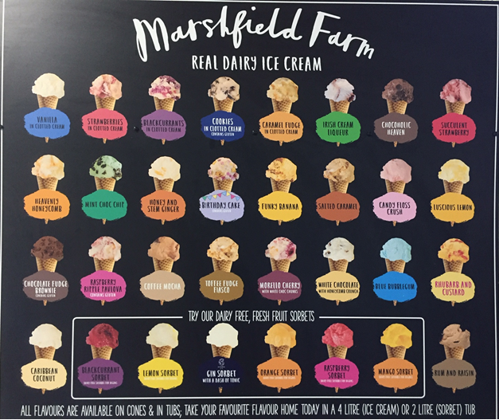
Where is the Maths in that?
Notes:
Photo taken by and property of Rachel Beddoes – permission to use

Slide 11
Suggestions
Combinations of flavours
  Two scoops?
  Three scoops?…..
Pricing structure
  how much would you charge?
Most popular flavours?
  Do a class survey
  Analyse results
Sketch a graph of sales.. in a year?
What do you notice? What do you wonder?

Slide 12
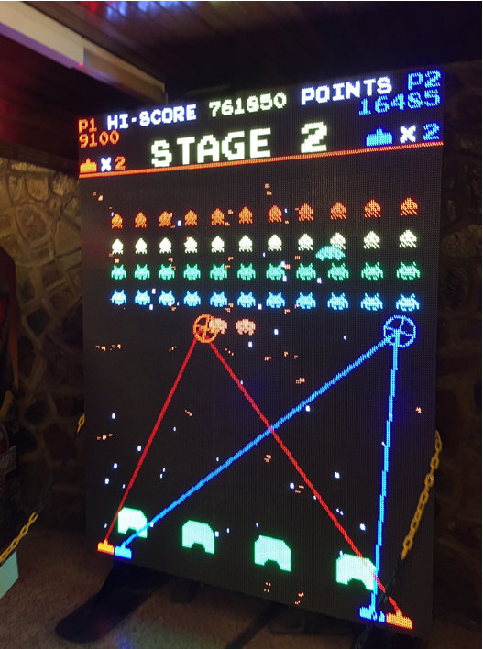
Where is the Maths in that?
Notes:
Photo taken by and property of Rachel Beddoes – permission to use

Slide 13
Suggestions
Angles
Scoring system
Large numbers – place value
Multiplication
Coding/computing
What do you notice? What do you wonder?

Slide 14
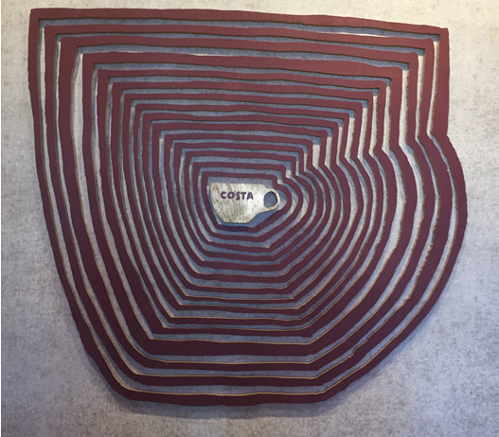
Where is the Maths in that?
Notes:
Photo taken by and property of Rachel Beddoes – permission to use

Slide 15
Suggestions
Enlargement
  Could you create a similar pattern starting with a different original shape?
How many cups of coffee to fill the biggest cup compared to the original cup?
  Do an experiment?
Number of beans needed to fill the biggest cup compared to the original cup?
  Do an experiment?
What do you notice? What do you wonder?

Slide 16
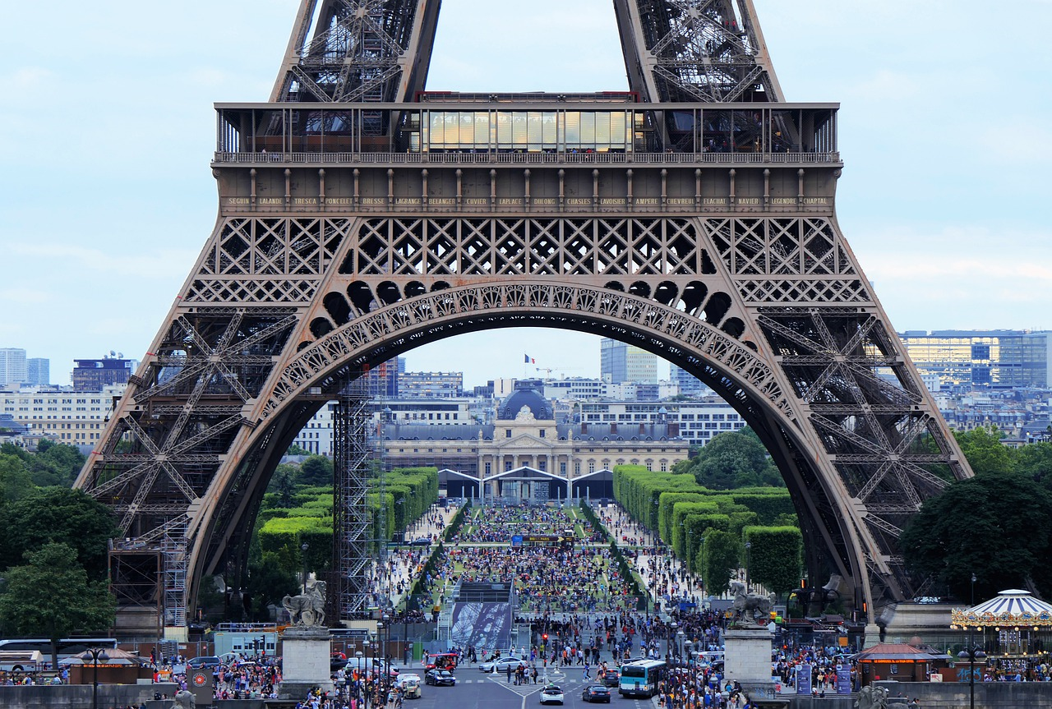
Where is the Maths in that?
Notes:
https://pixabay.com/photos/eiffel-tower-arch-tourism-crowd-4416700/ Image by Phil Riley from Pixabay

Slide 17
Suggestions
Shapes
  Triangles? Semi Circles?
  How many can you see?
Estimate
  How many people are in the photograph?
  Visit in a year…. a day……. an hour?
  How much money taken in a year … a day……an hour?
What do you notice? What do you wonder?

Slide 18
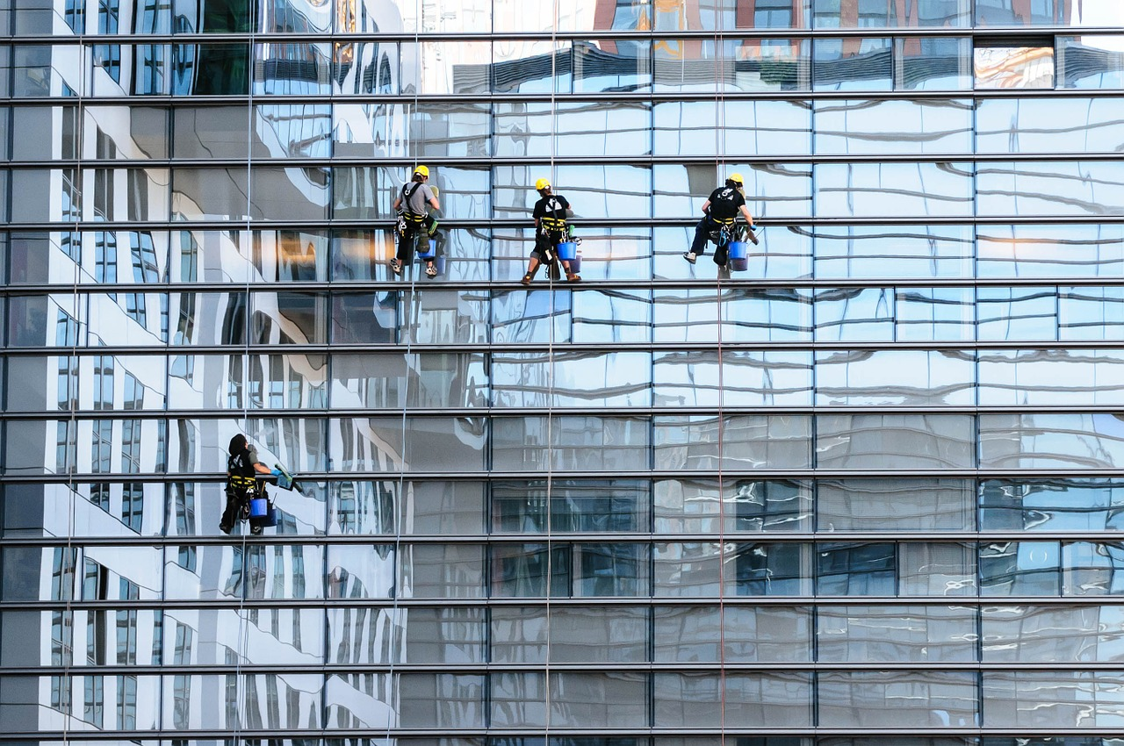
Where is the Maths in that?
Notes:
https://pixabay.com/photos/glass-facade-window-cleaner-facade-817732/ Image by Gerhard Bögner from Pixabay

Slide 19
Suggestions
Rectangles
Tessellation
Reflection
Translation
Amount of water needed?
Cost to clean?
How are the cleaners being held up?
What do you notice? What do you wonder?

Slide 20
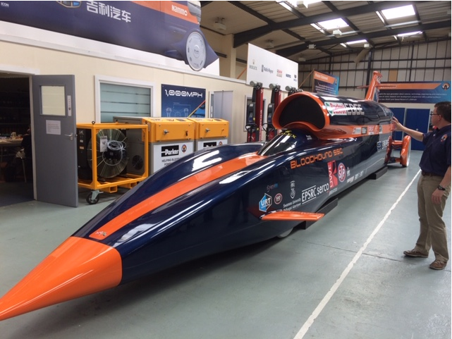
Where is the Maths in that?
Notes:
Photo taken by and property of Rachel Beddoes – permission granted to use
*You could replace this photo with one of Bloodhound with the new livery if you wish

Slide 21
Suggestions
Bloodhound SSC
World speed records? Compare …..
  Human
  Animal
  Land
  Water
  Air ………
How fast can it go? Mph? Different units?
Aerodynamics?
Cost of project?
What do you notice? What do you wonder?

Slide 22
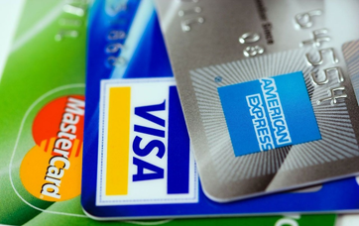
Where is the Maths in that?
Notes:
https://pixabay.com/en/american-express-cards-credit-89024/

Slide 23
Suggestions
What are these?
  Have you seen them before? Where?
  Talk about how they work
Security
  How many combinations
    Pin number (4 digits)
    Security code (3 digits)
Prime Numbers
Try https://www.youtube.com/watch?v=56fa8Jz-FQQ Y6
Try https://www.youtube.com/watch?v=FBbHzy7v2Kg Y3-6
What do you notice? What do you wonder?

Slide 24

Where is the Maths in that?
Notes:
https://pixabay.com/photos/water-drop-liquid-splash-wet-1759703/

Slide 25
Suggestions
Symmetry
Circles
  Look at pattern in sizes
    How long will the ripples continue for?
    Does how high the water drop from make a difference?
Reflection
What do you notice? What do you wonder?

Slide 26
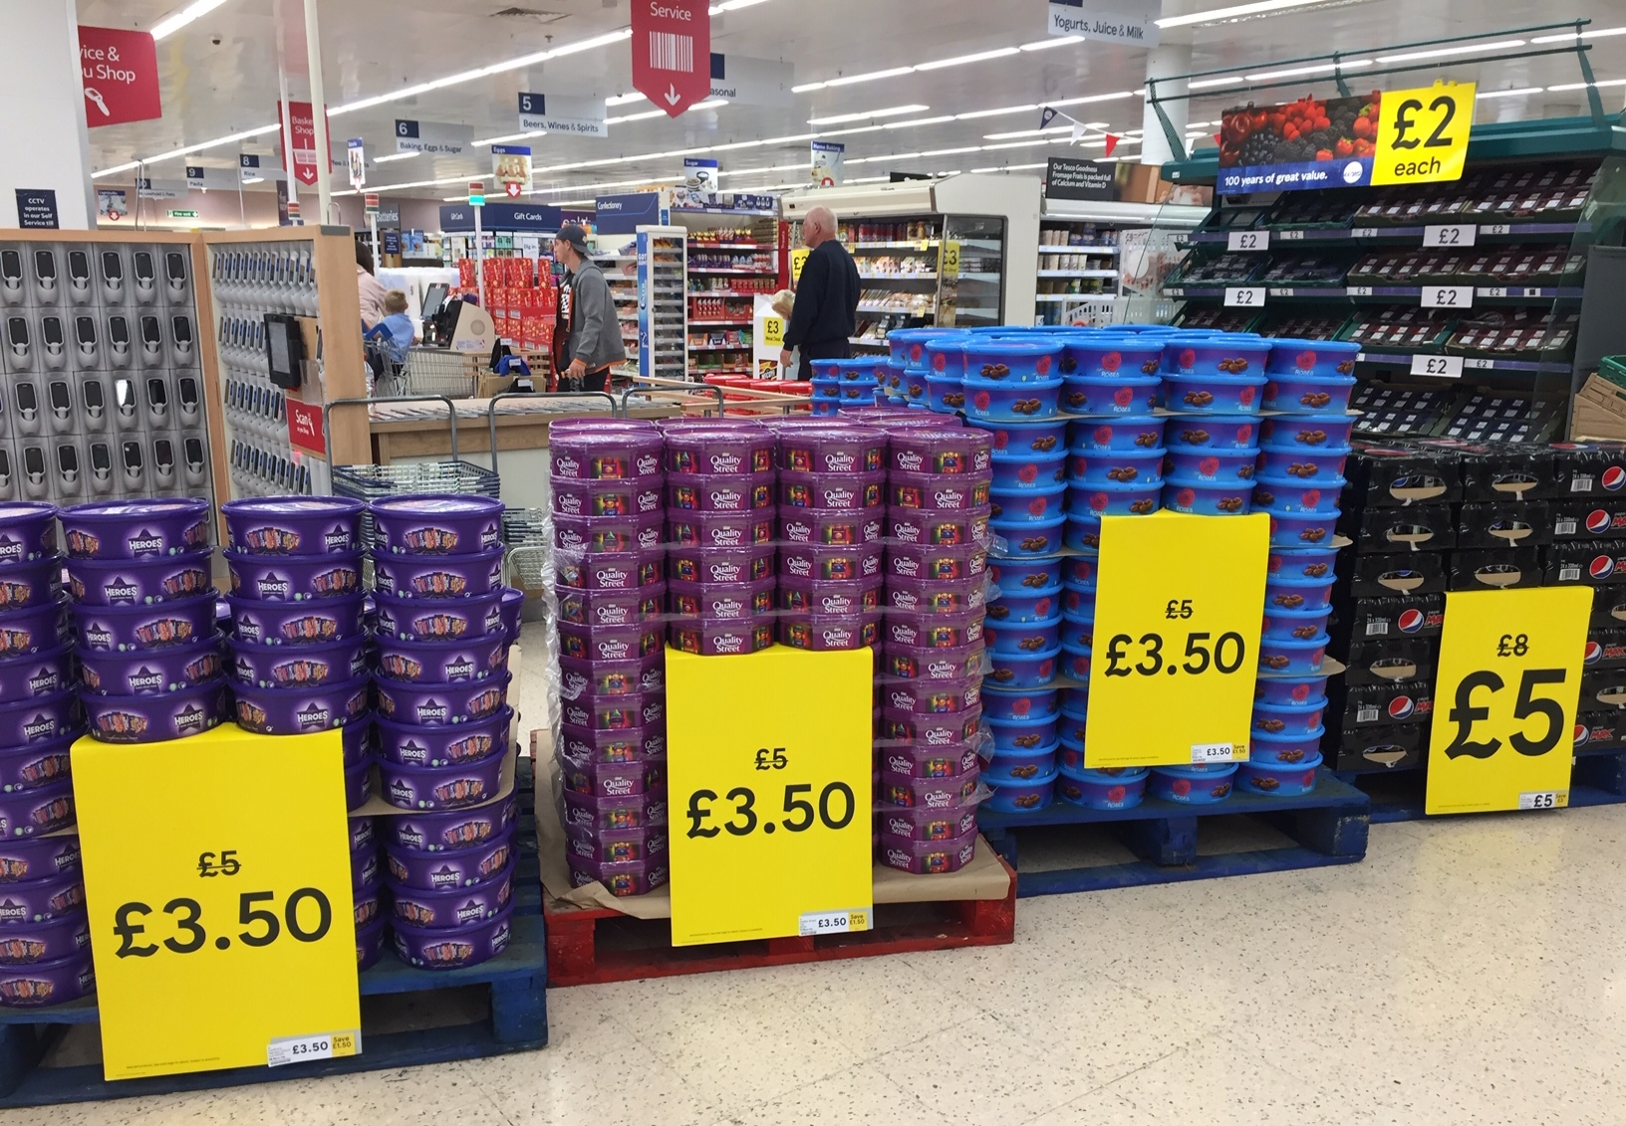
Where is the Maths in that?
Notes:
Photo taken by and property of Rachel Beddoes – permission granted to use

Slide 27
Suggestions
Estimation of…
  No of tubs
  Total cost of all goods on display
  Total amount saved (with discount)
    Per tub, per chocolate, per gram of chocolate?
  No of sweets in a tub? All the tubs?
  Amount of sugar on display
  How much chocolate is eaten over the Christmas period?
Ideas to develop further (possibly into a lesson) on next slides
What do you notice? What do you wonder?

Slide 28
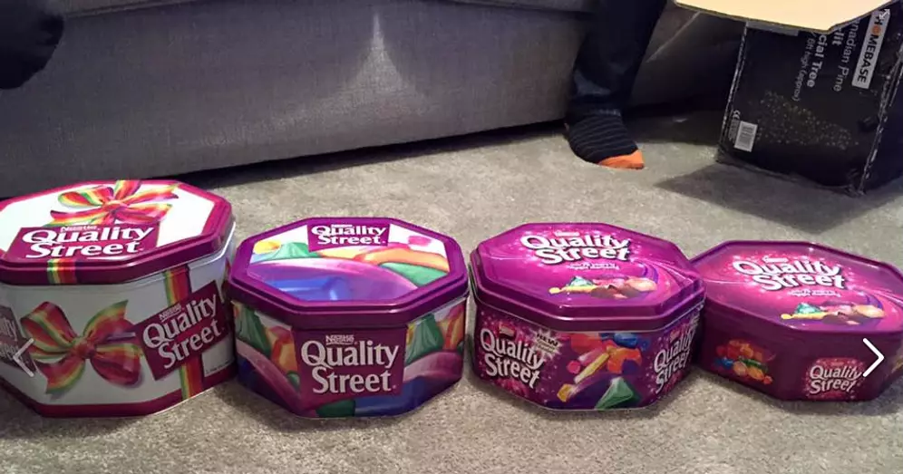
Making the Headlines!
How about ‘doing some maths’ on this data and turning it into a newspaper headline or story?
2015
780g
1985
1.7kg
2017
750g
2015
780g
2018
720g
2019
629g
Notes:
Ideas include comparing the sizes of tins/tubs and doing some weighing/measuring. Can you work out how much one sweet weighs etc… How many sweets do you lose each year? Vote on favourite chocolates and do a bar chart?
https://www.dailymail.co.uk/news/article-6476653/Quality-Street-tins-shrink-Size-Christmas-favourites-fallen-40-cent-decade.html

Slide 29
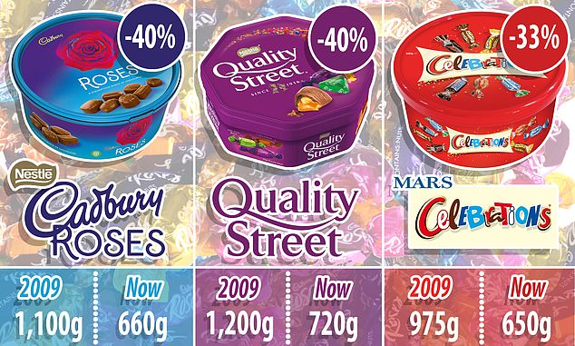
Quality Street, Celebrations and Roses tins shrink AGAIN: Size of Christmas favourites has fallen by 40 per cent in past decade despite price staying almost the same
PUBLISHED: 16:03, 9 December 2018
To read the article click on the date
2018
2018
2018
2019 – 620g
2019 – 629g
2019 – 650g
Continued on next slide
Notes:
https://www.dailymail.co.uk/news/article-6476653/Quality-Street-tins-shrink-Size-Christmas-favourites-fallen-40-cent-decade.html

Slide 30
From Christmas 2017 to 2018 -The standard size tub of Quality Street has been reduced from 750g to 720g and Celebrations tins have shrunk from 680g to 650g.
The company said the equivalent was three sweets.
How many sweets have been lost between Christmas’ …
2018 to 2019?
2017 to 2019?
2015 to 2019?
1985 to 2019?
What other questions would you like to find the answers to?
How are you going to present your findings?

Slide 31
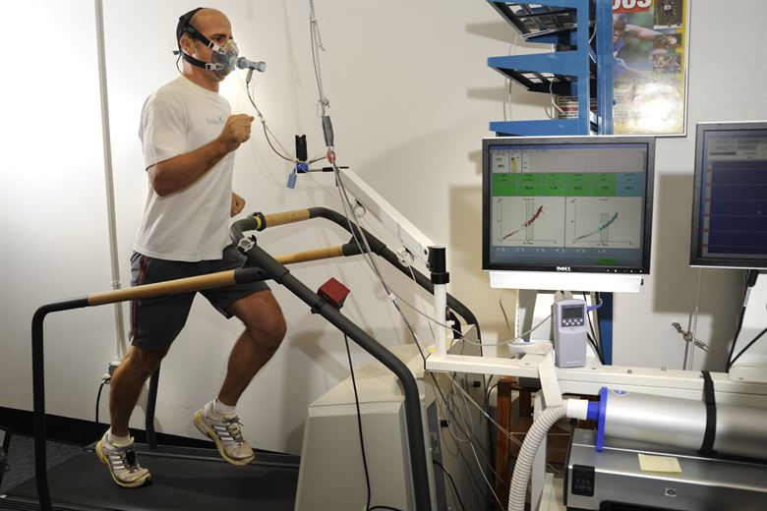
Where is the Maths in that?
Notes:
https://images.app.goo.gl/VL7Ab5QFnyeukmi97
Usage rights: Free to use, modify or share freely

Slide 32
Suggestions
Using data to measure fitness, improve performance
Graphs
Average heart rate, oxygen levels – compare levels of athletes
Steps per day – how far do you travel on 10,000 steps?
What do you notice? What do you wonder?

Slide 33
About the AMSP
A government-funded initiative, managed by MEI, providing national support for teachers and students in all state-funded schools and colleges in England.
It aims to increase participation in AS/A level Mathematics and Further Mathematics, and Core Maths, and improve the teaching of these qualifications.
Additional support is given to those in priority areas to boost social mobility so that, whatever their gender, background or location, students can choose their best maths pathway post-16, and have access to high quality maths teaching.

Slide 34




Contact the AMSP
01225 716 492
admin@amsp.org.uk
amsp.org.uk
Advanced_Maths

